Slide 1
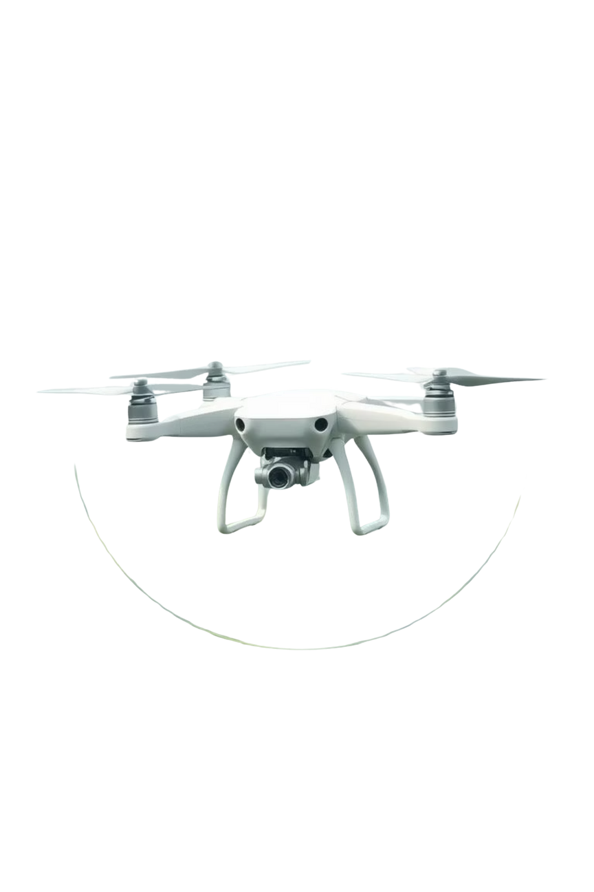

Drone Bird Deterrent System
A comprehensive, multi-layered system designed for medicine delivery drones in hilly regions.
Presented By
Rishi Raj Prajapati
© 2025 Collins Aerospace. | Collins Aerospace Proprietary. | This document does not include any export controlled technical data.
Notes:
1

Slide 2




Core Design Principles
Visual Deterrents
Sonic Deterrents
High-intensity LED strobes and reflective tape disorient birds.
Species-specific distress calls and predator sounds.
Physical Protection
Adaptive Control
Lightweight propeller guards for critical components.
Arduino-based system adjusts deterrent intensity.
© 2025 Collins Aerospace. | Collins Aerospace Proprietary. | This document does not include any export controlled technical data.
Notes:
2

Slide 3
Technical Specifications
Microcontroller
Arduino Nano 33 IoT
32-bit ARM Cortex-M0+, WiFi/Bluetooth
Central control
Rs. 2,500 | 50mA
Bird Detection
HC-SR04 Ultrasonic Sensors (3x)
2cm-400cm range
Detect birds
Rs. 600 | 45mA
Visual Deterrent
High-power LEDs (CREE XP-E2)
3W per LED, 1000 lumens
3+ mile visibility
Rs. 3,000 | 400mA
Audio Deterrent
Class D Amplifier + Speaker
PAM8403 amp, 4Ω 10W speaker
Bird distress calls
Rs. 1,500 | 800mA
Power Management
DC-DC Converters
Multiple voltage rails
Efficient power
Rs. 1,200 | 95% efficiency
© 2025 Collins Aerospace. | Collins Aerospace Proprietary. | This document does not include any export controlled technical data.
Notes:
3

Slide 4
Complete System Configuration
Primary Visual: Red holographic reflective tape (Rs. 1,000)
Power Management: Extended battery, regulation (Rs. 4,000)
Active Visual: 2x high-intensity LED strobe lights (Rs. 10,000)
Control System: Arduino-based activation (Rs. 3,500)
Emergency Features: Auto-landing (Rs. 2,500)
Sonic Deterrent: Multi-frequency system (Rs. 8,000)
Installation Kit: Mounting hardware, cables (Rs. 1,500)
Physical Protection: Lightweight propeller guards (Rs. 2,000)
Total System Cost: Rs. 38,500
Weather Protection: IP65 housing (Rs. 6,000)
Rs. 11,500 under budget
Estimated Weight: 0.85 kg
0.65 kg under limit
© 2025 Collins Aerospace. | Collins Aerospace Proprietary. | This document does not include any export controlled technical data.
Notes:
4

Slide 5
Environmental Protection & Operational Modes
Weather Resistance
Intelligent Activation System
IP65 Weatherproof Housing
Standby Mode: Continuous monitoring
Aerodynamic Wind Resistance
Alert Mode: Visual deterrents (100m radius)
Wide Temperature Range (-10°C to +50°C)
Active Deterrent Mode: Full system (20m approach)
Corrosion Protection
Emergency Mode: Auto-landing on imminent strike
Power Management
Safety & Compliance
Multi-rail architecture (12V, 5V, 3.3V)
FAA 3-statute mile visibility for LEDs
Minimal battery impact
Audio limited to <85dB
Draws power from drone's main battery
Manual override capability
© 2025 Collins Aerospace. | Collins Aerospace Proprietary. | This document does not include any export controlled technical data.
Notes:
5

Slide 6
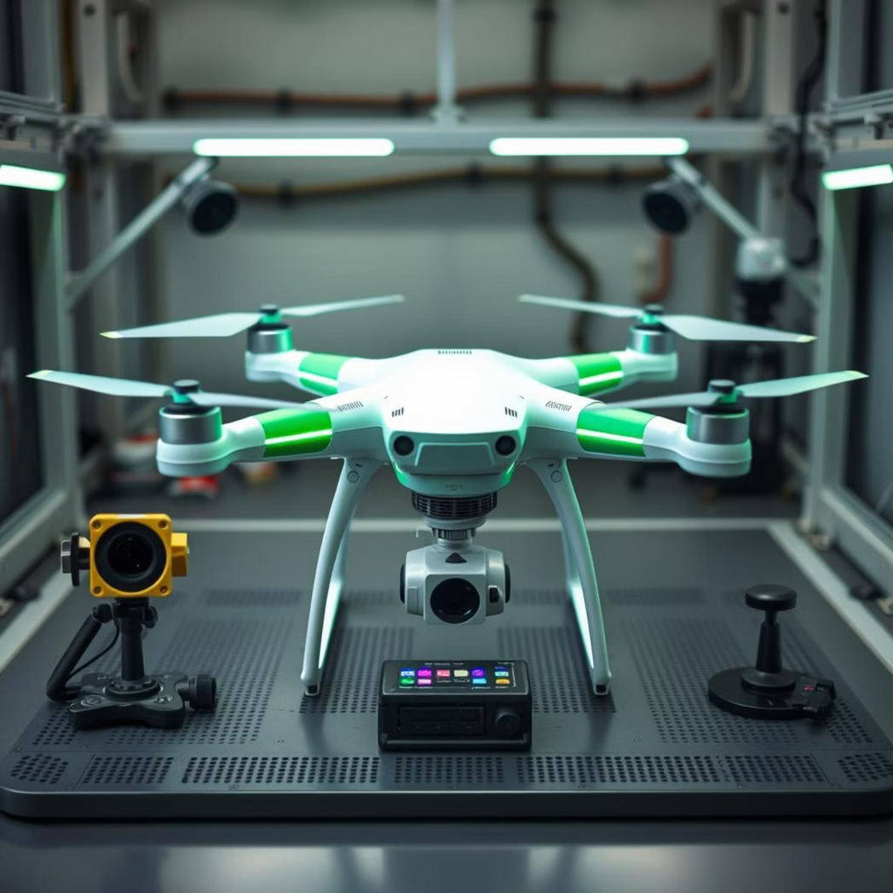
Implementation Timeline & Validation
12-Week Development Schedule
Performance Validation Testing Protocols
Environmental Testing: IP65, temperature, vibration
Weeks 1-2
Deterrent Effectiveness: Bird species range testing
Component procurement, circuit design
System Integration: Power, flight impact
Weeks 3-4
PCB design, fabrication
Weeks 5-6
Assembly, initial testing
Weeks 7-8
Software development, integration
Weeks 9-10
Field testing, optimization
Weeks 11-12
Documentation, final validation
© 2025 Collins Aerospace. | Collins Aerospace Proprietary. | This document does not include any export controlled technical data.
Notes:
6

Slide 7
Competitive Advantages
Superior Multi-Modal Approach
Cost-Effective Implementation
Combines visual, sonic, physical deterrents
Total cost: Rs. 38,500
Effective against 90% of bird species
Significantly less than commercial alternatives:
Species-specific sonic targeting
RoBird system: >Rs. 100,000
Intelligent activation prevents habituation
Autonomous laser systems: >Rs. 200,000
Weather-resistant for reliable operation
Comparable effectiveness for medicine delivery
© 2025 Collins Aerospace. | Collins Aerospace Proprietary. | This document does not include any export controlled technical data.
Notes:
7

Slide 8
Conclusion
Optimal solution for protecting medicine delivery drones in hilly regions.
High Effectiveness
Budget & Weight
Reliability
Multi-layered visual, sonic, physical deterrents.
Meets strict constraints.
Intelligent control, weather protection, safety features.
Leverages proven technologies for challenging environments.
© 2025 Collins Aerospace. | Collins Aerospace Proprietary. | This document does not include any export controlled technical data.
Notes:
8

