Slide 1

Enterprise Transformation Framework for Scalable SaaS Adoption and Sustainable Digital Business Evolution
Team Members:
1. Rishi Kumar - 2411021060413
  2. Aarushi Joshi - 2411021060577
  3. Pradyumn Bisen - 2411021060368
  4. Akshayadevi K - 2411021061046
Name of the Mentor: Dr. T Prashant
E1CSA313/E1ITA306 Design Project -1

Slide 2

Agenda
Introduction
Review of literature
Observations from the literature review
Limitations from the literature review
Problem Definition & Proposed Methodology
  Problem Statement
  Proposed Research / Methodology
  Hardware Requirements
  Software Requirements
References
Plagiarism Report

Slide 3

Introduction
• Enterprise digital transformation requires a structured approach for scalable SaaS adoption and long-term business evolution.
• SaaS provides flexible cloud-based solutions that can reduce dependence on traditional on-premise systems.
• Enterprises often use multiple platforms such as SAP, Salesforce, ServiceNow and Microsoft 365 across different functions.
• Adopting multiple SaaS solutions creates challenges in integration, security, cost, scalability and migration planning.
• A unified framework can support SaaS evaluation, risk analysis, recommendation and phased transformation planning.
• The proposed solution uses SAP BTP with SAPUI5/Fiori, SAP CAP and SAP HANA Cloud as the development platform.

Slide 4

Review of literature
S.No | Author / Journal / Year | Research / Methodology | Performance Metrics | Advantages | Disadvantages
1 | K. Ramchand, M. B. Chhetri, R. Kowalczyk J. Cloud Computing, 2021 | Application Portfolio Profiling + Portfolio Assessment; CCCC framework | Migration cost / affordability; portfolio suitability | Links cloud readiness with cost planning | Needs detailed application data
2 | S. Shuraida, R. Titah Technology in Society, 2023 | Comparison of adopting and non-adopting firms; adoption decision analysis | Adoption drivers; role of inertia and perceived benefits | Shows organizational decision behaviour | Decision context may vary by firm
3 | V. Christiansen, M. Haddara, M. Langseth Procedia Computer Science, 2022 | Systematic literature review using DOI and TOE frameworks | 13 major cloud-ERP adoption factors | Combines technology, organization and environment factors | Broad review; not a working selection system
4 | M. Haddara, S. Gøthesen, M. Langseth Procedia Computer Science, 2022 | Literature review of cloud-ERP challenges across adoption stages | Customization, reliability, security, change management | Highlights implementation challenges | Focused mainly on SME cloud-ERP context
5 | O. Zide, O. Jokonya Procedia Computer Science, 2022 | Systematic review + quantitative content analysis using TOE | Security, cost and regulation factors | Identifies recurring adoption factors | Focused on DMaaS rather than multi-SaaS transformation
6 | R. Guo, A. Tafti, R. Subramanyam Electronic Commerce Research, 2025 | Empirical study of 457 firms on internal IT modularity | Relationship between IT modularity and cloud adoption | Connects internal architecture to adoption readiness | Does not provide a migration planning tool
7 | M. H. Hasan, M. H. Osman, N. I. Admodisastro, M. S. Muhammad Journal of Systems and Software, 2023 | Systematic literature review of legacy-to-cloud migration | Pre-, during- and post-migration concerns | Highlights architecture and quality issues | Quality considerations remain incomplete
8 | P. Rohit, S. K. De Information and Software Technology, 2021 | Graph-based dependency discovery and phase-wise migration | Application clusters; migration sequence; cost | Supports phased migration planning | Requires application dependency data
9 | M. Fahmideh, J. Grundy, G. Beydoun, D. Zowghi, W. Susilo, D. Mougouei Information and Software Technology, 2022 | Model-driven framework for legacy reengineering to cloud | Method coverage; scenario-based evaluation | Supports consistent reengineering methods | Framework tailoring adds complexity
10 | T. R. Merlo, F. Fard, S. Hawamdeh Sustainability, 2025 | Mixed-methods study using SLR + enterprise survey | Cloud readiness, privacy/security, sustainability | Connects cloud adoption with digital transformation and sustainability | Calls for further work on long-term preservation

Slide 5

Observations from the Literature Review
• Cloud/SaaS adoption depends on more than technical capability; organizational and environmental factors also matter.
• Security, cost, vendor lock-in, data access and integration repeatedly appear as important decision factors.
• Application portfolio assessment and early cost analysis can reduce migration delays and unexpected expenditure.
• Legacy migration research supports phased planning and dependency analysis before moving applications.
• Digital transformation research highlights cross-functional coordination and organizational complexity.
• Sustainability and long-term data management are increasingly considered alongside cloud adoption.

Slide 6

Limitations from the Literature Review
• Many studies focus on a single area such as adoption, migration, security or cost rather than the complete transformation lifecycle.
• SaaS selection and cloud migration are often treated as separate decision problems.
• Several frameworks are designed for a specific application type, organization size or migration context.
• Multi-SaaS integration, vendor dependency and post-migration monitoring are not consistently combined in one framework.
• There is limited practical decision support that connects enterprise requirements to transparent SaaS scoring and a phased roadmap.
• These gaps motivate an integrated, enterprise-level SaaS transformation framework.

Slide 7

Problem Statement / Scope of the Project
Problem Statement
Companies want to switch to new computer programs, but it's confusing to pick the right ones and do it safely — so our project makes a simple step-by-step plan to help them do it the right way.
Scope
• Enterprise profile and current-system assessment
• SaaS catalog and weighted evaluation
• Cost and risk analysis
• Recommendation and migration planning
• Dashboard/report generation

Slide 8

Proposed Idea / Solution
• An SAP-based Enterprise SaaS Transformation Platform will collect an organization’s profile and current IT environment through SAPUI5/Fiori.
• SAP CAP services will process assessment data and connect the application to SAP HANA Cloud.
• A SaaS evaluation engine will compare products such as Microsoft 365, Salesforce, SAP solutions and ServiceNow against weighted business requirements.
• The platform will analyze cost, security, integration and migration risks and generate a recommendation with reasons.
• A transformation planner will convert the assessment into phases such as assessment, SaaS selection, pilot, migration, integration, deployment and monitoring.
• The final dashboard will present readiness, recommended SaaS options, risk level and migration roadmap.

Slide 9

Objectives of the Idea / Solution as Design Project
• To develop an enterprise assessment module for capturing business, technical and security requirements.
• To create a SaaS catalog covering major enterprise platforms and their relevant capabilities.
• To implement a transparent weighted scoring model for SaaS evaluation and recommendation.
• To identify cost, security, integration, migration and vendor-dependency risks.
• To generate a phased transformation roadmap based on enterprise requirements and dependencies.
• To present the assessment and recommendations through an SAPUI5/Fiori dashboard backed by SAP HANA Cloud.

Slide 10

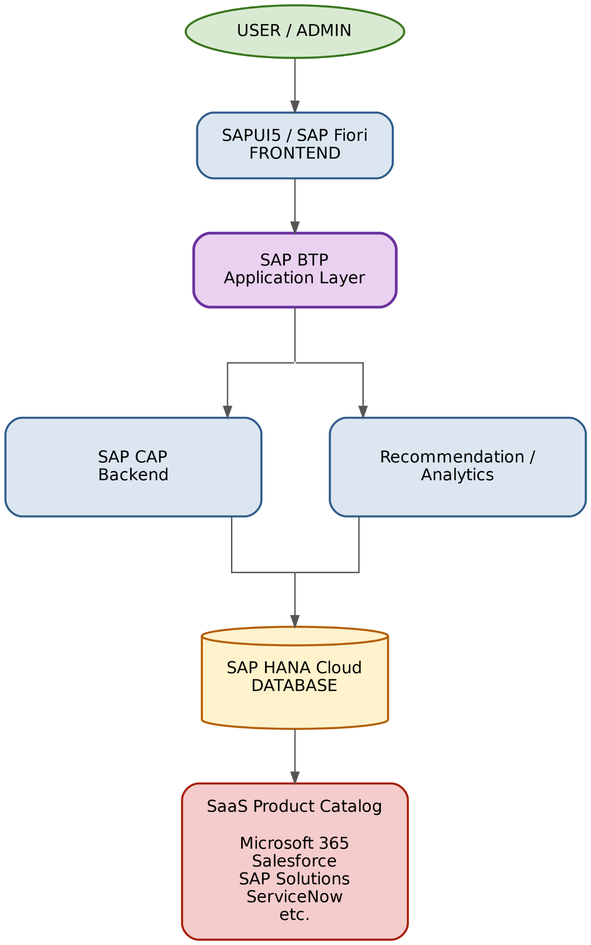
Proposed Research / Methodology
1. Requirement Analysis – identify enterprise, SaaS and transformation requirements.
2. Enterprise Assessment – collect current systems, budget, growth, security and integration needs.
3. SaaS Evaluation – apply weighted criteria to catalogued SaaS products.
4. Risk Analysis – security, integration, migration and vendor dependency.
5. Transformation Planning – generate a phased migration and adoption roadmap.
6. Implementation – build the solution on SAP BTP using SAPUI5/Fiori, CAP and HANA Cloud.
7. Testing & Evaluation – validate recommendation logic, data consistency, response time and
report generation.
SAP-based technical architecture

Slide 11

Hardware Requirements
• Development laptop/desktop with Intel Core i5 / equivalent or higher
• Minimum 8 GB RAM; 16 GB recommended for SAP development tools
• At least 256 GB SSD with sufficient free space for development tools and local project files
• Stable broadband/Wi-Fi connection for SAP BTP and HANA Cloud services
• Modern display and browser for SAPUI5/Fiori testing
• Optional cloud/server resources are handled through SAP BTP rather than local deployment

Slide 12

Software Requirements
• SAP Business Technology Platform (BTP) – cloud platform for application development and deployment
• SAPUI5 / SAP Fiori – frontend for enterprise forms, dashboards and reports
• SAP Cloud Application Programming Model (CAP) – backend services and business logic
• SAP HANA Cloud – persistent storage for enterprise, SaaS, assessment, risk and recommendation data
• SAP Business Application Studio – development environment
• SAP Integration Suite – optional extension for connecting external SaaS platforms
• Git / GitHub and Postman – version control and API testing

Slide 13

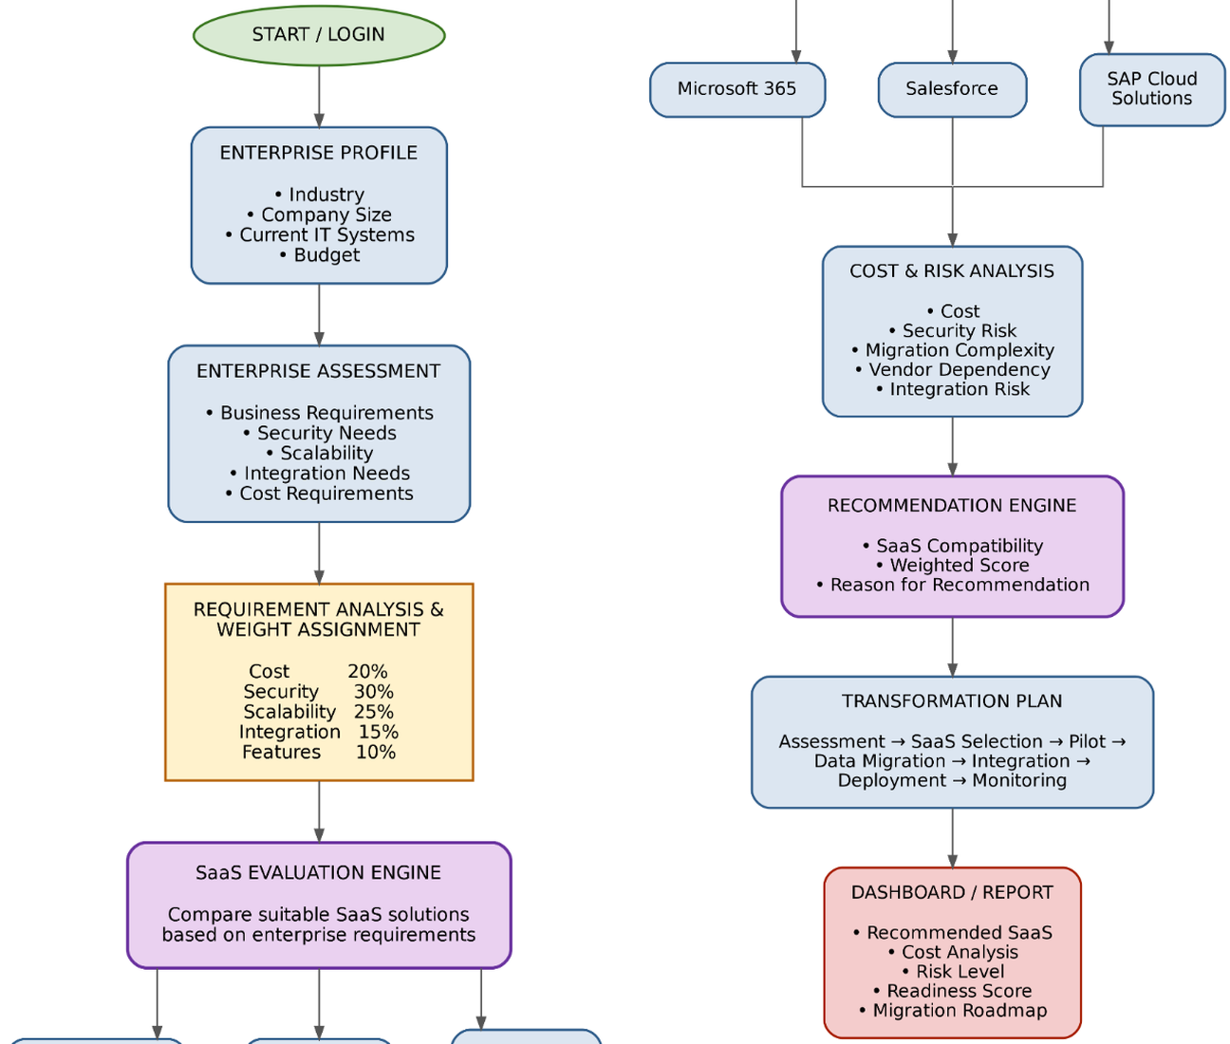
Process / Flow / Design Diagram
Process Flow
1. Start / Login
2. Capture enterprise profile and requirements
3. Assign weights for cost, security, scalability, integration and features
4. Evaluate SaaS products from the catalog
5. Analyze cost and risk
6. Generate recommendation and reason
7. Create transformation plan
8. Display dashboard / report

Slide 14

Proposed Modules
1. User & Admin Management – login, roles and basic access control.
2. Enterprise Profile & Assessment – company size, systems, budget, growth and requirements.
3. SaaS Product Catalog – products, categories, capabilities and evaluation criteria.
4. SaaS Evaluation Engine – weighted scoring across cost, security, scalability, integration and features.
5. Cost & Risk Analysis – migration complexity, security risk, vendor dependency and integration risk.
6. Recommendation Engine – compatibility score and explanation of the recommendation.
7. Transformation Planner – phased roadmap from assessment to monitoring.
8. Dashboard & Reports – readiness score, recommendations, risk summary and roadmap.

Slide 15

References
[1] Ramchand, K., Chhetri, M. B., & Kowalczyk, R. (2021). Enterprise adoption of cloud computing with application portfolio profiling and application portfolio assessment. Journal of Cloud Computing, 10, 1. DOI: 10.1186/s13677-020-00210-w
[2] Shuraida, S., & Titah, R. (2023). An examination of cloud computing adoption decisions: Rational choice or cognitive bias? Technology in Society, 74, 102284. DOI: 10.1016/j.techsoc.2023.102284
[3] Christiansen, V., Haddara, M., & Langseth, M. (2022). Factors Affecting Cloud ERP Adoption Decisions in Organizations. Procedia Computer Science, 196, 255–262. DOI: 10.1016/j.procs.2021.12.012
[4] Haddara, M., Gøthesen, S., & Langseth, M. (2022). Challenges of Cloud-ERP Adoptions in SMEs. Procedia Computer Science, 196, 973–981. DOI: 10.1016/j.procs.2021.12.099
[5] Zide, O., & Jokonya, O. (2022). Factors affecting the adoption of Data Management as a Service (DMaaS) in SMEs. Procedia Computer Science, 196, 340–347. DOI: 10.1016/j.procs.2021.12.022
[6] Guo, R., Tafti, A., & Subramanyam, R. (2025). Internal IT modularity, firm size, and adoption of cloud computing. Electronic Commerce Research, 25(1), 319–348. DOI: 10.1007/s10660-023-09691-8
[7] Hasan, M. H., Osman, M. H., Admodisastro, N. I., & Muhammad, M. S. (2023). Legacy systems to cloud migration: a review from the architectural perspective. Journal of Systems and Software, 202, 111702. DOI: 10.1016/j.jss.2023.111702
[8] Rohit, P., & De, S. K. (2021). Phase-wise migration of multiple legacy applications – A graph-theoretic approach. Information and Software Technology, 137, 106606. DOI: 10.1016/j.infsof.2021.106606
[9] Fahmideh, M., Grundy, J., Beydoun, G., Zowghi, D., Susilo, W., & Mougouei, D. (2022). A model-driven approach to reengineering processes in cloud computing. Information and Software Technology, 144, 106795. DOI: 10.1016/j.infsof.2021.106795
[10] Merlo, T. R., Fard, F., & Hawamdeh, S. (2025). Cloud Computing’s Impact on the Digital Transformation of the Enterprise: A Mixed-Methods Approach. Sustainability, 17(13), 5755. DOI: 10.3390/su17135755
[11] SAP Developer Center. (2026). Introduction to Application Development Using CAP; SAP BTP, SAPUI5/Fiori and SAP Business Application Studio documentation.
[12] SAP Help Portal. (2026). SAP Business Technology Platform Developer Guide; SAP Cloud Application Programming Model; SAP HANA Cloud documentation.

