Slide 1
Transformers For NLP
CSE 705 - Recent Advances in Deep Learning and Reinforcement Learning
Instructor: - Prof. Alina Vereshchaka
Presented by: - Rishi Joshi, Aastha Sood

Slide 2
What is a transformer?

Slide 3
What is a transformer?
Consists of an encoder and a decoder that can process words simultaneously.
Consists of an attention mechanism without using RNNs.
Unlike RNNs, transformers process the entire input at once.
Introduced in 2017 by a team at Google Brain.
Quickly replacing LSTMs and RNNs which are much slower to train.
Led to the development of pre-trained models like BERT and GPT

Slide 4
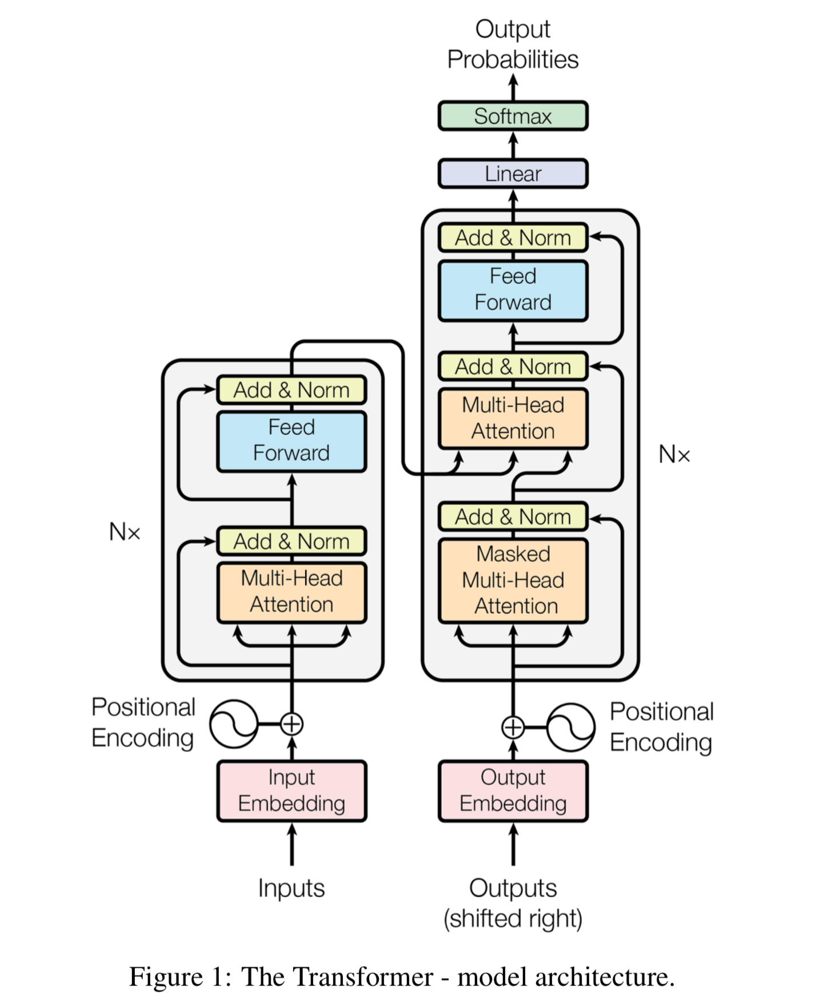

Slide 5
NLP Task and Dataset

Slide 6
NLP Task and Dataset
NLP Task: -
Perform sentiment analysis on tweets using the BERT transformer and compare the results with LSTM.
Dataset: -
Financial Tweets
Contains 5322 unique tweets divided into positive, negative and neutral.

Slide 7
What is LSTM?

Slide 8
What is LSTM?
They are a type of RNN, capable of learning long-term dependencies.
They are explicitly designed to avoid the long-term dependency problem
LSTMs have a chain like structure, but the repeating module has a different structure.
Instead of having a single neural network layer, there are four, interacting in a very special way.
Notes:
Let’s say while watching a video you remember the previous scene or while reading a book you know what happened in the earlier chapter. Similarly RNNs work, they remember the previous information and use it for processing the current input.

Slide 9
BERT - Bidirectional Encoder Representations from Transformers

Slide 10
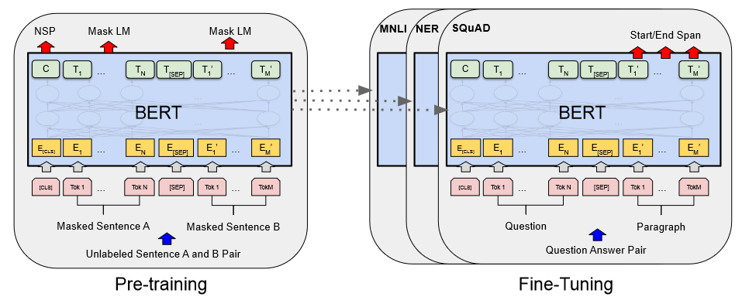
BERT Architecture

Slide 11
LSTM - Long Short Term memory

Slide 12
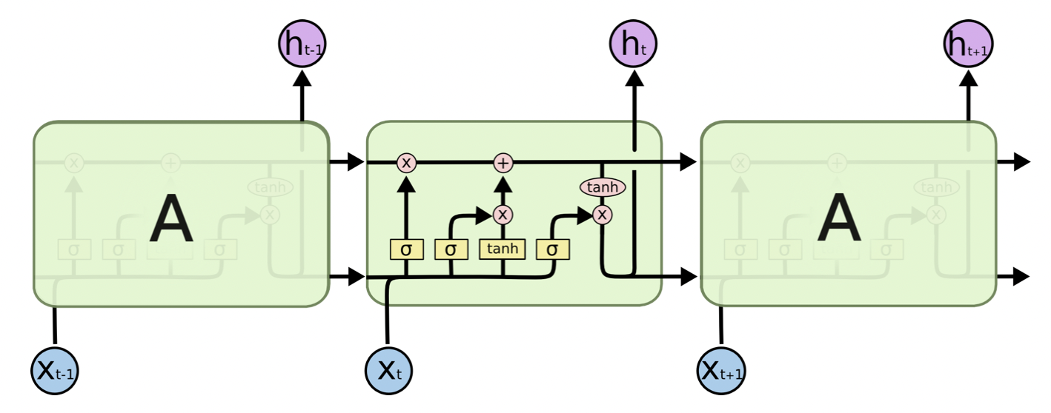
LSTM Architecture

Slide 13
BERT Results

Slide 14
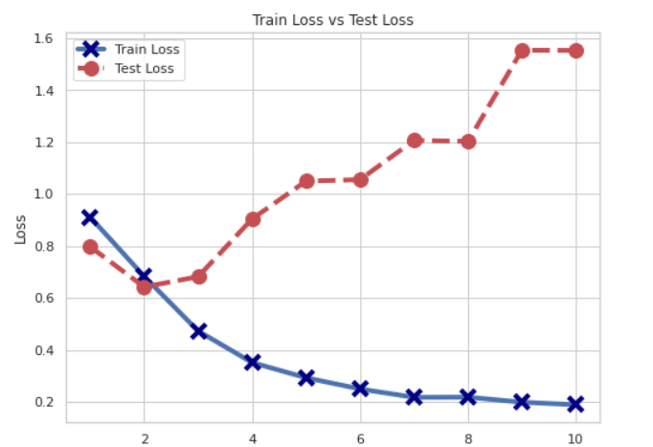
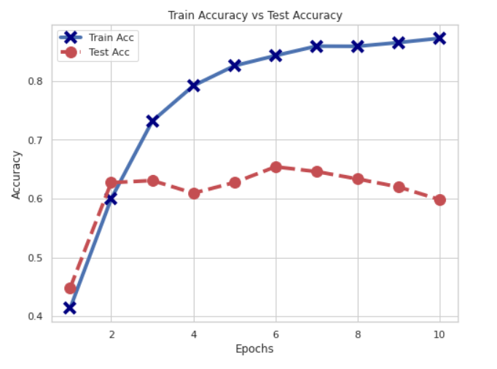
Training Loss / Accuracy vs Testing Loss / Accuracy

Slide 15
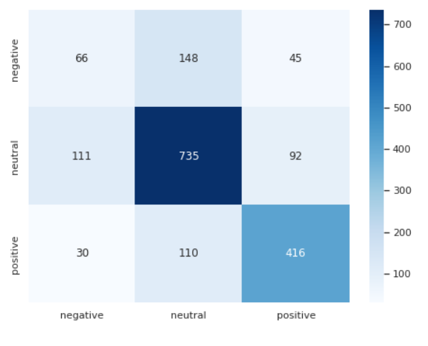
Confusion Matrix

Slide 16
LSTM Results

Slide 17
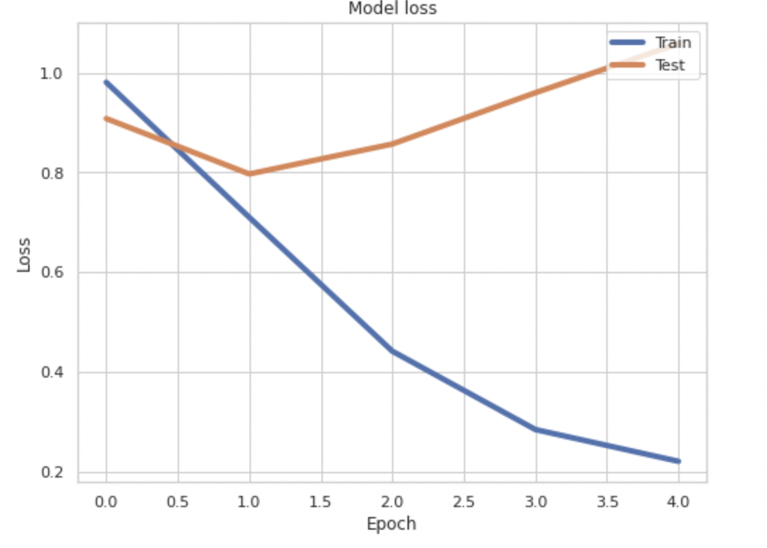
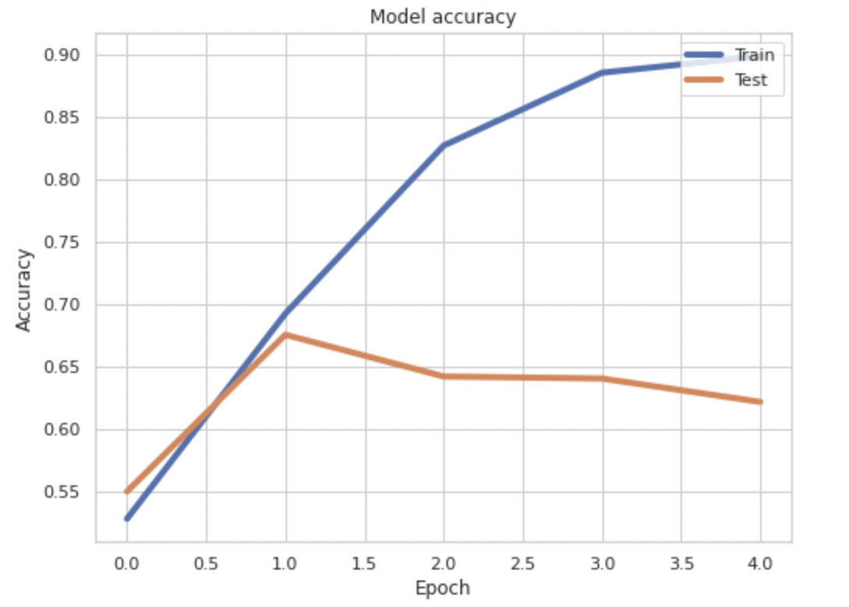
Training Loss / Accuracy vs Testing Loss / Accuracy

Slide 18
Contribution Summary
Team Member | Presentation / Project Part | Contribution (%)
Rishi Joshi Aastha Sood | BERT LSTM | 50% 50%

Slide 19
References

Slide 20
References
https://towardsdatascience.com/understanding-lstm-and-its-quick-implementation-in-keras-for-sentiment-analysis-af410fd85b47
https://colah.github.io/posts/2015-08-Understanding-LSTMs/
https://neptune.ai/blog/how-to-code-bert-using-pytorch-tutorial
https://mccormickml.com/2019/07/22/BERT-fine-tuning/#4-train-our-classification-model
Alex Graves, et al., Framewise Phoneme Classification with Bidirectional LSTM and Other Neural Network Architectures, 2005.
CodeEmporium - Transformer Neural Networks - EXPLAINED! (Attention is all you need) - https://www.youtube.com/watch?v=TQQlZhbC5ps
Ashish Vaswani, Noam Shazeer, Niki Parmar, Jakob Uszkoreit, Llion Jones, Aidan N. Gomez, Lukasz Kaiser, Illia Polosukhin, et al., Attention Is All You Need, 2017

Slide 21
Thank You!

