Slide 1
🚗 DriveVerse
One Identity. Every Vehicle Service.
Presented by:
Rishik Jariwala & Jash Chothani

Slide 2
01. PROBLEM & MARKET LANDSCAPE
The Problem & Existing Gaps
Problem Statement
⚠️ Information Silos
Documents (DL, RC, Insurance, PUC) are scattered across physical files, email threads, and disjointed portals.
⚠️ Compliance Failures
Missed renewal deadlines result in heavy traffic fines and legal disputes.
⚠️ Security Risks
Lack of geofencing triggers or real-time location alerts leaves vehicles vulnerable to theft.
Gaps in Existing Solutions
✗ Government Portals (DigiLocker)
Static databases with zero proactive alert triggers. Poor user experience and no navigational utilities.
✗ Standalone Apps
Cluttered with advertisements. Single-purpose and fail to link directly with government records.
✗ Physical glove-box files
High risk of damage or loss; completely ineffective in security alerts or on-road emergencies.

Slide 3
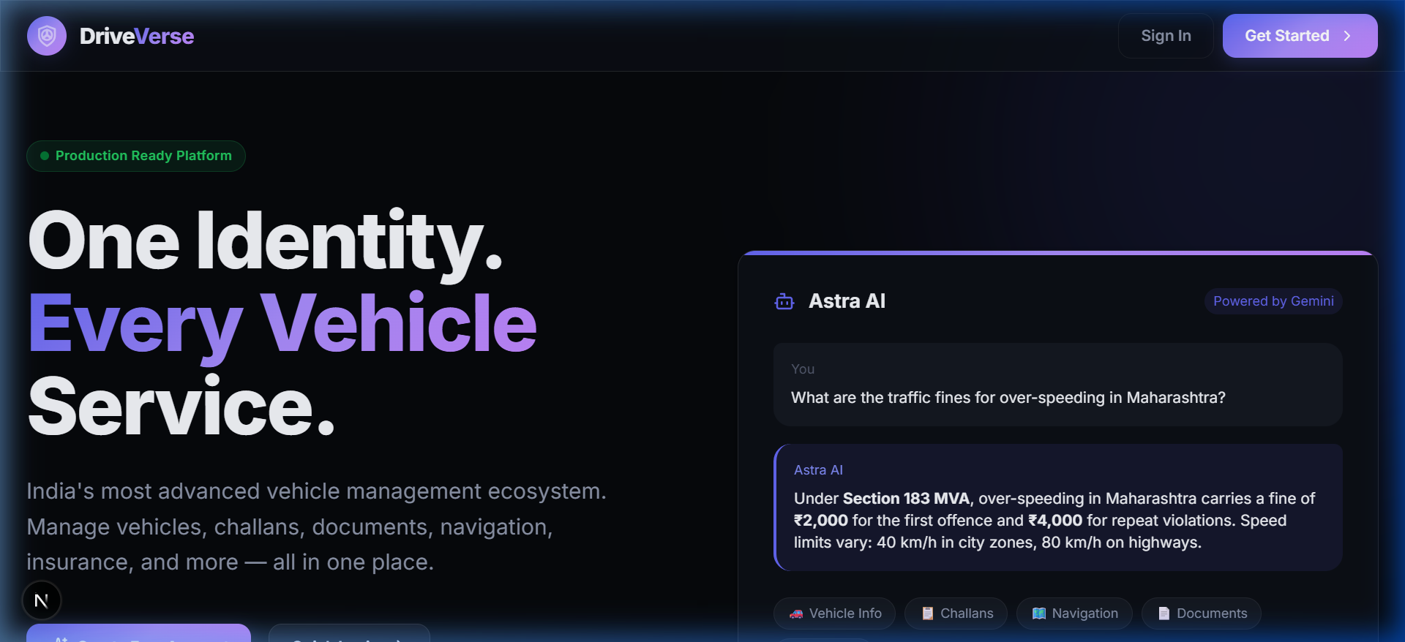
02. ARCHITECTURE & TECHNOLOGY
Tech Stack & User Flow
The Technology Stack
💻 Frontend:
Next.js 15 · TypeScript · TailwindCSS · Framer Motion
💻 Backend:
FastAPI · Python 3.12 · SQLAlchemy (async) · PostgreSQL · Redis
💻 AI Copilot:
Google Gemini 2.0 Flash (Astra AI integration)
💻 Security:
JWT Token Rotation · bcrypt password hashing · AES Fernet encryption
User & Data Flow
1. User logins via OTP/OAuth ➔ 2. Garage pulls live DigiLocker & e-Challan data ➔ 3. Astra AI assists user and displays telemetry on maps.

Slide 4
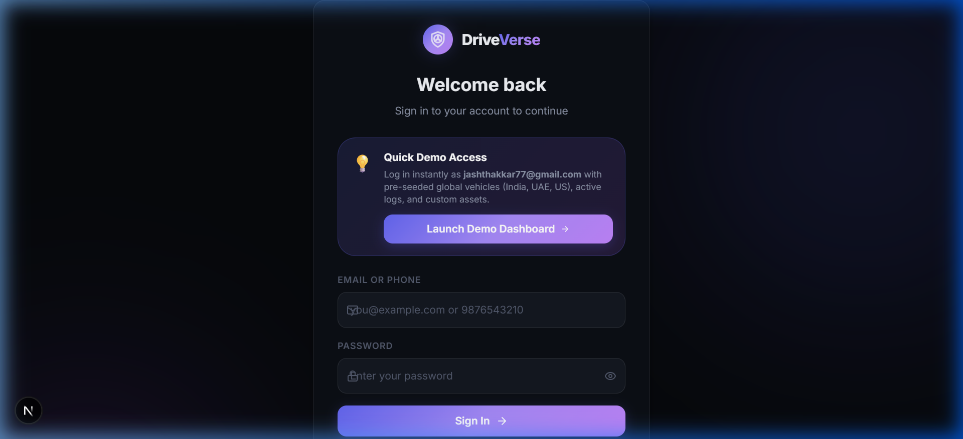
03. THE UNIFIED ECOSYSTEM
Our Solution: DriveVerse
Core Pillars of DriveVerse
⚡ Unified Garage
Track all vehicles in one hub with 7 switchable custom themes.
⚡ Astra AI Co-Pilot
Gemini-powered voice and multilingual (EN/HI/MR) assistant.
⚡ Integrated Doc Vault
Secure DigiLocker vault tracking DL, RC, PUC, Insurance expiries.
⚡ Advanced Anti-Theft
Geofencing safe zones, tamper detection, and real-time OTP alerts.

Slide 5
04. SYSTEM WORKFLOW & BENEFITS
How DriveVerse Avoids the Problems
🛡️ Automated Alerts (No Expiry Oversights)
Proactive 30/15/7 day expiry countdown alerts for Insurance & PUC policies via Email & SMS OTP ensure 100% compliance.
🛡️ Geofencing Safe Zones (Active Theft Prevention)
Real-time geofence circles alert vehicle owners instantly if their vehicle moves outside safe boundaries or detects tamper events.
🛡️ Live Navigation (Avoid Speed Traps & Fines)
Integrates real-time speed limit indicators, road safety warnings, and live traffic alerts, keeping the driver informed and ticket-free.
🛡️ Unified Challan Center (No Delinquency)
Direct e-Challan synchronization scans and alerts owners of traffic violations instantly, allowing immediate online resolution.
The DriveVerse Core Flow
1. Data Sync
FastAPI connects with DigiLocker, e-Challan APIs and Google Maps to collect active telemetry & compliance details.
2. Astra AI Intelligence
Gemini AI parses user questions, navigation cues, and document status to formulate proactive driving recommendations.
3. Notification Hub
Redis queues route critical notifications (expiries, tamper alerts, geofence breaches) directly to user devices.

Slide 6
05. ROADMAP & HURDLES
Challenges & Future Vision
Showstoppers & Challenges
⚡ Legacy Government API Access
Integrating with regional RTO databases and state-specific e-Challan systems is complex due to slow response times and security protocols.
⚡ Offline Voice AI & Navigation
Ensuring critical navigation alerts and Astra AI voice commands remain functional in areas with poor or zero cellular network connectivity.
Future Scope
🚀 Predictive Vehicle Diagnostics
Deploying machine learning models to analyze engine telematics and predict parts wear-and-tear before a breakdown occurs.
🚀 Smart Electric Vehicle (EV) Portal
Providing real-time battery analytics, health scoring, and smart route optimization mapped specifically through charging grids.
🚀 Logistics & Enterprise Fleet Portal
Scaling the architecture to support logistics operators, enabling them to track and manage compliance for hundreds of trucks in a single dashboard.

Slide 7
Thank You!
Redefining Indian Mobility, Redesigning Driving Experiences.
Project Team:
Rishik Jariwala | Jash Chothani
DriveVerse — Built with Next.js, FastAPI, and Google Gemini AI

