Slide 1
Smart Electronic Voting Machine Using Arduino
A project by team Quarks and Sparks ⚡

Slide 2
TABLE OF CONTENTS
01
Introduction
02
Requirements
03
Methodology
04
Conclusion
Opening overview presenting the topic briefly
Essential components and specifications
Approach and steps used for project implementation
Findings and outcomes of the project analysis

Slide 3
01
INTRODUCTION
Opening overview presenting the topic briefly

Slide 4
DECLARATION
We, the students of B.Tech of School of Engineering, Jawaharlal Nehru University, New Delhi, hereby declare that we have independently carried out the project titled “Smart Electronic Voting Machine” during the academic year 2022-2023.
Name and Roll Number of students
Anshit Sinha (22/11/EC/44)
Aadarsh Kumar (22/11/EE/02)
Rishik Ashili
Abhishek Yadav

Slide 5
ABSTRACT
The Voting System: Rules defining expression of people's desires and achieving results. For this purpose an electronic voting machine EVM is introduced which will:
Replaces conventional manual voting methods.
Faster, efficient, reliable, and error-free compared to manual voting.
Key Features of the Proposed Machine:
Speed: Faster than manual voting system.
Efficiency: More efficient and streamlined process.
Reliability: Provides accurate and reliable results.
Ease of Operation:
User-friendly design for easy voting process.
Voters can easily cast their votes.
Instant display of final results by pressing a result button.
Which will Lead to:
Enhanced voting experience with improved speed, efficiency, and accuracy.
Simplified process for conducting elections

Slide 6
INTRODUCTON
TITLE
OBJECTIVE
OVERVIEW
PROCESS
DISPLAY
RESULT
Project on Simple & Smart Electronic Voting Machine Using Arduino
Eradicate defrauding of manual voting systems
n number of switches representing political parties
Voters choose their preferred candidate from the panel of buttons
Final vote displayed on LCD for voter satisfaction
Automatic calculation of the result

Slide 7


PROBLEM STATEMENT
“Design a Smart Electronic Voting Machinewhich should be secure
without any malpractice in result.
Cost range should be in Rs.800 to 1500/-with less storage occupied,
no monitoring, by using Arduino uno.
It should be easy to operate with results faster and no prone to human error.”

Slide 8
OBJECTIVE
To reduce manual work
To decrease expenses
To perform operations on EVM easily
To make the EVM portable for easy transportation
To save time in the voting process

Slide 9
02
REQUIREMENTS
Approach and steps used for project implementation

Slide 10
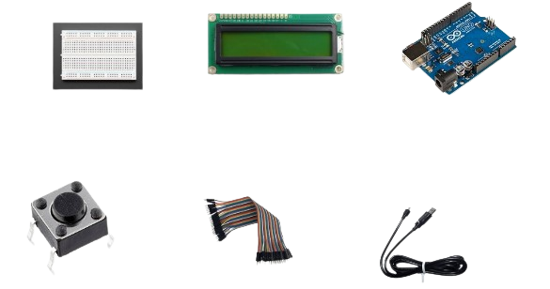
REQUIREMENT ANALYSIS
Arduino UNO
LCD display (16x2)
I2C Converter
Push buttons
Connecting cables
Male to male jumper wires
Breadboard

Slide 11
03
METHODOLOGY
Approach and steps used for project implementation

Slide 12
METHODOLOGY
This project focuses on developing a simple and smart electronic voting machine using Arduino.
The Arduino serves as the main component, handling all the operations in the system.
SYSTEM COMPONENTS:
Arduino Board, LCD Display (16x2), Jumper Wires (connecting wires), I2C Converter, Breadboard, Push Buttons
CONNECTIONS:
Connecting push button terminals to Arduino's digital pins.
Grounding the Arduino and connecting push button terminals to the ground supply.
Connecting LCD display pins to the I2C converter pins.
Connecting I2C pins to Arduino's SCL, VCC, SDA, and SCC.

Slide 13
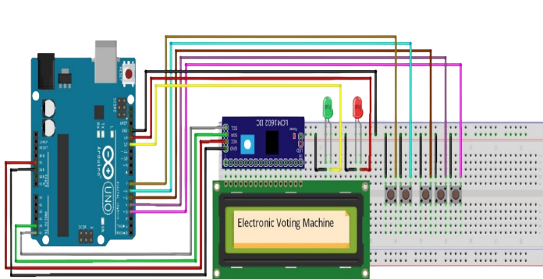
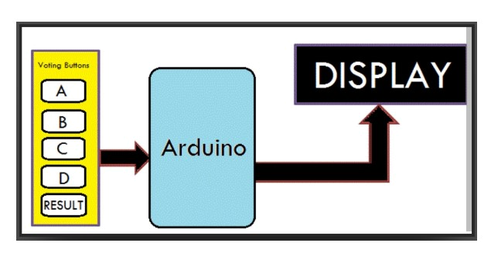
CONCEPTUAL DESIGN
BLOCK DIAGRAM

Slide 14
04
CONCLUSION
Findings and outcomes of the project analysis

Slide 15
CONCLUSION
Smart Electronic Voting Machine using Arduino offers a secure and efficient alternative to manual and traditional electronic voting systems.
The system ensures ease of operation, faster results, and reduced chances of errors.
It provides transparency and voter satisfaction through the display of final votes.
Further improvements and research are needed to enhance the security and privacy aspects of electronic voting systems.

Slide 16
THANKS

