Slide 1


Deploying and Improving existing AI/ML based Fault Classification and Fault Location Detection Algorithms of Transmission Lines on Edge Devices Sai Rishik Thakkallapally 20MCME05 Sudhanshu Mishra Mridula Verma School of Computer and Information Sciences

Slide 2
About the company (for intern students only)
Ge Grid Automation operates as part of General Electric , a multinational conglomerate is a product-based company which involves the application of advanced technologies to enhance the efficiency , reliability and performance of electrical grids. This includes solutions for smart grid management , substation automation and grid control systems. The goal is to optimize the operation of power systems, improves fault detection and enable better integration of renewable energy sources.

Slide 3
Research Objectives
Deploying existing AI/ML based Fault Classification and Fault Location Models on Edge Devices
To convert a Tensorflow Model for Fault Classification and Location into Tensorflow Lite and validate its performance and accuracy using Python based inference.
To implement and optimize Tensorflow Lite model inference in C and C++ for windows environments, including the generation of dynamic link libraries (DLL’s) for efficient deployment.
To cross compile and generate shared object files (.so) for deploying the Tensorflow Lite model on ARM-based machines, ensuring compatibility.
Evaluate the Tensorflow Lite model on real data, based on the results. Fine-tune the model as per the requirements.
Compare the AI/ML models with existing physics-based methods.

Slide 4
Problem Statement
The detection, classification, and localization of faults in long transmission lines are vital tasks for ensuring the reliability and stability of power systems. Transmission lines are highly susceptible to faults due to environmental conditions, equipment failures, and other unforeseen events, which can result in significant disruptions or even system collapse in severe cases. Hence, it is essential to monitor and address faults effectively to maintain the safe and continuous operation of the power system. While traditional physics-based techniques for fault detection, classification, and localization have been widely used, advancements in artificial intelligence and machine learning (AI/ML) present an opportunity to enhance these methods. AI/ML algorithms can complement existing techniques by improving the accuracy, speed, and adaptability of fault monitoring and protection schemes, thereby increasing the security and dependability of the power system.

Slide 5
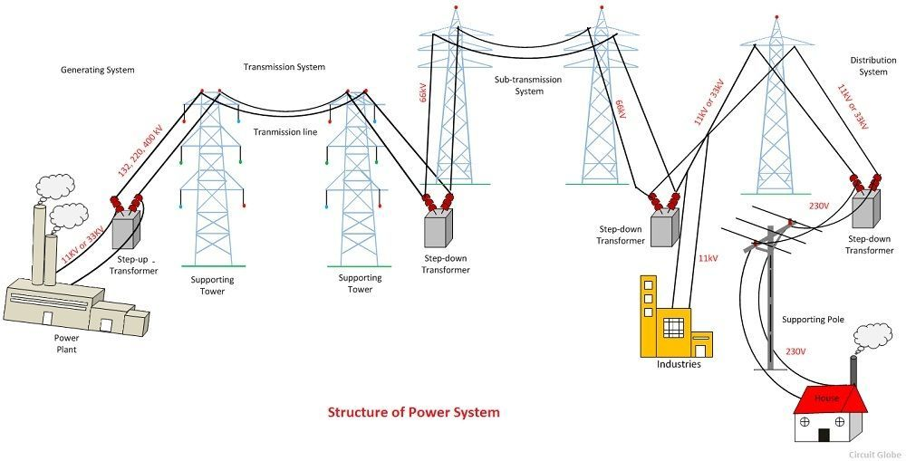
Power systems Introduction
The power system is a network that converts energy from renewable and nonrenewable resources into electrical energy.
It consists of three main components: Generation, Distribution, and Transmission systems.
The devices connected to the power system include synchronous generators, motors, transformers, circuit breakers, conductors, and more.
The power plant generates electricity, which is then transmitted through the transmission system.
The transmission lines transfer the electricity to the substations, where it is distributed to the consumers through the distribution system.
The six main components of the power system are the power plant, transformer, transmission line, substation, distribution line, and distribution transformer.
This system is complex and can be subdivided into several subsystems, including the generating substation, transmission substation, and distribution substation

Slide 6
Structure of Power Systems
The power system is the complex enterprise that may be subdivided into the following sub-systems. The subsystems of the power system are as follows:-
Generating Substation
Transmission Substation
Sub-Transmission Substation
Distribution Substation
Transmission Substation:
The transmission substation carries overhead lines that transfer generated electrical energy from the generation to the distribution substations. It supplies large amounts of power to bulk power substations or very big consumers.
The transmission lines have two primary functions:
Transporting energy from generating stations to bulk receiving stations and
Interconnecting two or more generating stations.
Neighboring substations are also interconnected through the transmission lines. The transmission voltage is standardized at 69kV, 115kV, 138kV, 161kV, 230kV, 345kV, 500kV, and 765kV, line-to-line, and operates at more than 66kV. Transmission lines above 230kV are usually referred to as extra high voltage (EHV).

Slide 7
Transmission Lines
Transmission lines are specialized cables or structures designed to conduct electromagnetic waves in a contained manner.
They are used to connect radio transmitters and receivers with their antennas, distribute cable television signals, route calls between telephone switching centers, and connect computer networks and high-speed computer data buses
The transmission lines have uniform cross-sectional dimensions along their length, giving them a uniform impedance, called the characteristic impedance, to prevent reflections
The primary functions of transmission lines are to transport energy from generating stations to bulk receiving stations and interconnect two or more generating stations. Neighboring substations are also interconnected through the transmission lines.
The transmission voltage is standardized at 69kV, 115kV, 138kV, 161kV, 230kV, 345kV, 500kV, and 765kV, line-to-line, and operates at more than 66kV.
Transmission lines above 230kV are usually referred to as extra high voltage (EHV) . The high voltage line is terminated in substations called high voltage substations, receiving substations, or primary substations. In high voltage substations, the voltage is stepped down to a suitable value for the next part of the flow toward the load.

Slide 8
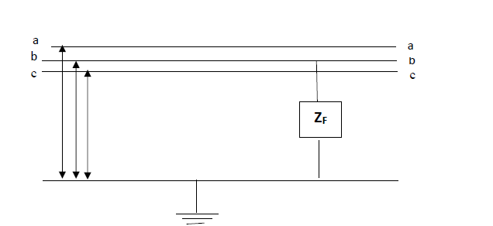
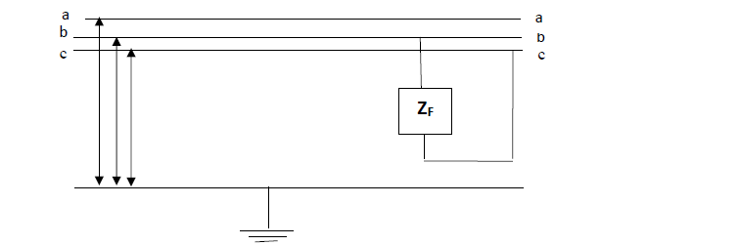
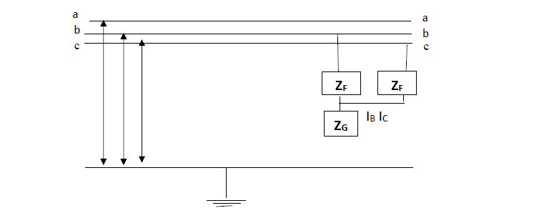
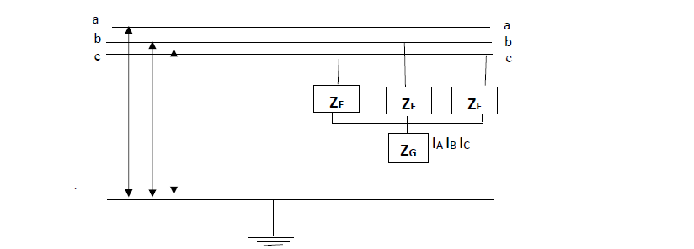
Types of faults in Transmission Lines
Electrical faults due to lightning strikes during stormy weather conditions, or tree contacts with transmission lines or insulation failure in power system equipment affect transmission lines to a large extent
Types of faults –
a)Phase to Ground fault (L–G fault) b) Phase to Phase fault (L–L fault)
(AG,BG,CG) (AB,BC,CA)
c) Double Phase to Ground fault (LL–G fault) d) Three Phase fault ( LLL fault)
(ABG,BCG,CAG) (ABC)

Slide 9
Fault Detection in power systems
In power systems, detecting and locating faults on transmission lines is critical for restoring power quickly and preventing harm to people, property, and the environment. Fast detection, classification, and resolution of faults help maintain the stability and safety of the power system.
Fault Classification involves identifying and categorizing issues on transmission lines, such as short circuits or open circuits. This is done using protective relays and monitoring systems that analyze electrical signals in real-time, allowing for a quick response to keep the system stable.
Fault Location Detection is the process of finding the exact spot where a fault has occurred. By studying changes in electrical signals and the time they take to travel through the system, the location of the fault can be determined, enabling faster repairs and reducing power outages.

Slide 10
Physics Based Methods being used
Physics Based methods for Fault classification
Impedance measurement-based method
Travelling waves-based analysis
Symmetrical components-based fault classifications
Physics Based methods for Fault Location Detection
Takagi Technique
Modified Takagi Technique
Novosel et. al., Technique

Slide 11
Project Progress
Model Conversion: Converted the Tensorflow model to Tensorflow Lite for fault classification and location.
Accuracy Validation: Verified the accuracy and performance of the Tensorflow Lite model using Python framework, ensuring no significant loss of precision.
C/C++ Inference Implemented: Developed and tested inference code with C and C++, generating DLL files for Windows systems to enable integration and execution.
ARM Deployment Prepared: Cross compiled to produce .so files for ARM based platforms, ensuring compatibility for embedded environments.

Slide 12
Model Conversion
The machine models we use with Tensorflow Lite are originally built and trained using Tensorflow core libraries and tools.
Once you have built a model with Tensorflow core, you can convert it to a smaller, more efficient model called Tensorflow lite model.
Conversion of Tensorflow models has a few step process. The first step of the process, you should evaluate where the model can be directly. This determines if the content of the model is supported by the standard Lite runtime environments based on the Tensorflow operations it uses.
If model uses operations outside of the supported set, you have to refactor the model.

Slide 13
Model Conversion Continued..
The Lite Converter takes a Tensorflow model and generates a tensorflow lite model, which is an optimized FlatBuffer format identified .tflite extension).
The existing Fault classification model is a .pkl file whereas Fault location model is a h5 format model.
Tensorflow lite inputs only models of format h5 or SavedModel format. So, classification model should be rebuilt as it uses scikit-learn library.
A classification model is developed using an Artificial Neural Network (ANN), where various combinations of layers and neurons are systematically explored, and the optimal configuration is selected based on performance metrics.

Slide 14
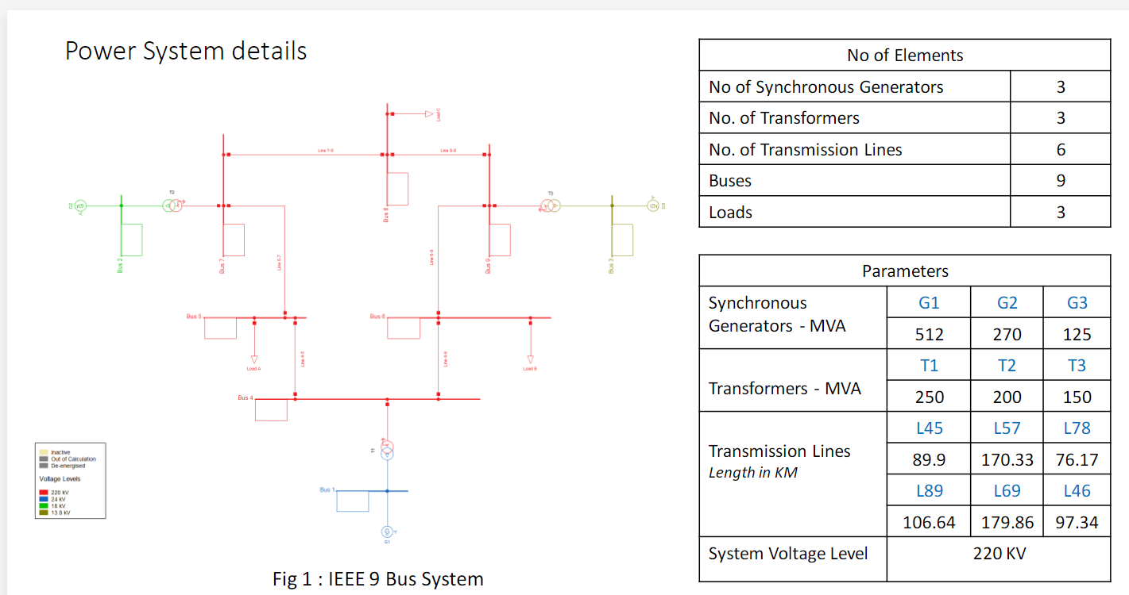
Dataset Information
Dataset 1 (Only Used for fault classification)
Got Power system simulated fault analysis MATLAB data .The system consists of 4 generators 11 × 10^3 V, Transformers are present in between to simulate and study the various faults at the midpoint of the transmission line
The circuit was tested under normal and various fault conditions to collect data on the measured line voltages and currents at the output side of the power system. The collected data, which consisted of nearly 12,000 labeled data points, was then saved for analysis
Dataset 2 ( Used for both fault classification and Fault Location)
A simulation tool known as Power Factory is used to simulate a 9-bus system in which the various faults is simulated on line connecting bus 5 and 7 The data of currents and voltages are captured from bus 5.
The second dataset contains 10 fault types mainly AG , BG ,CG ,ABG, BCG, CAG ,AB ,BC,CA,ABC and fault location from 5 to 100 with step size

Slide 15
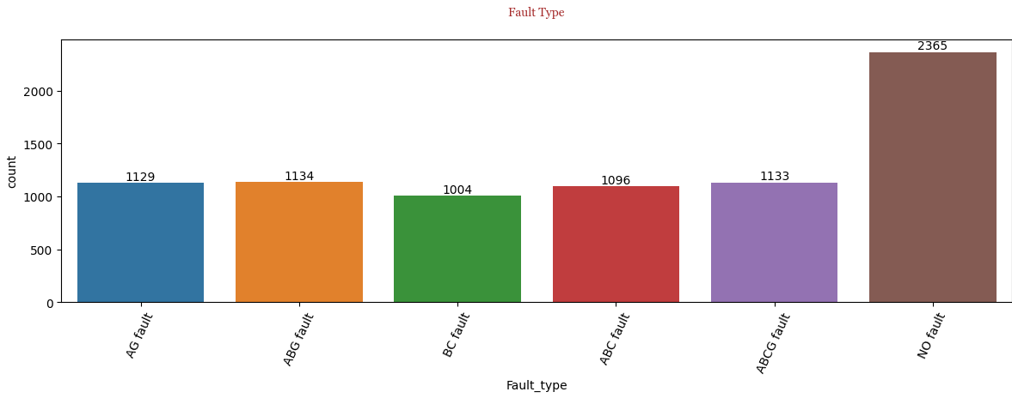
Dataset 1 Information
Data consists of 10 columns Ia Ib Ic , Va , Vb , Vc , G , A , B , C .
Based on the G , A , B ,C values which are either 0 or 1 the data can be classified into the following faults – No fault (0000) , AG fault (1100) , BG fault (1010) , CG fault(1001) , ABG fault (1110) , ABC fault (0111) , ABCG fault (1111)
A new column is created named Fault type where fault type is specified based on G,A,B,C values and then they are visualised using Matplotlib

Slide 16
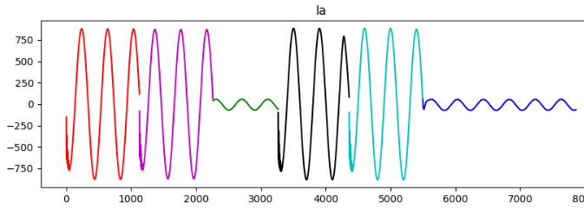
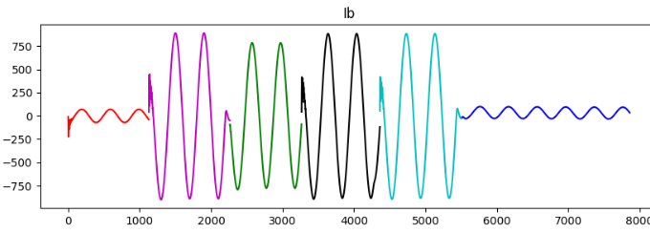
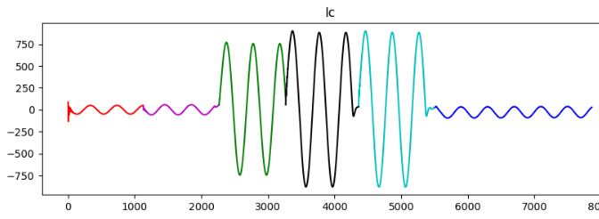
Dataset1 Continued..
The data is then separated into 7 data frames so that Ia Ib , Ic values can be plotted separately
Red – AG fault , Magenta – ABG fault , Green – BC fault , Black – ABC fault , Cyan – ABCG fault , Blue – No fault

Slide 17
Dataset 2 Information
The second dataset contains 10 fault types mainly AG , BG ,CG ,ABG, BCG, CAG ,AB ,BC,CA,ABC and fault location from 5,100 with step size of 5.
Firstly, this dataset is used for fault location detection
The training data consists of fault CG and locations from 5 to 100 , with fault resistance as 20
The test dataset contains location from 5 to 100 with fault resistance as 25.

Slide 18
Accuracy Validation Performance Metrics of Lite Models
Fault Classification Model
Fault Location Model
Model | Size | Accuracy
Actual Tensorflow Model | 202 KB | 99.33%
Converted Model without specifying quantization | 57 KB | 99.22%
Converted Model with Float16 quantization | 31 KB | 99.22%
Converted Model with Dynamic quantization | 22 KB | 99.21%
Model | Size | Mean Absolute Error
Actual Tensorflow Model | 1622 KB | 0.34
Converted Model without specifying quantization | 561 KB | 0.40694662
Converted Model with Float16 quantization | 305 KB | 0.406947
Converted Model with Dynamic quantization | 197 KB | 0.61782795

Slide 19
C/C++ Inference Implemented
Inference code for Tensorflow lite models was developed in both C and C++ to enable seamless execution and real time predictions.
Dynamic Link Library files were generated for the Tensorflow lite inference code. These DLL files encapsulate the necessary functionality, allowing easy deployment on the respective systems.
An executable file was built to demonstrate the Tensorflow Lite inference process. This executable integrates all required header files, libraries and DLL’s providing a self-contained runtime environment for the inference task.
Bazel with clang compiler setup is used for generating the DLL’s. Bazel was also used as the build system for managing dependencies, compiling code and generating corresponding executable file.
This approach ensures the generated DLL files can be reused in diverse applications and frameworks. The generated DLL’s and executable were tested to ensure functionality, compatibility and efficiency in performing Tensorflow Lite Inference.

Slide 20
ARM Deployment
After validating the Tensorflow lite inference code functionality on Windows, the next step involved deploying the inference framework on ARM-based machines.
The ARM GCC compiler was used to cross compile the C and C++ inference code for ARM architecture, ensuring compatibility with target hardware.
The toolchain facilitated the generation of both dynamic link libraries (.so) and executable files optimized for ARM machines.
Bazel was employed as the build system for managing dependencies, configuring the ARM GCC toolchain, and generating the required binaries.
The C and C++ inference code was compiled into an executable file and .so files were generated for deployment on ARM machines.
The generated binaries were designed to integrate seamlessly with the TensorFlow Lite runtime on the ARM platform.
The compiled executables and libraries were deployed onto the ARM-based machines for testing and validation. The inference tasks were performed to verify the functionality, accuracy, and performance of the deployed code.

Slide 21
Proposed research work for the next semester
The tensorflow lite models, initially developed using simulated data, will be deployed and tested with real world data to evaluate their performance in practical scenarios.
This step aims to identify any discrepancies in model prediction and performance when exposed to real operational constraints.
Based on the results from testing with real data, fine tuning of the models will be undertaken to improving their accuracy and reliability.
The fine-tuning process will involve retraining or optimizing the model parameters to align better with the characteristics of real data.
After fine-tuning, the performance of the tensorflow lite models on real data will be compared with traditional physics-based methods. This comparison will focus on metrics, speed, resource efficiency to determine relative strengths and weaknesses of both approaches.

Slide 22
Thank You

Slide 23
References
Kunjin Chen, Caowei Huang, Jinliang He , et al. "Fault detection, classification and location for transmission lines and distribution systems: a review on the methods “, pp. 1-9, 2016
Yahui Wang a, Qiushi Cui b,∗,1, Yang Weng c,2, Dongdong Li a,1, Wenyuan Li, et al. "Learning picturized and time-series data for fault location with renewable energy sources “, pp. 1-13, 2022
Ganiyu Adedayo Ajenikoko & Segun, Olufemi Sangotola, et al. "Fault location of transmission line based on CNN-LSTM double-ended combined model “, pp. 1-11, 2022
Rui Fan, Tianzhixi Yin, Renke Huang, Jianming Lian,, and Shaobu Wang, , et al. "Transmission Line Fault Location Using Deep Learning Techniques “, pp. 1-5, 2023
Notes:
23

