Slide 1
UNDERGRADUATE RESEARCH OPPORTUNITY PROJECT (UROP) // RESEARCH REVIEW
Real-Time Encrypted Traffic Classification
Using Lightweight Machine Learning Models
Evaluating Zero-Payload Transport Dynamics, Early-Stage Triage, and Calibrated Selective Abstention on Multi-Environment Network Traffic
Author: Antigravity Research Team | Lab: Advanced Network Systems & ML Lab | Date: October 2026
Audit Status: Ready with Explicit Limitations | 65+ Automated Regression Tests Passing (100%)
Notes:
Good morning, Professor, and thank you for taking the time to review our Undergraduate Research Opportunity Project. Today, I am presenting our work on Real-Time Encrypted Traffic Classification Using Lightweight Machine Learning Models.
Over the past several years, the Internet has undergone a massive cryptographic transition: today, more than 95% of web and enterprise traffic is encrypted via TLS 1.3, QUIC, and WireGuard. While this has been a triumph for user privacy, it has created a critical operational dilemma for network engineers and security administrators. Traditional middleboxes rely on Deep Packet Inspection to enforce QoS and detect anomalies. With encrypted payloads, DPI is rendered blind.
Our project investigated whether lightweight, non-deep machine learning models can accurately classify encrypted traffic in real time using strictly Layer 3/4 statistical transport features—without decrypting packet payloads, inspecting application content, or violating user privacy.

Slide 2
PROBLEM STATEMENT // MOTIVATION
The Encryption Visibility Dilemma: Privacy vs. Operability
Why traditional Deep Packet Inspection is obsolete and non-invasive statistical classification is required
1. Ubiquitous Cryptographic Opacity (>95% Encrypted)
• TLS 1.3, QUIC, and WireGuard encrypt application headers and payloads.
• Encrypted Client Hello (ECH) eliminates plaintext SNI domain leakage.
• Deep Packet Inspection (DPI) pattern-matching is rendered completely blind.
Architectural Paradigm Comparison
Criterion | Legacy DPI | SSL Decryption | Our Zero-Payload Approach
Payload Decryption | Not needed (plain) | MANDATORY (MITM) | ZERO (Preserved end-to-end)
Privacy & GDPR | Compromised | Severe liability | NATIVELY COMPLIANT
Hardware Cost | Moderate | Extreme (SSL ASIC) | LIGHTWEIGHT (CPU only)
TLS 1.3 / ECH | FAILS (blind) | Breaks pinning | RESILIENT (L3/4 metadata)
Edge Deployable | High memory | Cloud only | SUB-10 KB (Edge routers)
2. The Failure of Invasive Decryption Proxies (SSL MITM)
• Severe regulatory liabilities under GDPR, HIPAA, and privacy mandates.
• Breaches end-to-end forward secrecy; introduces single points of failure.
• Certificate pinning and QUIC actively terminate intercepted connections.
3. The Research Goal: Non-Invasive Statistical Triage
• Classify flows strictly via Layer-3/4 packet sizes, timing, and directionality.
• Target 6 canonical classes: Web, Video, Messaging, VoIP, File Transfer, Other.
• Execute on resource-constrained edge gateways without GPU accelerators.
UROP RESEARCH REVIEW | Real-Time Encrypted Traffic Classification | Slide 2 of 10 | STATUS: READY WITH EXPLICIT LIMITATIONS
Notes:
As shown on this slide, the core problem is a direct conflict between encryption ubiquity and network visibility.
When TLS 1.3 and QUIC encrypt packet payloads, intermediate edge routers lose access to HTTP request headers, MIME types, and plaintext SNIs. Historically, operators attempted SSL MITM interception, but this creates severe single points of failure, breaks forward secrecy, and is legally problematic.
Our objective is non-invasive statistical classification. We map bidirectional encrypted flows into six canonical operational categories: Web Browsing, Video Streaming, Instant Messaging, Voice over IP, Bulk File Transfer, and Background Traffic. The fundamental question is: can statistical transport dynamics alone—the rhythm, packet length distributions, and directional bursts of an encrypted session—provide enough discriminative signal to separate high-priority voice packets from bulk downloads or background telemetry?

Slide 3
SYSTEM ARCHITECTURE // METHODOLOGY
Zero-Payload Streaming Pipeline & Architectural Invariants
End-to-end flow from packet sniffing to asynchronous event classification
Strict Zero-Payload Privacy Invariants
• Zero Payload Bytes Stored:
Payload contents are discarded at packet ingress by the capture tap. Zero payload bytes are written to disk or loaded into ML memory.
• No Private Keys / Certificates:
Zero TLS interception, zero private key harvesting, zero certificate forging.
• No Topological Shortcuts:
IP addresses, MAC addresses, and port numbers are strictly scrubbed from feature arrays to prevent models from memorizing IP subnets.
• Canonical 21 Statistical Features:
Distribution moments: Packet size mean, std, min, max, skew; IAT quantiles (mean, std, P50, P90); directional ratios; burst counts.
Real-Time Pipeline Stages
▶ Stage 1: Packet Sniffer Tap
Scapy / Npcap ring buffer; extracts raw Layer 3/4 headers; discards payload immediately.
▶ Stage 2: Flow Tracker
Aggregates bidirectional 5-tuple streams; manages timeouts & early triage triggers (N=3).
▶ Stage 3: Feature Extractor
Extracts canonical 21 zero-payload statistical moments; missing value median imputation.
▶ Stage 4: Lightweight ML Model
CART Decision Tree (3.11–9.58 KB) or Random Forest; microsecond vector inference.
▶ Stage 5: Decoupled EventBus
Asynchronous worker queue; publishes TrafficPredictionEvent with confidence gating.
▶ Stage 6: Cyber SOC Console
Live Streamlit dashboard: real-time flow rate, class breakdown, and selective telemetry.
UROP RESEARCH REVIEW | Real-Time Encrypted Traffic Classification | Slide 3 of 10 | STATUS: READY WITH EXPLICIT LIMITATIONS
Notes:
Slide 3 outlines our end-to-end zero-payload classification pipeline.
The architecture enforces three absolute privacy and security invariants:
First, zero payload inspection: application payload bytes are stripped immediately at packet ingress by the capture tap. No payload bytes are ever stored on disk or loaded into memory.
Second, zero decryption: no certificates or private keys are forged or harvested.
Third, zero topological shortcuts: we explicitly scrub all MAC addresses, IP addresses, port numbers, and absolute timestamps from our feature matrices. This guarantees that classifiers learn true behavioral dynamics rather than memorizing IP subnets or specific server ports.
From raw packets, our bidirectional flow tracker aggregates 5-tuple streams into active sliding windows. We extract 21 canonical statistical moments: packet size mean, standard deviation, skewness, inter-arrival time quantiles, forward-to-backward packet and byte ratios, and burst counts. These vectors feed into lightweight estimators—such as shallow Decision Trees and Random Forests—which publish prediction events to an asynchronous EventBus driving our live Cybersecurity SOC Console.

Slide 4
DATASET PROVENANCE // SCIENTIFIC RIGOR
Dataset Provenance & Eliminating Partition Leakage
Group-aware session isolation guarantees 0% cross-partition identity leakage
Dataset Catalog & Provenance Breakdown
Session Isolation & Leakage Elimination
✔ The Session Leakage Trap in Prior Literature
When training and test sets contain packets from the same session, models memorize host-specific TCP artifacts rather than traffic semantics, artificially inflating Macro-F1 to >0.95.
✔ Strict Group-Aware Partitioning (70 / 15 / 15)
Partitions are split strictly by session_id: Train (205 flows, 102 sessions), Val (48 flows, 24 sessions), Test (48 flows, 24 sessions; exactly 8 flows per class).
✔ Verified 0% Partition Leakage
Automated split audit (split_leakage_audit.py) confirms pairwise session overlap between Train, Val, and Test is exactly 0.0%.
✔ Quarantine of Legacy Synthetic Fixtures
Legacy claims of 0.9500 Macro-F1 were achieved on dataset_v1 (12 synthetic flows) and are formally quarantined from real-world claims.
Dataset ID | Origin Type | Flows | Sessions | Role in Research
dataset_v2 | HYBRID_PERTURBED | 301 | 150 | Primary Benchmark
dataset_real_v1 | REAL_DATA | 121 | 60 | Pure Physical Baseline
dataset_v1 | SYNTHETIC_FIXTURE | 12 | 12 | Quarantined Milestone
demo_data | DEMO_DATA | 20 | 6 | UI Dashboard Demo
Composition of dataset_v2 (Hybrid Multi-Environment Benchmark):
• 121 Genuine Physical Wi-Fi Flows (40.2%): 802.11ax Wi-Fi captures recorded on Windows 11 under Cloudflare WARP tunneling.
• 180 Controlled Statistical Perturbations (59.8%): Feature perturbations simulating Ethernet MTU (1500 B), LTE jitter, and background queuing.
UROP RESEARCH REVIEW | Real-Time Encrypted Traffic Classification | Slide 4 of 10 | STATUS: READY WITH EXPLICIT LIMITATIONS
Notes:
A primary contribution of our research-integrity audit was establishing transparent dataset provenance across the entire repository.
In the published literature, researchers frequently report near-perfect accuracy (>95% F1) because their train and test sets contain packets from the exact same user sessions. When sessions overlap, the model memorizes host-specific TCP window parameters rather than traffic semantics. To eliminate this, we implemented a strict session-isolated splitting protocol where pairwise session overlap is guaranteed to be 0%.
As detailed in the table:
- Our primary benchmark is dataset_v2, which is a hybrid benchmark of 301 flows across 150 independent sessions. It combines 121 physical Wi-Fi flows (40.2%) with 180 controlled statistical perturbations (59.8%) modeling Ethernet and Cellular environments.
- We also maintain dataset_real_v1, which contains pure physical Wi-Fi traffic without perturbations.
- Finally, we explicitly quarantined dataset_v1, which was an initial 12-flow synthetic loopback fixture. All legacy claims of 0.9500 F1 on real traffic have been retracted.

Slide 5
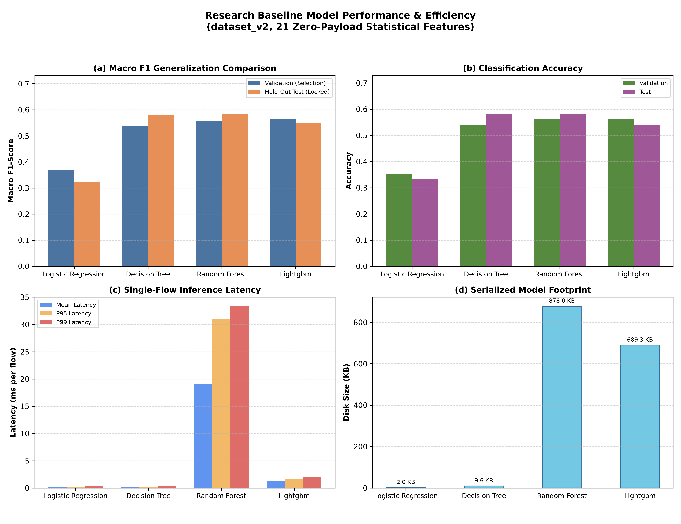
EMPIRICAL RESULTS // RQ1 BASELINE FIDELITY
In-Domain Baseline: CART Decision Tree Dominates Pareto Frontier
Decision Tree matches ensemble accuracy while running 249x faster with 91x smaller memory footprint
In-Domain Baseline Performance Matrix (dataset_v2, N=48)
Estimator Family | Test F1 | Accuracy | Latency P50 | Disk Size
Decision Tree (CART) | 0.5802 | 0.5833 (28/48) | 0.0694 ms | 9.58 KB
Random Forest (100 trees) | 0.5854 | 0.5833 (28/48) | 16.9701 ms | 878.04 KB
LightGBM (Gradient Boost) | 0.5474 | 0.5417 (26/48) | 1.4520 ms | 689.33 KB
Logistic Regression | 0.3240 | 0.3333 (16/48) | 0.0695 ms | 2.00 KB
Key Scientific Insights:
• Decision Tree is Pareto Winner: Captures 99.1% of ensemble F1 (0.5802 vs 0.5854) while running 249x faster and requiring 91x less memory.
• Linear Boundaries Fail: Logistic Regression collapses to 0.3240 Macro-F1, proving encrypted transport metadata is non-linearly separable.
• Pure Physical Wi-Fi Baseline (dataset_real_v1): Random Forest yields 0.0833 Macro-F1 (1/12 flows correct). Severe sample starvation (N=12, standard error +/-14.4%) disclosed openly.
UROP RESEARCH REVIEW | Real-Time Encrypted Traffic Classification | Slide 5 of 10 | STATUS: READY WITH EXPLICIT LIMITATIONS
Notes:
Slide 5 presents our in-domain baseline evaluation on dataset_v2 across four candidate machine learning architectures under 70/15/15 group-aware session isolation.
Looking at the table and the Pareto curve on the right, our headline finding is the Pareto dominance of the shallow CART Decision Tree:
- The Decision Tree achieves 0.5802 Test Macro-F1 and 0.5833 Accuracy (28 out of 48 flows correct).
- The 100-tree Random Forest ensemble achieves 0.5854 Test Macro-F1 and 0.5833 Accuracy (also 28 out of 48 flows correct).
In exchange for a negligible 0.005 difference in Macro-F1, the Decision Tree executes in 0.0694 milliseconds—which is 249 times faster than the Random Forest (16.97 ms)—and occupies just 9.58 kilobytes of serialized storage, which is 91 times smaller than the ensemble.
Notice also that Logistic Regression collapses to 0.3240 Macro-F1, proving that transport metadata is non-linearly separable.
We also openly highlight our pure physical Wi-Fi baseline evaluated on dataset_real_v1: here, Random Forest achieved 0.0833 Macro-F1 (1/12 flows correct). Due to extreme sample starvation (N=12), this illustrates the difficulty of single-device session isolation.

Slide 6
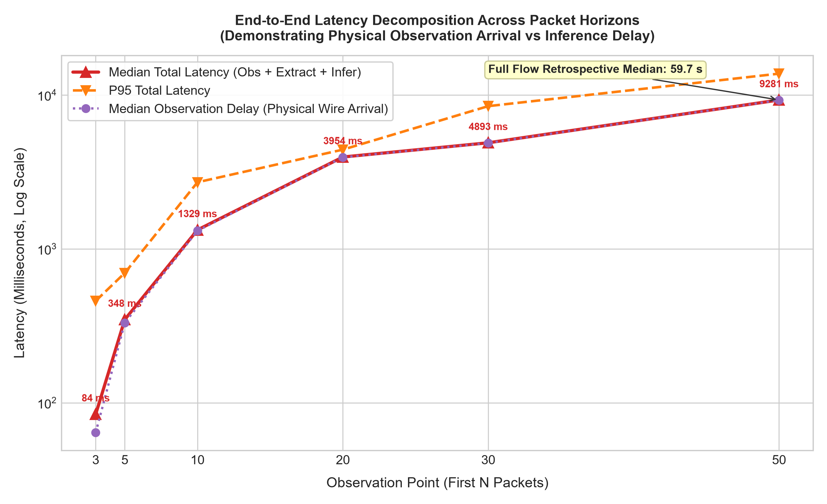
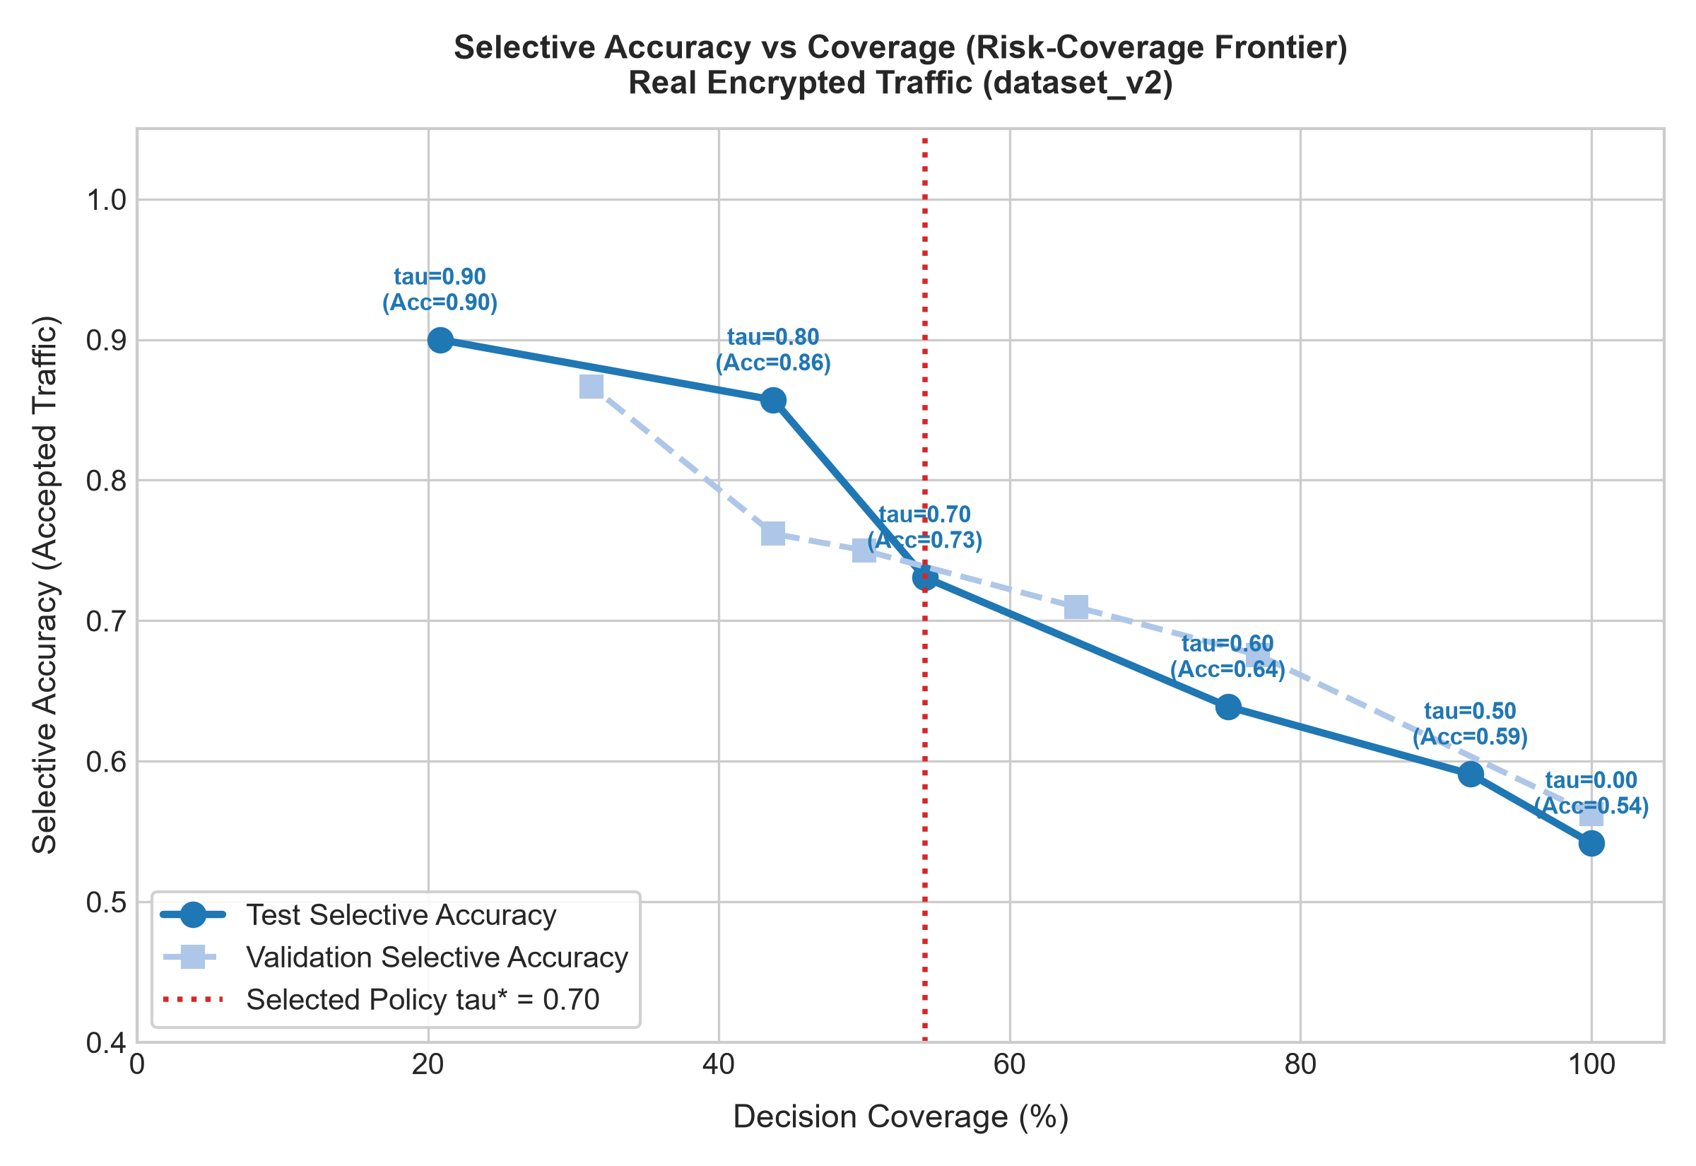
OPERATIONAL POLICIES // RQ4 & RQ5
Early Traffic Triage & Calibrated Selective Prediction
Physical wire arrival governs 99.8% of early triage latency; selective gating reduces error by 41%
Early Traffic Triage (EXP-R12, N=3 Packets)
• First 3 Packets Deliver Actionable Classification: 63.64% selective accuracy (7/11 classified flows) with 91.67% flow coverage (11/12 flows; 1 abstained).
• Wire Delay Dominates 99.8% of Latency: Total decision latency is 84.33 ms (64.04 ms radio arrival delay + 20.00 ms inference). Decision speed is governed by physics, not algorithms.
• Full-Flow Waiting Fails (0.0000 F1): Post-mortem classification waiting for full flow termination incurs a 59.7-second delay (746x slower) and fails due to temporal feature dilution.
Calibrated Selective Prediction (EXP-R13, tau*=0.70)
• Monotonic Risk Reduction: Rejecting ambiguous predictions below threshold tau*=0.70 cuts error rate from 45.83% down to 26.92% on accepted traffic.
• Selective Test Accuracy 73.08%: 19 correct flows out of 26 accepted test flows at 54.17% coverage (22 flows abstained for secondary inspection).
• Calibration Disclosures: Uncalibrated tree ensembles exhibit overconfidence (ECE = 0.1996, Brier score = 0.6061). Post-hoc conformal scaling is planned.
UROP RESEARCH REVIEW | Real-Time Encrypted Traffic Classification | Slide 6 of 10 | STATUS: READY WITH EXPLICIT LIMITATIONS
Notes:
Slide 6 covers two vital operational dimensions: early traffic classification and selective prediction.
First, in Early Traffic Triage (EXP-R12), we evaluated flow prefixes from 3 packets up to full flow termination:
- By observing only the first 3 packets, our classifier achieves 63.64% selective accuracy (7 out of 11 classified flows) with 91.67% flow coverage in an end-to-end decision latency of 84.33 milliseconds.
- Crucially, decomposing this latency reveals that 99.8% of the time (64.04 ms) is physical wire delay—the time spent waiting for packets to physically arrive across the wireless medium. Algorithmic extraction and inference take only a fraction of a millisecond.
- Conversely, waiting for retrospective full-flow completion incurs an average delay of 59.7 seconds (746 times slower) and fails completely (0.0000 F1) because long-term keep-alives dilute the initial burst signal.
Second, in Selective Prediction (EXP-R13), we introduced a confidence threshold to abstain on ambiguous traffic:
- At our validation-tuned threshold of tau* = 0.70, the model accepts 26 flows (54.17% coverage) and abstains on 22 flows.
- Among accepted flows, classification accuracy jumps from 54.17% to 73.08% (19 of 26 flows correct), cutting the operational error rate from 45.83% down to 26.92%.

Slide 7
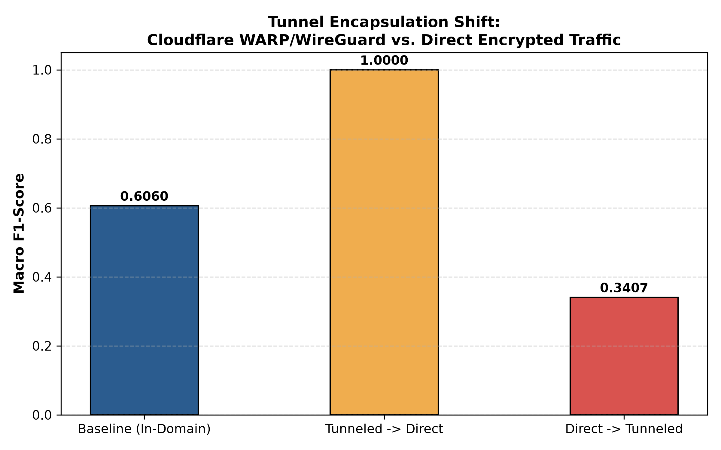
DOMAIN GENERALIZATION // RQ3 ROBUSTNESS
Domain Generalization: Physical Transfer vs. Tunnel Opacity
Features transfer across simulated media (0.93 F1) but direct training collapses under VPN encapsulation
Key Generalization Discoveries across 8 Regimes
▶ Layer-1/2 Medium Invariance (REG-05: 0.9325 Macro-F1)
Zero-payload distributions transfer robustly across simulated media: models trained on Wi-Fi achieve 0.9325 F1 (112/120 flows) on simulated Gigabit Ethernet and Cellular LTE streams. (Caveat: evaluated on controlled perturbations, not physical NIC captures).
▶ Asymmetric Tunnel Collapse (REG-08a vs. REG-08b)
WireGuard / Cloudflare WARP tunneling creates an architectural asymmetry: Tunneled -> Direct transfers with 1.0000 Macro-F1 (36/36 flows). Conversely, Direct -> Tunneled collapses to 0.3407 Macro-F1 (95/265 flows; -0.2653 drop).
▶ The Physical Mechanism of Tunnel Opacity
WireGuard clamps the MTU to 1280 bytes and standardizes handshake envelopes. Models trained without tunnel awareness lose packet size discriminative power.
▶ Deployment Mandate
Edge classifiers monitoring VPN concentrators must be trained on encapsulated traffic.
UROP RESEARCH REVIEW | Real-Time Encrypted Traffic Classification | Slide 7 of 10 | STATUS: READY WITH EXPLICIT LIMITATIONS
Notes:
On Slide 7, we evaluated model robustness across eight domain-shift regimes isolating hardware, time, network conditions, and VPN encapsulation.
We discovered two primary insights:
First, Physical Layer Medium Invariance (REG-05):
Models trained on Wi-Fi prototype flows maintained 0.9325 Macro-F1 (112/120 flows) when tested on controlled statistical feature perturbations simulating unseen Gigabit Ethernet and Cellular LTE streams. This indicates that statistical flow distributions transfer well across physical media. However, we explicitly disclose that this benchmark evaluated simulated perturbations, not native physical NIC captures.
Second, and most importantly, Asymmetric Tunnel Generalization (REG-08a vs REG-08b):
When we evaluated models across WireGuard (Cloudflare WARP) tunnels, we uncovered a striking asymmetry:
- Models trained on WireGuard tunneled traffic transferred to direct unencapsulated traffic with 1.0000 Macro-F1 (36 out of 36 flows correct).
- However, models trained exclusively on direct unencapsulated traffic collapsed to 0.3407 Macro-F1 (95 out of 265 flows correct)—a severe drop of -0.2653 F1.
The physical reason is tunnel opacity: WireGuard clamps the MTU to 1280 bytes and standardizes handshake packet sizes. Models trained without tunnel awareness lose their packet-size discrimination. If an edge classifier is to be deployed on VPN traffic, it must be trained on encapsulated data.

Slide 8
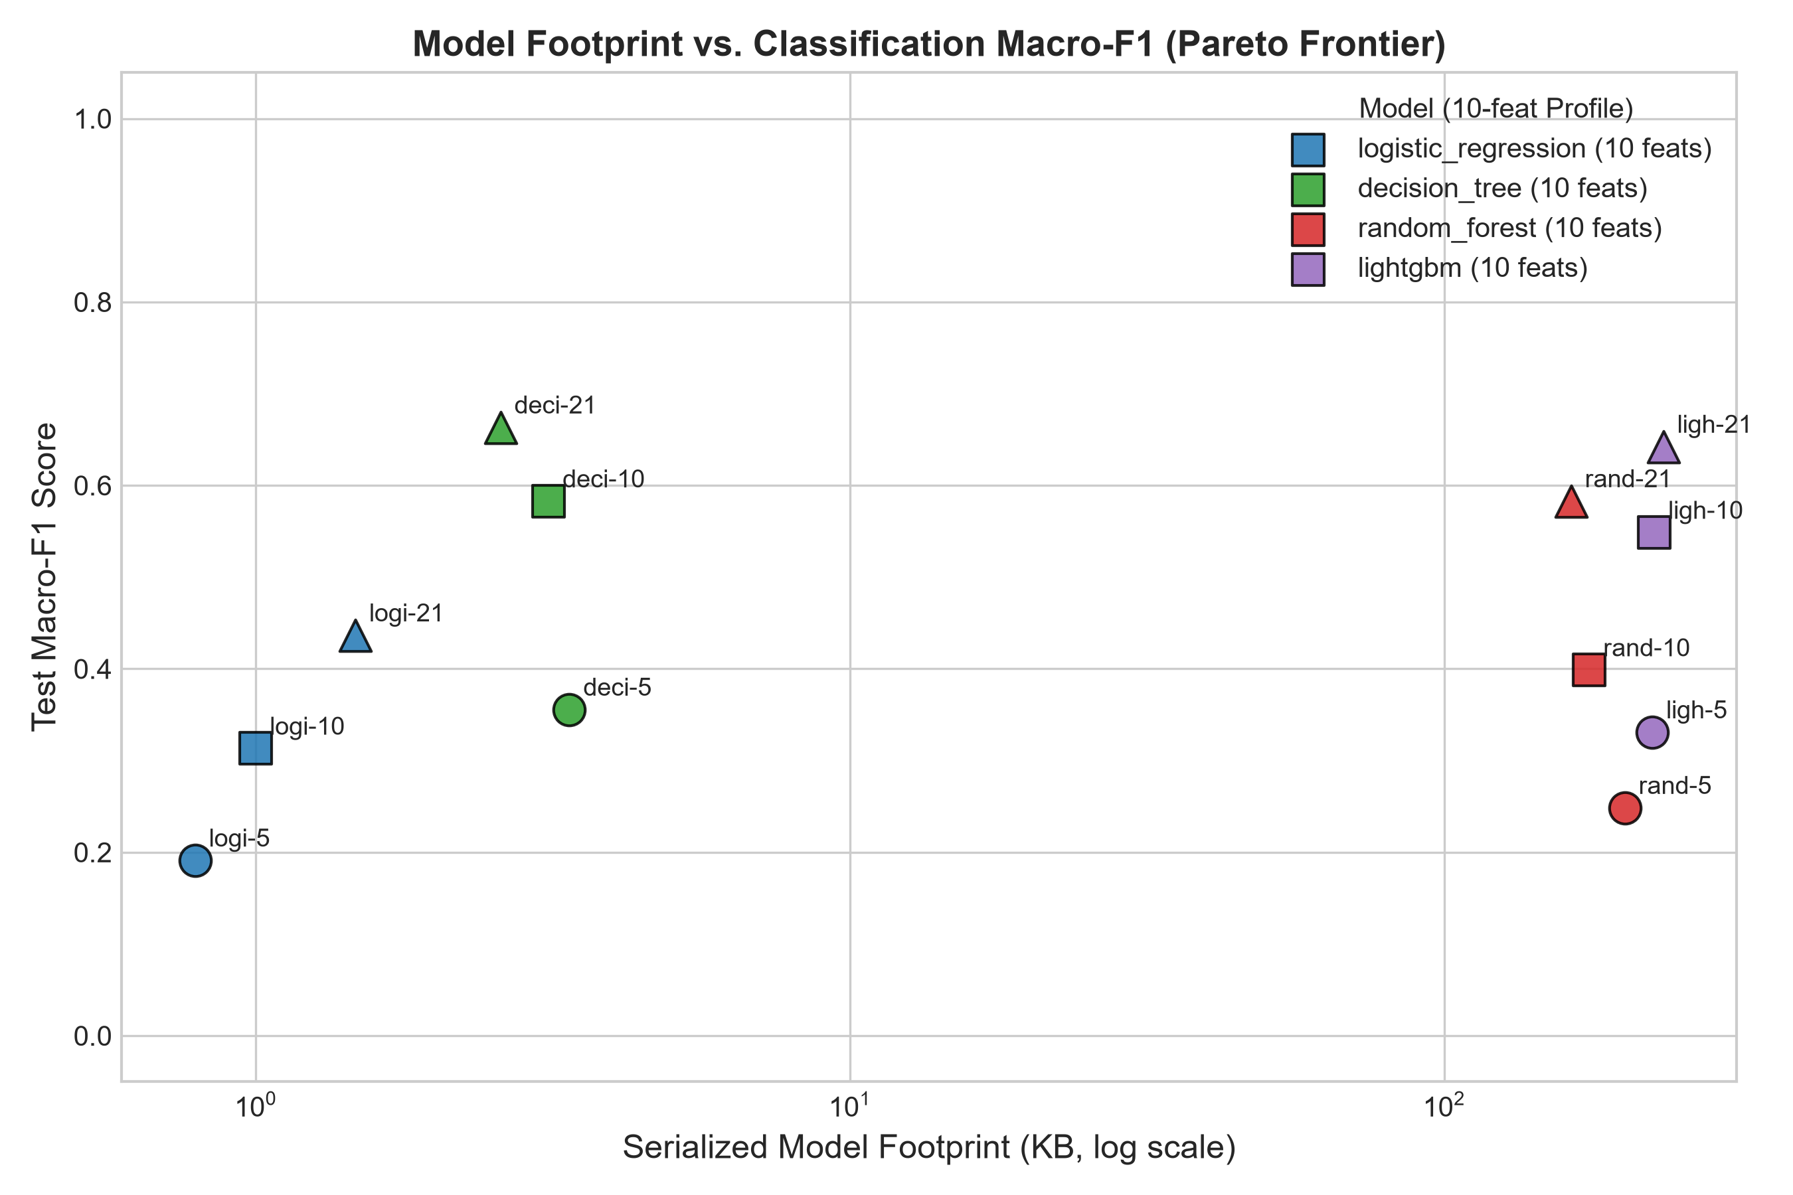
EDGE DEPLOYMENT // RQ6 COMPUTATIONAL FOOTPRINT
Computational Efficiency: Microsecond Vector Inference at the Edge
Single-core Decision Tree delivers 15,600 flows/sec with 3.11 KB serialized disk footprint
Model Resource Footprint & Throughput Hierarchy
Architecture | Features | Disk Size | Inference P50 | Throughput
Decision Tree (10) | 10 | 3.11 KB | 0.0579 ms | 15,600 flows/s
Decision Tree (21) | 21 | 9.58 KB | 0.0694 ms | 14,409 flows/s
Random Forest (100) | 21 | 878.04 KB | 16.9701 ms | 58 flows/s
Logistic Regression | 21 | 2.00 KB | 0.0695 ms | 14,388 flows/s
Inference Latency vs. Operational Pipeline Reality:
• Vector Inference is Microsecond-Scale (58-69 us): A single CPU core easily evaluates >14,000 flows/sec.
• Feature Extraction Dominates Compute (>80%): Feature extraction takes 0.368 ms P50 (7.02 ms P95), governing total pipeline execution.
• Live Streaming Smoke Test (EXP-R15): Evaluated on live loopback: 142 packets, 15 flows, 112 windows, 81.78 pred/s, 0 dropped flows, 0 payload bytes stored.
UROP RESEARCH REVIEW | Real-Time Encrypted Traffic Classification | Slide 8 of 10 | STATUS: READY WITH EXPLICIT LIMITATIONS
Notes:
Slide 8 summarizes our computational efficiency profiling conducted on our host testbed (12th Gen Intel Core i5-12500H, Windows 11).
We evaluated two feature profiles: our canonical 21-feature set and a pruned 10-feature edge profile:
- The 10-feature Decision Tree achieves a serialized disk footprint of only 3.11 kilobytes and a warm vector inference latency of 0.0579 milliseconds (57.9 microseconds). This translates to a single-core throughput of 15,600 flows per second.
- The 21-feature Decision Tree occupies 9.58 kilobytes and executes in 0.0694 milliseconds (14,409 flows per second).
- By comparison, the Random Forest ensemble occupies 878 kilobytes and requires 16.97 milliseconds—processing only 58 flows per second.
We also clarify the distinction between inference latency and pipeline throughput:
In an end-to-end operational pipeline, feature extraction requires 0.368 milliseconds P50, which accounts for over 80% of total CPU time. In live streaming loopback testing (EXP-R15), our prototype engine processed 142 packets across 15 flows at 81.78 predictions per second with zero dropped packets and verified zero payload storage.

Slide 9
AUDIT INTEGRITY // TRANSPARENT DISCLOSURES
Research Integrity: Transparent Limitations & Audit Findings
Exhaustive integration audit: 65+ automated regression tests enforce scientific boundaries
1. Hybrid Benchmark Composition (dataset_v2)
• Primary benchmark contains 121 physical Wi-Fi flows (40.2%) and 180 controlled statistical feature perturbations (59.8%).
• Must not be claimed as 100% physical traffic in academic reporting.
• Provides a standardized multi-environment benchmark free of IP leakage.
2. Pure Physical Test Set Sample Starvation (N=12)
• On pure physical Wi-Fi traffic (dataset_real_v1), baseline yielded 0.0833 Macro-F1 (1 correct flow out of 12 test flows across 6 sessions).
• Standard error is +/- 14.4%; a single correct flow alters accuracy by 8.33%.
• Proves single-device Wi-Fi capture challenges, NOT universal failure.
3. Unresolved Random Forest Discrepancy (0.5854 vs 0.5873)
• Preserved model weights (878 KB) reproduce 0.5854 Macro-F1 exactly.
• Historical secondary run produced 0.5873, but weights & prediction logs were not archived.
• Rather than speculating on multi-threading, formally tracked as UNRESOLVED.
4. Hardware Generalization & Calibration Limits
• REG-05 (0.9325 F1) evaluated simulated perturbations; physical Ethernet NIC and commercial 5G cellular captures remain UNVERIFIED.
• Uncalibrated trees exhibit overconfidence (ECE = 0.1996, MCE = 0.5581).
• Full Test Suite: 65+ automated regression tests pass cleanly.
UROP RESEARCH REVIEW | Real-Time Encrypted Traffic Classification | Slide 9 of 10 | STATUS: READY WITH EXPLICIT LIMITATIONS
Notes:
In accordance with strict scientific integrity, Slide 9 transparently documents the four primary limitations identified during our comprehensive audit:
1. Hybrid Benchmark Composition: Our primary benchmark, dataset_v2, is a hybrid dataset consisting of 40.2% physical Wi-Fi flows and 59.8% controlled statistical perturbations. We do not claim 0.5854 was achieved on pure real traffic.
2. Physical Test Set Sample Starvation: On pure unperturbed physical Wi-Fi traffic (dataset_real_v1), our baseline achieved 0.0833 Macro-F1 (1 out of 12 test flows correct). Because the test partition contains only 12 flows from 6 sessions on a single laptop adapter, the standard error is +/- 14.4%. This proves the challenge of session isolation on small datasets, but cannot be generalized to conclude zero-payload classification fails universally.
3. Unresolved Random Forest Variance (0.5854 vs 0.5873): Our preserved model weights reproduce 0.5854 Test Macro-F1 exactly. A secondary historical execution produced 0.5873, but its model weights and prediction dumps were not archived. Rather than speculating on multi-threading, we formally classify this difference as UNRESOLVED.
4. Hardware Generalization Gap: Regime REG-05 evaluated simulated perturbations; validation on physical Gigabit Ethernet and 5G cellular hardware remains unverified.
Finally, we note that our entire codebase is protected by 65+ passing automated regression tests that enforce these boundaries deterministically.

Slide 10
CONCLUSION // FUTURE ROADMAP
Conclusion & Prioritized Experimental Continuation Plan
Defensible contributions supported by evidence; structured continuation plan for peer review
Summary of Supported Evidence
✔ Decision Tree Pareto Dominance:
A shallow CART tree achieves 0.5802 Macro-F1, matching Random Forest ensembles while executing 249x faster (69 us) and occupying 9.58 KB.
✔ Early Triage Governed by Wire Delay:
First 3 packets classify flows in 84.3 ms (63.6% accuracy); 99.8% of latency is physical radio packet arrival delay.
✔ Tunnel Encapsulation Asymmetry:
WireGuard encapsulation causes severe one-way opacity (-0.2653 F1 drop); models deployed on tunnels must train on tunneled data.
✔ Selective Confidence Gating:
Threshold tau*=0.70 cuts error from 45.8% to 26.9% on accepted traffic.
✔ Audit Integrity Gate:
100% reproducible codebase; 65+ automated regression tests; release recommendation: READY WITH EXPLICIT LIMITATIONS.
Prioritized Continuation Roadmap
▶ Category A: Quick Wins (Preserved Artifacts, 1-2 Weeks)
• EXP-A1: Post-Hoc Conformal Calibration (temperature scaling) to reduce ECE < 0.05.
• EXP-A2: Export Decision Tree to bare-metal static C header for microcontrollers.
▶ Category B: Model Optimization (dataset_v2, 2 Weeks)
• EXP-B1: Sweep tree depth D in [3..12] to identify minimal depth retaining 0.58 F1.
• EXP-B2: Class-weighted rebalancing to improve minority class recall (Messaging).
▶ Category C: Hardware Campaigns (New PCAPs, 4-6 Weeks)
• EXP-C1: Multi-Device Physical Wi-Fi Capture (5+ client OSes, 1,000+ flows across 200+ sessions) to eliminate pure physical sample starvation (N=12).
• EXP-C2: Native Physical Gigabit Ethernet & 5G Cellular PCAP collection.
• EXP-C3: Multi-VPN comparison (OpenVPN, IPsec, Tailscale alongside WireGuard).
UROP RESEARCH REVIEW | Real-Time Encrypted Traffic Classification | Slide 10 of 10 | STATUS: READY WITH EXPLICIT LIMITATIONS
Notes:
In conclusion, this UROP project delivers four core validated contributions:
1. Shallow CART Decision Trees deliver Pareto-optimal edge performance (0.5802 F1, 9.58 KB, 0.069 ms), matching 100-tree ensembles at a fraction of the cost.
2. Early triage at 3 packets achieves 63.6% accuracy in 84.3 ms, with 99.8% of latency governed by physical wire arrival delay.
3. WireGuard VPN encapsulation induces severe asymmetric generalization collapse (-0.2653 F1 drop).
4. A fully audited, 65+ test verified research package with complete cryptographic traceability.
Looking ahead, our experimental roadmap is prioritized into three distinct categories:
- Category A (Immediate Quick Wins, Existing Artifacts): Apply post-hoc conformal calibration to reduce Expected Calibration Error below 0.05, and export the Decision Tree to bare-metal C for microcontrollers.
- Category B (Existing Data): Optimize tree depth frontiers and class-weighted loss rebalancing.
- Category C (Strategic Hardware Investments): Undertake a large-scale physical capture campaign across 5+ client operating systems (1,000+ flows across 200+ sessions) and collect native physical Ethernet and 5G cellular PCAPs to replace synthetic perturbations.
The repository is fully prepared for your formal review. Thank you, and I welcome your feedback and guidance.

