Slide 1

SMART INDIA HACKATHON 2026
Problem Statement ID – SIH_DT_2026
Problem Statement Title - Digital Twin Framework for MALE UAV Aero Piston Engines
Theme - Aviation & Defence Technology
PS Category - Software
Team ID -
Team Name (Registered on portal)

Slide 2
IDEA TITLE
Proposed Solution:
AeroTwin AI is a centralized Digital Twin framework that acts as a continuous virtual mirror of an aero-piston engine operating onboard a MALE UAV. The solution functions as follows:
  Real-Time Telemetry Ingestion: Captures high-frequency sensor data (RPM, CHT, EGT, Vibration) via CAN bus & MQTT pipelines.
  Hybrid AI Architecture: Combines thermodynamic physics models with deep learning (PyTorch) to evaluate health indices.
  Predictive Diagnostics: Estimates Remaining Useful Life (RUL) and flags degradation trends before threshold breaches.
  Mission Replay HMI: Empowers propulsion engineers to reconstruct flights and analyze hot-weather/altitude stress.
Problem Resolution:
Transitions UAV monitoring from dangerous, reactive threshold alarms to proactive, AI-driven predictive maintenance, preventing mid-air asset loss.
Unique Value Propositions:
• Physics-Informed AI reduces false positives.
• Explainable AI (XAI) pinpoints exact root causes.
• Edge-to-Ground bandwidth optimization.

Slide 3
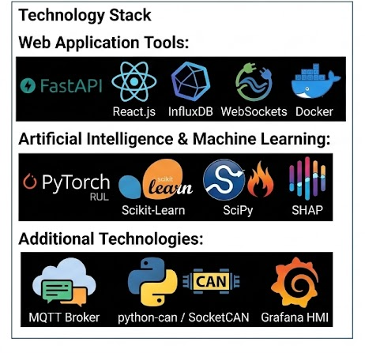
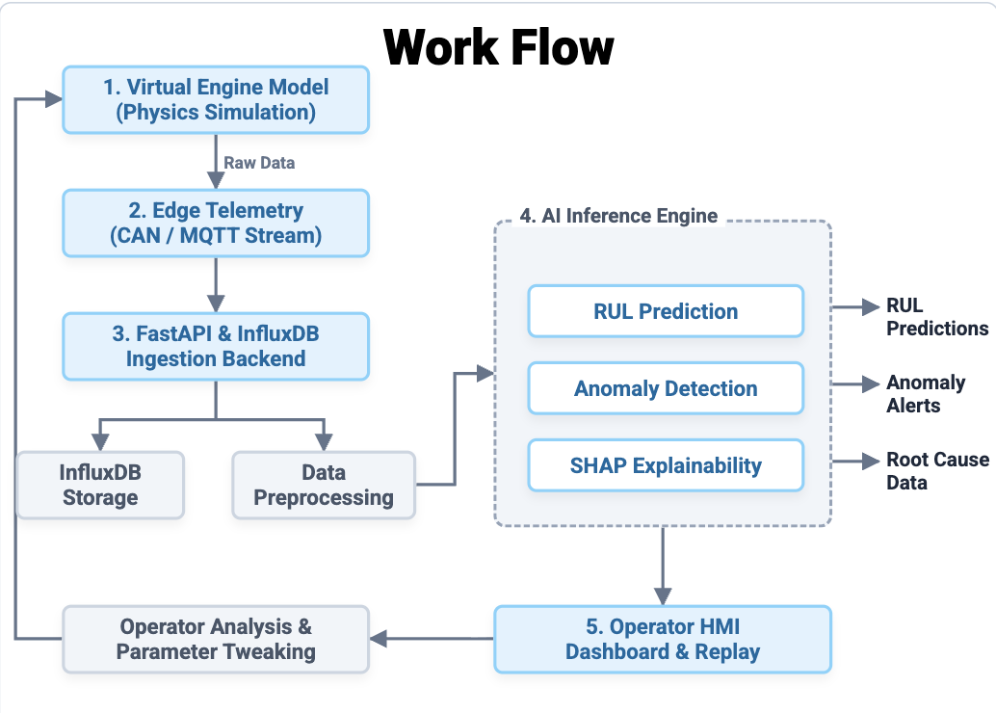
TECHNICAL APPROACH
Your Team Name

Slide 4
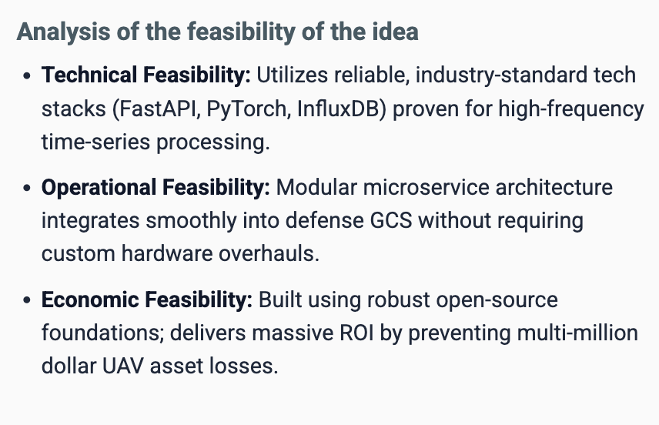
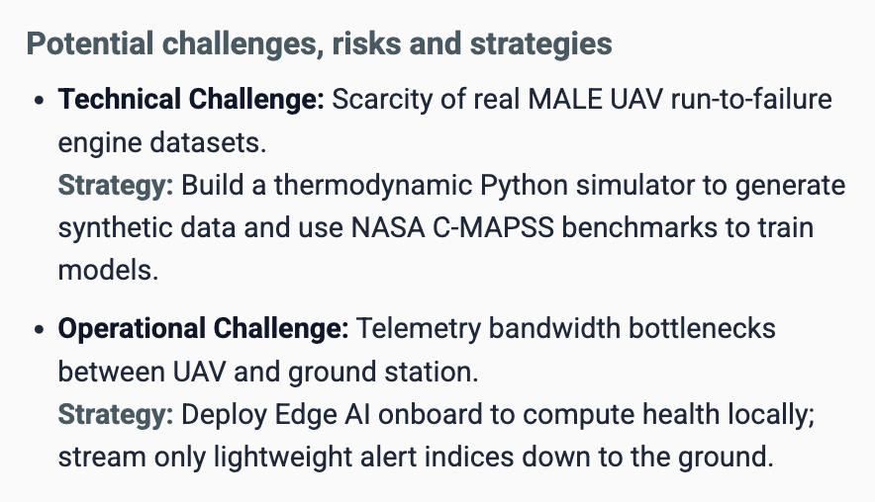
FEASIBILITY AND VIABILITY
Your Team Name

Slide 5
IMPACT AND BENEFITS
Your Team Name
Data-Driven Decision Making
Impact: Continuous sensor telemetries synthesized into high-fidelity physics-AI hybrid simulations.
Benefit: Provides ground control operators and defence engineers with actionable, real-time diagnostic insights for smarter tactical decisions.
Predictive Maintenance & Fleet Readiness
Impact: AI-driven Remaining Useful Life (RUL) estimation and proactive fault prediction.
Benefit: Shifts maintenance from fixed intervals to condition-based servicing, drastically reducing unpredicted downtime and boosting fleet availability.
Scalability & Strategic Value
Impact: Modular twin architecture adaptable to diverse engine models and UAV configurations.
Benefit: Enhances indigenous defence tech capabilities and seamlessly scales across civilian and military UAV operations.
Operational Reliability & Mission Success
Impact: Real-time digital twin monitoring and anomaly detection for aero piston engines.
Benefit: Maximizes MALE UAV mission success rates and prevents critical mid-air engine failures.
Cost Efficiency & Resource Optimization
Impact: Early detection of minor mechanical stress, overheating, and component wear.
Benefit: Prevents catastrophic engine loss, extends overall propulsion system lifespan, and significantly lowers maintenance/replacement expenditures.

Slide 6
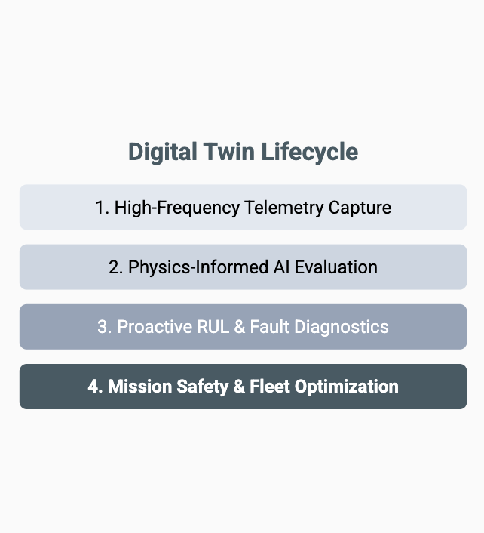
RESEARCH AND REFERENCES
Your Team Name
Data Research:
NASA Prognostics Data Repository (C-MAPSS Turbojet/Turbofan datasets).
  Link - https://data.nasa.gov/dataset/cmapss-jet-engine-simulated-data
IC Engine Thermodynamic Efficiency & EGT correlations.
  Link - https://www.sciencedirect.com/science/article/abs/pii/S0196890412000210
UAV CAN bus & MAVLink telemetry protocol specifications.
  Link - https://mavlink.io/en/guide/uavcan_interaction.html
Technology Research:
FastAPI Documentation
  Link - https://fastapi.tiangolo.com/
PyTorch Deep Learning & PINNs
  Link - https://pytorch.org/
InfluxDB Time-Series Optimization
  Link - https://influxdata.com/

