Slide 1

DATA WRANGLING AND HUSBANDRY COURSE PROJECT TOPIC: EDA ON NYC EMS INCIDENT DISPATCH DATA
Team Members:
Anirudh Gaur (216007356)
Prashanth Aripirala (219000924)
Rishik Salver (217001710)
Rohit Macherla (219008045)

Slide 2
About the dataset
The dataset is sourced from the NYC Open Data API, which is a repository of public data sets provided by the City of New York.
It contains information on over 2 million emergency EMS calls made to the New York City Fire Department (FDNY) between January 2019 and October 2021.
The dataset includes a variety of fields such as the type of emergency, location, time of day, and response times by FDNY.

Slide 3
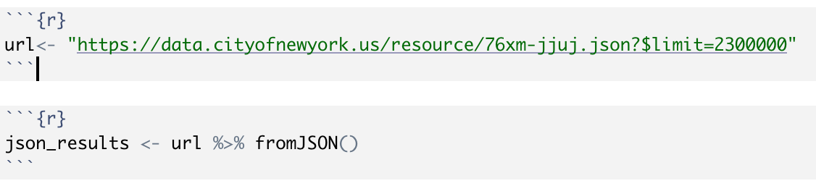
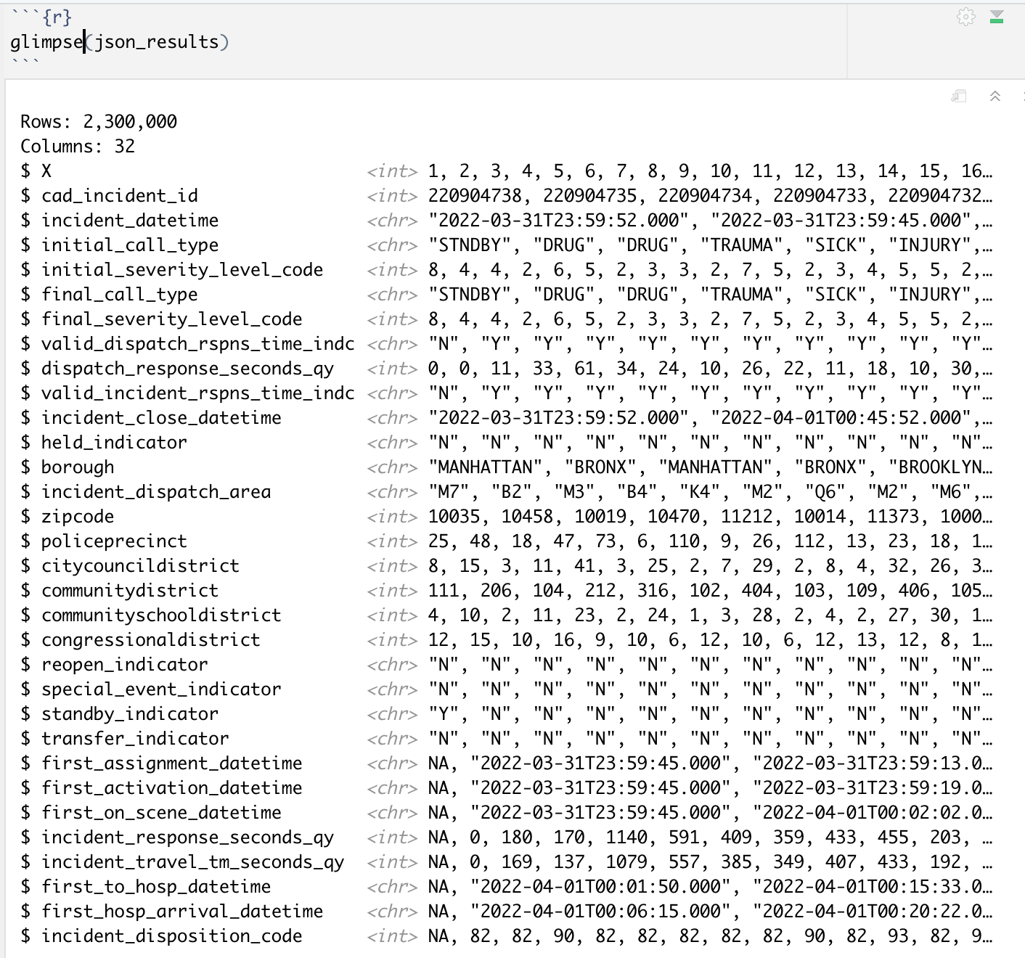
OBTAINING THE DATASET
The URL provided is used to fetch the data from the NYC EMS Incident Dispatch Dataset.
The ‘fromJSON()’ function is used to convert the fetched data from JSON format to a usable R data frame.
The fetched data is limited to 2,300,000 records using the $limit parameter in the URL to prevent overload or excessive memory usage.

Slide 4
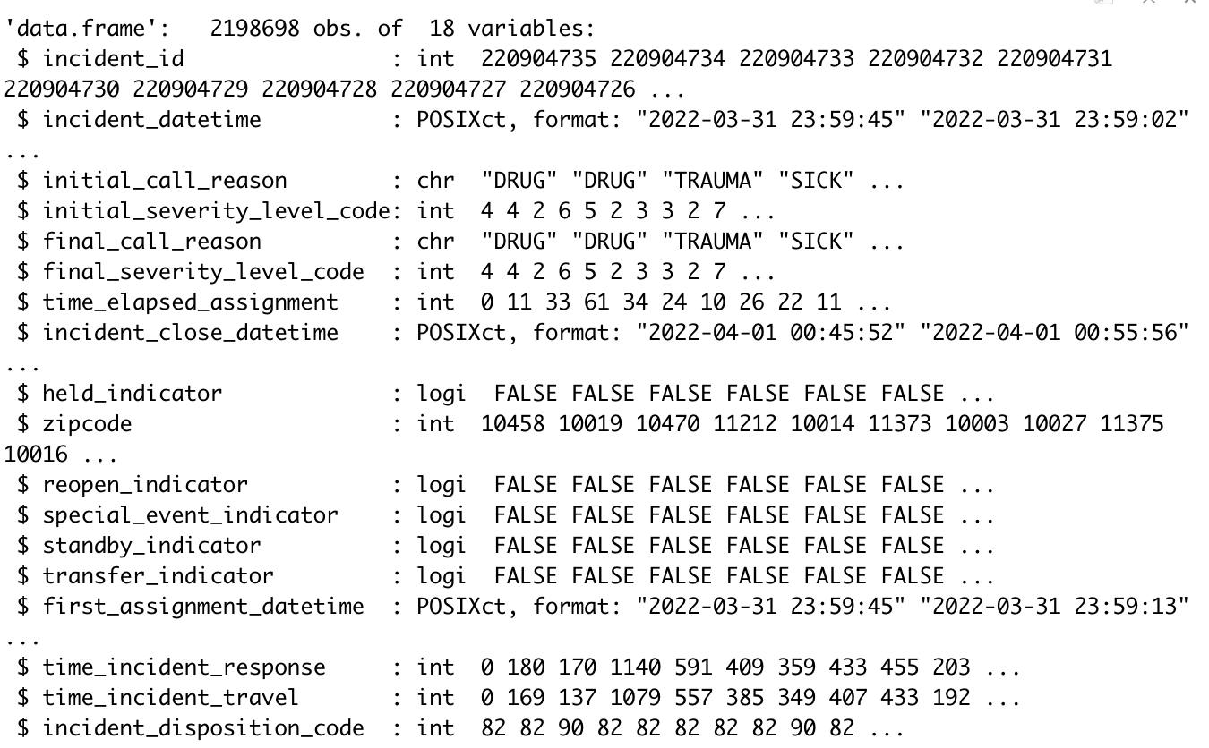
PRE-Processing of dataset
We preprocessed the data by dropping unnecessary columns, renaming some of the columns, and converting data types to improve the quality of the data.
To ensure data quality and accuracy, we removed rows with missing or NA values from the dataset.

Slide 5
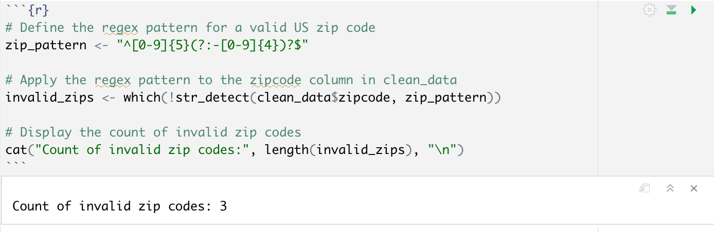
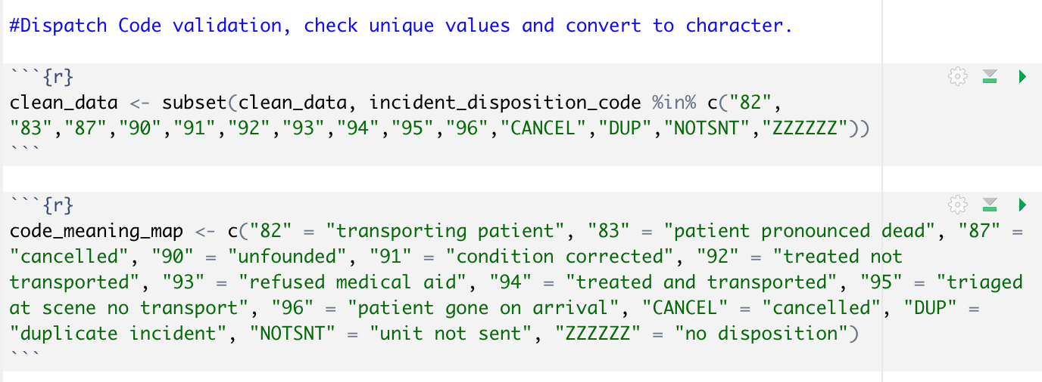
Addressing invalid and out of range values
A regex pattern was defined for a valid US zip code. The pattern was applied to the zip code column in the to filter out the invalid zip code.
The data set is processed to consider values in a given subset and the rest of the rows are dropped. Another column is added to classify each value of dispatch code.

Slide 6
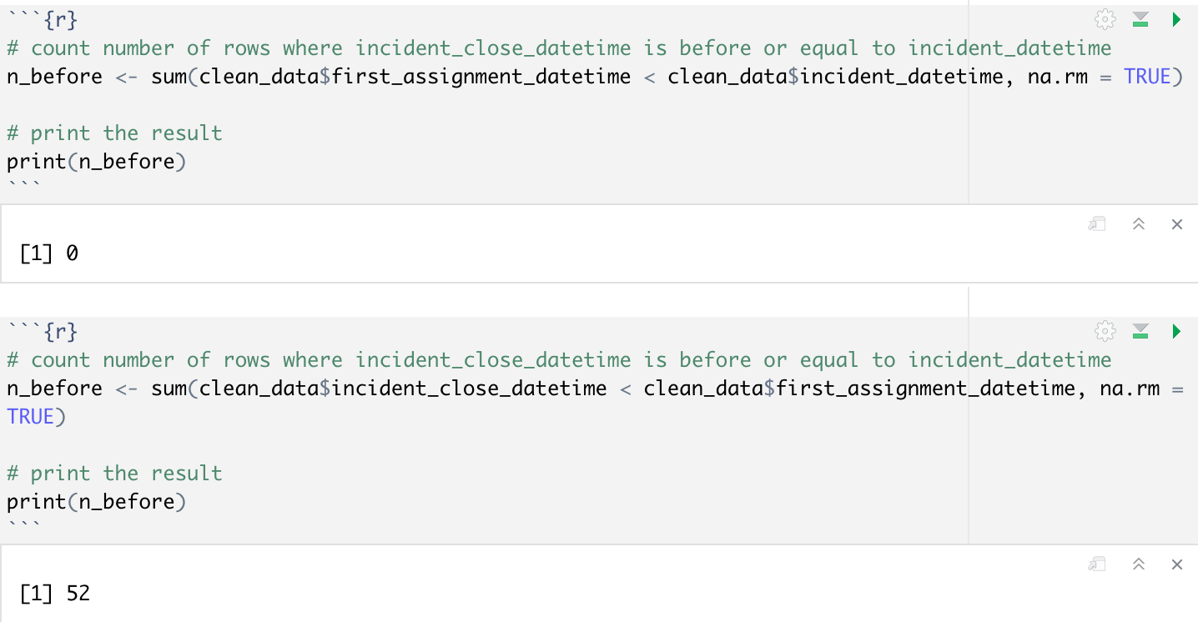
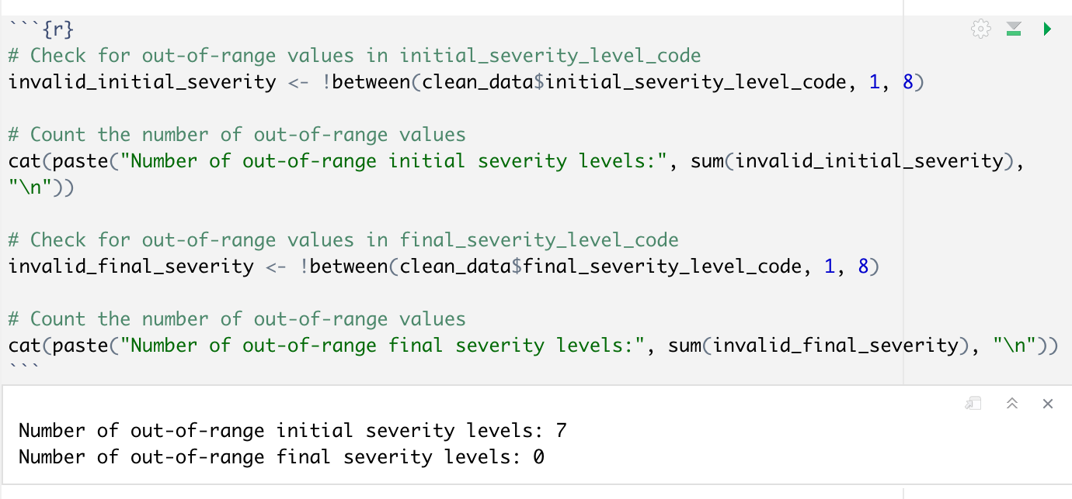
Edge case detection

Slide 7
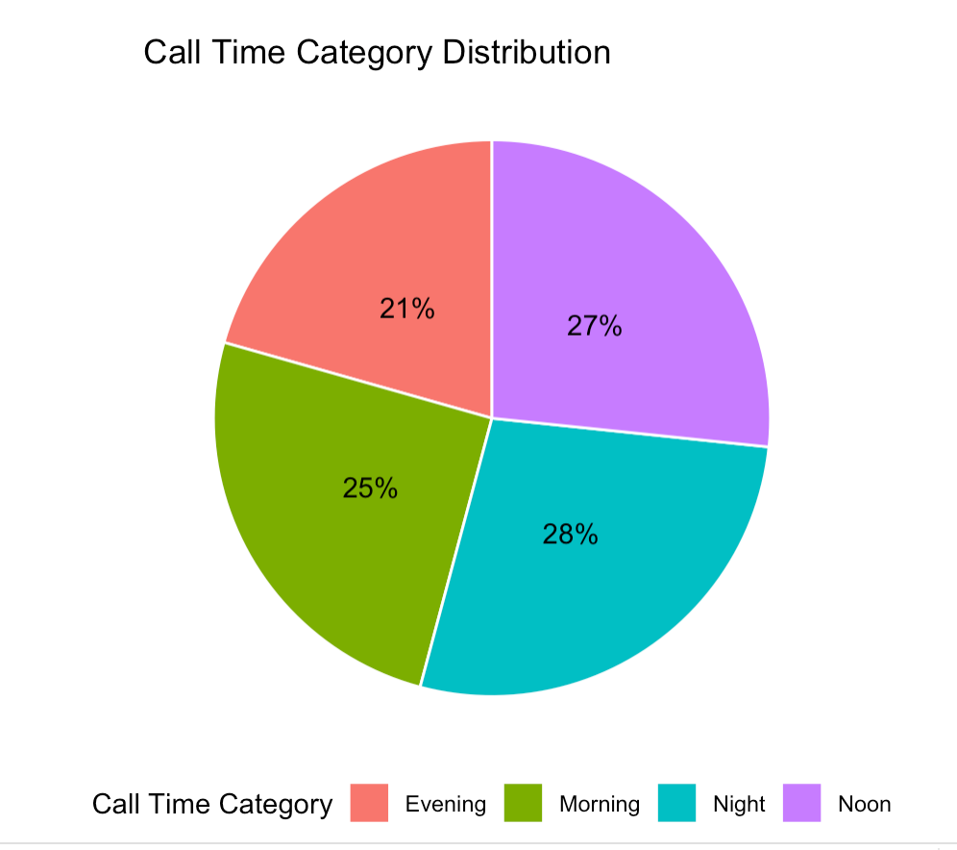
Call time category distribution
We created a new function categorize_call_time to categorize the call time into four categories: Morning, Noon, Evening, and Night based on the hour of the day.
The Pie chart helps us to identify the patterns at which calls are made.
Useful for identifying which time of the day would require more resources and work force.

Slide 8
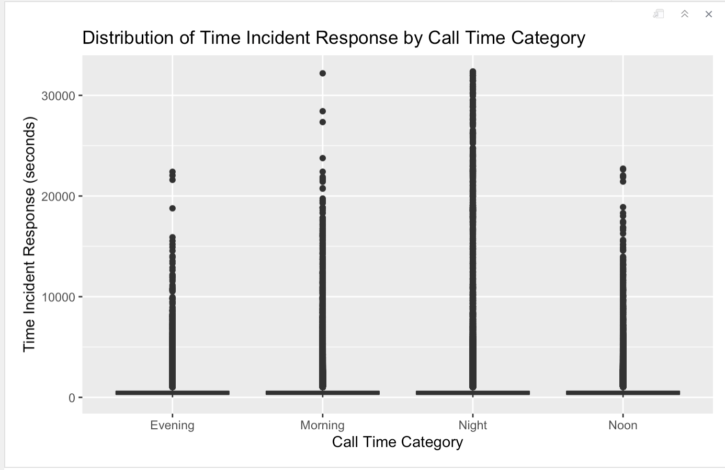



Removing outliers
A boxplot was used to visualize the distribution of Time Incident Response across different Call Time Categories.
The plot can help us understand how the Time Incident Response varies across different Call Time Categories.
We defined a function called remove_outliers which takes the data and a variable as input and removes the outliers from that variable using the interquartile range (IQR) method.

Slide 9
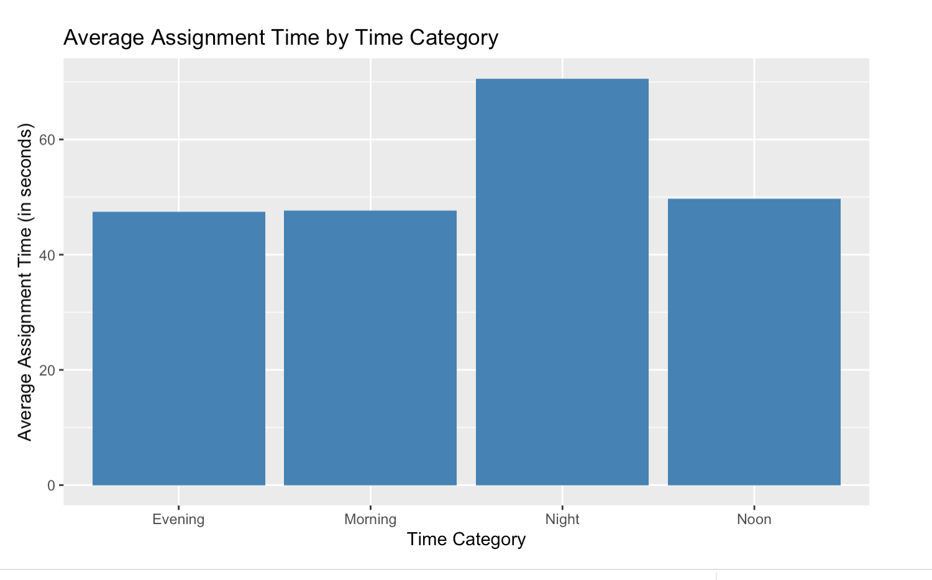
Analyzing response & assignment times
The graph shows the average assignment time for incidents, grouped by time category.
It can be used to analyze how well the department is equipped to handle the workload during different times of the day.
The data can be used to identify if additional resources are required to reduce the assignment time during certain periods.

Slide 10
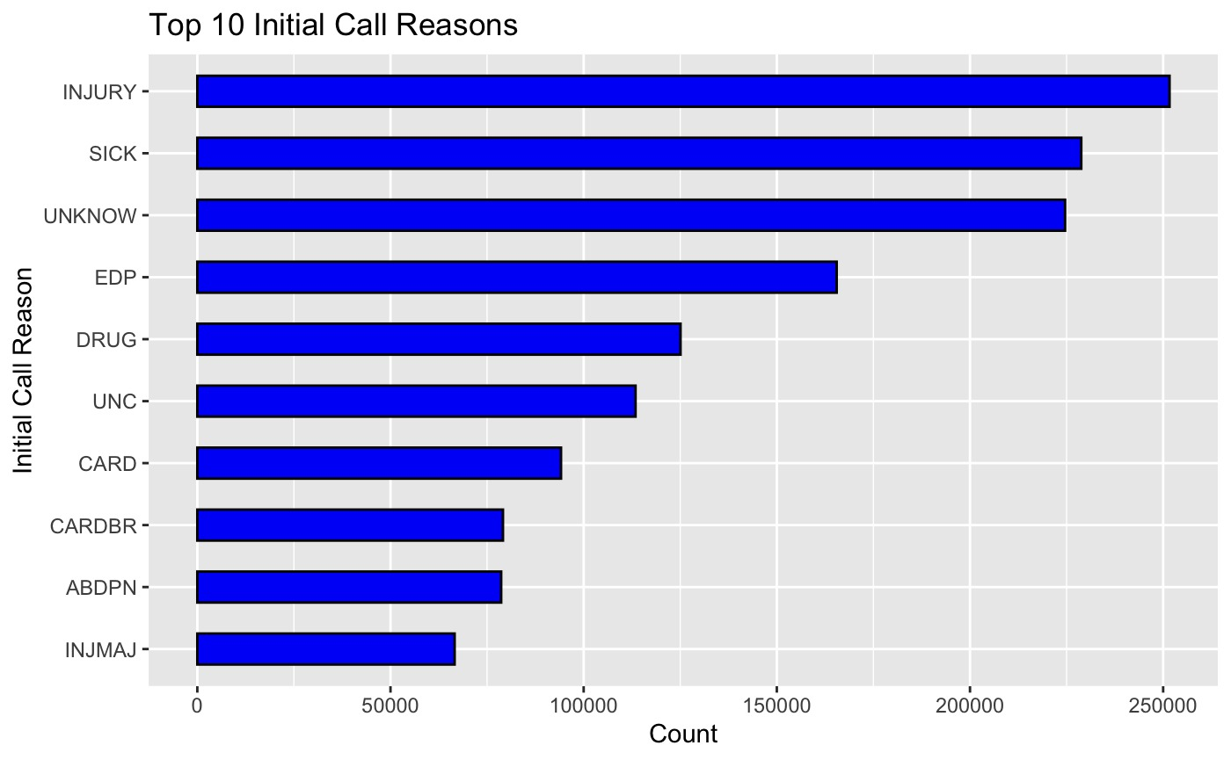
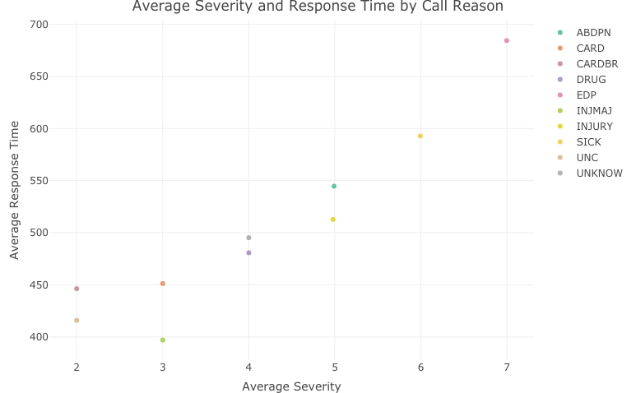
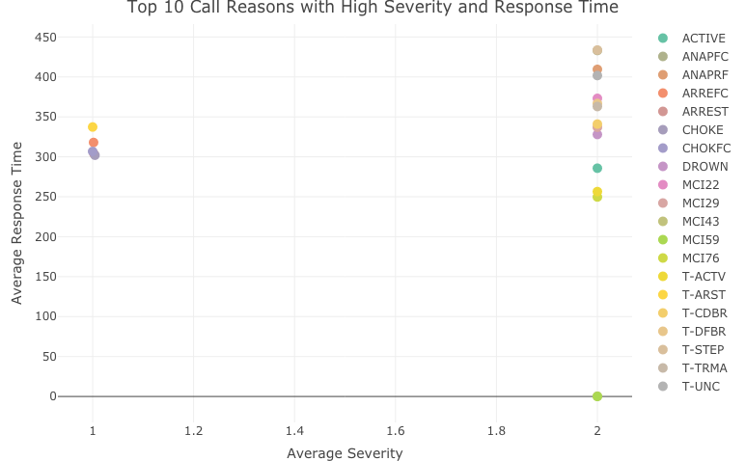
EXPLORING THE REASONS BEHIND EMS CALLS

Slide 11
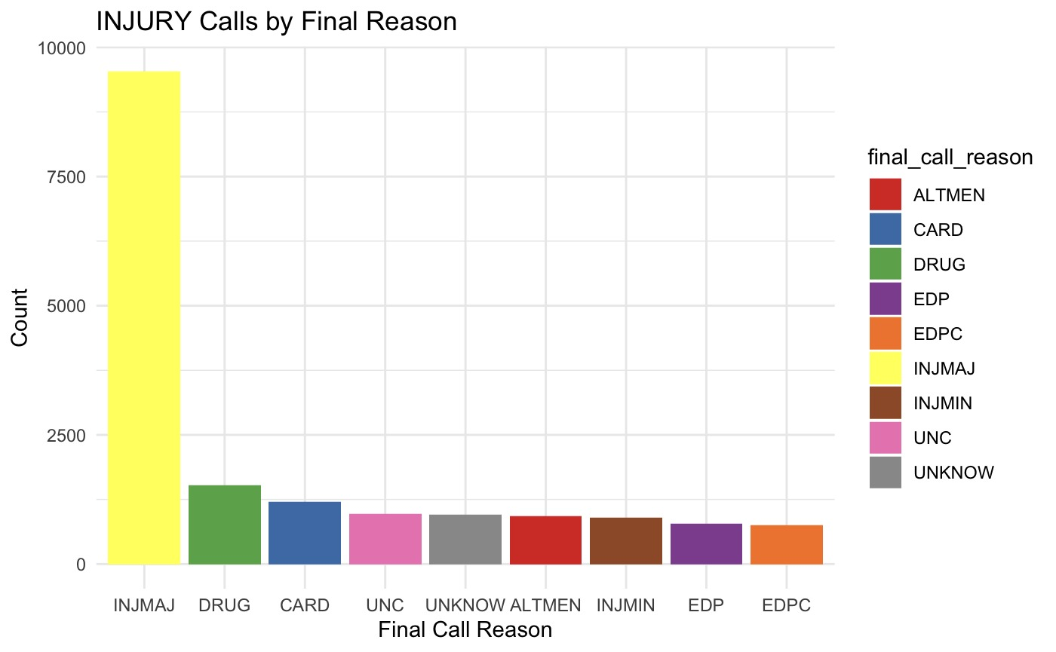
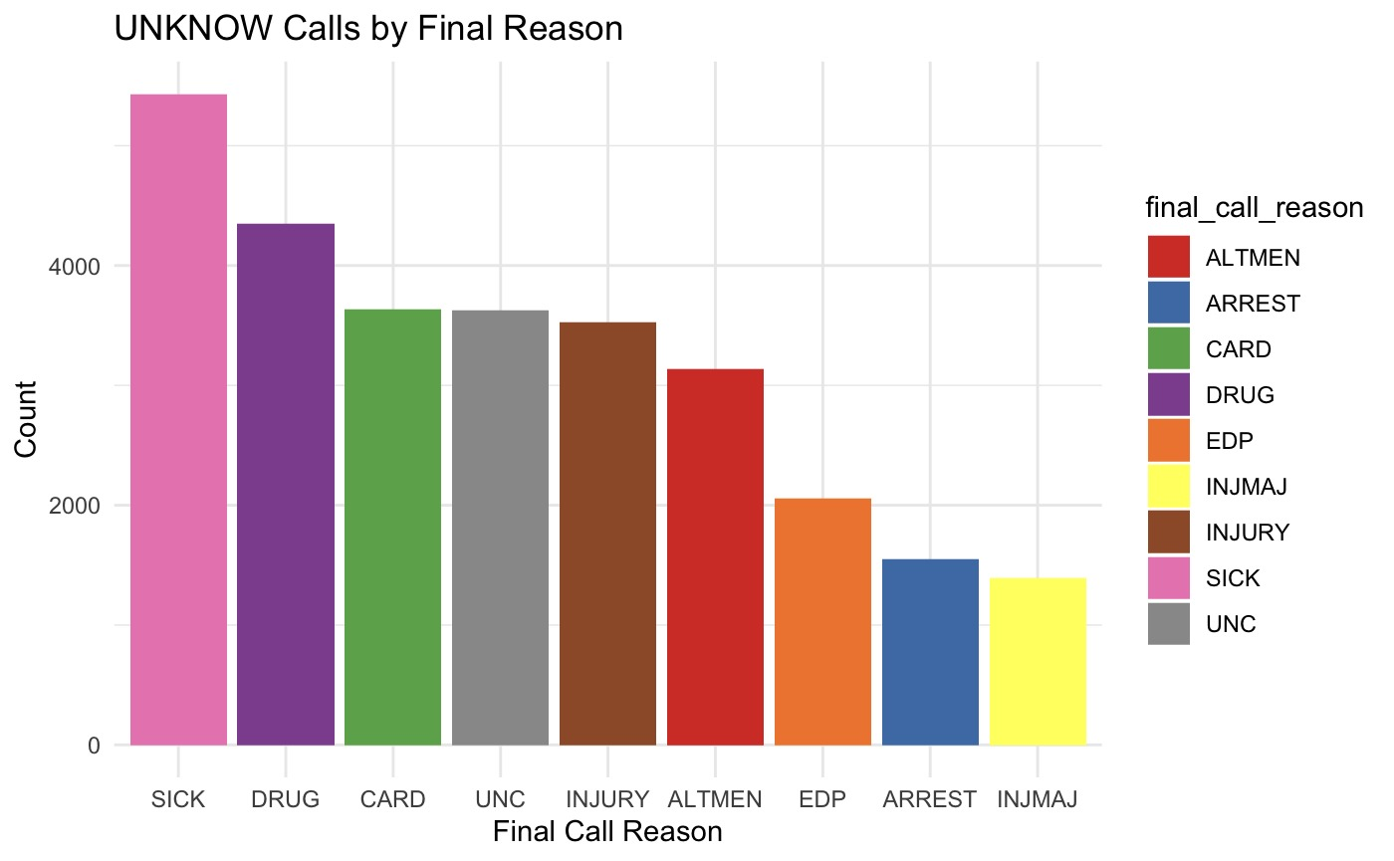
EMS CALLS: FINAL REASONS DIFFER FROM INITIAL
Approximately 300k incidents which have different initial and final call reasons.
This analysis will assist in improving the accuracy of emergency response times by helping dispatchers and EMS workers anticipate the most likely final reasons for a given type of initial call.

Slide 12
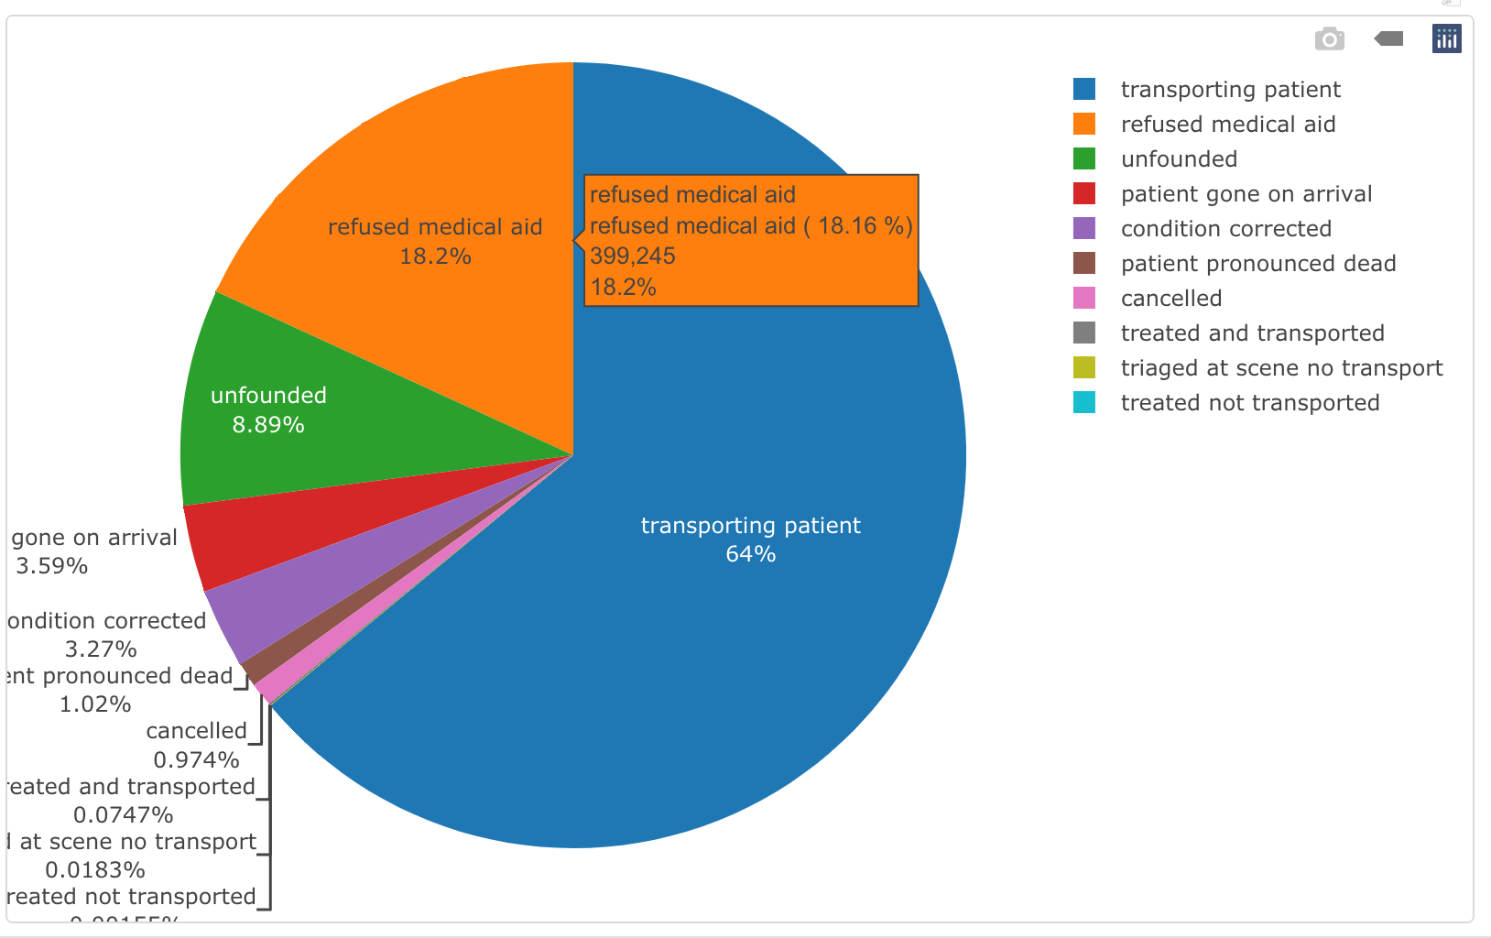
DISTRIBUTION OF INCIDENT DISPOSITION CODE
These are the codes assigned while closing the incident by the EMS operator, indicating the response by the emergency services.
The pie chart shows the distribution of incident disposition codes, indicating which types of incidents were most frequent and the kind of response by emergency services.
This information can be useful for identifying patterns and trends in emergency incidents and for informing resource allocation and training for emergency services personnel.

Slide 13
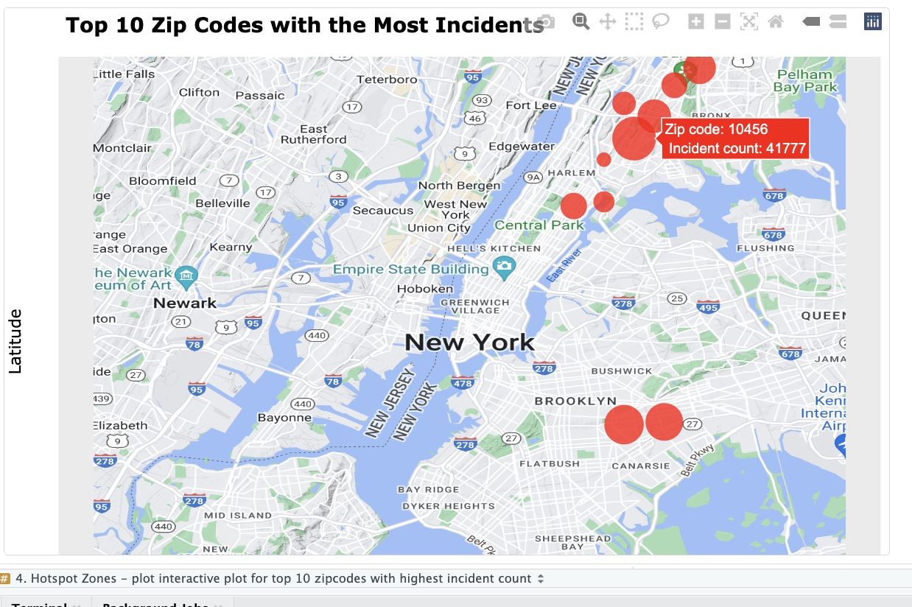
Geographical Distribution of AREAS with the Most Incidents
In this, we are first calculating the number of incidents per zip code. The top 10 zip codes with the highest incident counts are considered.
We used the maps API from Google Cloud to generate an NYC map. Zip codes have been plotted on the map as circles proportional to their incident counts.
This plot could help the department to stock in additional resources for the areas which are more prone.

Slide 14
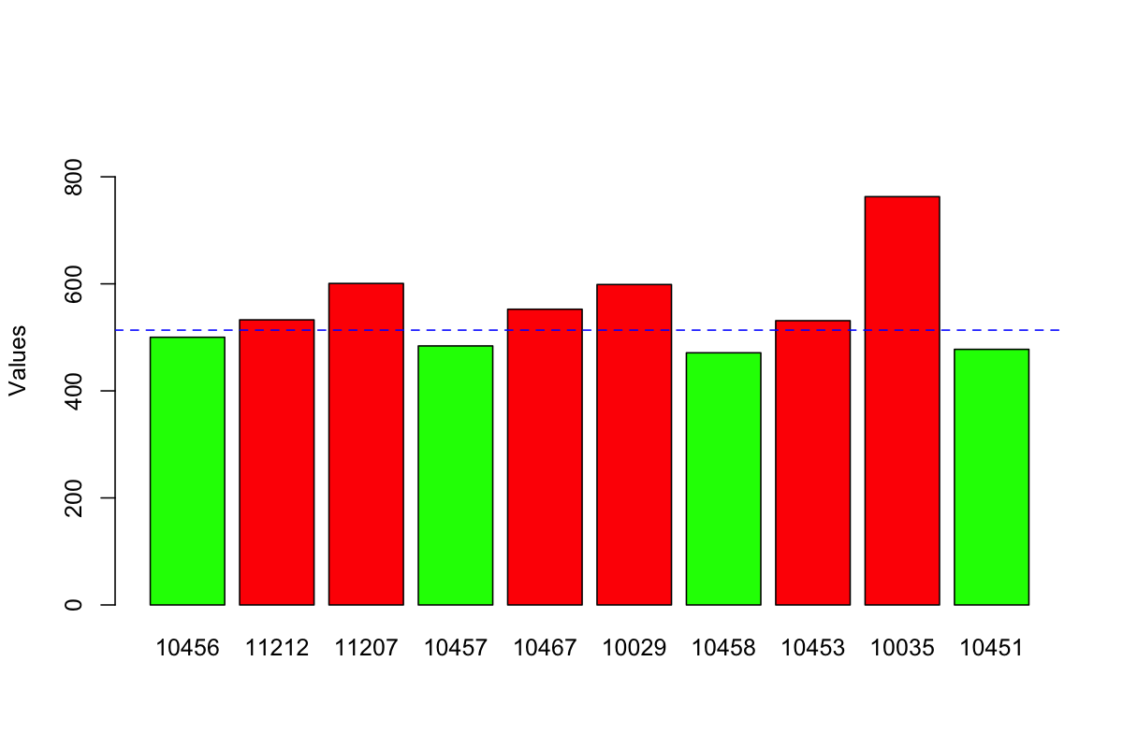
Hotspot response times
Although many hotspot zones have effectively managed to cope with the higher incident count, there are still some areas where improvements could be made.

Slide 15
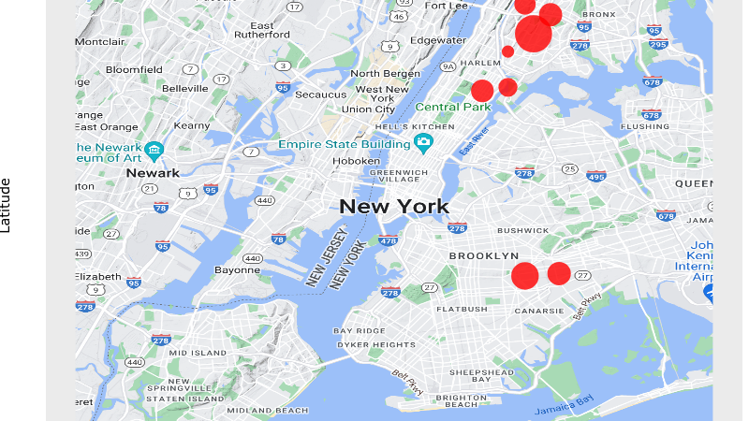
Geographical Distribution of AREAS with the HIGHEST RESPONSE TIME

Slide 16

Conclusion
Overall, our analysis has revealed some key insights into the NYC EMS response system.
Through our examination of call volume, hotspot zones, etc. we were able to identify key trends and patterns which can be helpful for the department.
Overall, these findings suggest that there may be opportunities for improving the efficiency and effectiveness of the EMS response system in NYC through targeted resource allocation and strategic planning.

