Slide 1
Machine Learning Based Intoxication Detection
By : Rishika Kalra
2021A3PS2651P

Slide 2
Objective
The objective of this project is to develop a non-invasive, camera-based system for detecting alcohol intoxication by analysing thermal images of the face. This system will integrate an infrared camera with a mobile application, allowing for real-time processing of facial thermal images using deep learning models, such as convolutional neural networks (CNNs). The goal is to accurately classify individuals based on their intoxication levels, providing a fast, reliable, and contact-free alternative to traditional methods. Ultimately, the project aims to contribute to road safety by offering a practical solution for identifying intoxicated drivers, reducing the risk of alcohol-related accidents​.

Slide 3
Literature review
Recent advancements focus on developing non-invasive alcohol detection methods using imaging and machine learning to overcome the limitations of traditional tools like breathalyzers and blood tests.
Thermal Imaging with Infrared Cameras Infrared cameras capture facial temperature changes caused by alcohol consumption. This method, using devices like FLIR ONE, is non-invasive and works in various lighting conditions, making it ideal for real-time roadside checks.
Deep Learning for Image Processing Convolutional Neural Networks (CNNs) process thermal images to classify alcohol levels. Models like NasnetMobile and MobileNet have shown high accuracy in detecting intoxication levels, demonstrating CNNs' effectiveness in visual data analysis.

Slide 4
Preprocessing and Augmentation Techniques like Gaussian noise, blur filters, and data augmentation improve model performance by simulating real-world conditions, making models more resilient and generalizable.
Local Difference Patterns (LDP) LDPs analyze pixel variations in specific facial regions, detecting intoxication with 85% accuracy. This simple, robust method is effective for immediate detection without a sober baseline image.
Hybrid Embedded Systems Combining image processing with sensor networks, this approach uses machine learning algorithms, such as k-NN and neural networks, to achieve up to 98% accuracy in detecting intoxicated drivers, enhancing its practical use in vehicles.
Gait Analysis Fine-grained gait classification using Bilinear CNNs converts gait signals into images for intoxication detection, showing superior performance and requiring no additional hardware.

Slide 5
Dataset Overview
The first dataset represents an extract from a very big video file(kxr lab dataset), a raw collection of videos. There are 15 individual video clips featuring non-intoxicated subjects or participants. The selected clips are of each particular video for the solo focused analysis of a person's behavior and physiological characteristics, which do not include or require the presence of alcohol.The video input is from a single larger video and segmented according to each participant.All the videos have been of subjects in non-intoxicated states as a control group to be compared eventually against intoxicated sets.The raw videos have no preprocessing or changes whatsoever.
The second dataset consists of a dukan dataset of 65 videos of different participants (not the same as the last dataset), each filmed under (A-F) different levels of intoxication, ranging from mild to severe alcohol consumption.The videos showcase different participants exposed to different levels of alcohol consumption (a total of 65 videos) in different stages of intoxication(A-F).This dataset incorporates new participants different from the non-intoxicated dataset. The videos are provided in raw form without preprocessing.
The third dataset consists of a wide variety of larger files recorded during Oasis 2024, which were cut into 459 different files consisting of non intoxicated participants using the ffmpeg module.The new entrants to the experiment differentiate from the kxr lab dataset and the dukan dataset participants regarding behaviours and physiological response diversity.The raw videos are provided without preprocessing.

Slide 6
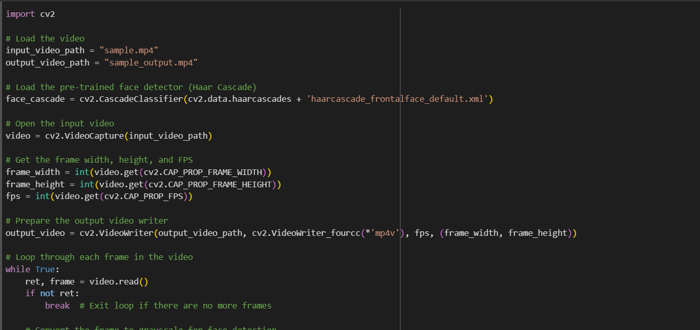
Experiments and Results
Face detection using cascade classifier

Slide 7
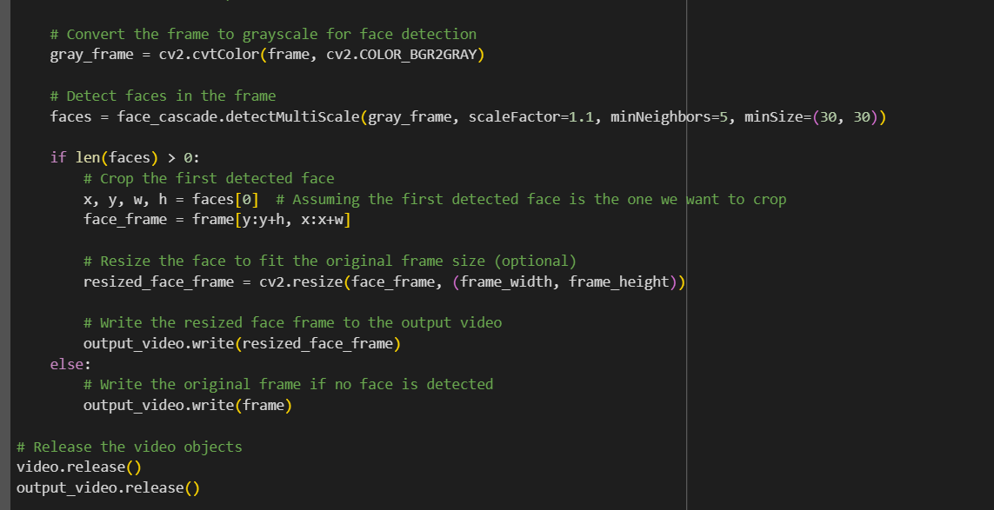

Slide 8
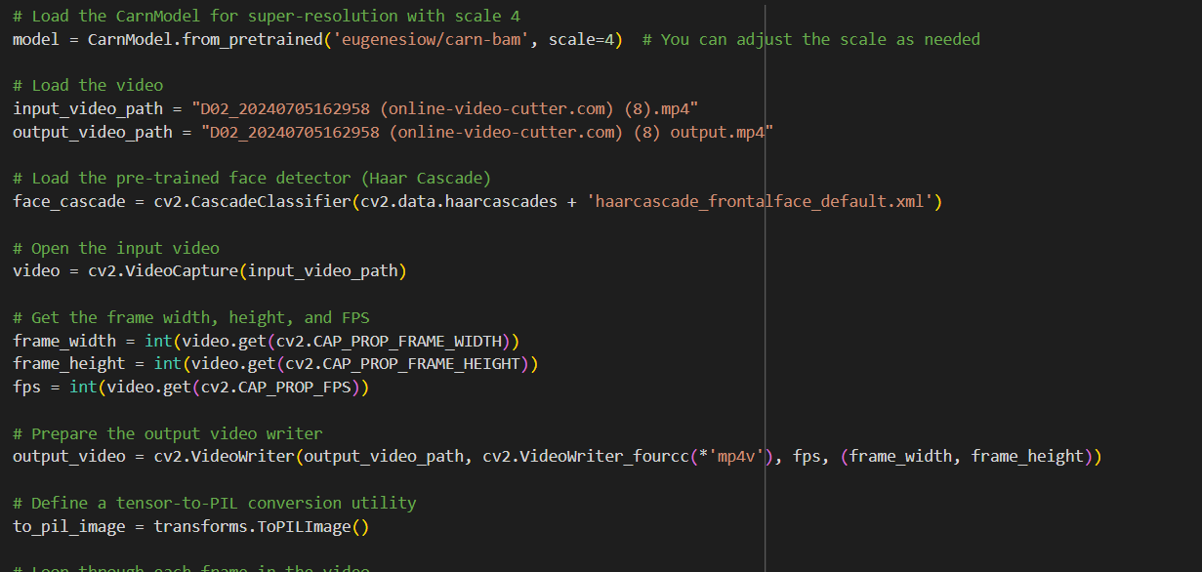
2) Face detection using super resolution model

Slide 9
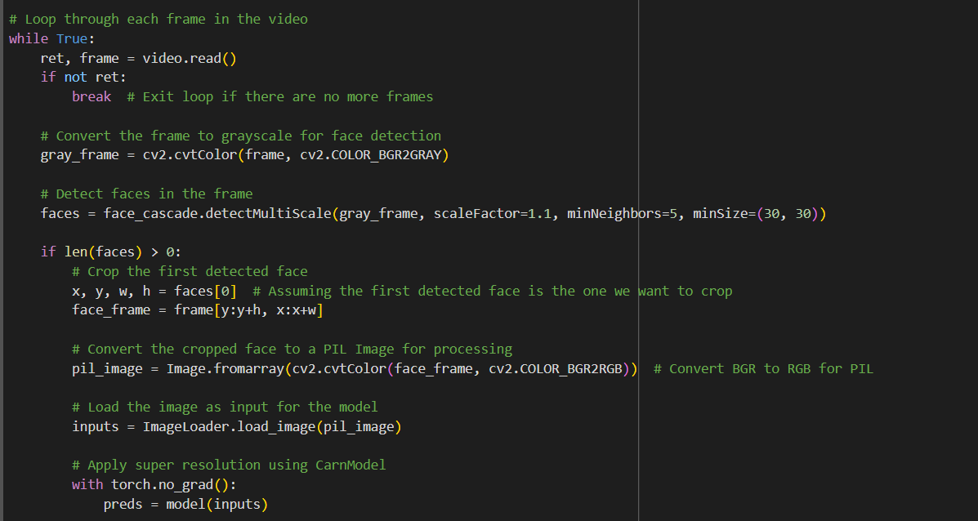

Slide 10
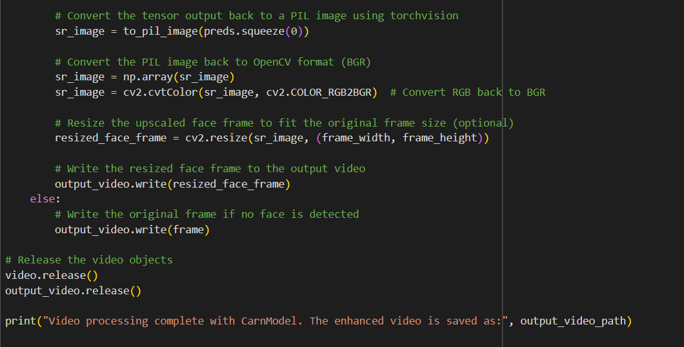

Slide 11
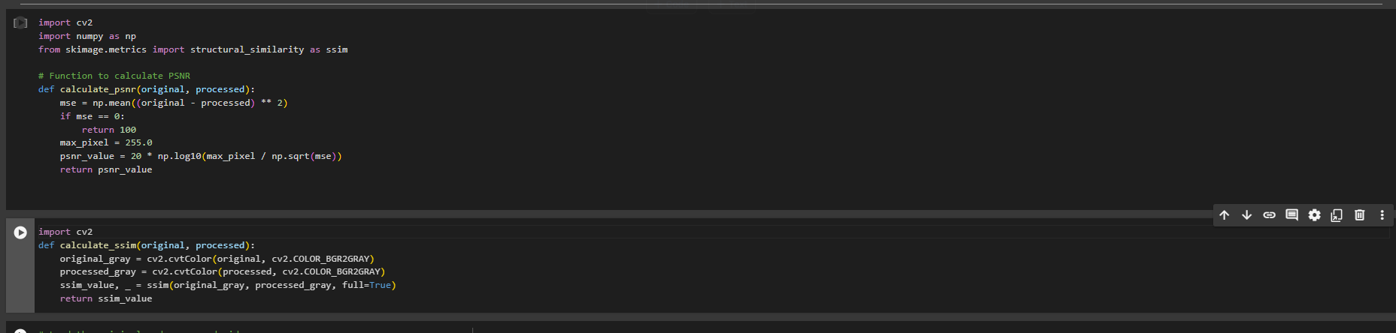
3) Calculating psnr and ssim values

Slide 12
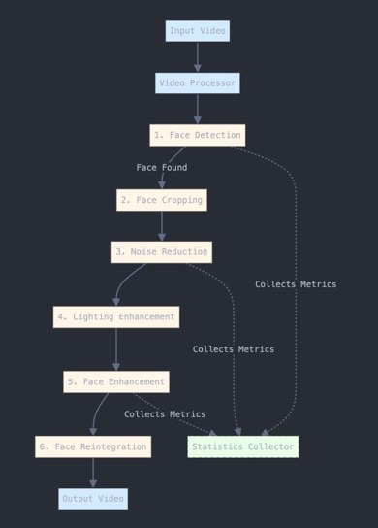
4)Suggested Preprocessing pipeline
The system features a streamlined pipeline starting with the VideoProcessor, responsible for frame extraction and output generation. It integrates an ImprovedFaceDetector using OpenCV's Haar Cascade to accurately detect and isolate faces. Enhancement begins with NoiseReducer, applying adaptive bilateral and Gaussian filtering, followed by LightingEnhancer using CLAHE for optimal brightness and contrast. The AdaptiveFaceEnhancer applies super-resolution when necessary, while the FaceReintegrator ensures seamless blending of enhanced faces into the original frame. The system's performance is tracked by EnhancementStatsCollector, monitoring metrics like processing time, quality, and detection confidence.

Slide 13
Results
PSNR (Peak Signal-to-Noise Ratio) and SSIM (Structural Similarity Index) are two commonly used metrics for evaluating the quality of images and videos, especially in the context of image processing and compression.
PSNR (Peak Signal-to-Noise Ratio)
Typical Values: For effective super-resolution models, PSNR values usually range from 25 dB to 40 dB.
Interpretation:
Below 20 dB: Generally indicates poor quality, with significant differences from the original image.
20 dB to 25 dB: Acceptable quality, but noticeable artifacts may be present.
25 dB to 30 dB: Fair to good quality, with some visible artifacts but overall decent resemblance to the original image.
30 dB to 35 dB: Good quality, often acceptable for practical applications.
Above 35 dB: Excellent quality, indicating that the super-resolved image is very close to the original image
The PSNR values that we got for the respective videos ranged from 28.75 to the highest being 36.12 for the non intoxicated dataset(kxr lab dataset).

Slide 14
SSIM (Structural Similarity Index)
Typical Values: For effective super-resolution models, SSIM values typically range from 0.7 to 1.0.
Interpretation:
Below 0.5: Indicates poor structural similarity; significant loss of details and visual integrity.
0.5 to 0.7: Fair structural quality; some noticeable artifacts and differences from the original.
0.7 to 0.85: Good structural similarity; generally acceptable, with some minor artifacts that may not be easily noticeable.
Above 0.85: Excellent structural similarity; the super-resolved image retains most of the original structure and visual details.
1.0: Perfect structural similarity (rare in practice).
The SSIM values ranged from 0.4095 to 0.885 non intoxicated dataset(kxr lab dataset).

Slide 15
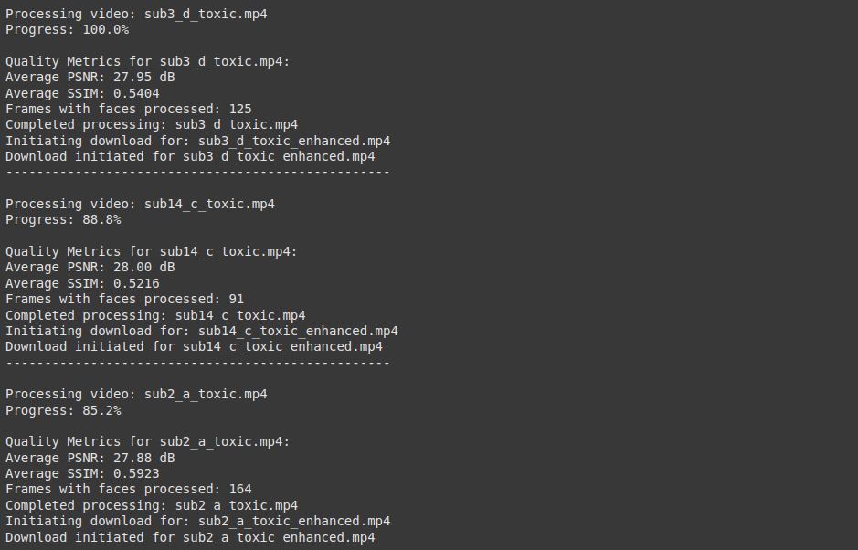
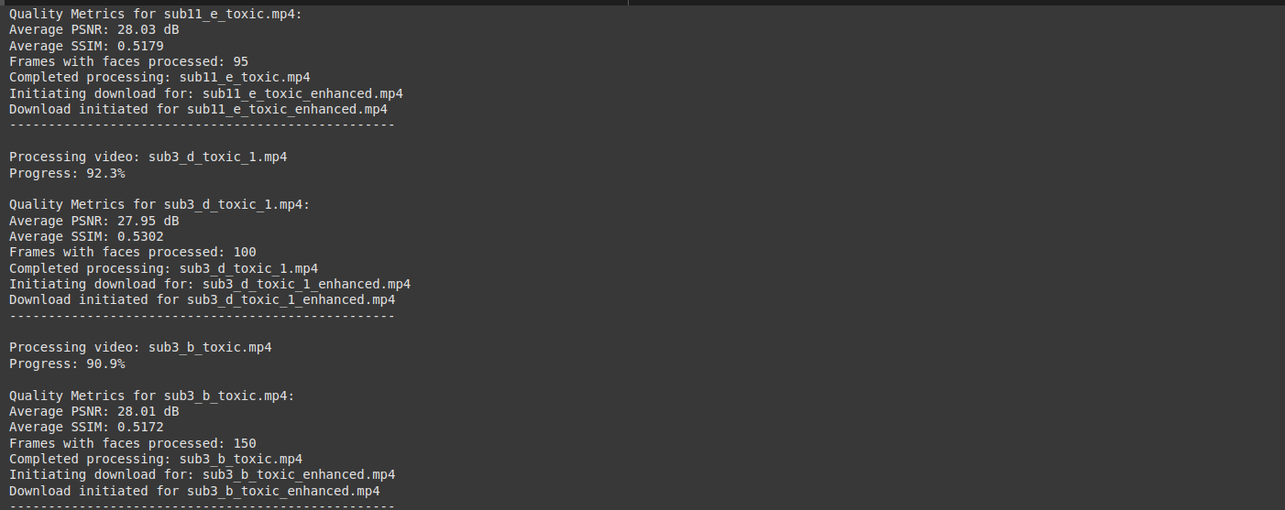
For the dukan intoxicated dataset, the PSNR values ranged from 27.88 to 28.04 and the SSIM values ranged from 0.5114 to 0.5972.

Slide 16

Proposed Classification Models
CNN could extract spatial features like facial expressions, body posture, or eye redness indicating intoxication.
LSTM could analyze temporal patterns, such as erratic movements or prolonged unnatural expressions.
CNN + LSTM could combine spatial and temporal cues for detecting evolving signs of intoxication.
3D CNN could simultaneously capture spatial and temporal dynamics, like staggered movements or delayed reactions.

Slide 17
Conclusion and Future work
The video processing application successfully enhances facial image quality using super-resolution techniques, with promising PSNR and SSIM results for non-intoxicated(kxr lab) and intoxicated(dukan) dataset. These metrics validate the effectiveness of the approach, making it applicable to real-world scenarios like video surveillance and conferencing.
Future Work:
Work on the suggested preprocessing pipeline for application to both intoxicated and non-intoxicated dataset.
Further train suggested classification models to improve accuracy in distinguishing sober vs. intoxicated states.

Slide 18
Thank you!

