Slide 1
KV-Cache Optimization
for LLM Inference
KIVI · TopK · SnapKV · MLA — Llama-2-7B on H100 80GB
Team KV · Rishika Mamidibathula (rm4318), Suhas Morisetty (vm2825), Ziheng Wang (zw3153), Tony Tian (jt3640) GitHub: github.com/rishika1099/KV-Cache-Implementation W&B: wandb.ai/rm4318-columbia-university/kv-cache-hpml
Dr. Kaoutar El Maghraoui · Columbia University · HPML Spring 2026
HPML · Spring 2026
1 / 16

Slide 2
Motivation — The KV Cache Bottleneck
Why KV cache is the bottleneck
LLM decoding is memory-bandwidth bound, since every generated token requires re-reading the KV cache from GPU memory.
KV-cache memory grows linearly with sequence length, batch size, and number of layers.
At BS=32 and seq=4K, Llama-2-7B needs ~65 GB just for KV cache, nearly saturating an H100 80GB GPU.
Model weights stay fixed, but KV cache keeps expanding during generation, creating major memory and latency bottlenecks.
Three compression approaches
• Quantization: Fewer bits per KV element (KIVI)
• Sparse selection: Attend to only important tokens (TopK, SnapKV)
• Latent projection: Low-rank bottleneck representation (MLA)
KV Cache Memory
mem = 2 × L × H × D × S × B × dtype
Symbol | Value | Meaning
L | 32 | Layers
H | 32 | Attn heads
D | 128 | Head dim
S | 4096 | Seq length
B | 32 | Batch size
dtype | 2 B | FP16
Total | 65.5 GB | → OOM risk
HPML · Spring 2026
2 / 16

Slide 3
Experimental Setup & Methods Overview
Model & Harness
Hardware
Evaluation
Llama-2-7b-chat-hf · 32L 32H 128D
PyTorch 2.4.1 · Transformers 4.44
Greedy decode · seed=42 · BS varied
1× H100 80GB HBM3 (Modal cloud)
CUDA 12.1 · Triton 3.0 · flash-attn 2.5
Custom KIVI CUDA+Triton kernels
LongBench: 6 tasks × 20 examples
qasper · multifieldqa_en · triviaqa
2wikimqa · multi_news · lcc
Synthetic fixed size batches for uniform throughput measurements
Five Methods at a Glance
Method | Type | Compression | Quality (overall) | Key Tradeoff
Baseline (FP16) | Reference | 1× | 0.291 | —
KIVI 4-bit | Quantize | ~4× | 0.292 (+0.3%) | Slower at B=1; wins at B≥16
KIVI 2-bit | Quantize | ~8× | 0.273 (−6.2%) | Best batch throughput; quality cost
TopK K=1024 | Sparse | N/A (attn scope) | 0.292 (+0.4%) | Per-step scoring overhead at B=1
SnapKV 0.4 | Evict | ~2.5× | 0.295 (+0.3%) | No per-step cost; one-shot eviction
MLA (B=1) | Latent | 3.9× | 0.081* (−65%) | Needs more training; KV+decode win
* MLA baseline uses different truncation (2048 vs 4096 tokens) — quality numbers not directly comparable to other methods
HPML · Spring 2026
3 / 16

Slide 4
Technical Approach
Unified view of the KV cache pipeline and compression points.
Input Tokens
Prefill
(Attention)
KV Cache
(HBM)
Decode
(Attention)
Output Tokens
▶
▶
▶
▶
Baseline (FP16): no intervention — full K/V retained and read at every decode step.
KIVI
Quantize K/V to INT2/INT4
at cache write
TopK
Attend to only top-K
tokens at each decode step
SnapKV
Evict low-vote tokens
once after prefill ends
MLA
Store latent vector c
instead of full (K, V)
★ MLA is the only method that fundamentally changes what is stored — replacing (K, V) with a compressed latent vector c. All other methods compress or select from existing K/V tensors.
HPML · Spring 2026

Slide 5
Profiling Methodology
Tools
Metrics captured
• PyTorch Profiler / torch.profiler
• TTFT (time to first token)
kernel-level op timing
prefill latency in ms
• torch.cuda.max_memory_allocated()
• Decode throughput
peak GPU memory per run
tokens/sec at each batch size
• Weights & Biases
• Peak GPU memory
run-level metric logging + comparison
GB via CUDA memory tracker
• Custom timing harness
• LongBench task score
TTFT + per-token decode latency
F1, ROUGE-L, or edit-similarity per task
• Modal volume cache
model & dataset pinned across runs
Stability: 5 batches per config, first excluded as warmup; mean of 4 stable batches reported. Model + dataset loaded from pinned Modal volumes for run-to-run reproducibility.
HPML · Spring 2026

Slide 6
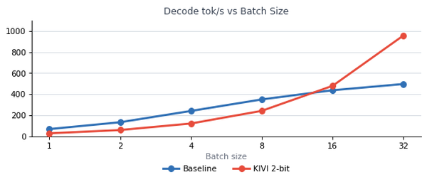
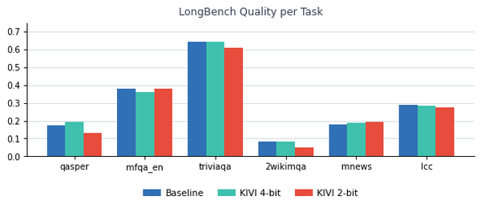
KIVI — 2/4-bit Asymmetric KV Quantization
Design
• Keys: per-channel quantization (scale/zero per head across seq dim) • Values: per-token grouped quantization (group_size=32) • Residual buffer: last 128 tokens always FP16; quantized only when full • Kernels: triton_quantize_and_pack fuses INT4 packing; cuda_bmm_fA_qB_outer dequantizes on-the-fly during GEMM • Cache format: 9-tuple per layer (quantized blocks + scales + zeros + residual) Crossover insight: INT4 GEMV is slower than FP16 GEMV at low batch (GEMV doesn't saturate tensor cores). KIVI wins only once decode becomes near-GEMM at BS≥16, where HBM bandwidth saving outweighs dequant cost.
HPML · Spring 2026
4 / 16

Slide 7
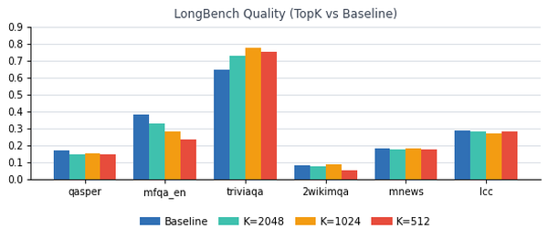
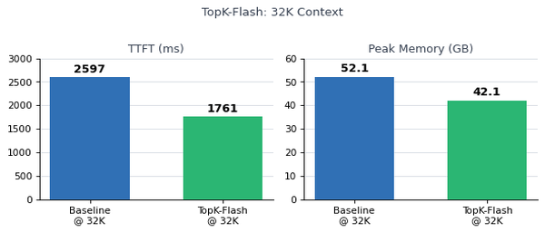
TopK / TokenSelect — Sparse Attention
Design
Three-region KV cache (full FP16 retained): Sink (128) + Top-K middle (dynamic) + Local (512) • Scoring: Triton kernel _topk_score_kernel fuses Q·K^T across all 32 heads → softmax → sum → top-K indices • Cache reuse: cosine similarity (threshold=0.9) skips re-scoring if query is similar to previous step • RoPE correction: true_seq_length passed to each step to preserve positional encoding after cache slicing TopK-Flash variant: Paged KV pool (256-token pages) + flash_attn_with_kvcache enables zero-copy selective attention. At 32K prefill: TTFT −33%, memory −19% (52→42 GB). Baseline OOMs at 64K; TopK-Flash handles it at 65.8 GB.
HPML · Spring 2026
5 / 16

Slide 8
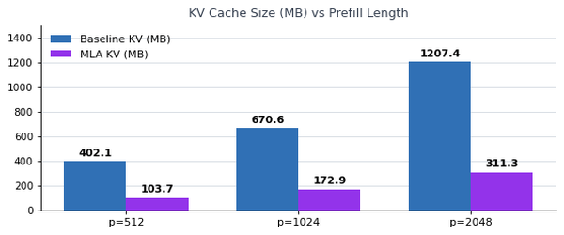
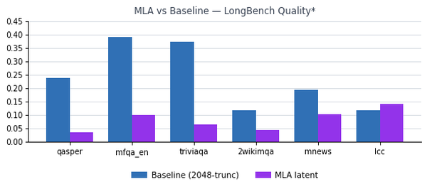
MLA — Multi-head Latent Attention via TransMLA
Design
• Latent KV: stores a compressed latent vector c per token instead of full (K,V) tensors; expanded during attention; Attention Absorption speeds up inference. • Model: botsxc/llama2-7b-chat-mla-2048-8 (freqfold-8, 2048 latent dimension,256 context length calibration), no training • KV reduction: consistently 3.9× smaller across all prefill lengths (402→104 MB at p=512) • Decode speedup: 1.26–1.32× at B=1 — confirms HBM-bandwidth-bound decode even for single-request inference Quality limitation: Overall drops 0.238 → 0.081 (−65%) on LongBench. QA/retrieval tasks collapse (triviaqa −83%). Only lcc (code) marginally improves. Root cause: checkpoint calibrated at 256-token context with 4x compression and without finetuning — insufficient capacity for long context. Needs finetuning.
* MLA baseline used 2048-token truncation vs 4096 for other methods
HPML · Spring 2026
6 / 16

Slide 9
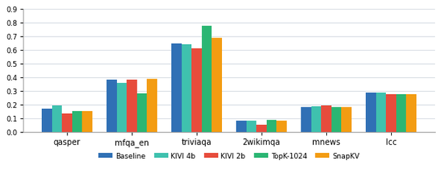
LongBench Quality — All Methods (6 tasks × 20 examples)
KIVI 4-bit & TopK K=1024 statistically tied with baseline (0.292) — lossless compression at target budget. SnapKV 0.4 marginally outperforms (+0.3%). TopK beats baseline on triviaqa across all K values (+20% at K=1024); worst on multifieldqa_en (mid-context pruning). KIVI 2-bit & TopK K=512 converge to ~0.274 via complementary failure modes.
HPML · Spring 2026
7 / 16

Slide 10
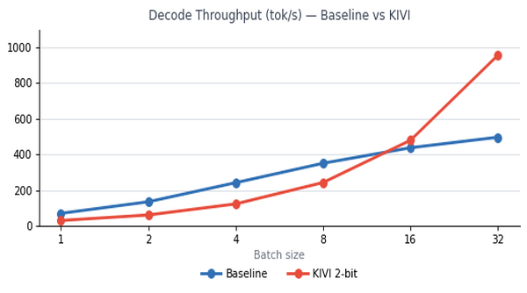
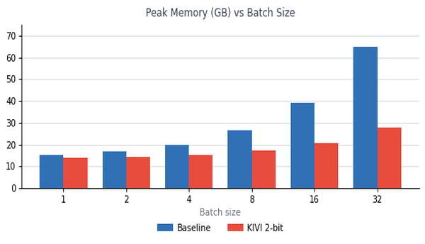
Throughput & Memory — All Methods
KIVI:
KIVI B=1: 30 tok/s (0.4× baseline) — INT4 GEMV is slower than FP16 GEMV. Crossover at BS=16 (480 vs 438). BS=32: 957 vs 497 tok/s (1.93×). BS=128: 1526 tok/s (baseline OOM at BS=64).
TopK:
TopK B=1: 43 tok/s (0.6× baseline) — per-step scoring overhead exceeds attention savings at 1K context. Gains appear only at 32K+ where selection cost < attention cost.
MLA:
MLA B=1: 43-44 tok/s (1.26-1.32× over baseline) — 3.9× KV reduction directly translates to decode speedup. Unique advantage: faster even at low batch.
SnapKV:
SnapKV: no per-step overhead; decode throughput equivalent to baseline over the compressed cache. Memory ~2.5× smaller.
HPML · Spring 2026
8 / 16

Slide 11
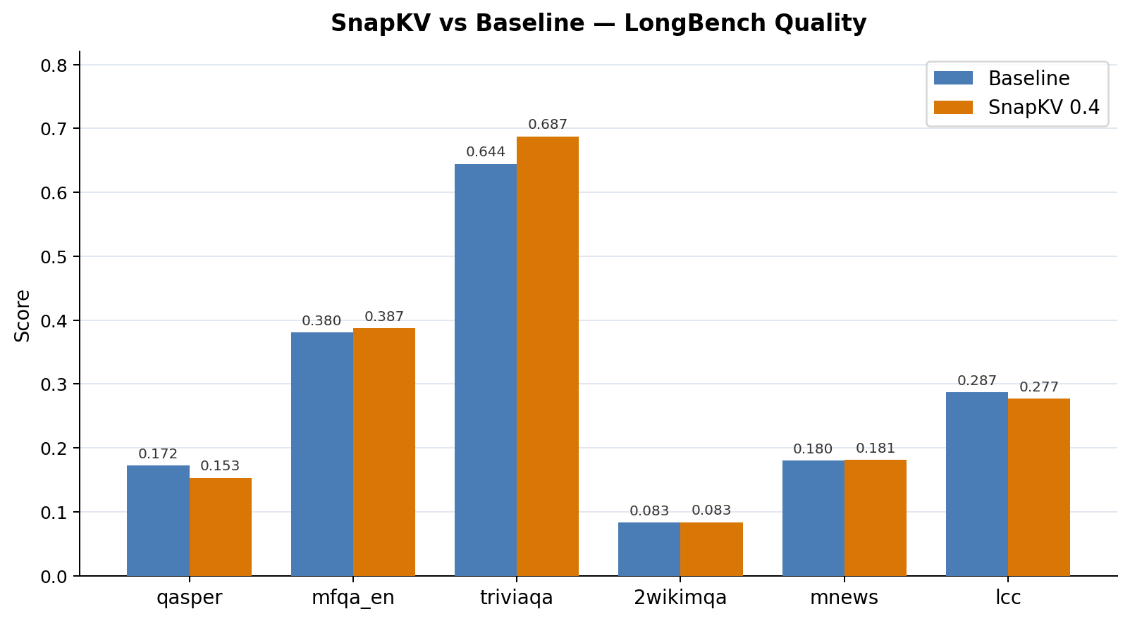
SnapKV — One-Shot Prefill Eviction (budget_ratio = 0.4)
Design
How it works (5 steps):
1. Prefill:
run full causal attention over complete prompt 2. Vote: average attention scores over last 32 query positions per head 3. Pool: max-pool (kernel_size=7) to smooth noise 4. Select: keep top floor(S × 0.4) tokens per head; evict the rest permanently 5. Decode: standard decode over fixed reduced cache — zero per-step overhead Key insight: triviaqa improves +4.3pt because the observation-window vote actively selects answer-aligned positions and removes irrelevant prefix noise. Only qasper degrades (−2.0pt) where scattered evidence spans fall outside the observation window.
Task | Baseline | SnapKV | Δ
triviaqa | 0.6444 | 0.6870 | +0.043
multifieldqa | 0.3803 | 0.3870 | +0.007
OVERALL | 0.2914 | 0.2946 | +0.003
qasper | 0.1723 | 0.1526 | −0.020
HPML · Spring 2026
9 / 16

Slide 12
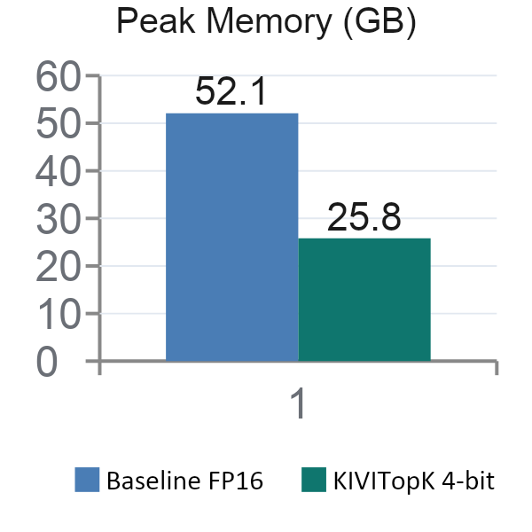
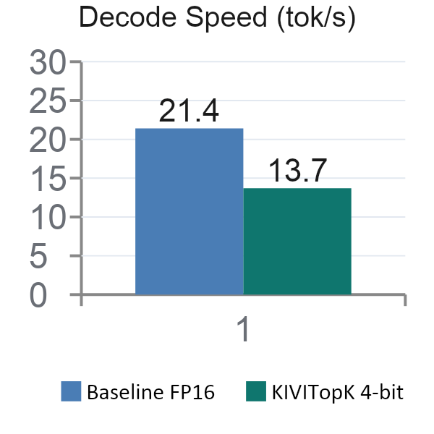
KIVI × TopK — Quantised-Sparse Hybrid (32K context)
How it works
Prefill:
F.scaled_dot_product_attention (flash-attn backed, O(T) memory) — avoids OOM at 32K
Score:
cuda_bmm_fA_qB_outer over all 32K K tokens — unavoidable; need scores before selection
Select:
torch.topk → n_sink + K + n_local positions gathered from packed INT4 V rows (64 KB vs 2 MB full)
Attend:
Gathered INT4 buffer fed directly into cuda_bmm_fA_qB_outer — no intermediate FP16 write
Residual:
FP16 matmul on last 128 tokens + sum — data stays 4-bit through the main kernel
Metric
Baseline FP16
KIVITopK 4-bit
Δ
Decode speed
21.4 tok/s
13.7 tok/s
−36%
Why decode is still slower (−36%)
Peak GPU mem
52.1 GB
25.8 GB
−51%
• Q@K^T scores all 32K tokens every step — identical cost to baseline (can't skip: need scores to select)
LongBench quality
0.291
0.297
+noise
• Extra overhead: topk + sort + gather that baseline never pays
Llama-2-7B · H100 · prefill=32768 · gen=512 · B=1
HPML · Spring 2026
10 / 16

Slide 13
Tradeoff Analysis — Quality vs Memory vs Throughput
Method | KV Compression | Quality Overall | Decode B=1 | Best Batch Tput | Deployment Fit
Baseline | 1× | 0.291 | 70 tok/s | 497 @ BS=32 | Reference
KIVI 4-bit | ~4× | 0.292 ✓ | 29 tok/s | 873 @ BS=32 | Batch serving ≥ BS=16
KIVI 2-bit | ~4× | 0.273 | 27 tok/s | 957 @ BS=32 | Max-batch, accept noise
TopK K=1024 | None* | 0.292 ✓ | 43 tok/s | N/A (B=1 only) | Single-req, long-ctx
SnapKV 0.4 | ~2.5× | 0.295 ✓ | ~70 tok/s † | N/A (B=1 only) | Quality-neutral compress.
MLA (B=1) | 3.9× | 0.081 ✗ | 43 tok/s | N/A (B=1 only) | Needs retraining
Key Observations
No single dominant method — each occupies a distinct quality/memory/latency operating point
KIVI 4-bit is the headline win for batch serving: lossless quality + 2.3× memory + 1.93× throughput at BS=32
TopK- Method has additional over because of its sparsity. So benefits in terms of time appear at long context usually from >32K
MLA is a memory and latency win today; quality needs a retrained checkpoint at longer context and higher rank; speed needs absorption implementation
* TopK does not reduce KV storage size — only attention scope is sparse. † SnapKV B=1 throughput interpolated from short-context measurements; not directly benchmarked at long context.
HPML · Spring 2026
11 / 16

Slide 14
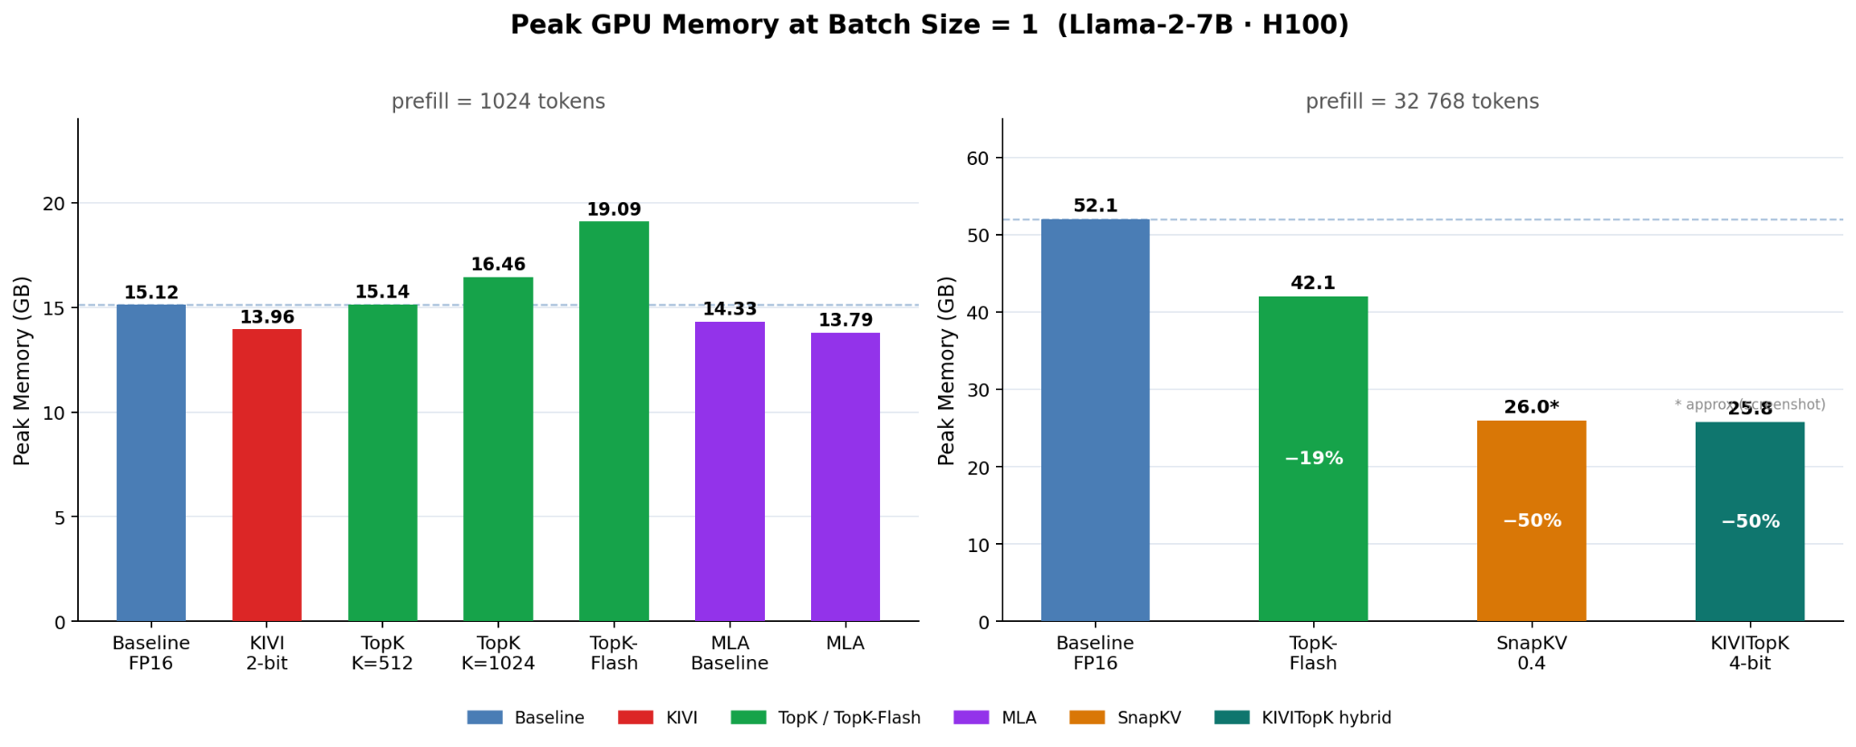
Tradeoff Analysis — Quality vs Memory vs Throughput
At 1K context, KV compression barely moves the needle — model weights (~14 GB) dominate and all methods cluster within 1.5 GB of each other; the real savings only unlock at 32K+ where the KV cache grows large enough to rival the weights.
HPML · Spring 2026
12 / 16

Slide 15
Kernel-Level Observations & Long-Context Failure Analysis
INT4 GEMV inefficiency at low batch
Triton fused Q·K^T scoring kernel
cuda_bmm_fA_qB_outer performs on-the-fly INT4→FP16 dequantization per GEMV. Modern tensor cores target INT8/FP16 GEMM; INT4 GEMV does not map to tensor core units, causing 2.5× slowdown vs FP16 GEMV at B=1. The bandwidth saving only pays off when decode approaches GEMM territory at BS≥16.
_topk_score_kernel fuses the per-head dot product + softmax + sum-across-heads in a single Triton launch. At 1K-4K sequence lengths, kernel launch overhead is negligible; the critical path is always HBM bandwidth, not compute or launch latency. PyTorch fallback incurs 2–3× overhead due to separate kernel dispatches.
Paged KV eliminates fragmentation at 32K+
KIVI residual buffer: hot FP16 path
TopK-Flash's 256-token page pool eliminates the contiguous 52 GB allocation that standard flash-attn requires at 32K context. This reduces TTFT by 33% — not from sparsity, but from allocation and prefill memory-access pattern improvement. Baseline OOMs at 64K; paged allocation handles it at 65.8 GB.
The last residual_length=128 tokens are never quantized. At short generation lengths where total decode tokens < residual_length × n_layers, nearly all attention falls on the FP16 residual — KIVI provides minimal storage benefit in this regime. This is why KIVI TTFT is 3× slower than baseline: the full prefill quantization cost is paid upfront regardless.
HPML · Spring 2026
13 / 16

Slide 16
Lessons Learned & Future Work
What Worked
What Didn't Work
• KIVI 4-bit: +0.3% quality, 4× smaller KV, 1.93× throughput at BS=32 — deployable today
• TopK slower at B=1 (43 vs 70 tok/s) — scoring overhead > sparse attention gain at 1K context
• SnapKV 0.4: lossless on 5/6 tasks with zero per-step overhead — surprisingly robust
• KIVI TTFT 3× slower — prefill quantization overhead is non-negligible for latency-sensitive use
• TopK K=1024 matches baseline quality via different failure mode (wins triviaqa, loses multifieldqa)
• MLA quality collapse at this checkpoint, batching and absorption needs to be integrated
• TopK-Flash paged KV provides real 32K TTFT and memory gains without quality cost
Future Work that could be explored:
01 Batched decode for TopK
02 MLA checkpoint retraining at 4K+ context
03 KIVI × TopK quantized-sparse hybrid
Amortizes per-step scoring cost; expect KIVI-style crossover at BS≥8–16 — paged KV in TopK-Flash already batch-ready
Retrain with r=16–32 latent at 4K–8K context; preserve 3.9× compression while recovering QA task quality
INT4 storage + sparse attention could yield batch-throughput (KIVI) and long-context TTFT (TopK-Flash) wins simultaneously
HPML · Spring 2026
14 / 16

Slide 17
Teamwork & Contributions
Member | UNI | Primary Contributions | Key Artifacts
Rishika Mamidibathula | rm4318 | TopK + TopK-Flash methods, long-context 32K evaluation, Modal + W&B harness,Code setup, TopK-KIVI hybrid ; | methods/topk_selection.py, llama_topk_flash_model.py, modal_topk_throughput.py,
Suhas Morisetty | vm2825 | KIVI 2/4-bit quantization, custom CUDA + Triton kernels, batch-size throughput benchmarking, benchmark setup | methods/kivi_quant.py, llama_kivi_model.py, methods/kivi_kernels/, modal_throughput.py, benchmark/
Ziheng Weng | zw3153 | MLA latent KV via TransMLA, MLA throughput sweep, SnapKV integration, RoPE + grouped-query plumbing | methods/transmla/, modal_mla_benchmark.py, modal_mla_throughput.py
Tony Tian | jt3640 | SnapKV integration, LongBench experimentation and analysis | methods/snapkv/, evaluation scripts, benchmark integration
Infrastructure & Collaboration
• Unified harness: same model, tokenizer, seed, and hardware across all comparisons
• Modal: reproducible H100 environment pinned via requirements.txt; results persisted to Modal volumes; all numbers reproducible
• W&B tracking: all runs logged at wandb.ai/rm4318-columbia-university/kv-cache-hpml — TTFT, decode throughput, peak memory, LongBench per-task scores, method config per run
HPML · Spring 2026
15 / 16

Slide 18
Thank You
Questions?
GitHub: github.com/rishika1099/KV-Cache-Implementation W&B: wandb.ai/rm4318-columbia-university/kv-cache-hpml
HPML · Spring 2026
16 / 16

