Slide 1
Task Manager with Progress Tracker
IBM Skillbuild AICTE Front-end Development Project
Presented By:
Student Name- Rishika Kumari
College Name- ITER Siksha ‘O’ Anusandhan
Department- Computer Science and Information Technology

Slide 2
OUTLINE
Problem Statement (Should not include solution)
System Development Approach (Technology Used)
Algorithm & Deployment (Step by Step Procedure)
Result
Conclusion
Future Scope(Optional)
References

Slide 3
Problem Statement
Managing daily tasks effectively is a challenge for many individuals. People often struggle with keeping track of their activities, deadlines, and overall progress, which reduces productivity. A system is required to help users organize tasks, mark them as complete, and track progress in a simple and user-friendly manner.

Slide 4
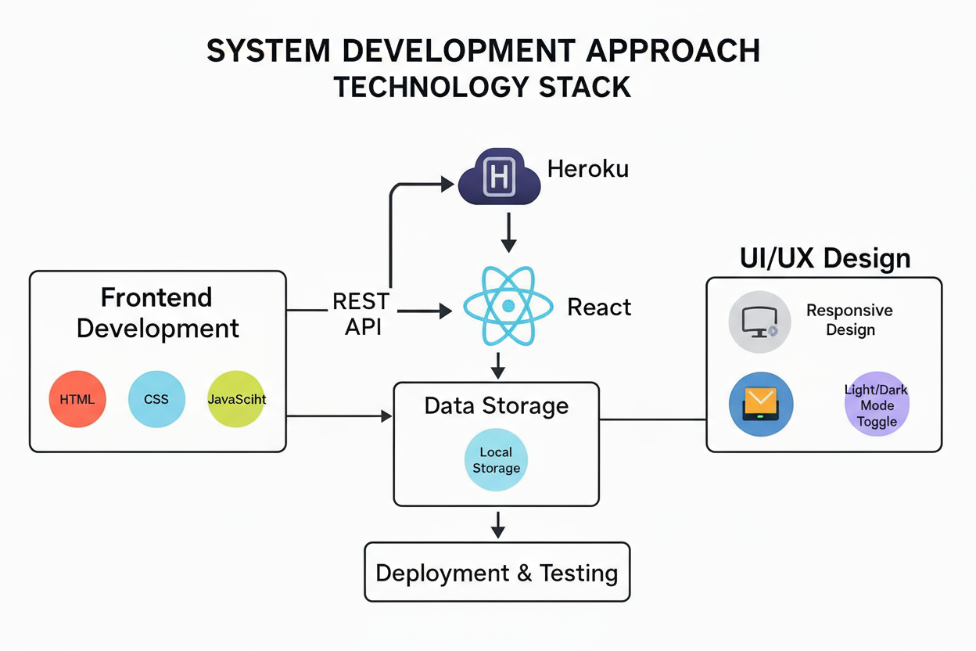
System Approach
Frontend: HTML, CSS, JavaScript
Data Storage: Local Storage (browser-based)
UI/UX: Responsive design with light/dark mode toggle

Slide 5
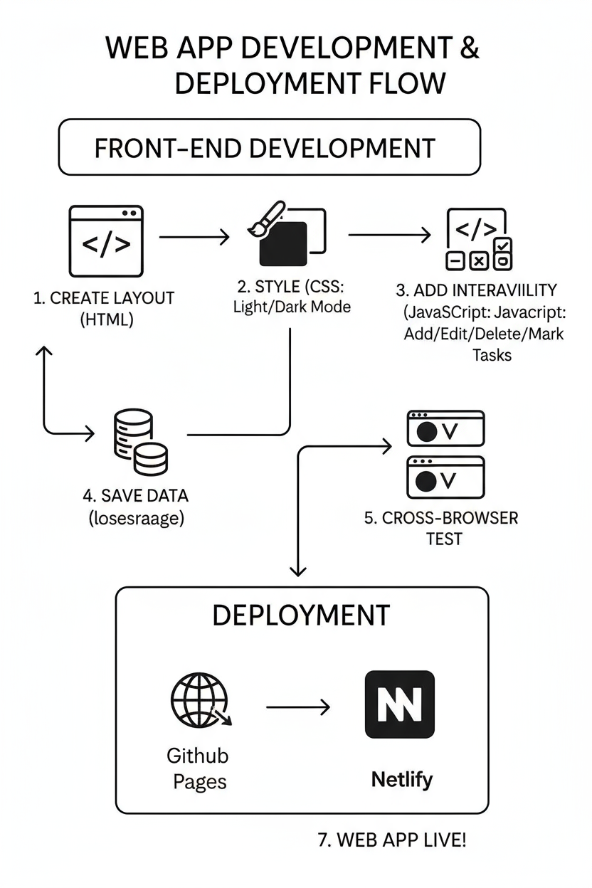
Algorithm & Deployment
Start with creating the basic layout in HTML (task input, task list, progress bar).
Style the interface using CSS (light/dark mode support).
Add functionality with JavaScript:
Add tasks
Edit tasks
Mark as complete
Delete tasks
Track progress dynamically
Store and retrieve tasks from localStorage to preserve data between sessions.
Test the application across browsers.
Deploy on a free hosting platform (e.g., GitHub Pages, Netlify).

Slide 6
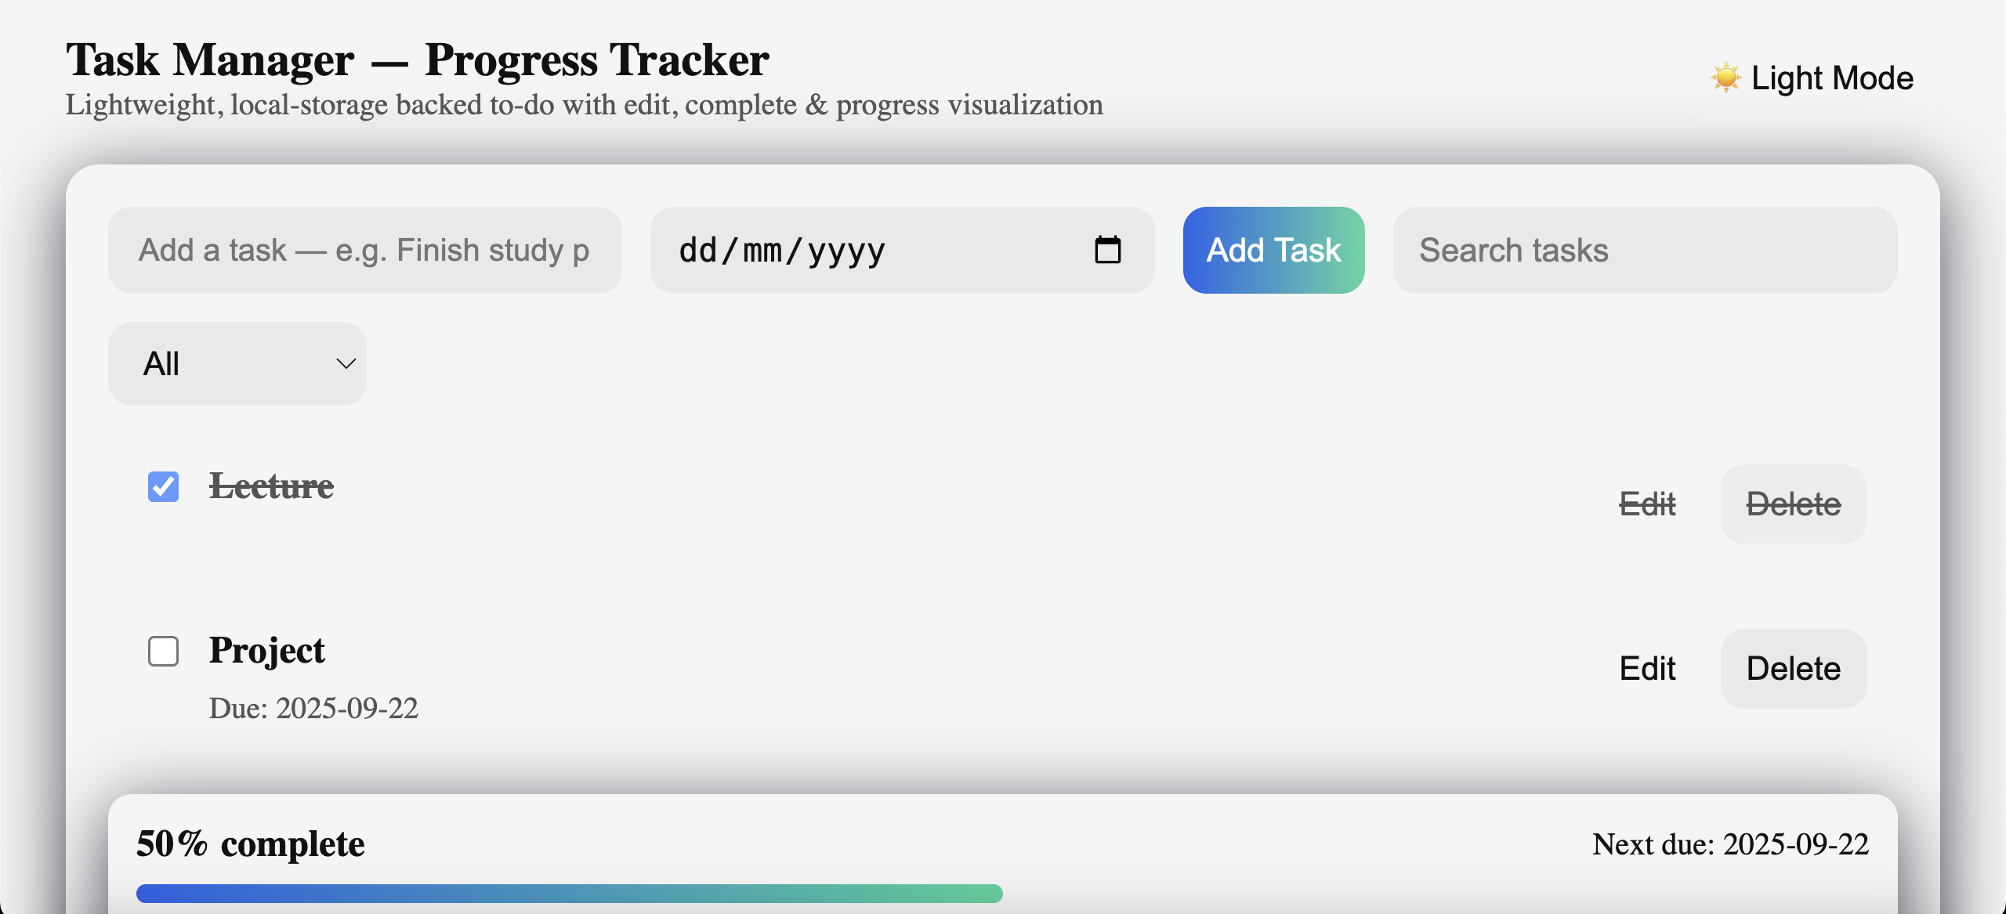
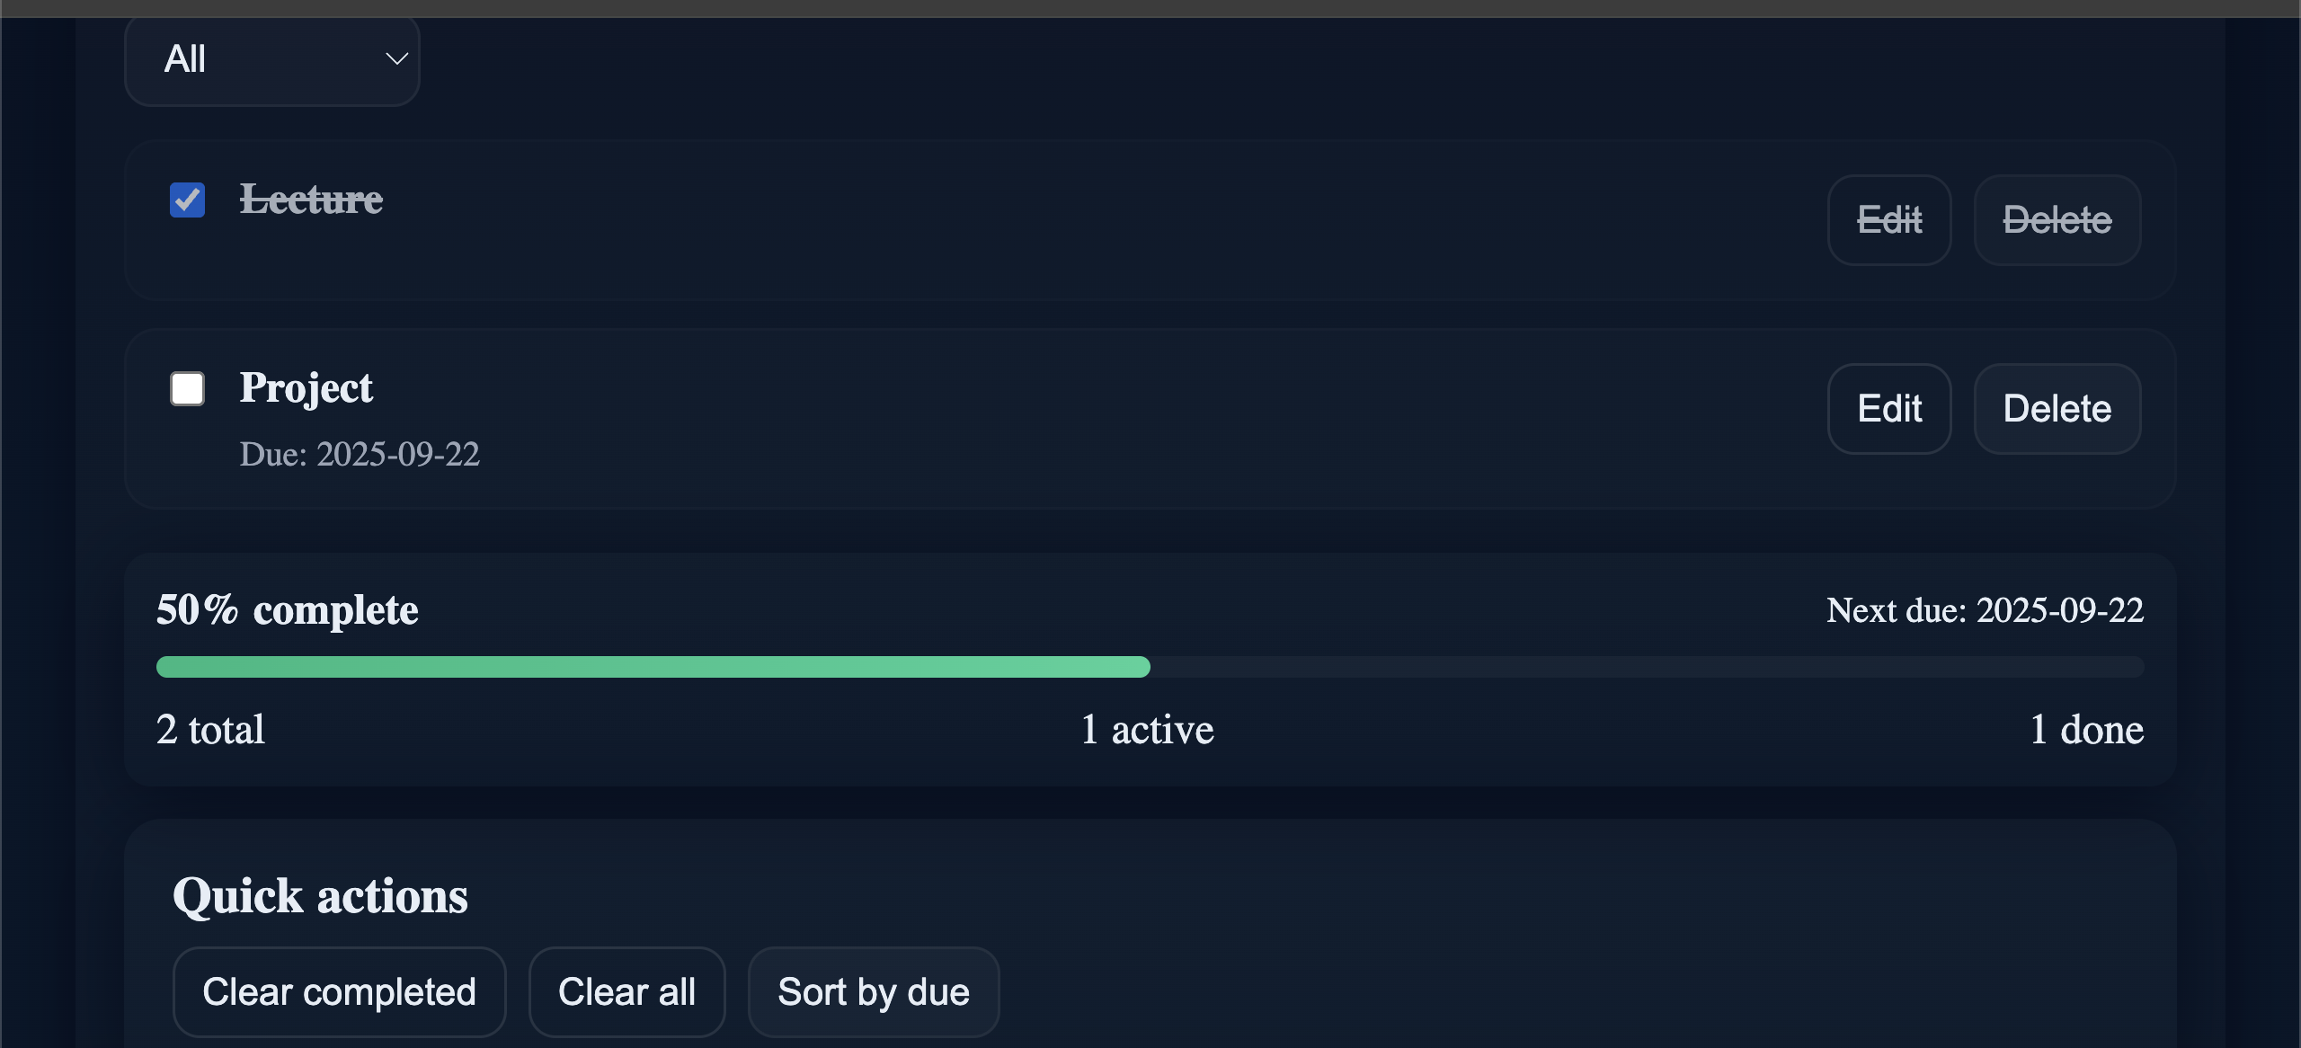
Result
The system allows users to create, manage, and track their tasks. It provides an interactive interface with a progress tracker and theme customization, improving productivity and personal time management.Attach your Github link
https://github.com/rishika174/Task-Manager-with-Progress-Tracker

Slide 7
Conclusion
The project successfully demonstrates a simple yet effective task management application. It enables users to manage their daily activities and visualize progress without requiring external databases or complex setups.

Slide 8
References
Mozilla Developer Network (MDN) Web Docs – https://developer.mozilla.org
W3Schools – https://www.w3schools.com
JavaScript.info – https://javascript.info
Netlify/GitHub Pages documentation for deployment

Slide 9
THANK YOU

