Slide 1
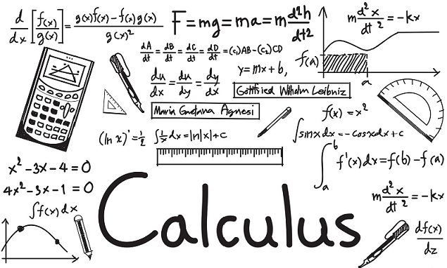
Calculus
Based on 3Blue1Brown's Visual Calculus Series

Slide 2
Contents
Limits
Derivatives
Integrals
Fundamental Theorem of Calculus
Multivariate Gradients
Numerical Methods (NumPy Demo)

Slide 3
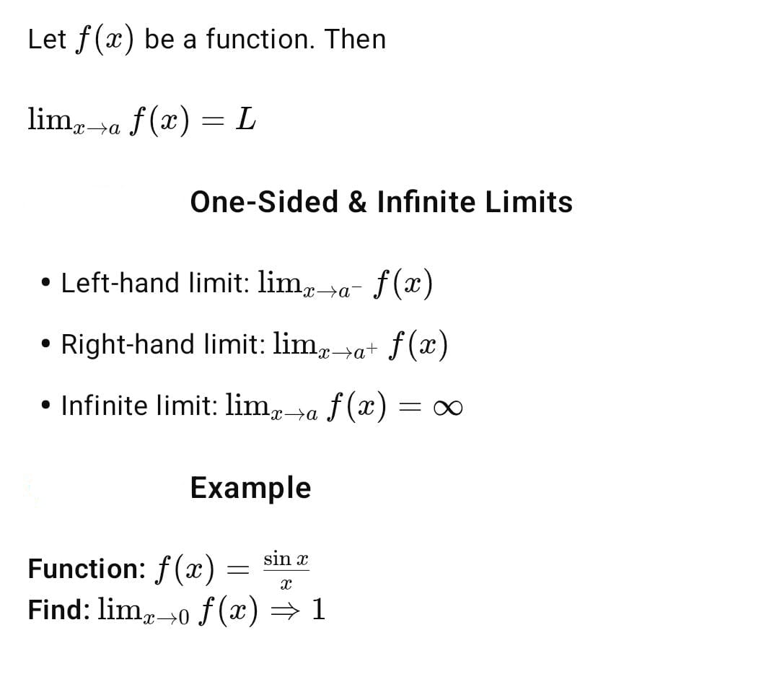
📘 PART I: Limits
🔷 Slide 3: Definition of Limit

Slide 4
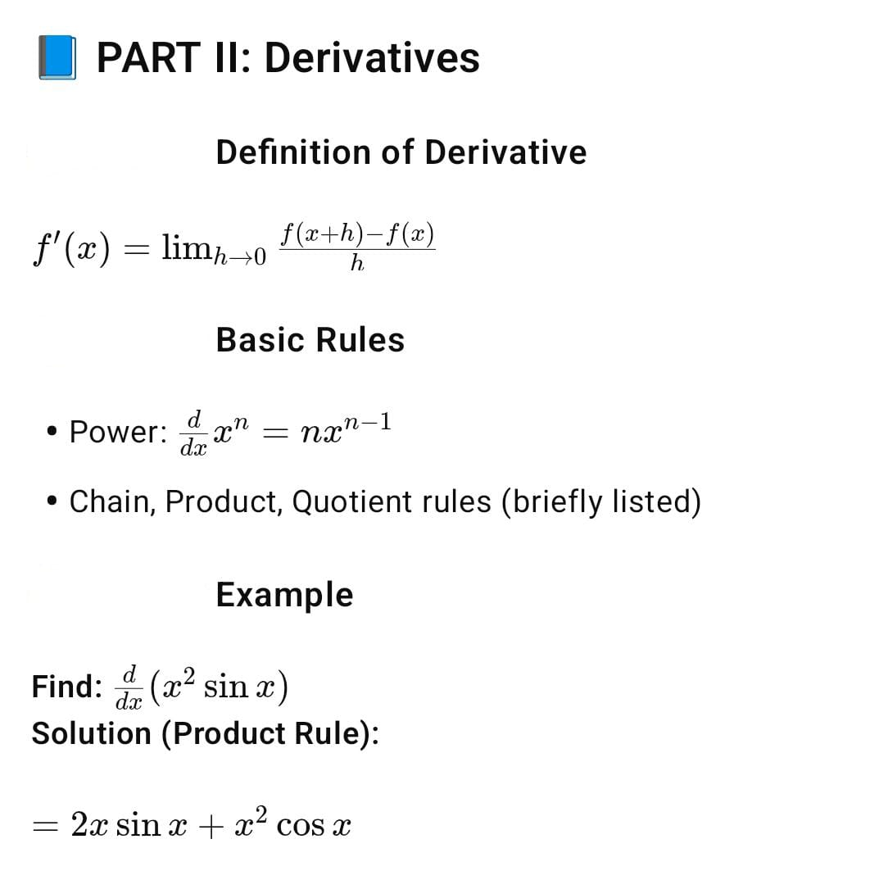
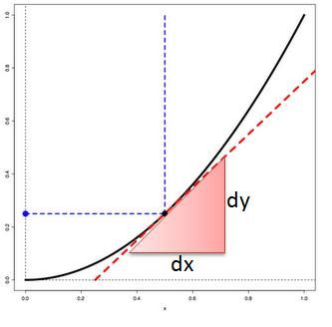

Slide 5
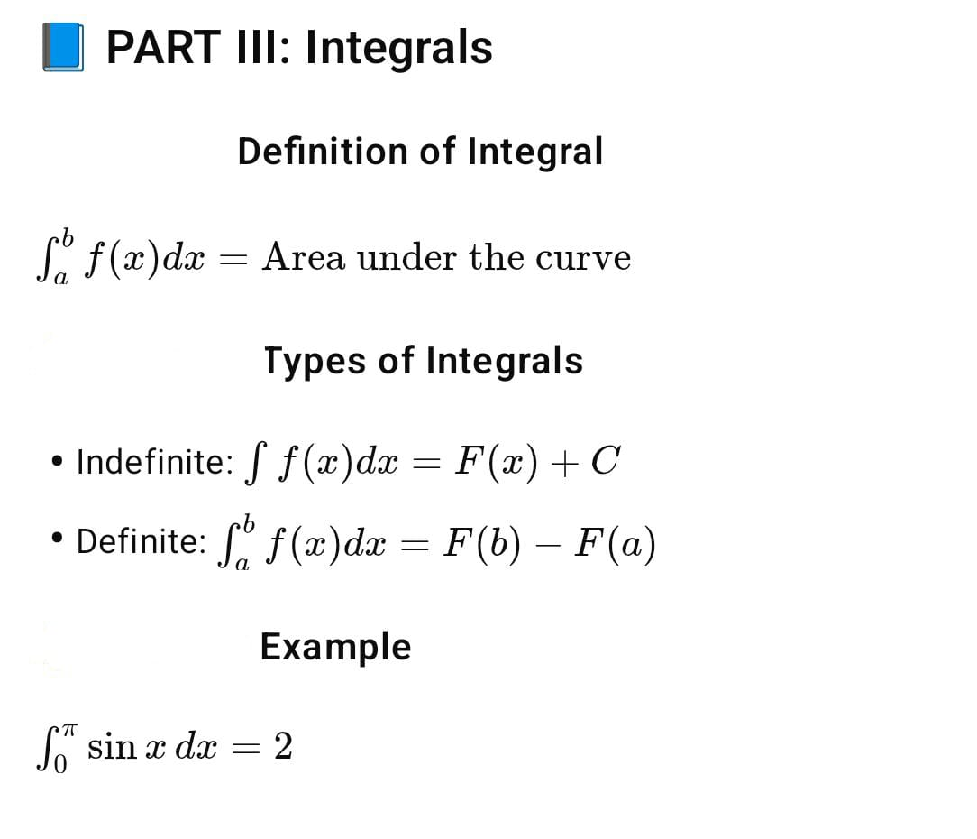
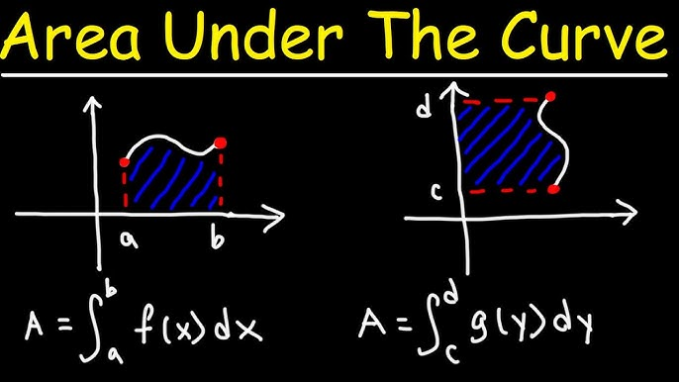
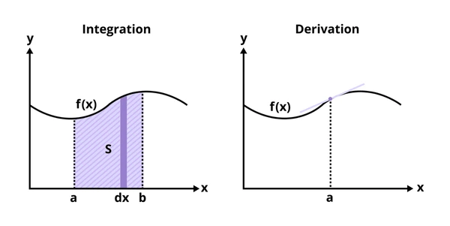

Slide 6
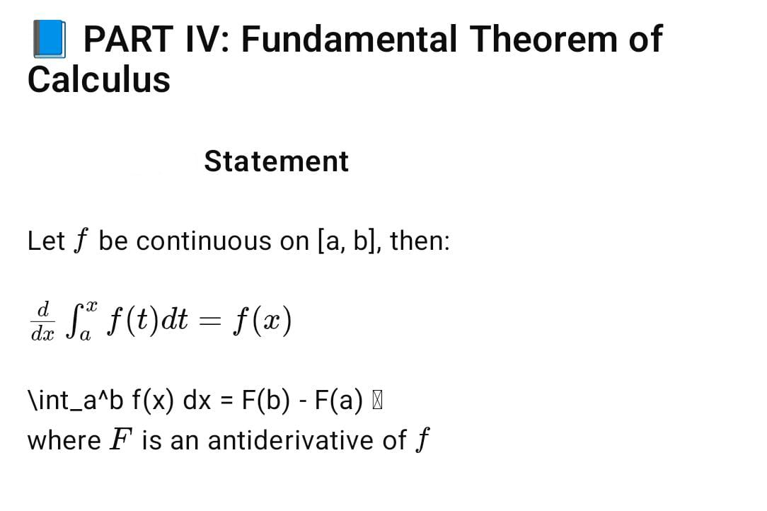
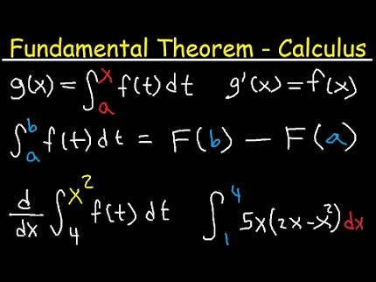

Slide 7
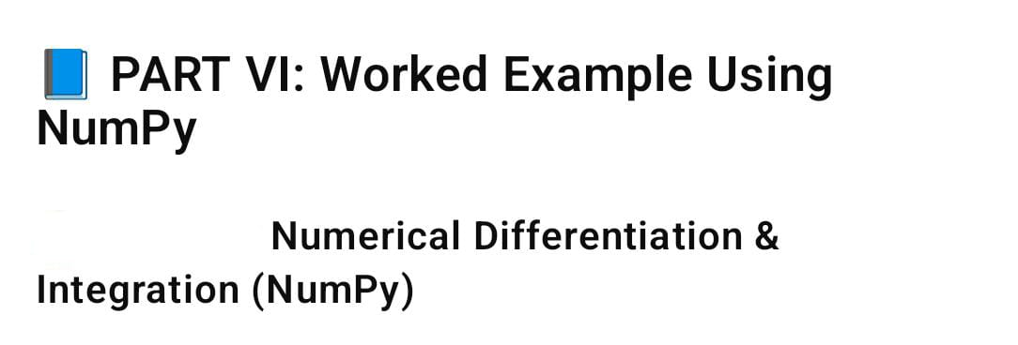
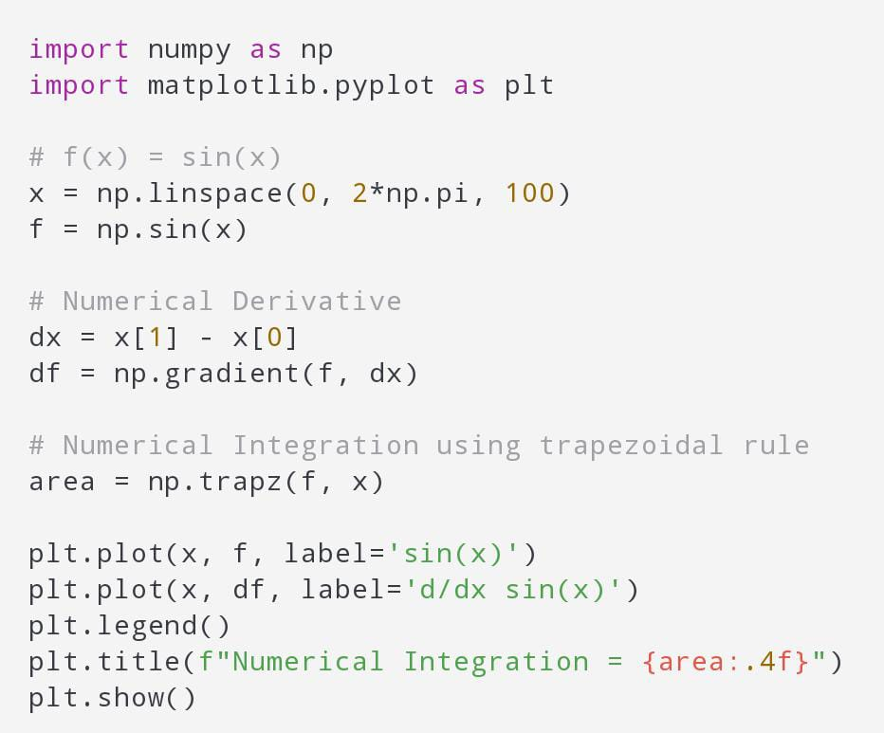
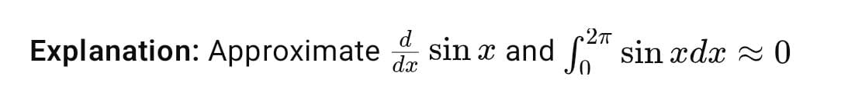

Slide 8
Summary
Calculus provides tools to analyze change and accumulation
Derivatives model rate; integrals model area and accumulation
Applications in: physics, economics, data science

Slide 9



References
3Blue1Brown Calculus Playlist
Archive.org – Calculus Book
NumPy documentation: https://numpy.org/doc/
h

Slide 10
🙏 Thank You!
👨‍🎓 Presented By:
Rajnish Kumar Sharma

