Slide 1

Presentation 1: Linear Algebra Slide 1: Title Foundations of Linear Algebra Vector Spaces, Transformations, Eigenvalues & PCA

Slide 2
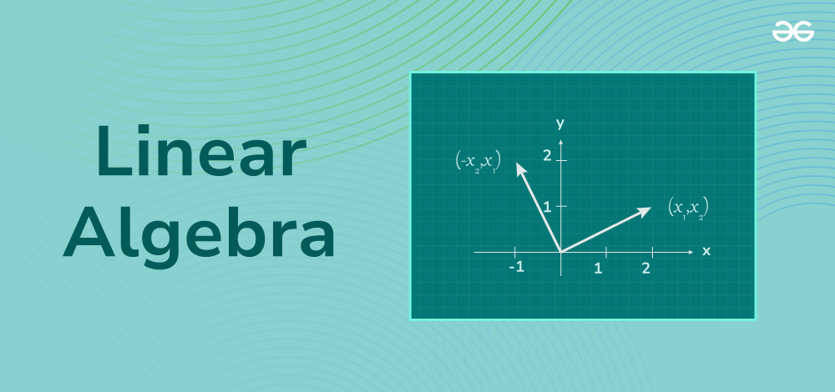
What is Linear Algebra?
Linear Algebra is the branch of mathematics concerned with vector spaces, linear transformations, and systems of linear equations. It uses tools like matrices and determinants to model and solve problems.
Applications:
Core part of machine learning algorithms (e.g., linear regression, neural networks)
Used in computer graphics to render and rotate objects
Essential in quantum mechanics and signal processing
.

Slide 3
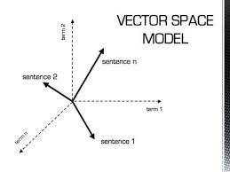
Vector Spaces
Definition: A vector space is a set of vectors that can be scaled and added, and it satisfies specific algebraic rules (axioms). These include:
Associativity and commutativity of addition
Distributivity of scalar multiplication
Existence of additive identity and inverses
Examples:
ℝ² (2D real coordinate space)
ℝ³ (3D space)
All 2×2 matrices
Set of all polynomials of degree ≤ n

Slide 4
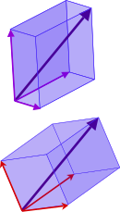
Basis and Dimension
Basis: A minimal set of linearly independent vectors that span the entire vector space.
Dimension: The number of vectors in the basis.
Example: ℝ² has a standard basis {(1,0), (0,1)} → These two vectors can generate any other vector in ℝ² by linear combination. → Therefore, the dimension is 2.

Slide 5
Linear Transformations
A linear transformation is a function between vector spaces that preserves vector addition and scalar multiplication. Mathematically: T(av + bw) = aT(v) + bT(w)
Linear transformations can be expressed using matrices. They are used to rotate, reflect, shear, or scale vectors.

Slide 6
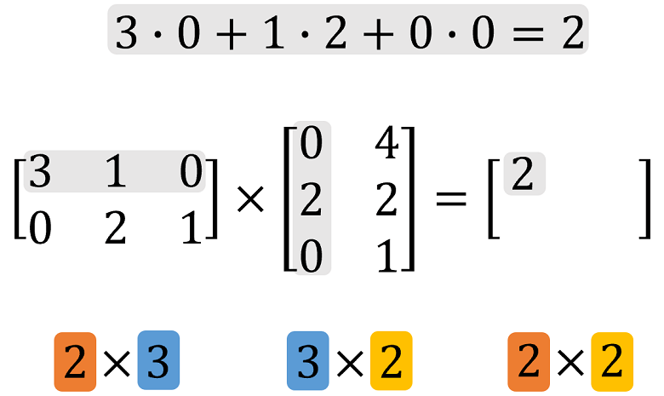
Matrix Representation of Transformations
Some common matrix transformations:
Rotation matrix (for rotating points by angle θ): $\begin{bmatrix} \cos\theta & -\sin\theta \ \sin\theta & \cos\theta \end{bmatrix}$
Scaling matrix (scaling both axes by factor k): $\begin{bmatrix} k & 0 \ 0 & k \end{bmatrix}$
Multiplying these matrices with vectors applies the corresponding transformation

Slide 7
Eigenvalues and Eigenvectors
If A is a square matrix, then a non-zero vector v is called an eigenvector of A if: Av = λv, where λ is a scalar called an eigenvalue.
Interpretation: The transformation A stretches or compresses v by a factor of λ, but doesn’t change its direction.
Applications:
System stability analysis
Google's PageRank algorithm
Principal Component Analysis (PCA)

Slide 8
Worked Example – Finding Eigenvalues
Matrix A = [[4, 1], [2, 3]]
Steps:
Find characteristic polynomial: det(A − λI) = 0
Solve for λ (eigenvalues)
Plug λ into (A − λI)v = 0 to find eigenvectors

Slide 9
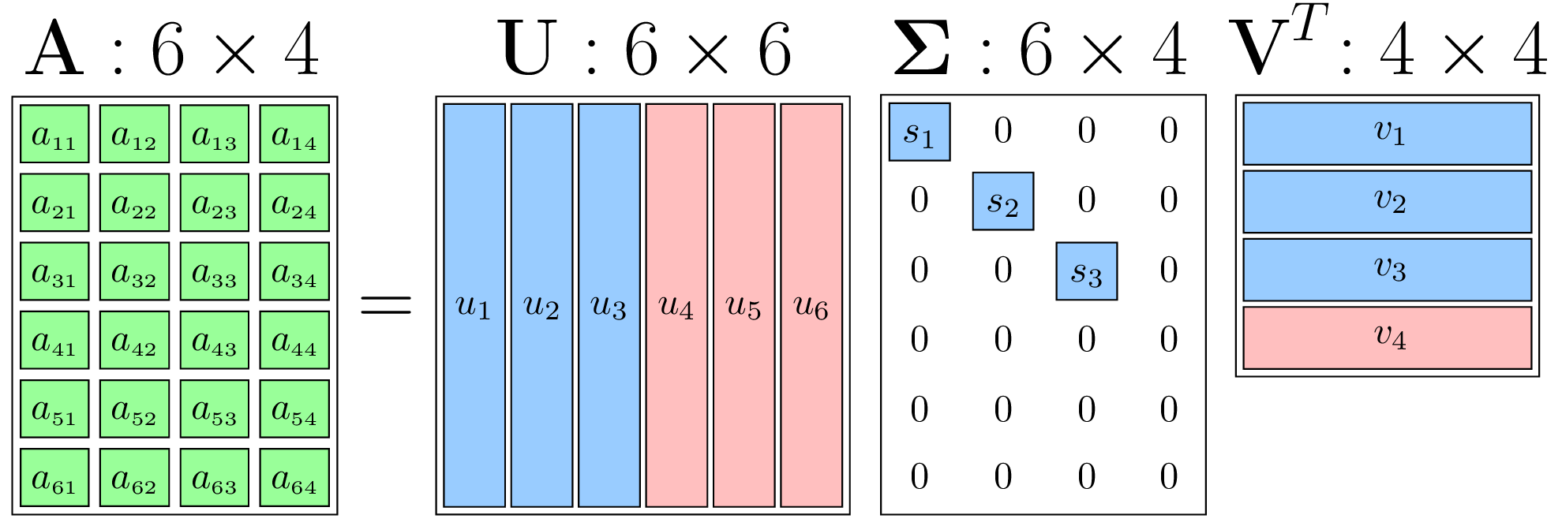
SVD – Singular Value Decomposition
SVD factorizes a matrix A into 3 matrices: A = UΣVᵀ
U and V are orthogonal matrices
Σ is a diagonal matrix with singular values
Applications:
Image compression (e.g., JPEG)
Noise reduction in signals
Recommender systems

Slide 10
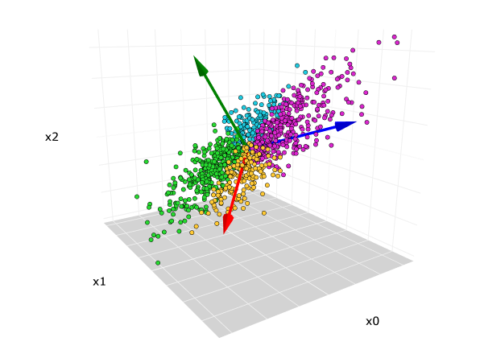
PCA – Principal Component Analysis
PCA is a dimensionality reduction technique that uses eigenvalues and eigenvectors to project data into a lower-dimensional space while preserving variance.
Steps:
Normalize dataset
Compute covariance matrix
Calculate eigenvectors and eigenvalues
Select top-k eigenvectors
Transform original data into new space

Slide 11
PCA in Action
Example: MNIST handwritten digits dataset
Each image has 784 features (pixels)
PCA can reduce this to 2 or 3 dimensions for visualization
Result: Clusters of similar digits form in lower dimensions

Slide 12
References (Linear Algebra)
3Blue1Brown: Essence of Linear Algebra (YouTube)
Gilbert Strang’s Textbook (PDF)

Slide 13
#Summary
**Linear Algebra builds up from vector spaces and basis. **Leads to matrices and transformations. **Eigenvalues and SVD help in real-world applications like PCA. **Foundation for data science, ML, graphics, and robotics.

Slide 14
Thank You!
Presented by: Rajnish Kumar Sharma
Email: sharmarajnish293@gmail.com

