Slide 1
THE ENCODER DECODER MODEL
Presented By:
Rishika Hazarika (210710007037) Shruti Sarma (210710007047) Shreyoshi Ghosh (210710007046)

Slide 2
Sequence-to-Sequence (Seq2Seq) Problem
Involves taking an input sequence (of any length) and mapping it to an output sequence (can be of a different length).
Challenge: the model must understand the meaning of the entire input sequence before generating the correct output.
Examples:
a. Machine Translation: “I love cats” → “J’aime less chats”
b. Speech Recognition: Audio waveform → “Hello, how are you?”
c. Text Summarization: Long document → Short summary
d. Question Answering: “Who discovered gravity?” → “Isaac Newton”
e. Chatbots: “How are you?” → “I’m doing well, thanks!”
Goal of a Seq2Seq model: to map one input sequence to an output sequence.

Slide 3
Machine Translation Systems Prior to Seq2Seq Models
Before deep learning-based Seq2Seq models, machine translation was handled by:
Rule-Based Machine Translation:
Relied on manually written grammatical rules and dictionaries for translating text.
Example: If translating English to French, “I eat an apple” → “Je mange une pomme”, this required predefined
grammar rules.
Disadvantage: Needed separate rules for different languages or for every sentence structure.
Problem: Could not handle new or complex sentences if their grammatical rules were not predefined.
Statistical Machine Translation:
Used probability-based models trained on bilingual corpora.
Key idea: Break sentences into phrases and find the most probable translation based on statistical alignment.
Example: If “I love” → “J’aime” appears in most training data, it is chosen.
Advantage: Learned from large datasets rather than predefined rules; more flexible than rule-based machine translation.
Disadvantage: Struggled with long sentences; word order issues; lot of training data required.

Slide 4
Neural Sequence-to-Sequence Learning: A Breakthrough
Sequence to Sequence Learning (Sutskever et al., 2014)
Proposed an end-to-end neural network approach for Seq2Seq tasks with minimal assumptions.
Used multilayered LSTMS: one to encode input into a fixed-dimensional vector and another to decode it.
Achieved a BLEU score of 34.8 on the WMT’14 English-French dataset, outperforming Statistical Machine Translation (33.3).
BLEU (Bilingual Evaluation Understudy) score: a metric to evaluate machine-generated translations by comparing them with human translations.
Higher BLEU score = better translation quality.

Slide 5
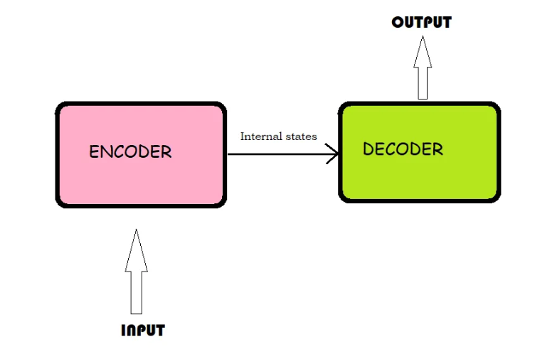
What is Encoder-Decoder Model?
In the seq2seq model, the encoder and the decoder architecture converts input sequences into output sequences.
According to Daniel Jurafsky & James H. Martin in their book “Speech and Language Processing: An Introduction to Natural Language Processing, Computational Linguistics, and Speech Recognition”:
The key idea underlying these networks is the use of an encoder network that takes an input sequence and creates a contextualized representation of it, often called the context. This representation is then passed to a decoder which generates a tasks specific output sequence.
Fig 1: A basic encoder-decoder model

Slide 6
LSTMs: A Foundation for Encoder-Decoder Models
RNNs were the first models to process sequential data.
Problem with RNNs → Forget long-term context due to vanishing gradient.
LSTM Solution → Learns what to remember and forget, handling longer sequences.
Memory Paths in LSTM:
Long-Term Memory → Stores important past information.
Short-Term Memory → Keeps recent context.
Why LSTM for Encoder-Decoder Models?
Encoders need LSTMs to store and pass meaningful context.
Decoders use this context for better predictions.

Slide 7
LSTM Architecture: Memory Cells & Gates
LSTMS use a memory cell to store important information over long sequences, solving the vanishing gradient problem in RNNs.
Three gates regulate information flow:
Input Gate → Decides what new information to store in the memory cell.
Forget Gate → Removes irrelevant or outdated information.
Output Gate → Determines what processed information is sent as output.
How it helps in Encoder-Decoder Models?
Ensures that relevant context is retained across long sequences.
Helps the encoder store useful information for the decoder to generate accurate outputs.

Slide 8
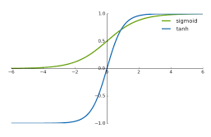
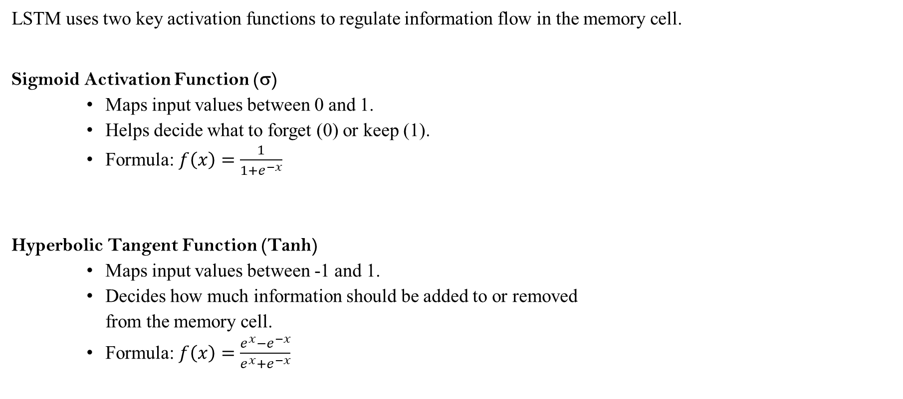
LSTM Activation Functions: Sigmoid & Tanh
LSTM uses two key activation functions to regulate information flow in the memory cell.
Sigmoid Activation Function (σ)
Maps input values between 0 and 1.
Helps decide what to forget (0) or keep (1).
Formula: $f\left(x\right)=\frac{1}{1+e^{−x}}$
Hyperbolic Tangent Function (Tanh)
Maps input values between -1 and 1.
Decides how much information should be added to or removed
from the memory cell.
Formula: $f\left(x\right)=\frac{e^{x}−e^{−x}}{e^{x}+e^{−x}}$

Slide 9
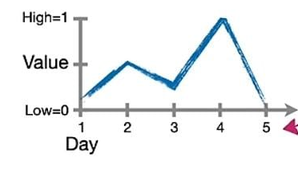
Understanding LSTM: A Step-by-Step Example
We are taking some data where the X-axis represents the day it was recorded, and the Y-axis represents the stock value.
Our goal is to remember the stock value on Day 1 to accurately predict the value on Day 5.

Slide 10
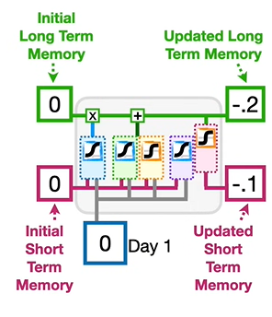
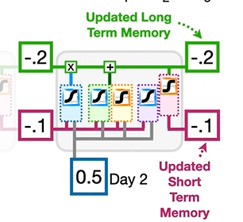
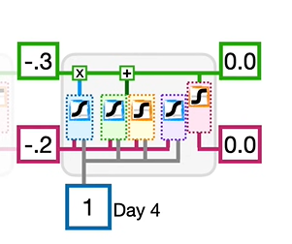
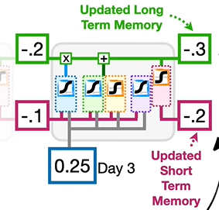
Understanding LSTM: A Step-by-Step Example
At each step, the LSTM model goes through three key stages:
Stage 1: Forget Gate – Determines what percentage of the long-term memory should be retained.
Stage 2: Input Gate - Creates a potential long-term memory and decides how much of it should be added to the existing long-term memory.
Stage 3: Output Gate – Updates the short-term memory by starting with the new long-term memory and determining how much of it should be passed on to the next step.

Slide 11
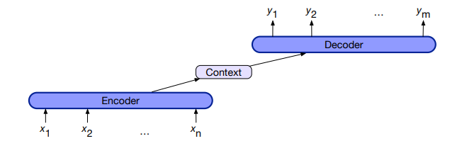
Encoder-Decoder Architecture
1. Encoder:
Takes an input sequence (e.g. a sentence in English) and processes it using layers like RNNs, LSTMs, etc.
Converts the input into a fixed-length representation called a context vector. This vector captures the meaning of the entire input sequence.
2. Context Vector:
This is the compressed form of the input sequence.
Contains the ‘context’ or meaning of the input sequence.
3. Decoder:
Takes the context vector and generates the output sequence one step at a time.
At each step, it predicts the next token (word/character) using previous outputs and the context vector.
Continues until it generates the full output sequence.
Fig 2: A basic encoder-decoder architecture

Slide 12
Step 1: Word Vector Generation (How Words Become Numbers)
Why do we need word vectors?
Computers don’t understand words directly so we convert them into numerical vectors (embeddings).
What are word vectors (embeddings?)
Dense numerical representations of words in a vector space.
How are word vectors formed?
Word vectors (embeddings) are learned automatically by training a model on large text data. The idea is:
Words that appear in similar contexts should have similar vectors.
The model assigns each word a vector of numbers (300-dimensional).
These numbers are adjusted so that words with similar meanings end up closer together in the vector space.

Slide 13
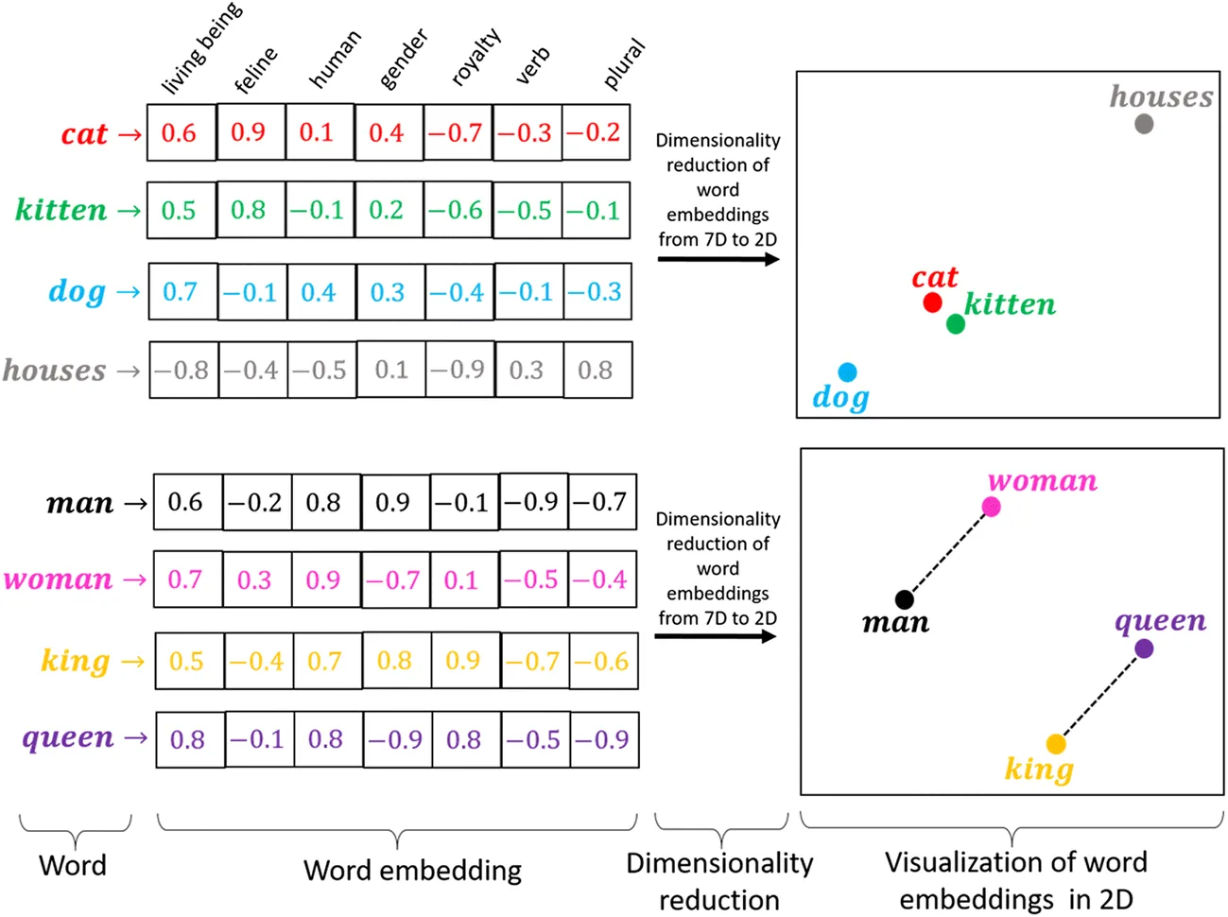
Fig3 : Word embedding (Courtesy of Medium)

Slide 14

Step 2: How Does the Encoder Work?
In an LSTM-based encoder, each word passes through an LSTM cell.
States in LSTM-based encoder:
1. Hidden state ($h_{t})$ - The working memory (short-term representation).
2. Cell State ($c_{t}) −The longterm memory storage$
Both the hidden state ($h_{t}$) and the cell state ($c_{t}$) are updated at each step as new words are processed.

Slide 15
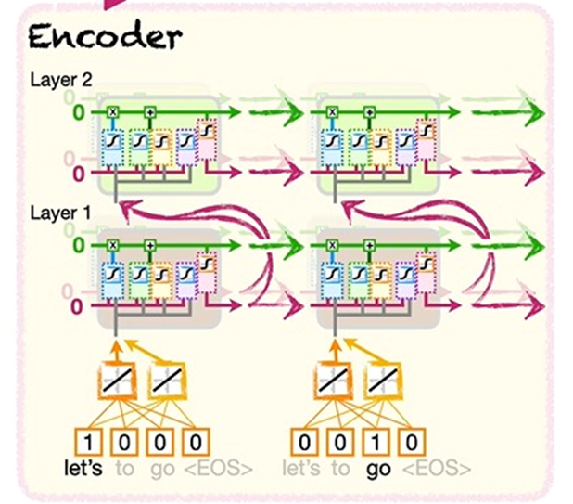
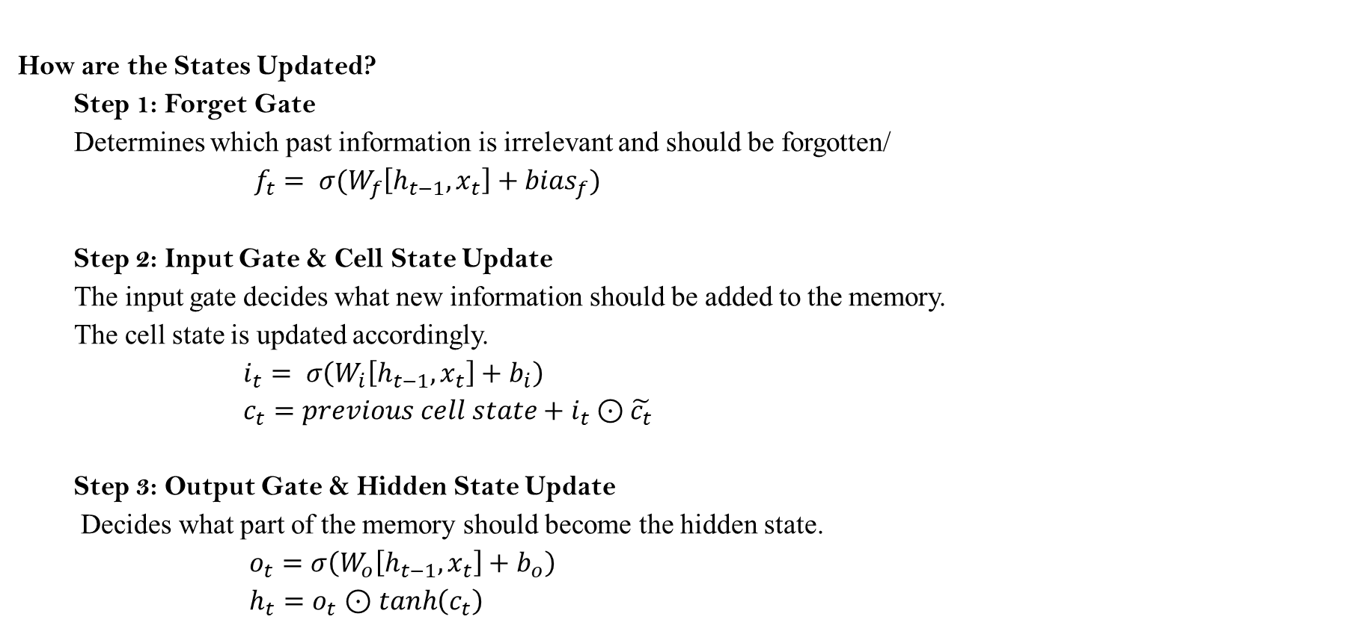
Step 2: How Does the Encoder Work?
How are the States Updated?
Step 1: Forget Gate
Determines which past information is irrelevant and should be forgotten/
$f_{t}= σ(W_{f}\left[h_{t−1}, x_{t}\right]+{bias}_{f})$
Step 2: Input Gate & Cell State Update
The input gate decides what new information should be added to the memory.
The cell state is updated accordingly.
$i_{t}= σ\left(W_{i}\left[h_{t−1}, x_{t}\right]+b_{i}\right)$
$c_{t}=previous cell state+i_{t}$ $⊙\tilde{c_{t}}$
Step 3: Output Gate & Hidden State Update
Decides what part of the memory should become the hidden state.
$o_{t}=σ\left(W_{o}\left[h_{t−1}, x_{t}\right]+b_{o}\right)$
$h_{t}=o_{t}$ $⊙$ $\tanh\left(c_{t}\right)$

Slide 16
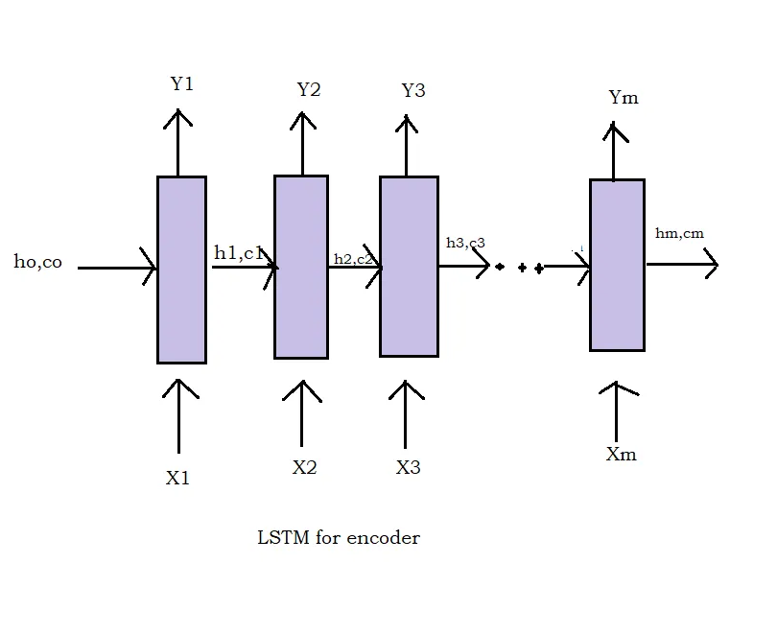
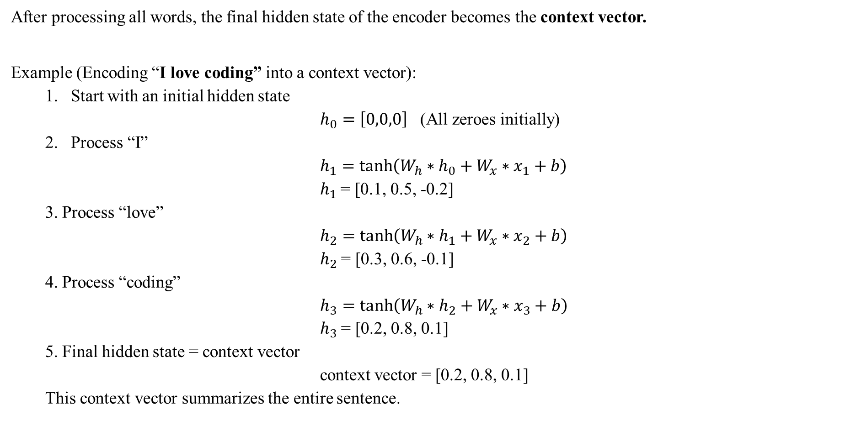
Step 3: How is the Context Vector Formed?
After processing all words, the final hidden state of the encoder becomes the context vector.
Example (Encoding “I love coding” into a context vector):
Start with an initial hidden state
$h_{0}=\left[0,0,0\right]$ (All zeroes initially)
Process “I”
$h_{1}=\tanh\left(W_{h}∗h_{0}+W_{x}∗x_{1}+b\right)$
$h_{1}$ = [0.1, 0.5, -0.2]
3. Process “love”
$h_{2}=\tanh\left(W_{h}∗h_{1}+W_{x}∗x_{2}+b\right)$
$h_{2}$ = [0.3, 0.6, -0.1]
4. Process “coding”
$h_{3}=\tanh\left(W_{h}∗h_{2}+W_{x}∗x_{3}+b\right)$
$h_{3}$ = [0.2, 0.8, 0.1]
5. Final hidden state = context vector
context vector = [0.2, 0.8, 0.1]
This context vector summarizes the entire sentence.

Slide 17
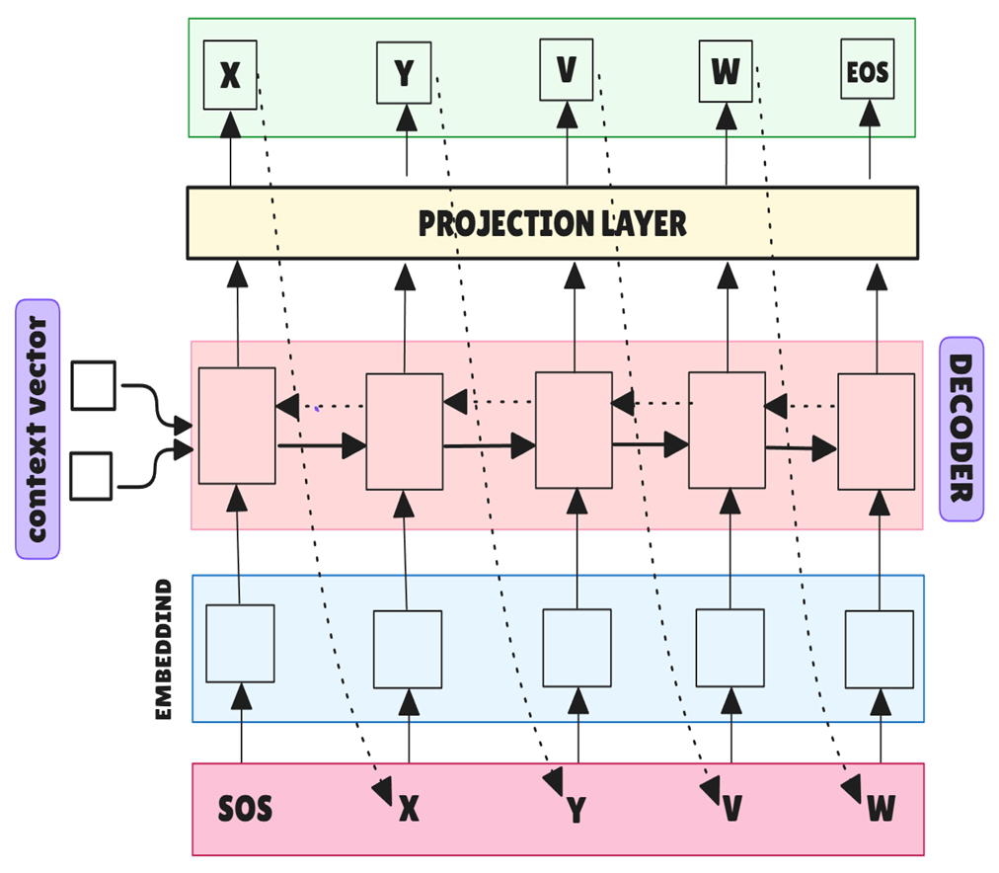
Decoder:
The decoder is the second part of the encoder-decoder model.
It generates output sequences from the encoded information.
Used in machine translation, text generation, and speech recognition.
How does a Decoder work?
The encoder’s final hidden state (context vector) is passed as the initial hidden state of the decoder.
The first input to the decoder is typically a special token <SOS> (Start of Sentence)
Using the LSTM architecture the first hidden (h_{t}) state is generated.

Slide 18
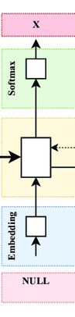
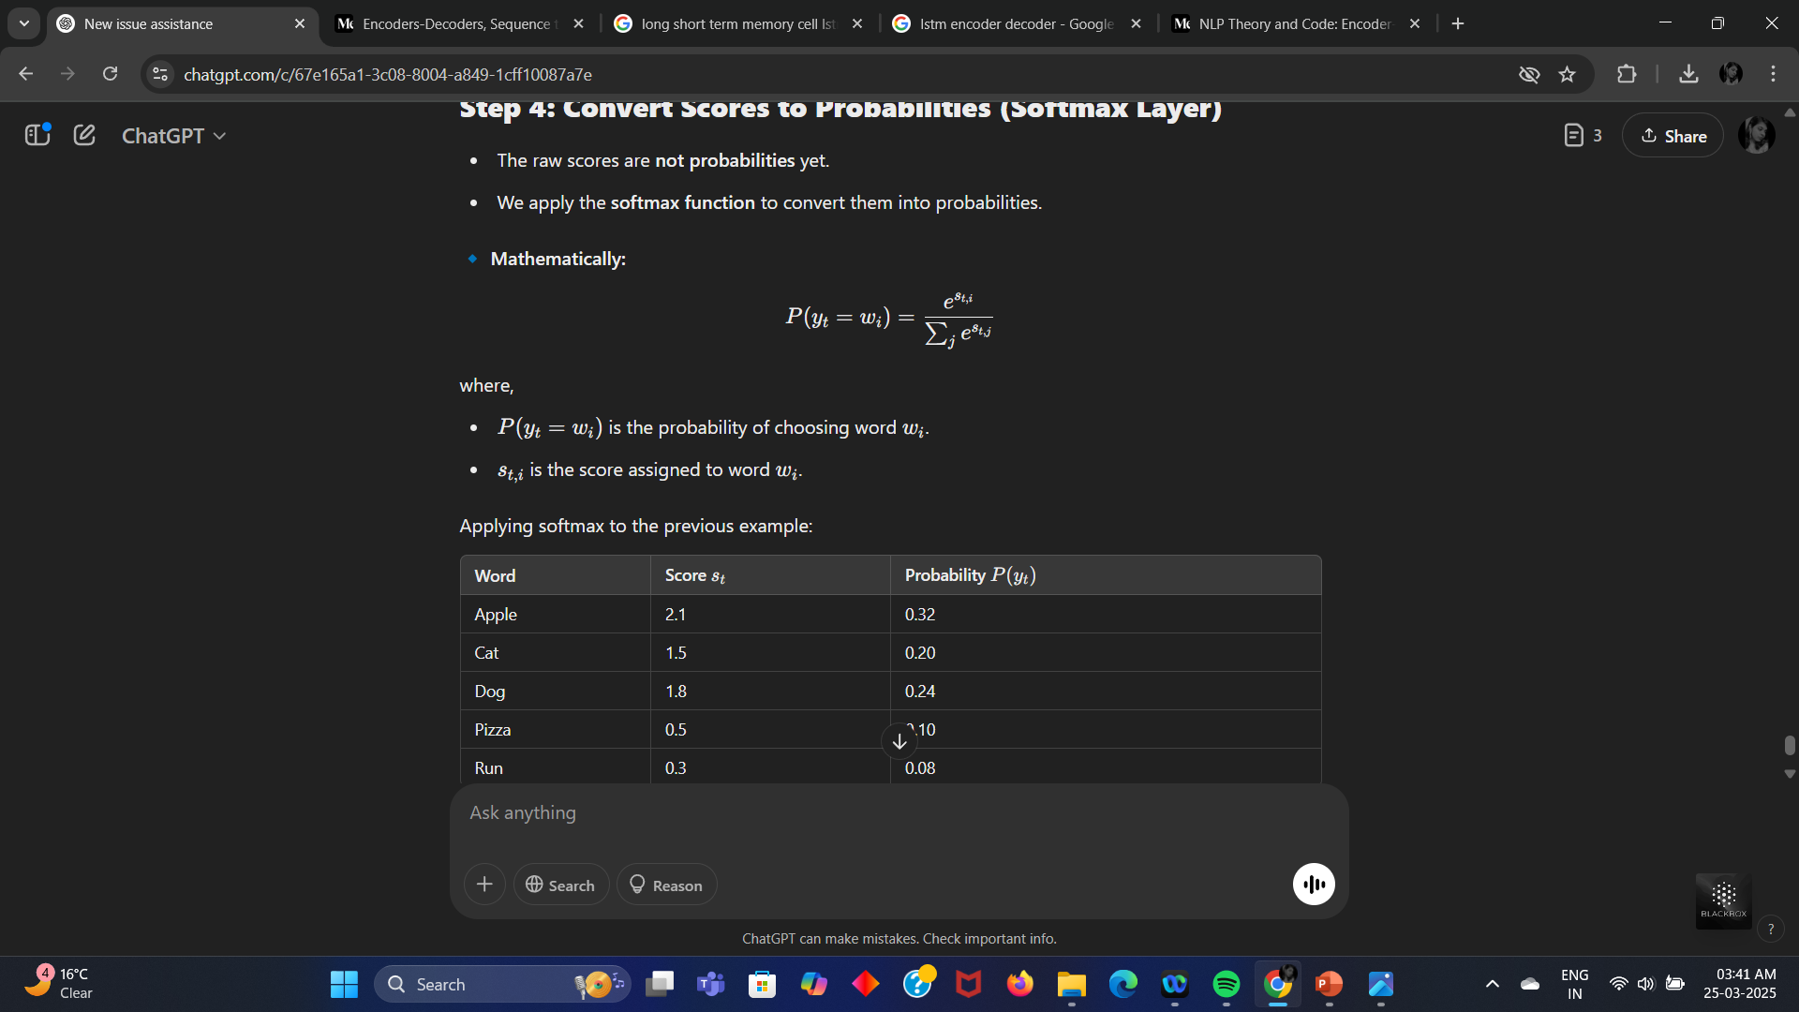
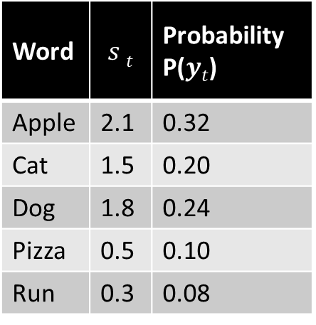
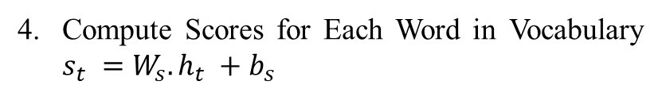



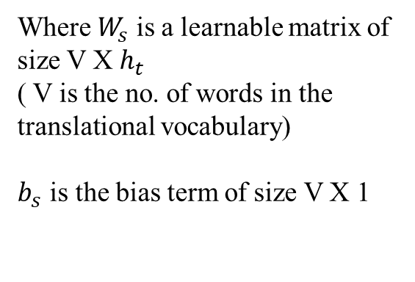
Where $W_{s}$ is a learnable matrix of size V X $h_{t}​$
( V is the no. of words in the translational vocabulary) $b_{s}$ is the bias term of size V X 1
Compute Scores for Each Word in Vocabulary $s_{t}​ =W_{s}​. h_{t}​ +b_{s}​$
Suppose we have 5 words in our vocabulary
$$h t$$
$$s t​ =W s​ ⋅h t​ +b s​$$
Word | $$s t$$ | Probability P($yt$)
Apple | 2.1 | 0.32
Cat | 1.5 | 0.20
Dog | 1.8 | 0.24
Pizza | 0.5 | 0.10
Run | 0.3 | 0.08
Words | $$s t​$$
Apple | 2.1
Cat | 1.5
Dog | 1.8
Pizza | 0.5
Run | 0.3
Convert Scores to Probabilities (Softmax Layer)
The Predicted Word is used as Input for the Next Time Step.
Repeat Until End-of-Sentence (EOS) Token is Generated

Slide 19
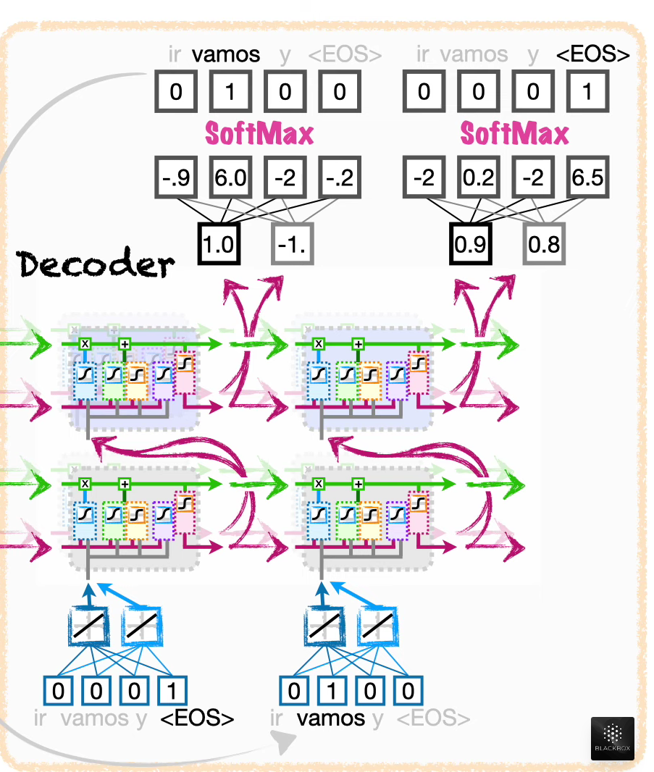
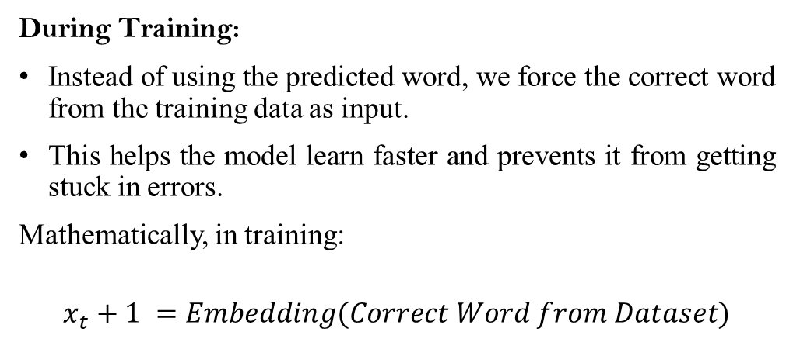
Training vs Testing - Teacher Forcing Rule
During Training:
Instead of using the predicted word, we force the correct word from the training data as input.
This helps the model learn faster and prevents it from getting stuck in errors.
Mathematically, in training:
$$x_{t}+1​ =Embedding(Correct Word from Dataset)$$
During Testing:
The decoder uses its own predicted words as inputs.
Errors accumulate if a wrong word is predicted, leading to poor output quality.

Slide 20
Advantages and Disadvantages of LSTM based Encoder- decoder
Advantages | Disadvantages
1. Better than regular RNNs. | 1. Fixed-size context vector leads to loss of information.
2. Can work with different input and output lengths. | 2. Slow for long sequences.
3. Encoder compresses input into a fixed-size context vector, which acts as a summary of the sentence. | 3. High memory usage.
How do we overcome the challenges?
Attention Mechanisms (as an add-on with existing LSTM architecture)
Paper: Attention-Based Sequence-to-Sequence (Bahdanau et al., 2015)
Transformer Model (attention mechanism and positional encoding)
Paper: Attention Is All You Need (Vaswani et al., 2017)

Slide 21

Conclusion
LSTM-based Encoder-Decoder models were a major breakthrough in sequence-to-sequence tasks but struggled with long-term dependencies.
Attention Mechanism improved this by dynamically focusing on relevant parts of the input sequence.
Transformers (introduced in Attention Is All You Need) completely replaced LSTMs, enabling parallel processing and greater efficiency.
Modern NLP models, including GPT and BERT, are built on these advancements, making deep learning-based language understanding more powerful than ever.

Slide 22
THANK YOU

