Slide 1
ORDER & SALES
Dashboard Analysis
Power BI Project Presentation
An overview of order volume, sales value, delivery performance,
and category-wise business trends.
Prepared using the provided Power BI dashboard

Slide 2
Project Overview
02
What this dashboard helps us understand
OBJECTIVE
01
Monitor orders
To summarize order activity and sales performance in one view, making it easier to identify leading cities, courier partners, and product categories.
Track total orders and compare delivered, returned, delayed, and cancelled orders.
02
Compare performance
See how order counts differ across cities and courier partners.
03
Understand sales
Compare sales value by product category and inspect order-level values.

Slide 3
Key Performance Indicators
03
Top-left cards provide a quick snapshot of the dataset
1.2K
₹14.81M
Total Orders
Total Order Value
Approximately 1,200 orders are represented.
Combined order value is about ₹14.81 million.
1,041
26
Delivered
Returned
Most orders are marked as delivered.
A small number of orders are marked as returned.
Note: KPI values are read from the supplied dashboard; rounded figures may be displayed as K or M.

Slide 4
Orders by City
04
Horizontal bar chart compares order counts across the displayed cities
Nagpur
Highest shown
Indore
Among the leaders
Patna
High volume
Bhopal
High volume
Kanpur
High volume
Jaipur
Mid-range
Lucknow
Lower among shown
Surat
Lower among shown
Takeaway: Nagpur has the highest order count among the cities visible in this chart. The bars show relative order volume, not sales value.

Slide 5
Orders by Courier Partner
05
The chart compares the number of orders handled by each courier
BlueRoute
~330
SwiftShip
~323
QuickKart
~304
ParcelPro
~281
Takeaway: BlueRoute has the largest order count among the four displayed partners, while ParcelPro has the smallest.
The values are approximate readings from the visual chart.

Slide 6
Sales by Product Category
06
Order value is compared across six product categories
Fashion
~₹3.55M
Electronics
~₹3.42M
Home & Kitchen
~₹2.78M
Beauty
~₹2.17M
Sports
~₹1.70M
Books
~₹1.32M
Takeaway: Fashion leads sales value, followed by Electronics and Home & Kitchen. Books has the lowest value among the categories shown.
Values are approximate, based on the axis scale in the dashboard.

Slide 7
Order Status Distribution
07
The doughnut chart shows how orders are split by status
Delivered
1.04K
86.75%
Interpretation
Delivered orders dominate the dataset at roughly 86.75%. Delayed and cancelled orders are smaller shares, while returns are the smallest segment.
Delayed
0.09K
7.17%
Cancelled
0.05K
3.92%
Returned
0.03K
2.17%
Business implication: prioritize reducing delays and cancellations while maintaining the current delivery performance.

Slide 8
Order-Level Value Trend
08
The line chart plots order value against Order_ID for the displayed records
40K
The displayed line generally declines from left to right, indicating lower order values across the sequence shown. Since the x-axis uses Order_ID rather than date, this should not be interpreted as a time trend.
30K
20K
10K
Recommendation: use a date field on the x-axis if the goal is to analyze sales over time.

Slide 9
KEY FINDINGS
What the dashboard tells us
01
Total order volume is approximately 1.2K, with total order value of ₹14.81M.
02
Delivered orders make up the clear majority of all orders.
03
Nagpur leads the displayed cities in order count.
04
BlueRoute leads the displayed courier partners by order count.
05
Fashion and Electronics contribute the largest category-wise sales values.
Suggested next steps: investigate delayed/cancelled orders, compare courier performance by delivery success, and add a date-based sales trend.

Slide 10
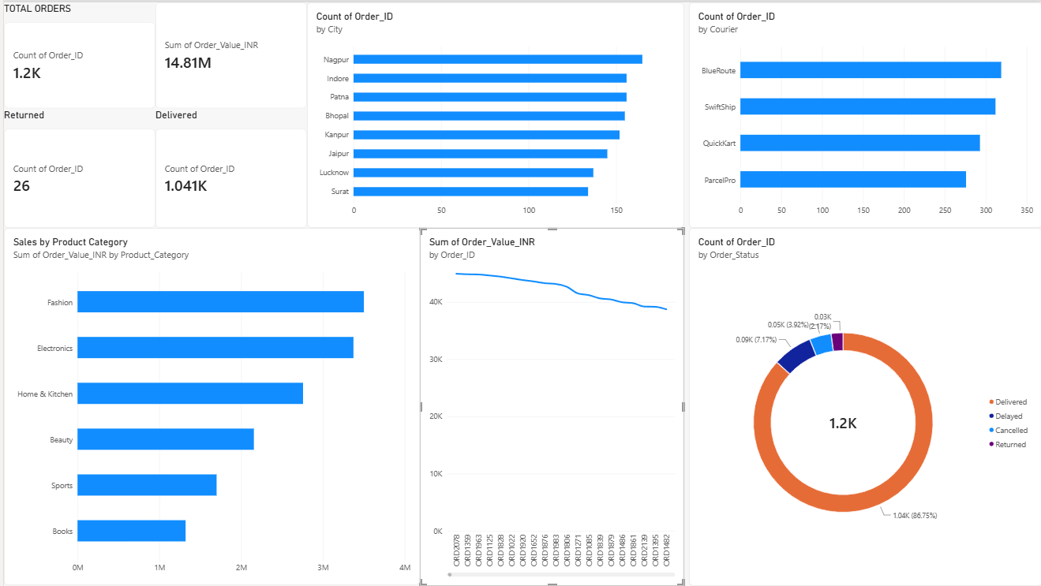
Power BI Dashboard
10
Full dashboard screenshot for reference

