Slide 1








Next Gen Employability Program
Data Analytics Applications with AI
Tools
Team Details – NG_CP_Team_5731
Name: RISHIKA N P
Name: SANJANA D
Name: NARMADHA K
College: Dr MGR-Janaki College ofArts and Science for Women,
Chennai

Slide 2

The content is curated from online/offline resources and
used for educational purpose only.

Slide 3

Project Title
COMPANY BUSINESS ANALYSIS

Slide 4

Table of Contents
• Project Objective
• Introduction
• Requirements
• Modules
• Output – Screenshots
• Future Enhancement
• conclusion
• References

Slide 5
Project Objectives: Strategic Analytical Framework
The primary objective of this project is to conduct a comprehensive analysis of historical share market data to evaluate stock price performance and trading behavior. The study aims to examine price movements using Open, High, Low, Close, and Volume indicators. It further seeks to identify market trends, assess volatility, and generate data-driven insights through interactive visualization and analytical tools in
Power BI.

Slide 6
Introduction
The share market plays a vital role in the financial system by facilitating the buying and selling of securities among investors. It reflects the economic performance of companies and influences investment decisions worldwide. Stock prices fluctuate daily based on market demand, supply, investor sentiment, and economic conditions.This project focuses on analyzing historical stock market data using key indicators such as Open, High, Low, Close, and Volume. By utilizing Power BI for data visualization and analysis, the study aims to interpret price
trends, trading patterns, and overall market behavior in a structured and analytical manner.

Slide 7
Requirements
This project requires historical stock market data including Date, Open, High, Low, Close, and Volume. The data must be accurate and continuous for proper analysis. Microsoft Power BI is required to import, clean, and visualize the data. The system should support Power BI Desktop for creating interactive dashboards. Basic
knowledge of data visualization and stock market concepts is also required to perform effective analysis.

Slide 8
Modules
Problem understanding
The problem addressed in this project is to analyze historical stock data to identify meaningful insights and support better investment decisions
Data analysis
The solution involves using Power BI to transform raw stock data into interactive dashboards.
Through data visualization and analytical tools, the project provides clear insights into stock
performance, volatility, and trading activity.

Slide 9
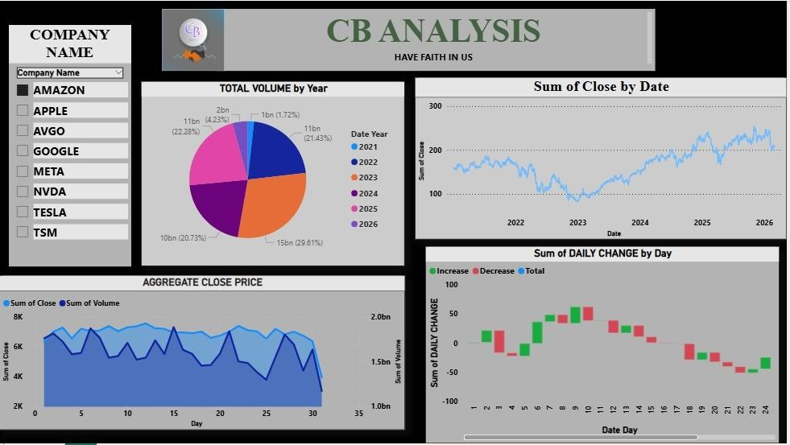
Output – screenshot

Slide 10
Future enhancement
This project can be further enhanced by integrating real-time stock market data through live APIs to enable dynamic and up-to-date analysis. Advanced analytical techniques such as machine learning models can be implemented to improve prediction accuracy. Additional
financial indicators like RSI, Moving Average Convergence Divergence (MACD), and Bands
can be incorporated for deeper technical analysis.The dashboardBollinger can also be expanded by adding comparative analysis of multiple companies or sector-wise performance. Furthermore, deployment through Power BI Service can enable cloud-based access and sharing for broader user interaction and decision-making support.

Slide 11
Conclusion
This project successfully transforms raw share market data into meaningful insights
through interactive visualization and analysis. It helps in understanding price trends,
trading patterns, and market performance in a clear and structured manner. Overall, the
dashboard supports informed and data-driven decision-making

Slide 12
References
• https://nodejs.org/api/net.html
• https://learn.microsoft.com/power-platform/power-bi/learn
• https://community.powerbi.com/
• https://www.makeovermonday.co.uk/

