Slide 1
MACHINE LEARNING & AI / WEEK 4
Heart Disease
Prediction
A full machine learning pipeline, from data cleaning to model evaluation
Binary classification • UCI Heart Disease dataset
Capstone project
Notes:
This capstone predicts whether a record indicates heart disease. It is an educational model, not a clinical diagnostic tool.

Slide 2
The data has 920 records and substantial missingness
Four source cohorts; the label combines all positive severity values into one class.
920
4
13
509
records
source cohorts
predictor fields
positive labels
Target definition
Missing values by field
num = 0 → No disease
num = 1–4 → Disease present
ca
611
thal
486
slope
309
fbs
90
oldpeak
62
Excluded from predictors: record ID and cohort name
trestbps
59
thalch
55
chol
30
WEEK 4 CAPSTONE / HEART DISEASE PREDICTION
02
Notes:
There are 920 rows and a binary target has_disease = (num > 0). The source contains 411 negative and 509 positive records. Missing counts are taken directly from the raw CSV. The highest missingness is in ca (611), thal (486), and slope (309), so imputation is necessary.

Slide 3
Preprocessing stays inside the training pipeline
The 80/20 split is stratified; the test set remains held out through model selection.
01
02
03
04
Split
Numeric fields
Categories
Compare
80% train
20% test
stratified
Median imputation
missing flags
standard scaling
Most frequent
imputation
one-hot encoding
Logistic regression
Decision tree
class balanced
Comparison metrics
Accuracy • Precision • Recall • F1 • ROC AUC
WEEK 4 CAPSTONE / HEART DISEASE PREDICTION
03
Notes:
Random state is 42. Continuous numeric columns are median-imputed with missingness indicators and standardized. Categories use mode imputation and one-hot encoding. Both steps are fitted only on training data by the pipeline. Logistic regression and a depth-limited decision tree use balanced class weights. The model with higher validation ROC AUC is selected, then refit on all development data before the final test evaluation.

Slide 4
Logistic regression leads on ROC AUC and recall
Held-out test metrics; model selection used validation ROC AUC.
Logistic regression
Decision tree
Accuracy
0.832
0.810
Precision
0.838
0.853
Recall
0.863
0.794
F1
0.850
0.822
ROC AUC
0.908
0.882
Accuracy 0.832 | Precision 0.838 | Recall 0.863 | F1 0.850 | ROC AUC 0.908
WEEK 4 CAPSTONE / HEART DISEASE PREDICTION
04
Notes:
Validation ROC AUC was 0.870 for logistic regression and 0.815 for the decision tree. After selecting logistic regression by validation ROC AUC, both candidates were refit on the full 80% development split. On the untouched 20% test set, logistic regression scores 0.832 accuracy, 0.838 precision, 0.863 recall, 0.850 F1, and 0.908 ROC AUC. The decision tree scores 0.810, 0.853, 0.794, 0.822, and 0.882 respectively. Each metric uses the positive class as disease present, and the threshold is the default 0.5.

Slide 5
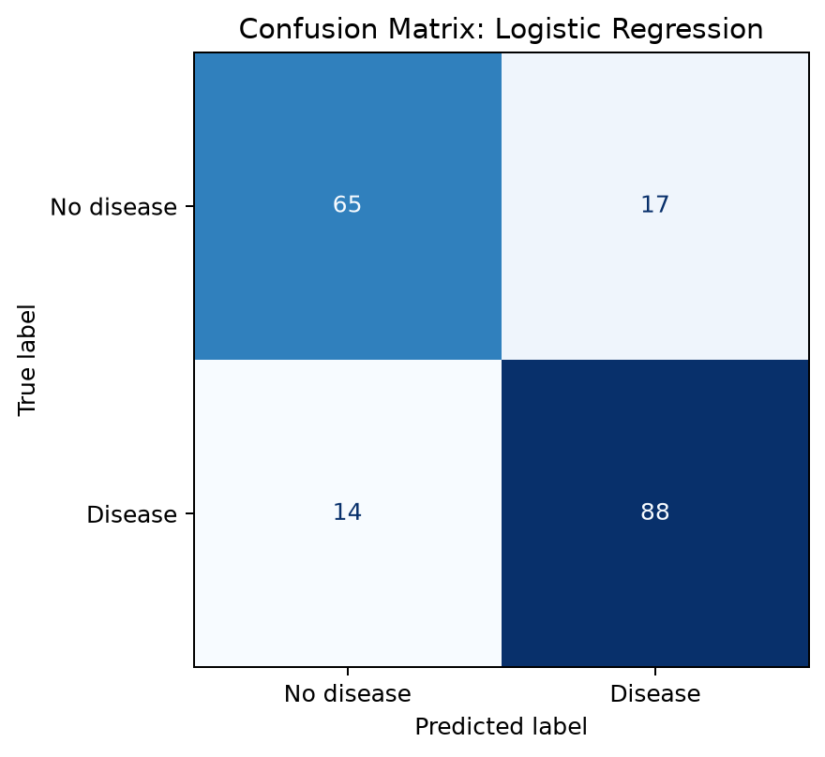
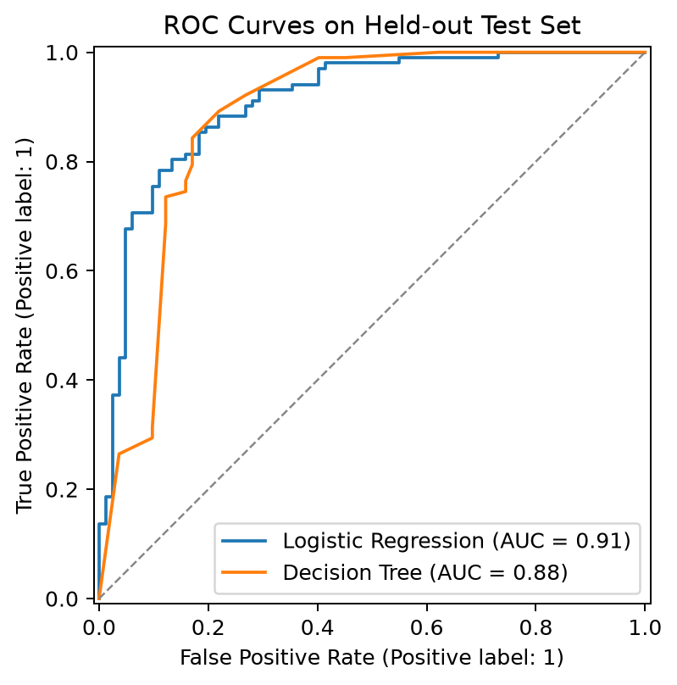
The error profile shows 14 missed positive cases
Confusion matrix and ROC curves on the same held-out test split.
At the default 0.5 threshold: 88 / 102 positive test records were detected.
WEEK 4 CAPSTONE / HEART DISEASE PREDICTION
05
Notes:
Confusion matrix row and column ordering is [No disease, Disease], giving TN=65, FP=17, FN=14, TP=88. Recall is 88/(88+14)=0.863. ROC curves compare ranking performance across thresholds. Raising or lowering the threshold changes the error tradeoff.

Slide 6
Useful baseline; not a clinical decision system
A single held-out split is a starting point for evaluation, not external validation.
What the experiment shows
What to validate next
• Logistic regression performed best on ROC AUC.
• Recall was 0.863 at the default threshold.
• Missing data was handled within the training pipeline.
• Test across cohorts with group-aware validation.
• Check calibration, confidence intervals, and fairness.
• Select a threshold with clinical input.
• Evaluate on a current external dataset.
Educational prototype only | Not intended for diagnosis or treatment decisions
WEEK 4 CAPSTONE / HEART DISEASE PREDICTION
06
Notes:
The current result comes from one random split of a multi-cohort historical dataset. Generalization to current clinical settings is unknown. Future work should use cohort-aware validation and external data, assess calibration and subgroup performance, and establish an appropriate threshold with qualified clinical experts.

