Slide 1
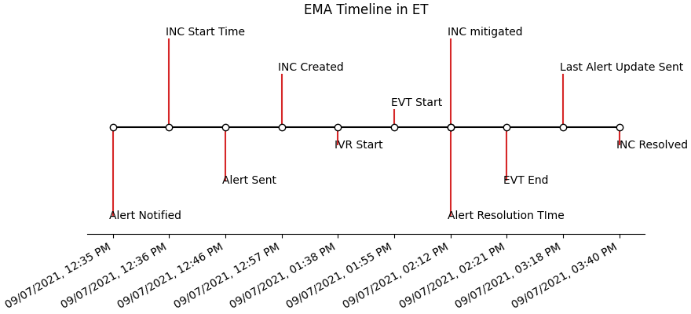
115791 : ~~Network Event | Multiple Tools and Services | Multiple Regions
Event Management Analysis (EMA) – Outage Summary and Treatment Timeline
Outage: | Tools And Service~~
Alert Start Date: | 09/07 12:46 PM
COMM ID: | 115791 - Priority 1:BHN;Charter;TWC;
Primary INC: | INC000009580699
Associated INC(s):
Alert Duration: | 2 hours, 31 minutes
Customer Impact: | ALL; 1,385,582
EMA Disposition
Summary of Event Customer care representatives in multiple call centers are experiencing latency in multiple applications including Avaya and Webex. ITSOC has been engaged to investigate.

Slide 2
Executive Level Summary – 109142
Summary of Event
After
Outage Details
…..
Areas of Interest
Could the call volume be reported sooner ?

Slide 3
Event Timeline – 109142
UpdateNumber | Priority | Time Sent | Duration
0 Degraded | Medium | 09/07 12:46 PM | 18 minutes
1 Degraded | Medium | 09/07 01:05 PM | 32 minutes
2 Degraded | High | 09/07 01:37 PM | 38 minutes
3 Failure - Red | EN | 09/07 02:16 PM | 1 hr, 2 mins
4 Resolved | EN | 09/07 03:18 PM
6pm
3pm
4pm
5pm
7pm
8pm
10pm
ID | Category | Summary | Team(s)
A | Outage Declare/ Timeline | Primary INC: INC000009580699 @ 09/07 12:36 PM ET Created by Alarms Impact Category: Network Core -Initial Notification sent @ -Issue Resolved @ 09/07 03:40 PM ET. INC Duration: 2 hours, 42 minutes Outage Description: INC Dispositions: Categorizations: Network>Core>Routing Product Categorization: Network>Router>Configuration | Comm Desk NOC VO-Systems ISP
B | Comm Desk Communication Timeline | Comm Desk created Issue Alert 115791 @ 09/07 12:46 PM ET -Priority 1 Executive Notification sent to Top-Tier Management @ Comm Desk resolved Issue Alert 115791 @ 09/07 03:18 PM ET -Priority 1 Alert Duration:2 hours, 31 minutes | Comm Desk
C | Call Volume, TC, Cust. Impact | Call Tracking During this event is TC booked during this event : 1250/858 Customer Impact : Video : 1,385,582 ,Internet : 2,683,453 ,Voice : 2,650,525 | Comm Desk NOC
D | Custom IVR Deflection | Custom IVR Active: Yes/No Calls Heard: Calls Deflected: Pending Call Backs: In Queue Messaging Active: No IVR Start: 09/07 01:38 PM IVR Stop: None 6950;4721;298 | Comm Desk
E | Mitigate Resolve | Mitigation occurred at 09/07 02:12 PM for Routing .RESOLUTION STATEMENT Origin - Alarms Fix - IN0 applied ebgp access policy to customer peer to stop the false advertisements from being advertised up to the core Fix Time - 9/7/2021 1:12 PM CT DOA - Enterprise/Commercial Operations DOA Representative - N/A MTTR: 89 minutes Affected CI - brfdwifb2cw Self-Inflicted: Under Review Op Resolution: Specific Destinations Routing Issue>Resolved Product Resolution: Human Error>Corrected Configuration | NOC, ISP, VO Systems

Slide 4
Outage Treatment – 109142
Comm Desk Created NOC Created ROC Created IRIS Created
10am
4pm
6pm
11pm
Outage Treatment
4

Slide 5
Call Tracker Summary – 109142
Comm Desk Created NOC Created ROC Created IRIS Created
Event Window below refers to the duration of the NOC ticket
Event Window:
*Data table numbers aggregated by hour so they will not match the 15 minute increments showing in the graph
5

Slide 6
Trouble Call Summary – 109142
Comm Desk Created NOC Created ROC Created IRIS Created
Event Window below refers to the duration of the NOC ticket
Event Window:
*Data table numbers aggregated by hour so they will not match the 15 minute increments showing in the graph
6

Slide 7
Process Gap Analysis – 109142 Multiple Channel Outage, Enterprise
 | Assigned Action | Action # | Team/ Owner | Findings/Response | Action Due Date | Formal Review Date | Recommendations/Fix Actions | Proposed Fix Date
1
2

