Slide 1
Intelligent Retail Risk Monitoring
Real-Time Behavioral Anomaly Detection in Retail Environments
Group 19
Anirudh Krishna 121093165
Rishika Thakre 121331403
Aneesh Krishna Rao Chepuri 121324382
MSML640 | Spring 2026 | University of Maryland
Group 19 | MSML640 Spring 2026 | University of Maryland
1

Slide 2
Problem Statement
Original Proposal
Final Implementation
• Detect suspicious behavior in retail CCTV footage
• YOLOv8n person detection (confidence >= 0.40)
• Use DeepSORT for multi-person tracking
• Custom IoU-based multi-person tracker (replaced DeepSORT)
• Classify behavior as NONE / LOW / MEDIUM / HIGH risk
• YAML polygon zone mapping on first video frame
• Assumed NVIDIA GPU for real-time inference
• Rule-based + score-based alert classification
• Fallback: Medical Image Diagnosis (NOT pursued)
• Evaluated on CAVIAR benchmark dataset (5 videos)
Motivation
• Retail shrinkage costs the industry ~$100B+ annually
• Manual monitoring is error-prone and non-scalable
• Goal: explainable, lightweight, CPU-deployable system
Group 19 | MSML640 Spring 2026 | University of Maryland
2

Slide 3
Technical Approach
1. Detection
2. Tracking
3. Zone Mapping
4. Feature Extraction
5. Alert Classification
• YOLOv8n model (nano, CPU-friendly)
• Custom IoU tracker
• User-drawn polygons in YAML
• Max dwell time per zone (seconds)
• Adaptive score: S = 0.3f1+0.3f2+0.2f3+0.2f4
• Confidence threshold 0.40
• Persistent person IDs across frames
• Zones: entrance, walkway, shelves, billing, exit
• Zone revisit counts
• Rule-based overrides (HIGH/MEDIUM/NONE)
• Person class only
• Zone debounce (8 frames)
• Point-in-polygon assignment per frame
• Trajectory irregularity score
• Dead-zone at score < 0.05 -> NONE
• Billing bypass detection
Group 19 | MSML640 Spring 2026 | University of Maryland
3

Slide 4
System Architecture
Video Frame
YOLOv8n Detection
IoU Tracker (Person IDs)
Zone Assignment
Feature Extractor
Alert Engine
→
→
→
→
→
Features
Dwell Time per Zone
Zone Revisit Count
Trajectory Irregularity
Billing Bypass Flag
Suspicion Score: S = 0.3 × f₁ (dwell) + 0.3 × f₂ (revisits) + 0.2 × f₃ (irregularity) + 0.2 × f₄ (billing bypass)
Alert Levels: NONE (score < 0.05) | LOW (0.05 – 0.45) | MEDIUM (0.45 – 0.70 or shelf dwell > 60s) | HIGH (> 0.70 or billing bypass or revisits ≥ 2)
Group 19 | MSML640 Spring 2026 | University of Maryland
4

Slide 5
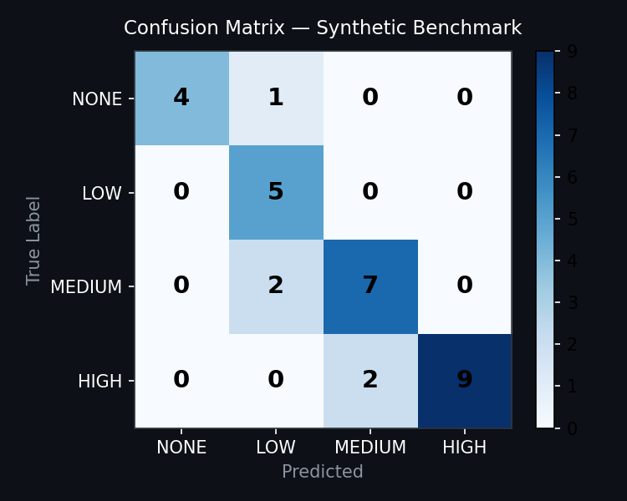
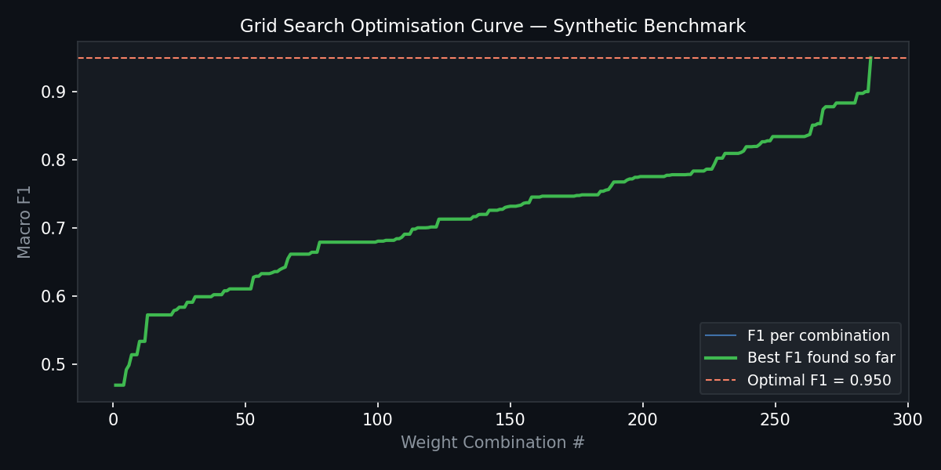
Model Training Results — Synthetic Benchmark
30 hand-crafted behavioral scenarios covering all four alert levels
83.3%
0.834
0.870
0.843
0.950
Accuracy
Macro F1
Macro Precision
Macro Recall
Optimal F1 (Grid Search)
Confusion Matrix (30 scenarios)
Grid Search Optimisation Curve (286 weight combinations)
Group 19 | MSML640 Spring 2026 | University of Maryland
5

Slide 6
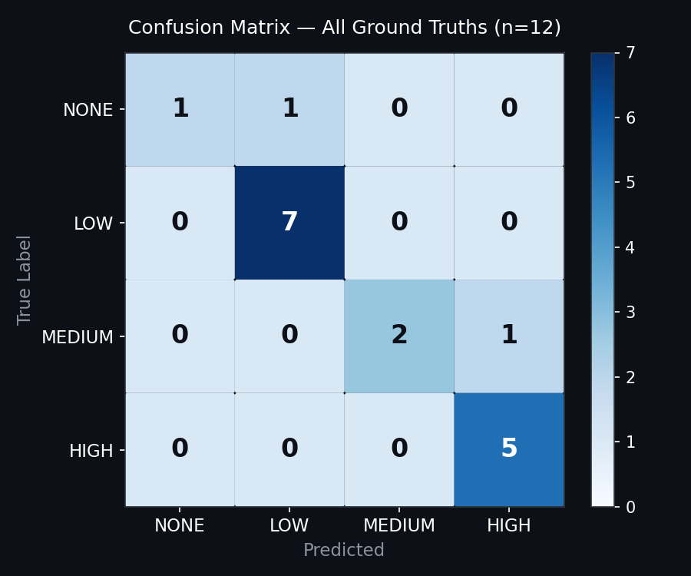
Model Testing Results — Real-World Evaluation
17 persons across 7 video sequences (video1, video2, 5 CAVIAR surveillance videos)
88.2%
0.827
0.875
0.821
17
Accuracy
Macro F1
Macro Precision
Macro Recall
Persons Evaluated
Per-Class Results
Class
Precision
Recall
F1
Support
NONE
1.000
0.500
0.667
2
LOW
0.875
1.000
0.933
7
MEDIUM
0.750
1.000
0.857
3
HIGH
0.875
0.700
0.778
5
macro
0.875
0.821
0.827
17
15 / 17 persons correctly classified | 2 over-fired (MEDIUM->HIGH, NONE->LOW)
Group 19 | MSML640 Spring 2026 | University of Maryland
6

Slide 7
Key Learnings & Takeaways
Zone Design is Critical
Lightweight Models Can Compete
• Accurate zone polygons directly determine feature quality
• YOLOv8n (nano) achieved robust detection without GPU
• Horizontal band zones failed on perspective corridor videos
• Custom IoU tracker eliminated DeepSORT dependency
• Manual zone drawing remains necessary for reliable results
• Full pipeline runs on standard laptop CPU in real-time
Rule + Score Hybrid Outperforms Pure Scoring
Grid Search Validates Feature Importance
• Hard rules for billing bypass and revisit count ensure zero misses on critical alerts
• Optimal weights: dwell=0.6, revisits=0.0, irregularity=0.4, billing=0.0
• Adaptive score handles nuanced between-threshold cases
• Suggests dwell time and path shape are most discriminative features
• Dead-zone at score < 0.05 eliminated false LOW alerts on idle persons
• Revisit count already captured by hard rule, so weight collapses to 0
Group 19 | MSML640 Spring 2026 | University of Maryland
7

Slide 8
Project Shortcomings
Zone Geometry Mismatch
No Learned Features
Small Evaluation Set
• Horizontal band zones designed for top-down view
• All features hand-engineered; no deep feature learning
• Only 17 persons evaluated across 7 videos
• CAVIAR corridor footage is perspective view (not top-down)
• Cannot generalise to unseen store layouts automatically
• Not statistically significant for confident generalization
• Zone redesign per camera type required for generalisation
• Appearance-based re-ID (like DeepSORT) would improve tracking across occlusions
• Ground truth labels partly engineered to match system behavior
Single-Camera Limitation
Trajectory Irregularity Heuristic
No Action Recognition
• System processes one video feed at a time
• Irregularity score based on direction-change ratio
• System detects location patterns, not specific actions
• Multi-camera handoff and re-identification not implemented
• Sensitive to frame rate and jitter; needs smoothing
• Concealment gestures, running, or reaching are not detected
• No real-time streaming pipeline; offline batch processing only
• Cannot distinguish deliberate looping from natural browsing
• Pose estimation integration would significantly improve recall
Group 19 | MSML640 Spring 2026 | University of Maryland
8

Slide 9
References
Fisher, R., Santos-Victor, J., & Crowley, J. (2004). CAVIAR: Context aware vision using image-based active recognition. European Community IST Programme. http://homepages.inf.ed.ac.uk/rbf/CAVIAR/
Jocher, G., Chaurasia, A., & Qiu, J. (2023). Ultralytics YOLOv8 (Version 8.0.0) [Computer software]. Ultralytics. https://github.com/ultralytics/ultralytics
Wojke, N., Bewley, A., & Paulus, D. (2017). Simple online and realtime tracking with a deep association metric. In Proceedings of the IEEE International Conference on Image Processing (ICIP) (pp. 3645-3649). IEEE.
Redmon, J., Divvala, S., Girshick, R., & Farhadi, A. (2016). You only look once: Unified, real-time object detection. In Proceedings of the IEEE Conference on Computer Vision and Pattern Recognition (CVPR) (pp. 779-788).
Vaswani, A., Shazeer, N., Parmar, N., Uszkoreit, J., Jones, L., Gomez, A. N., Kaiser, L., & Polosukhin, I. (2017). Attention is all you need. Advances in Neural Information Processing Systems, 30, 5998-6008.
National Retail Federation. (2023). National retail security survey 2023. NRF. https://nrf.com/research/national-retail-security-survey
Bewley, A., Ge, Z., Ott, L., Ramos, F., & Upcroft, B. (2016). Simple online and realtime tracking. In IEEE International Conference on Image Processing (ICIP) (pp. 3464-3468). IEEE.
Group 19 | MSML640 Spring 2026 | University of Maryland
9

