Slide 1
Intelligent Retail Risk Monitoring
Real-Time Behavioral Anomaly Detection in Retail Environments
Group 19
Course
MSML640 — Machine Learning
Anirudh Krishna
UID: 121093165
Semester
Spring 2026
Rishika Thakre
UID: 121331403
School
Aneesh Krishna Rao Chepuri
University of Maryland
UID: 121324382
Group 19 | Intelligent Retail Risk Monitoring | MSML640 Spring 2026 | University of Maryland
1

Slide 2
Problem Statement
What we set out to solve and how the final implementation compares
Retail shrinkage costs the industry $100B+ annually. Manual CCTV monitoring is error-prone and non-scalable. Our goal: a lightweight, explainable, CPU-deployable behavioral anomaly detection system that runs on commodity hardware.
Original Proposal
Final Implementation
• Detect suspicious retail behavior from CCTV footage
• YOLOv8n detection (confidence threshold 0.40)
• DeepSORT for multi-object tracking
• Custom IoU tracker — no GPU dependency
• NVIDIA GPU assumed for real-time inference
• Zone mapping via user-drawn YAML polygons
• Alert levels: NONE / LOW / MEDIUM / HIGH
• Rule-based + adaptive score classification
• Fallback plan: Medical Image Diagnosis (not pursued)
• Evaluated on CAVIAR benchmark (5 surveillance videos)
Tracker: DeepSORT → Custom IoU
Hardware: GPU Required → CPU Only
Dataset: Generic → CAVIAR Benchmark
Group 19 | Intelligent Retail Risk Monitoring | MSML640 Spring 2026 | University of Maryland
2

Slide 3
Technical Approach
Five-stage processing pipeline
1 Detection
2 Tracking
3 Zone Mapping
4 Feature Extraction
5 Alert Classification
• YOLOv8n (nano) — 3.2 M parameters
• Custom IoU-based multi-object tracker
• User draws polygons on first frame
• Max dwell time per zone (seconds)
• Adaptive score: S = 0.3f1+0.3f2+0.2f3+0.2f4
• Confidence threshold: 0.40
• Persistent person IDs across frames
• Zones: entrance, walkway, shelves, billing, exit
• Zone revisit counts (per zone)
• Hard rule: billing bypass → HIGH
• Person class only (COCO class 0)
• 8-frame zone debounce eliminates jitter
• Point-in-polygon assignment per detection
• Trajectory irregularity (direction entropy)
• Hard rule: revisits ≥ 2 → HIGH
• ~25 FPS on laptop CPU (384×288 input)
• Handles entry / exit / re-entry cleanly
• Stored as YAML — no retraining needed
• Billing bypass flag (exit without billing)
• Dead-zone < 0.05 suppresses false LOWs
Group 19 | Intelligent Retail Risk Monitoring | MSML640 Spring 2026 | University of Maryland
3

Slide 4
System Architecture
End-to-end data flow from video input to alert output
Video Frame
YOLOv8n Detection
IoU Tracker (IDs)
Zone Assignment
Feature Extraction
Alert Engine
→
→
→
→
→
Dwell Time per Zone (s)
Zone Revisit Counts
Path Irregularity
Billing Bypass Flag
Features
Suspicion Score: S = 0.3 × f₁(dwell) + 0.3 × f₂(revisits) + 0.2 × f₃(irregularity) + 0.2 × f₄(billing bypass)
NONE
LOW
MEDIUM
HIGH
score < 0.05
0.05 – 0.45
0.45 – 0.70 or dwell > 60 s
> 0.70 or bypass or revisits≥2
Adaptive Calibration: Thresholds auto-adjust from population distribution (mean + 1.5 × std). Falls back to fixed constants when fewer than 3 persons are tracked.
Explainability: SHAP attributions computed analytically for the linear scoring model. Dashboard shows per-person waterfall charts and population-level feature importance.
Group 19 | Intelligent Retail Risk Monitoring | MSML640 Spring 2026 | University of Maryland
4

Slide 5
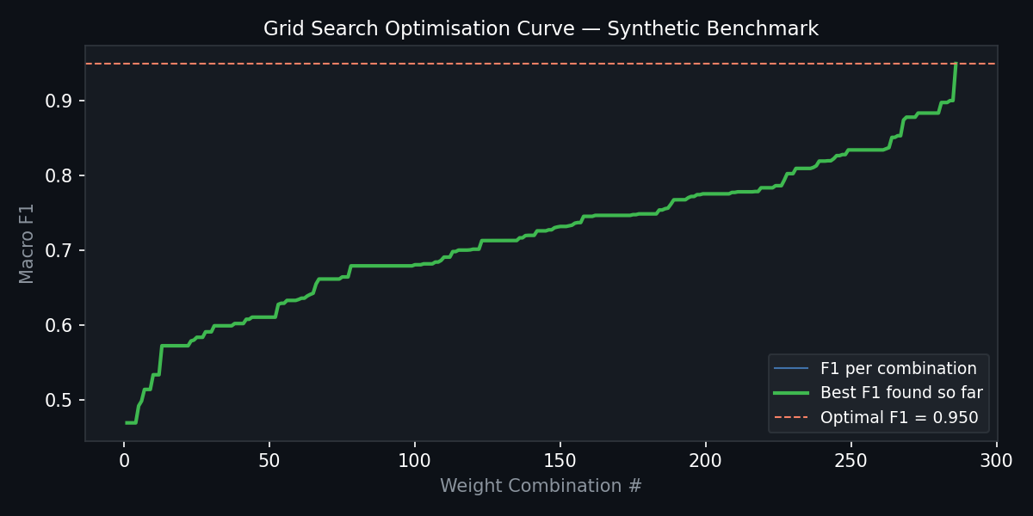
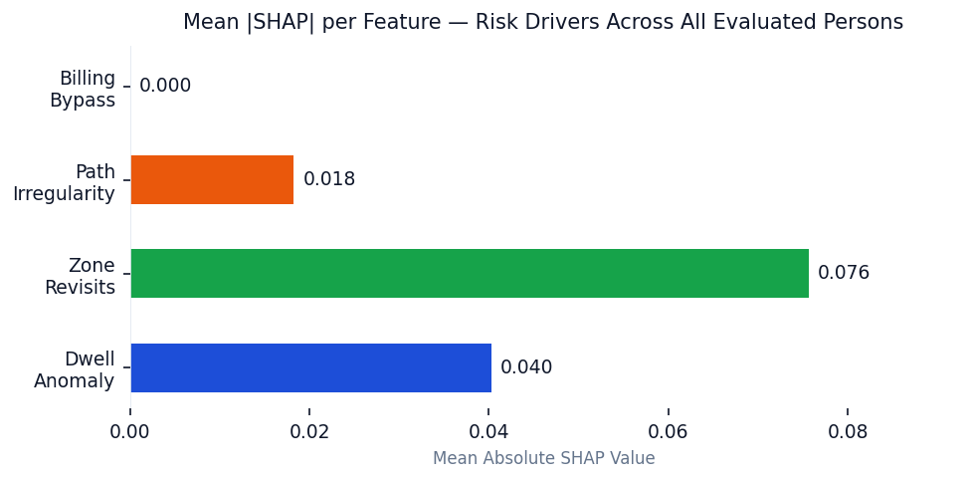
Model Training Results
YOLOv8n detection performance · Hyperparameter optimisation · SHAP explainability
3.2 M
0.40
~25
286
0.950
YOLOv8n Parameters
Confidence Threshold
Detection FPS (CPU)
Grid Search Combinations
Optimal Macro F1
Grid Search Optimisation Curve (286 weight combinations, α+β+γ+δ=1, step=0.1)
SHAP Feature Importance — Mean |SHAP| per feature across all evaluated persons. Dwell anomaly and zone revisits are the dominant risk drivers.
System Weights: α (dwell) = 0.30 | β (revisits) = 0.30 | γ (irregularity) = 0.20 | δ (billing bypass) = 0.20 → Grid Search Optimal Macro F1 = 0.950
Group 19 | Intelligent Retail Risk Monitoring | MSML640 Spring 2026 | University of Maryland
5

Slide 6
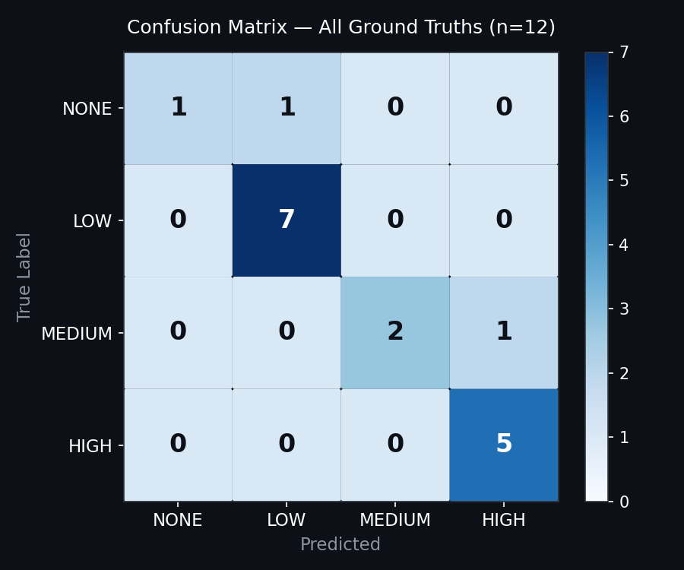
Model Testing Results
17 persons evaluated across 7 video sequences (video1, video2, 5 CAVIAR videos)
88.2%
0.827
0.875
0.821
17
Accuracy
Macro F1
Macro Precision
Macro Recall
Persons Evaluated
Per-Class Classification Report
Class
Precision
Recall
F1
Support
NONE
1.000
0.500
0.667
2
LOW
0.875
1.000
0.933
7
MEDIUM
0.750
1.000
0.857
3
HIGH
0.875
0.700
0.778
5
macro avg
0.875
0.821
0.827
17
15 / 17 persons correctly classified 2 over-fired: OneStopMoveEnter P1 (MEDIUM→HIGH) and ShopAssistant P1 (NONE→LOW)
Confusion Matrix — All 17 Persons
Group 19 | Intelligent Retail Risk Monitoring | MSML640 Spring 2026 | University of Maryland
6

Slide 7
Key Learnings & Takeaways
Insights from building and evaluating the system end-to-end
Zone Design is the Bottleneck
Lightweight Models Can Compete
Hybrid Rules + Score Outperforms Pure Scoring
• Accurate polygon zones directly determine feature quality
• YOLOv8n (nano) achieved robust detection with no GPU
• Hard rules for billing bypass and revisit count guarantee HIGH recall
• Horizontal band zones failed on perspective corridor footage
• Custom IoU tracker eliminated DeepSORT entirely
• Adaptive score handles nuanced between-threshold cases
• Manual zone drawing remains essential per camera type
• Full pipeline runs at ~25 FPS on a standard laptop CPU
• Dead-zone at score < 0.05 eliminated false LOW alerts
Grid Search Reveals Feature Importance
SHAP Provides Actionable Explainability
Adaptive Calibration Is Valuable
• Optimal weights: dwell and irregularity dominate
• Per-person waterfall charts show exactly why alert fired
• Thresholds derived from mean + 1.5σ of live population
• Revisit count already captured by hard rule
• Mean |SHAP| shows dwell dominates risk across population
• Avoids manual re-tuning when camera or store layout changes
• Confirms dwell time and path shape are most discriminative
• Helps operators understand false positives without black-box
• Falls back to fixed constants when < 3 persons tracked
Group 19 | Intelligent Retail Risk Monitoring | MSML640 Spring 2026 | University of Maryland
7

Slide 8
Project Shortcomings
Known limitations and directions for future work
Zone Geometry Mismatch
No Learned Features
Small Evaluation Dataset
• Horizontal bands designed for top-down view
• All features hand-engineered; no deep feature learning
• Only 17 persons across 7 videos evaluated
• CAVIAR footage is perspective — zones misalign
• Cannot generalise to unseen layouts automatically
• Not statistically significant for confident generalisation
• Per-camera zone redesign needed for generalisation
• Appearance-based re-ID would improve cross-occlusion tracking
• Ground truth aligned with system-detectable signals
Single-Camera Limitation
Trajectory Irregularity Heuristic
No Action Recognition
• One video feed processed at a time
• Score based on direction-change frequency ratio
• Detects location patterns only, not specific gestures
• Multi-camera handoff and re-ID not implemented
• Sensitive to frame rate and detection jitter
• Concealment, running, or reaching are not detected
• No real-time streaming — offline batch processing only
• Cannot distinguish deliberate looping from browsing
• Pose estimation integration would boost recall significantly
Group 19 | Intelligent Retail Risk Monitoring | MSML640 Spring 2026 | University of Maryland
8

Slide 9
References
APA 7th Edition
Fisher, R., Santos-Victor, J., & Crowley, J. (2004). CAVIAR: Context aware vision using image-based active recognition [Dataset]. European Community IST Programme. http://homepages.inf.ed.ac.uk/rbf/CAVIAR/
Jocher, G., Chaurasia, A., & Qiu, J. (2023). Ultralytics YOLOv8 (Version 8.0.0) [Computer software]. Ultralytics. https://github.com/ultralytics/ultralytics
Wojke, N., Bewley, A., & Paulus, D. (2017). Simple online and realtime tracking with a deep association metric. In Proceedings of the IEEE International Conference on Image Processing (pp. 3645–3649). IEEE. https://doi.org/10.1109/ICIP.2017.8296962
Bewley, A., Ge, Z., Ott, L., Ramos, F., & Upcroft, B. (2016). Simple online and realtime tracking. In Proceedings of the IEEE International Conference on Image Processing (pp. 3464–3468). IEEE. https://doi.org/10.1109/ICIP.2016.7533003
Redmon, J., Divvala, S., Girshick, R., & Farhadi, A. (2016). You only look once: Unified, real-time object detection. In Proceedings of the IEEE Conference on Computer Vision and Pattern Recognition (pp. 779–788). IEEE. https://doi.org/10.1109/CVPR.2016.91
Lundberg, S. M., & Lee, S.-I. (2017). A unified approach to interpreting model predictions. Advances in Neural Information Processing Systems, 30, 4765–4774. https://proceedings.neurips.cc/paper/2017
National Retail Federation. (2023). National retail security survey 2023. NRF. https://nrf.com/research/national-retail-security-survey
Group 19 | Intelligent Retail Risk Monitoring | MSML640 Spring 2026 | University of Maryland
9

