Slide 1

INDUSTRY 4.0 • CASE STUDY
AI-POWERED
SMART MANUFACTURING
A connected approach to machine reliability, product quality and production planning.
GROUP NUMBER 6
PREDICT
INSPECT
OPTIMIZE
Presented by:
Pranav • Piyush • Prashant • Nishita • Rishika
AI / ML • Industrial IoT • Computer Vision

Slide 2
01 • PROBLEM & PROPOSAL
Three operational problems, one AI-enabled system
Machine breakdowns
Product defects
Poor planning
• Unexpected failures and downtime
• Reactive, costly maintenance
• Manual inspection can miss defects
• Scrap, rework and customer returns
• Idle machines and bottlenecks
• Material, worker and order conflicts
PROPOSED SYSTEM
Sensors + cameras
AI / ML engine
Predictions + actions
Outcome: less downtime • better quality • higher productivity • lower costs
02

Slide 3
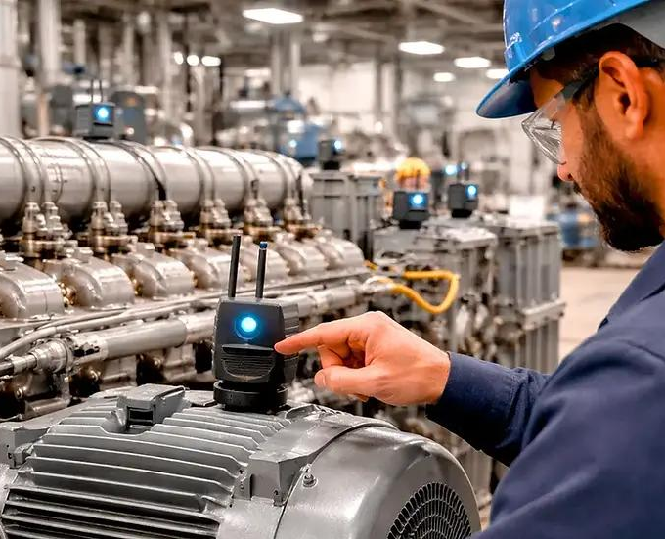
02 • AI SOLUTION
Predictive maintenance: detect failures before they happen
From reactive repair to condition-based maintenance
• Monitor temperature, vibration, pressure, motor current and operating hours.
• Use anomaly detection to identify unusual machine behaviour.
• Alert maintenance teams when failure risk rises.
• Edge AI can support rapid, local decisions.
Example: rising motor vibration triggers a service alert before a likely breakdown.
03

Slide 4
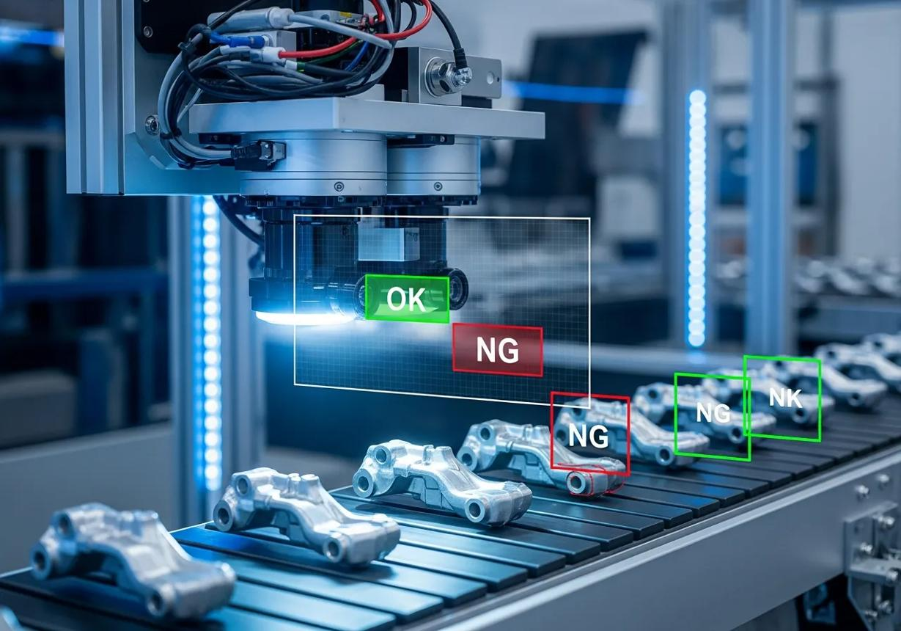
03 • AI SOLUTION
Computer vision: inspect products consistently
AI-assisted visual inspection
• Cameras capture products moving along the line.
• Supervised models learn from labelled good and defective examples.
• CNNs detect scratches, cracks, wrong dimensions, missing parts and assembly errors.
• Flag or reject suspect items; keep human review for uncertain cases.
Expected benefit: fewer defects escape inspection.
04

Slide 5
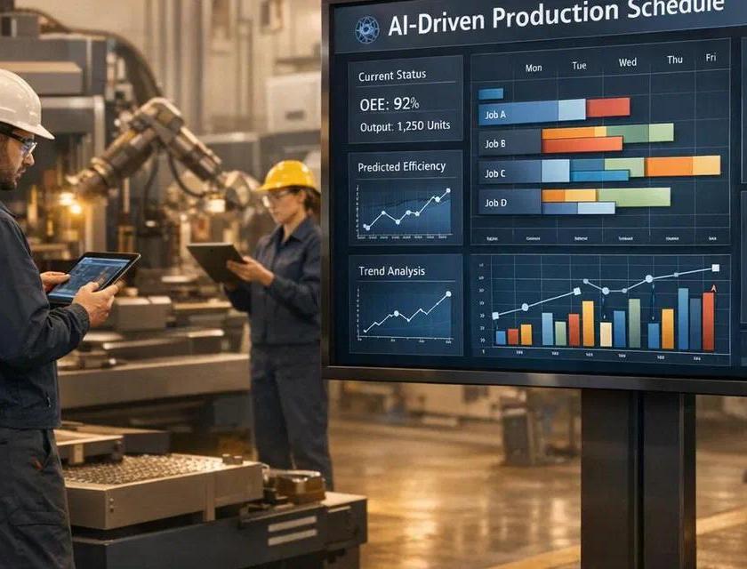
04 • AI SOLUTION
Smart production scheduling: optimize resources
Plan dynamically as conditions change
• Combine customer orders, machine availability, raw materials, workers and capacity.
• Optimize schedules to reduce idle time and bottlenecks.
• Shift jobs when a machine needs maintenance.
• Methods: Hill Climbing, Simulated Annealing, State Space Search and Agentic AI.
Example: move work from Machine A to Machine B during servicing.
05

Slide 6
05 • TECHNOLOGY & EXAMPLES
AI methods and industry benchmarks
Predictive maintenance
Quality inspection
Scheduling
• Unsupervised anomaly detection
• Industrial IoT + Edge AI
• Fuzzy / probabilistic reasoning
• Supervised classification
• Deep learning and CNNs
• Optimization algorithms
• State-space search and Agentic AI
INDUSTRY EXAMPLES REFERENCED IN THE SOURCE DOCUMENT
Tata Steel
Mahindra & Mahindra
Siemens
• Condition-based monitoring / digital twins
• Vision inspection and predictive alerts
• Industry 4.0 integration and digital twins
06

Slide 7
06 • BUSINESS CASE
Measure operational improvement and financial value
Overall Equipment Effectiveness (OEE)
ROI drivers
• Investment: sensors, edge hardware, software integration and staff training.
• Savings: reduced downtime, scrap/rework and emergency spare-parts costs.
• The payback target: 14–22 months.
AVAILABILITY
×
PERFORMANCE
×
QUALITY
OEE = Availability × Performance × Quality
• Source targets: availability >85% from a stated ~65–70% baseline.
• First-pass quality yield target: toward 98%+.
07

Slide 8
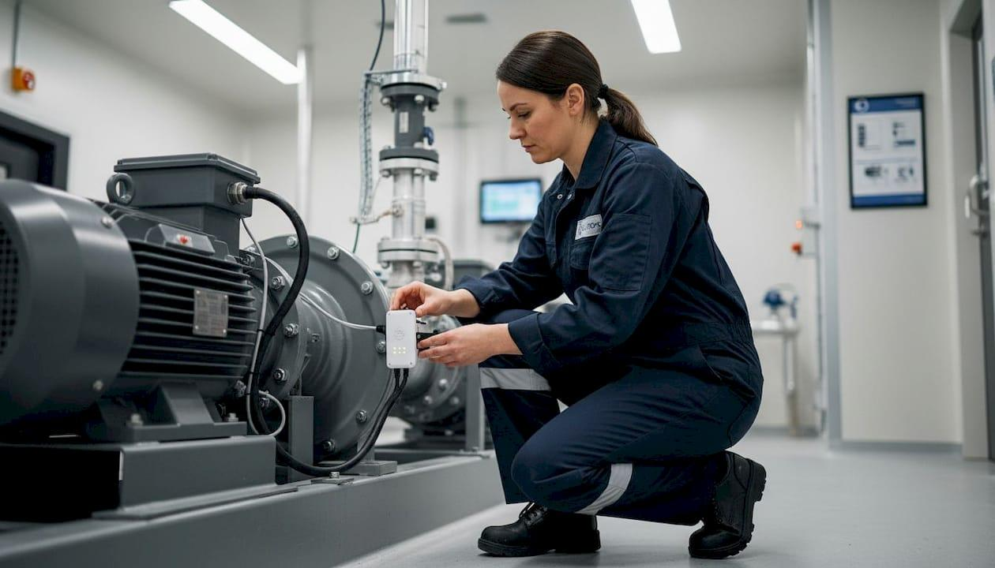
07 • IMPLEMENTATION & CONCLUSION
Deploy responsibly, prove value, then scale
Key implementation risks
• Legacy machines and poor data: retrofit sensors and improve data quality.
• Cybersecurity and AI errors: validate models, restrict access and retain human oversight.
• Employee resistance: start in advisory mode and train teams.
PHASED ROADMAP
1. Assess
2. Pilot
3. Validate
4. Integrate
5. Scale
KEY TAKEAWAY: connect factory data to timely action—predict failures, detect defects and optimize production.
08

