Slide 1
AI ENGINEERING HACKATHON
CampusOps AI: investigate first, then recover
Autonomous incident investigation and recovery, with human approval
THE PROBLEM
OUR APPROACH
One incident floods teams with thousands of signals across logs, metrics, traces, alerts, deploys, configs and tickets
Teams need answers, not another alert: what happened, why, what is impacted, what next
Jumping to one conclusion leads to false fixes
AI agent builds a timeline and several root-cause hypotheses
Weighs supporting and contradicting evidence; every claim is traceable
Recommends recovery; a human approves before any production-impacting action
Verifies recovery and replans if it fails
Evidence
Timeline
Hypotheses
Investigation
Root cause
Recovery plan
Verification
Build AI that can Reason. Plan. Act. Verify. Adapt. Humans stay in control of consequential decisions.
CampusOps AI | AI for Tech: AIOps / SRE / Autonomous IT
Tech Day @ Bannari Amman Institute of Technology | 31 October 2026

Slide 2
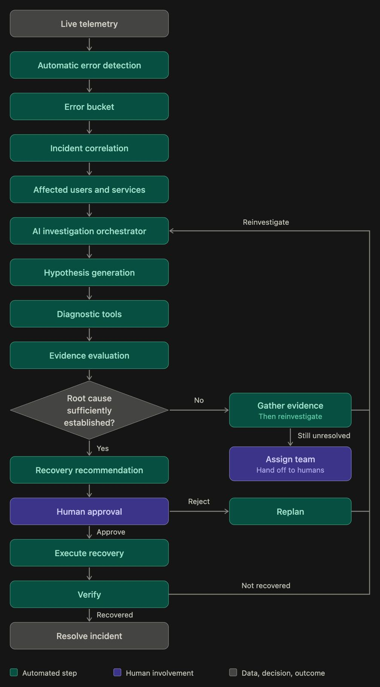
INVESTIGATION FLOW
End-to-end investigation flow
10 EVIDENCE SOURCES FED TO THE AGENT
Application and infrastructure logs
CPU/memory metrics, distributed traces, alerts
Deployment history, configuration changes
Service dependencies, previous incidents, support tickets
THREE LOOPS KEEP THE AI FROM STOPPING EARLY
Root cause not established: gather evidence, reinvestigate
Human rejects the plan: replan
Verification fails: reinvestigate
Hand-off: still unresolved after loops, assign a human team
Tech Day @ Bannari Amman Institute of Technology | 31 October 2026

Slide 3
AI REASONING
How the AI reasons
Confidence comes from an evidence ledger, not model self-report
TIMELINE AND DEPENDENCIES
MULTIPLE HYPOTHESES
EVIDENCE LEDGER
Anchor on incident time, search a window before it
Order by event time; flag skew and late data
Service graph: who depends on whom
3-5 candidates (bad deploy, DB saturation, config change)
Each states what we should see if true
Each item supports or contradicts a hypothesis
Confidence derived from weighted ledger
Every claim cites an evidence ID
INVESTIGATION PLANNING
IMPACT ASSESSMENT
REPLANNING
Agent picks diagnostic tools that discriminate between hypotheses
Tool results update the ledger
Affected services and users via dependency map
Severity feeds recovery priority
New or contradicting evidence re-ranks hypotheses
Failed recovery returns to investigation
CampusOps AI | AI for Tech: AIOps / SRE / Autonomous IT
Tech Day @ Bannari Amman Institute of Technology | 31 October 2026

Slide 4
GUARDRAILS AND STACK
Guardrails and tech stack
Reuse the existing project stack; no new frameworks for a 2-hour prototype
GUARDRAILS
CAMPUSOPS AI STACK
Gemini proposes; backend orchestrator controls tools, permissions and evidence
Read-only diagnostics run autonomously
Production-impacting actions need explicit human approval
Approval tied to the exact action shown; changes void it
Fixed catalog of actions; no free-form commands
No destructive remediation runs automatically
Prototype acts on simulated data; audit trail in PostgreSQL
Frontend: Next.js, React, TypeScript, Tailwind v4
Charts/graph: Recharts + React Flow (confirm installed)
Backend: Python, FastAPI, Pydantic
Data: PostgreSQL 15, pgvector, SQLAlchemy + Alembic
AI: Google Gemini API
Agent: custom Python state machine (plan, tool call, observe, replan)
Auth: JWT + Next.js BFF, HttpOnly cookies
Telemetry: deterministic simulated JSON fixtures
Docker Compose; Pytest
CampusOps AI | AI for Tech: AIOps / SRE / Autonomous IT
Tech Day @ Bannari Amman Institute of Technology | 31 October 2026

Slide 5
IMPACT
Impact: from alert overload to evidence-backed action
Expected benefits to be measured on simulated incidents, not yet results
Area | Today (manual) | With CampusOps AI
Evidence gathering | Engineers hop between logs, metrics, traces, deploys and tickets | Agent correlates all 10 sources around the incident time automatically
Root cause | First plausible theory wins; contradicting signals get missed | Several hypotheses ranked on supporting and contradicting evidence
Recovery | Fixes applied under pressure, sometimes without checking the result | Human-approved action, then automatic verification and replanning
Knowledge | Lessons live in people's heads and old tickets | Every claim traceable; similar past incidents retrieved for reuse
Who benefits: on-call engineers (less toil, faster diagnosis), operations leads (fewer wrong fixes, audit trail) and end users (shorter outages).
CampusOps AI | AI for Tech: AIOps / SRE / Autonomous IT
Tech Day @ Bannari Amman Institute of Technology | 31 October 2026

