Slide 1
DETECTING DROWSINESS IN DRIVERS
M. Rishi Kesava Reddy
21stuchh010234

Slide 2
TABLE OF CONTENTS
01
03
02
04
Different Approaches to Detecting Drowsiness
Driver Drowsiness Detection System
Project Requirements
Steps for Performing Driver Drowsiness System

Slide 3
DIFFERENT APPROACHES TO DETECTING DROWSINESS
There are several methods for detecting the driver's tiredness. They can be divided into three primary categories:
TECHNIQUES BASED ON BEHAVIORAL PARAMETERS:
This category includes determining the driver's weariness without the use of non-invasive devices. Analyzing the driver's behavior by looking at his or her eye closure ratio, blink frequency, yawning, head position, and facial expressions. The current parameter in this system is the driver's eye-closure ratio.

Slide 4
TECHNIQUES BASED ON VEHICULAR PARAMETERS:
This topic includes determining the driver's fatigue level through vehicle driving behaviors. Lane change patterns, steering wheel angle, steering wheel grip force, vehicle speed variations, and many more characteristics are among them.
TECHNIQUES BASED ON PHYSIOLOGICAL ELEMENTS:
This topic includes determining a driver's tiredness based on his or her physical condition. Respiration rate, heart rate, body temperature, and a variety of other parameters are examples of such variables.

Slide 5
TECHNOLOGY USED
PYTHON :
Python is a high-level, interpreted programming language that may be used for a variety of tasks. Python's design philosophy prioritizes code readability, as evidenced by its extensive use of whitespace
LIBRARIES USED :
Pygame.mixer
NumPy
Dlib
SciPy
OpenCV

Slide 6
PROJECT REQUIREMENTS:
PYTHON:
Python is a general-purpose programming language with a high level of abstraction.
OPENCV- Face and Eye Detection :
OpenCV is a large open-source library for computer vision, machine learning, and image processing, and it currently plays a critical part in real-time operations, which are critical in today's systems.
DLIB:
Dlib for Python is a high-level machine learning and computer vision library.
SCIPY:
Python modules for optimization, linear algebra, integration, interpolation, signal processing, and many more scientific and engineering applications are available in SciPy, a complete scientific computing library.

Slide 7
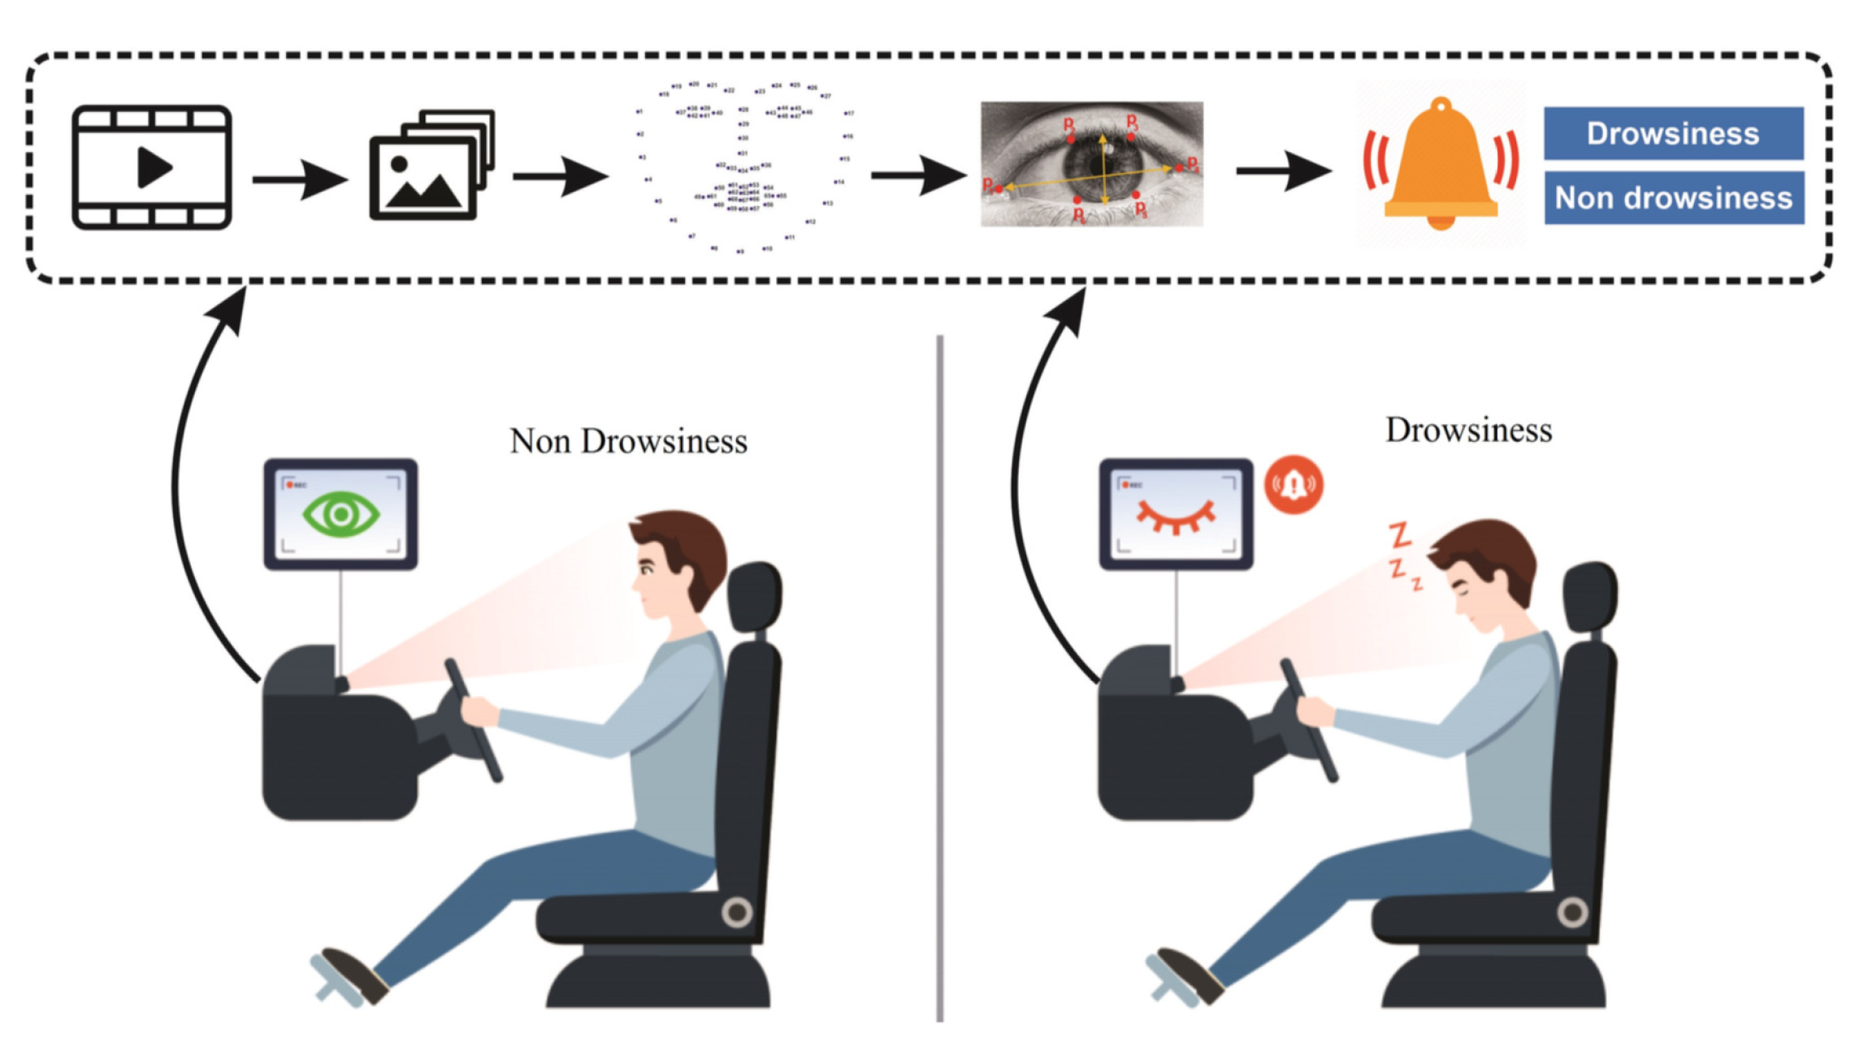
NUMPY NumPy is a fundamental package for numerical computing in Python, providing support for multi-dimensional arrays and matrices, along with a collection of mathematical functions to operate on these arrays.
.

Slide 8
DRIVER DROWSINESS DETECTION SYSTEM
DATA SET :
The dataset used in this model is taken from Kaggle. The dataset was created by writing a script that captures eyes from a camera and saving them to our local disc.
STEPS FOR PERFORMING DRIVER DROWSINESS DETECTION
Take An Image from A Camera as Input. We will use a webcam to capture images as input. So, in order to access the webcam, we created an infinite loop that will capture each frame.
2. Create A Region of Interest Based on The Detection of a face in an image . The OpenCV algorithm for object detection only accepts grayscale images as input To detect the objects, we don’t the need color information.

Slide 9
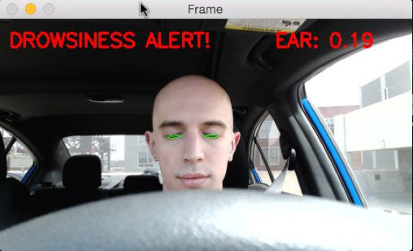
3. Detects The Eyes and Mouth from The ROI and Feeds to the Classifier. We must now extract only the eye’s data from the entire image. This can be accomplished by first extracting the eye’s boundary box and then using this code to extract the eye image from the frame.
4. The Classifier Will Determine Whether the Eyes Are Open or Closed. We normalize our data to improve convergence. To feed into our classifier, increase the dimensions. We load our model. Now we use our model to predict each eye and determine if they are closed or open.

Slide 10
5. Calculate A Score to Determine Whether a Person Is Drowsy. The score is essentially a value that will be used to determine how long the individual has closed his eyes. So, if both eyes are closed, we will continue to increase the score, whereas if both eyes are open, we will decrease the score. We display the result on the screen, which displays the person’s current status in real time. A threshold is defined, for example, if the score exceeds 15, it indicates that the person eyes have been closed for an extended period of time. This is when we use sound to beep the alarm.

Slide 11
CONCLUSION
Using dlib for driver sleepiness detection provides a reliable and efficient solution. Accurate and real-time monitoring of driver fatigue levels is made possible by combining its facial landmark detection skills with machine learning techniques. This technology not only improves road safety, but it also lays the path for the development of more sophisticated driver assistance systems. However, more research and improvement are required to overcome issues such as shifting lighting conditions and different face expressions, ensuring the systems' reliability and effectiveness in real-world circumstances.

Slide 12

THANK YOU

