Slide 1
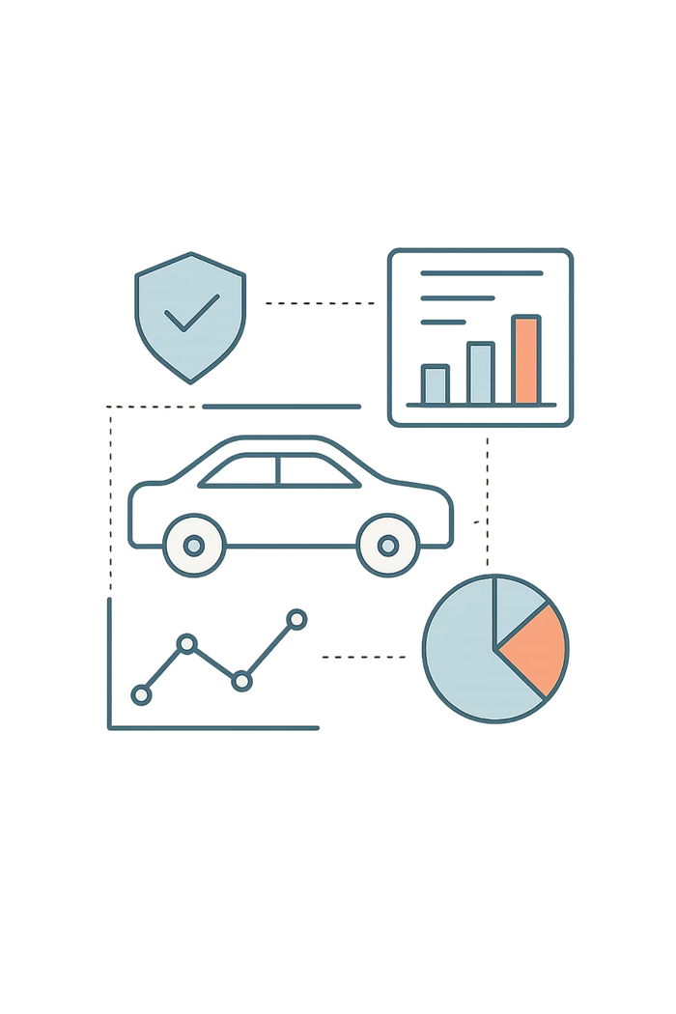

Automobile Insurance Analysis Report
Complaint & Premium Analysis using Power BI, Tableau & Python
NEW YORK STATE INSURANCE DATA
Notes:
1

Slide 2










Project Objective
Complaint Patterns
Trend Analysis
Premium Impact
Analyze complaint patterns across insurance companies
Study complaint trends over time
Evaluate premium growth and its impact
Company Comparison
Actionable Insights
Compare performance of top 5 companies
Provide actionable business insights
Notes:
2

Slide 3
Dataset & Data Preparation
Key Fields
Data Pipeline
Company Name & Filing Year
Complaint Ratio & Total Complaints
Upheld, Not Upheld & Question of Fact Complaints
Premiums Written
01
Extracted from MySQL database
02
Processed using Python (Pandas)
03
Cleaned & converted to structured format
04
Imported into Power BI and Tableau
Notes:
3

Slide 4
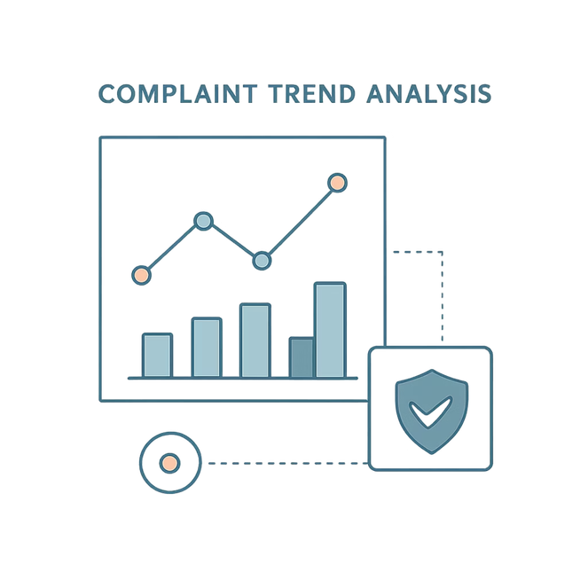
Complaint Diagnostic Analysis
Complaint Types Over Years
Not Upheld complaints dominate every year
Upheld complaints are very low → indicates good service
Complaint volume peaked around 2014
Total Complaints Trend
Complaints increased initially (2009–2011)
Peak observed in 2014
Decline after 2014 → improvement in operations
Notes:
4

Slide 5

Complaint Ratio Trend
Key Observations
Early Years (2009–2010)
After 2011
2015–2016
Significant drop in complaint ratio
Near-zero ratio → excellent performance
Highest complaint ratio observed
Notes:
5

Slide 6

Premium Analysis
Premium Trend (2009–2016)
Continuous growth in premiums from 2009 to 2016
Indicates business expansion and increased customer base
Premium vs. Complaints
Premiums increased steadily
Complaints fluctuated but stabilized
Growth did not negatively impact service quality
Notes:
6

Slide 7
Selected Company: Progressive Specialty Insurance
32
$130M
~2%
Avg Complaints/Year
Avg Premium
Avg Complaint Ratio
Moderate volume relative to business size
Strong revenue performance
Stable, low ratio over time
Progressive maintains stable performance with moderate complaints relative to its business size.
Notes:
7

Slide 8
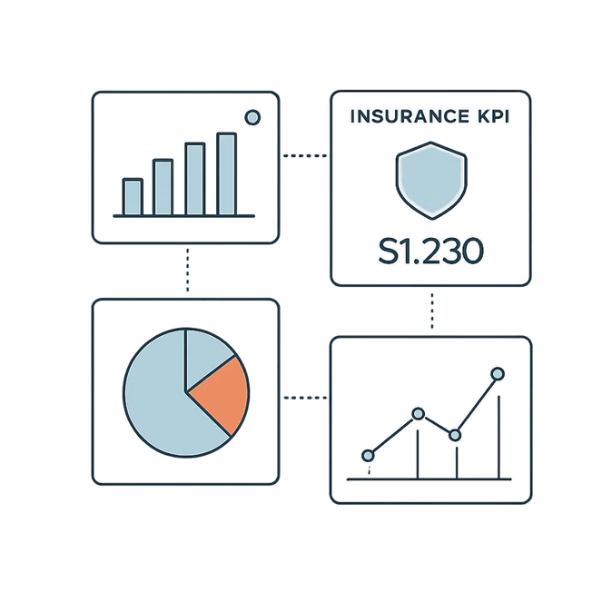
Power BI Dashboard Highlights
KPI Cards
Visuals include complaint distribution, complaint trends, premium trends, and premium vs. complaints. Majority of complaints are not upheld, complaint ratio remains low, and premium growth is consistent.
36K
87.43K
1.9%
Vigilant Insurance
Total Complaints
Total Premium
Avg Complaint Ratio
Best Company
Notes:
8

Slide 9
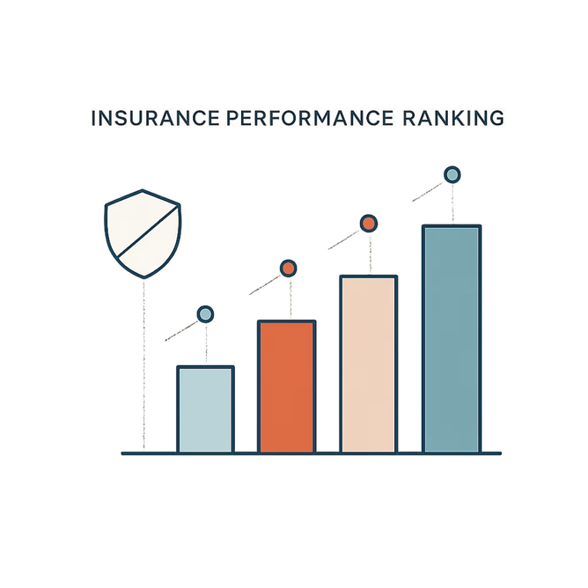

Company Comparison (Tableau)
Top 5 by Complaint Volume
High volume driven by large customer base:
Allstate Insurance
GEICO
State Farm
Country-Wide Insurance
Top 3 by Lowest Complaint Ratio
Zurich American
Greater New York
OneBeacon
Companies with low complaint ratio demonstrate better service. Higher premiums do not always mean more complaints.
Notes:
9

Slide 10
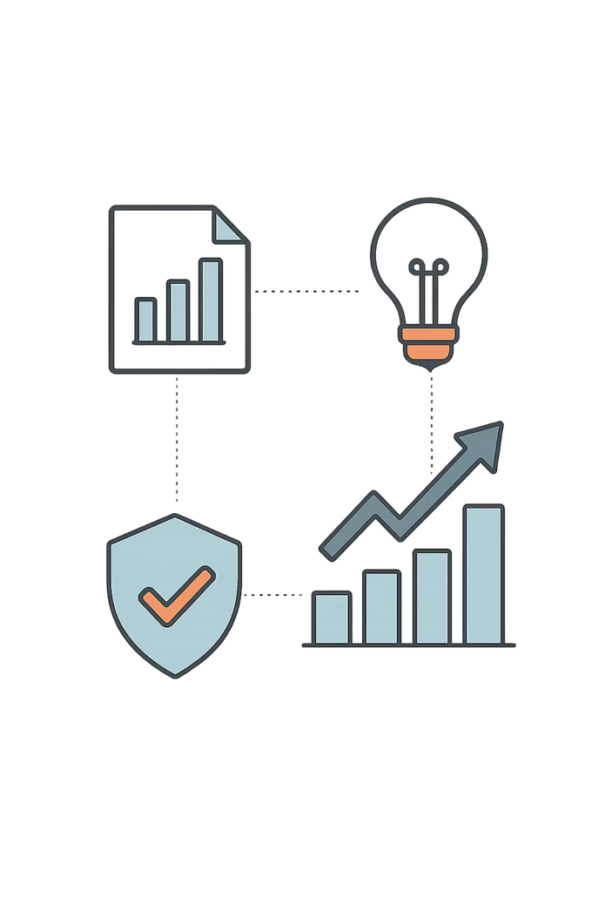
Key Insights & Recommendations
Key Insights
Most complaints are not upheld → customer misunderstanding or false claims
Complaint ratio is generally low across companies
Premium growth shows strong insurance market performance
Companies with low complaint ratio provide better service
Recommendations
Improve customer awareness about policy terms
Enhance claim transparency
Monitor complaint ratio regularly
Use dashboards for performance tracking
Insurance companies are able to scale their business (increase premiums) while maintaining low complaint ratios, indicating strong operational efficiency and customer service quality.
Notes:
10

