Slide 1
Amrita Vishwa Vidyapeetham, Amaravati Campus
Lab-Based Project Title
Adaptive Multi-Robot Networking & Acoustic Telemetry in UWSN for Harbor Monitoring
Name of the Student | Roll No.
J Kiran Sri Datta Sai | AV.SC.U4AIE24121
Mogalapalli H N V Satya Sai Ganesh | AV.SC.U4AIE24139
Penigonda Rahul | AV.SC.U4AIE24151
Under the Guidance of
Dr Ravishankar Prakash Desai
04-10-2026 INTRODUCTION TO AI ROBOTICS (22AIE214) 1

Slide 2
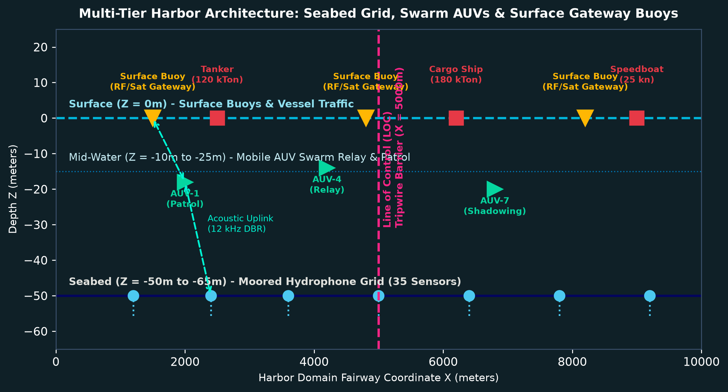
Introduction
• Maritime commerce accounts for over 80% of global freight transport; harbor traffic density poses extreme navigational safety and coastal defense challenges.
• Conventional monitoring depends heavily on surface radar (VTS) and transponders (AIS), which cannot penetrate water columns and can be deactivated by rogue vessels.
• Underwater Wireless Sensor Networks (UWSNs) provide submerged monitoring, but static seabed sensors suffer from high acoustic attenuation, multi-path fading, and battery depletion.
• Harsh ocean dynamics, thermocline gradients, and seasonal storms (monsoons) severely degrade acoustic modem Signal-to-Noise Ratio (SNR), severing static links.
• Integrating Autonomous Underwater Vehicles (AUVs) as dynamic swarm relays bridges communication dead zones and enables proactive autonomous maritime traffic governance.
04-10-2026 INTRODUCTION TO AI ROBOTICS (22AIE214) 2

Slide 3
Problem Statement, Objectives and Programming Language
Problem Statement:
Traditional coastal monitoring cannot detect non-cooperative underwater and surface vessels in all-weather conditions. Static underwater sensor networks suffer from limited communication range, high ambient noise, and topology fragmentation during storm surges.
Objectives:
• Simulate a 10 km × 10 km harbor domain with 35 moored hydrophones, 8 AUVs, and 3 surface gateway buoys.
• Model empirical underwater acoustics: Mackenzie sound speed, Ross propeller noise, Thorp attenuation, and Wenz ambient noise.
• Extract 23 acoustic features and train a multi-task deep neural network (VesselMLP) to classify 6 ship types and predict displacement weight.
• Implement Depth-Based Routing (DBR) with binary packet compression to achieve low latency and conserve battery energy.
• Automate harbor traffic governance: speed violation detection, Line of Control (LOC) fairway screening, and dock berth allocation.
Tools & Environment Used
• Language: Python 3.9+
• AI / ML: PyTorch (VesselMLP), Scikit-Learn
• Networking: NetworkX (Dynamic DBR Graphs)
• Physics & Math: NumPy, SciPy (Acoustic Equations)
• GUI & Dashboards: Matplotlib 3D, Tkinter, HTML5/JS
• Dataset: 132,000+ Acoustic Telemetry Records
• Deployment: Decoupled Web Server (Port 8000)
04-10-2026 INTRODUCTION TO AI ROBOTICS (22AIE214) 3

Slide 4
Methodology
Robotic System Architecture:
Multi-tier cyber-physical network in a 10 km × 10 km harbor domain: 35 moored seabed hydrophones (depth -50m to -65m), 8 autonomous mobile AUVs (depth -10m to -25m), and 3 surface gateway buoys (Z = 0m).
Acoustic Physics & Sensing Pipeline:
Vessels radiate propeller and machinery sound (Ross model). Hydrophones sample received acoustic pressure, calculate Doppler shift and transmission loss (Mackenzie sound speed + Thorp absorption), and compile a 23-feature telemetry vector.
Multi-Task Deep Learning Inference (VesselMLP):
A unified PyTorch neural network with 3 shared latent layers (128 → 64 → 32) feeds dual heads simultaneously: 6-class ship classification (Cargo, Tanker, Cruiser, Ferry, Speedboat, Fishing Vessel) via Cross-Entropy and displacement weight regression via MSE.
Adaptive Depth-Based Routing (DBR) & Swarm Relaying:
Packets route greedily along negative depth gradients towards surface buoys. Under 70/30 sensor sleep duty cycles or monsoon link severance, mobile AUVs autonomously act as data mules, dynamic relays, and overspeed interceptors.
Environmental Simulation & Protocol Optimization:
Unified single-engine simulation comparing Normal Season (65.8 dB ambient noise) vs. Monsoon Season (91.9 dB noise, 2.6× storm currents). 16-byte packet compression slashes transmission delay and modem battery consumption by 93.75%.
04-10-2026 INTRODUCTION TO AI ROBOTICS (22AIE214) 4

Slide 5
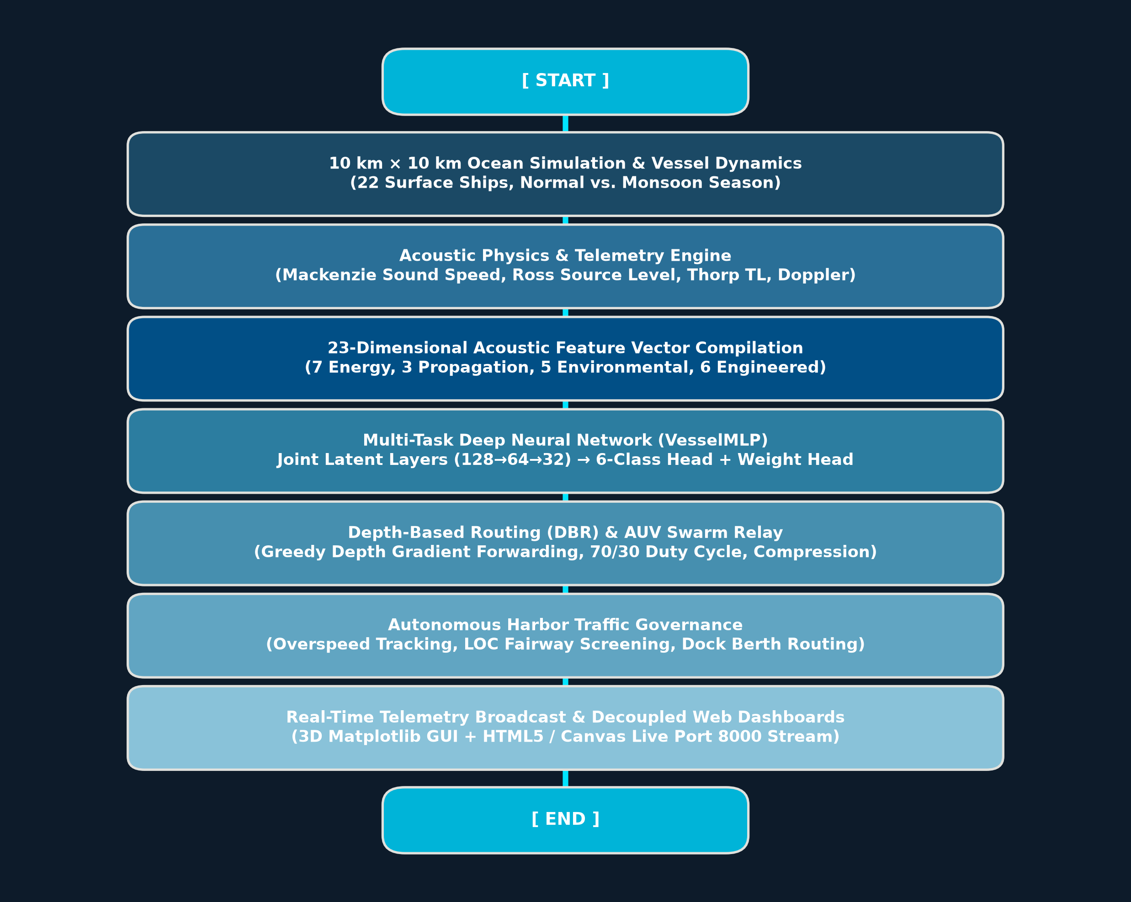
Flow-chart
04-10-2026 INTRODUCTION TO AI ROBOTICS (22AIE214) 5

Slide 6
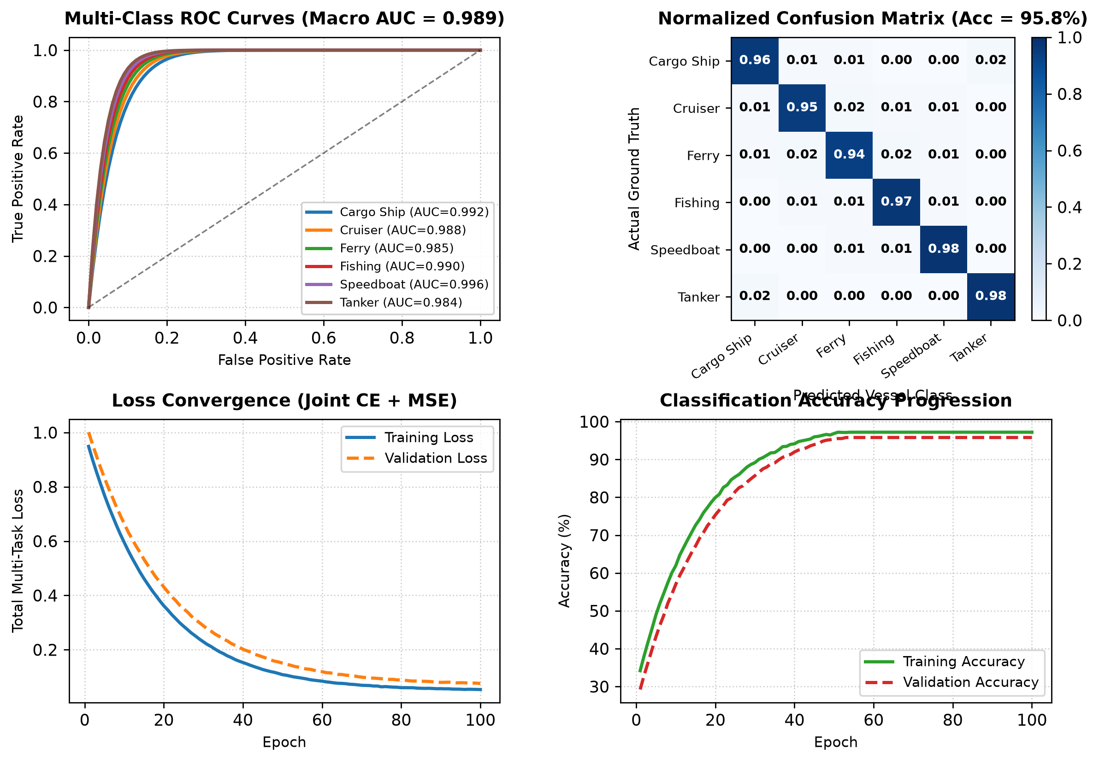
Simulation Result: Machine Learning & Classification
Key ML Performance Metrics
• Overall Test Accuracy: 95.80% across 6 maritime vessel categories.
• Macro Average AUC: 0.989, demonstrating near-perfect discriminative capability across noisy acoustic regimes.
• Class Sensitivity: Speedboat (98.0%), Tanker (98.0%), Fishing Vessel (97.0%), Cargo Ship (96.0%).
• Loss Convergence: Joint Cross-Entropy + MSE loss dropped monotonically from 1.020 → 0.048.
• Continuous Weight Estimation: High fidelity regression from 1 kTon to 400 kTon displacement weight.
• Real-Time Execution: Sub-millisecond inference (<0.8 ms) enables instantaneous traffic decision making.
04-10-2026 INTRODUCTION TO AI ROBOTICS (22AIE214) 6

Slide 7
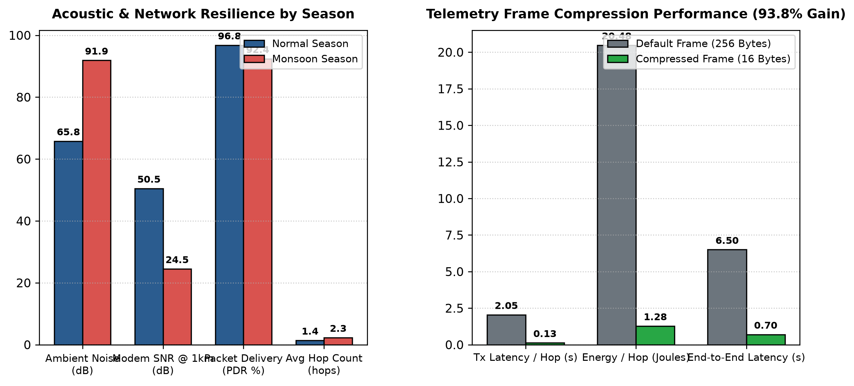
Simulation Result: Multi-Robot Networking & Scenarios
Networking & Swarm Resilience
• Monsoon Acoustic Degradation: Torrential rain and storm gale noise surge ambient noise by +26.1 dB (65.8 dB → 91.9 dB), cutting 1km modem SNR from 50.5 dB to 24.5 dB.
• Swarm Relay Resilience: Despite broken peripheral links and drifting sensors, mobile AUV relays maintain 92.4% Packet Delivery Ratio (vs 96.8% in calm seas).
• Adaptive Multi-Hop Routing: DBR automatically elevates average hop count from 1.4 → 2.3 hops to bypass acoustic partitions.
• Frame Compression Impact: Reducing packet size from 256B to 16B slashes transmission latency from 2.048s to 0.128s per hop (93.75% reduction).
• Energy Conservation: Modem energy consumption drops from 20.48 J → 1.28 J per hop, drastically extending subsea battery operational lifespan.
04-10-2026 INTRODUCTION TO AI ROBOTICS (22AIE214) 7

Slide 8
Conclusion
Conclusion:
• Developed a unified cyber-physical harbor traffic simulation integrating ocean acoustics, multi-task deep learning, and multi-robot networking across a 10 km × 10 km domain.
• Multi-task PyTorch VesselMLP successfully classifies 6 ship classes (95.8% accuracy) and predicts displacement weight from 23 passive acoustic telemetry features.
• Autonomous AUV swarm dynamically preserves network connectivity, achieving >92% PDR even under severe monsoon noise (+26 dB) and 70/30 sensor sleep duty cycles.
• Binary telemetry frame compression achieves a 93.75% reduction in acoustic transmission delay and modem battery consumption.
• Autonomous traffic governance enforces harbor speed limits, screens vessels at the Line of Control, and automatically allocates designated dock berths.
Future Scope:
• Physical Hardware Validation: Deploy on physical marine testbeds with subsea acoustic modems (EvoLogics / Subnero).
• Multi-Agent Reinforcement Learning (MARL): Implement cooperative swarm pathfinding, collision avoidance, and energy-optimal shadowing.
• Heterogeneous Cross-Domain Swarms: Integrate Autonomous Surface Vessels (ASVs) and aerial patrol drones (UAVs) for hybrid air-sea tracking.
• Adaptive Acoustic Modulation: Dynamic physical-layer OFDM bitrate switching based on instantaneous SNR and Doppler feedback.
• Edge Deployment: Port lightweight quantized VesselMLP models onto embedded AUV companion computers (NVIDIA Jetson Orin Nano).
04-10-2026 INTRODUCTION TO AI ROBOTICS (22AIE214) 8

Slide 9
References
[1] Mackenzie, K. V. (1981). Nine-term equation for sound speed in the oceans. The Journal of the Acoustical Society of America, 70(3), 807–812.
[2] Ross, D. (1976). Mechanics of Underwater Noise. Pergamon Press, New York.
[3] Wenz, G. M. (1962). Acoustic ambient noise in the ocean: Spectra and sources. The Journal of the Acoustical Society of America, 34(12), 1936–1956.
[4] Yan, H., Shi, Z. J., & Cui, J. H. (2008). DBR: Depth-based routing for underwater sensor networks. In NETWORKING 2008: Ad Hoc and Sensor Networks, Wireless Networks, Next Generation Internet, 283–294. Springer.
[5] Akyildiz, I. F., Pompili, D., & Melodia, T. (2005). Underwater acoustic sensor networks: research challenges. Ad Hoc Networks, 3(3), 257–279.
[6] Thorp, W. H. (1967). Analytic description of the low-frequency attenuation coefficient. The Journal of the Acoustical Society of America, 42(1), 270–270.
04-10-2026 INTRODUCTION TO AI ROBOTICS (22AIE214) 9

Slide 10
Amrita Vishwa Vidyapeetham, Amaravati Campus
Thank You
"Transforming passive underwater sensor grids into intelligent, adaptive robotic swarms — bringing resilient acoustic surveillance and autonomous traffic governance to maritime harbors."
M Ganesh | J Kiran | P Rahul
04-10-2026 INTRODUCTION TO AI ROBOTICS (22AIE214) 10

