Slide 1
Ploutos+
Interpretable Stock Movement Prediction with
Financial Large Language Models
Adaptive Expert Routing • Multimodal Evidence • Market-Regime Robustness
Rishikesh (24BDS030) • Vineel (24BDS010) • Arjun (24BDS039)
B.Tech DSA • Indian Institute of Information Technology, Dharwad
Course: LLM Applications in Finance | October 2026

Slide 2
PRESENTATION OUTLINE
01
Problem Statement & Motivation
02
Research Background & Related Work
03
System Architecture & Methodology
04
Dataset: StockNet Benchmark
05
Data Pipeline & Feature Engineering
06
Baseline Models & Results
07
PloutosGen Expert System
08
LLM Fine-Tuning (LoRA)
09
Training Results & Convergence
10
Live Inference Demo
11
Future Work: Phases 8–12
12
Summary & Contributions

Slide 3
PROBLEM STATEMENT & MOTIVATION
The Challenge
▸ Stock markets are inherently noisy, non-stationary, and influenced by heterogeneous signals
▸ Traditional models use single-signal approaches (only price OR only sentiment)
▸ Existing LLM approaches lack interpretability — predictions without reasoning
▸ No principled mechanism to dynamically weight experts by market regime
Our Approach: Ploutos+
▸ Multi-expert evidence integration (Technical + Sentiment + Fundamental)
▸ LLM-powered interpretable predictions with grounded rationales
▸ Adaptive expert routing conditioned on market regime
▸ Rigorous zero-leakage evaluation on StockNet benchmark
Core Research Question
"Can a financial LLM, guided by structured multi-expert evidence and adaptive expert routing,
produce interpretable, regime-robust stock movement predictions that surpass naive baselines?"

Slide 4
RESEARCH BACKGROUND
Foundation: Ploutos (Tong et al.)
Our Extension: Ploutos+
▸ Generates multi-expert financial evidence as structured prompts
▸ Uses LLMs for stock movement prediction with rationale generation
▸ Demonstrated on Chinese A-shares market
▸ Adaptive Expert Router — dynamic context-gated weighting
▸ Market-regime robustness analysis (Bull/Bear/Sideways)
▸ StockNet benchmark for reproducible English-market evaluation
Key Technologies
▸ Qwen2.5-1.5B-Instruct
Alibaba's instruction-tuned LLM — compact yet capable
▸ LoRA (Low-Rank Adaptation)
Parameter-efficient fine-tuning; only ~0.5% params trained
▸ PEFT + HuggingFace
Production-grade fine-tuning infrastructure
▸ StockNet Dataset
87 S&P 500 stocks, 2014–2015, prices + Twitter data

Slide 5
SYSTEM ARCHITECTURE
StockNet
Data
→
Label &
Split
→
Feature
Engineering
→
Expert
Evidence
→
Prompt
Builder
→
LLM
Fine-Tuning
→
Prediction +
Rationale
Technical Expert
Sentiment Expert
Human Expert (Proxy)
RSI-14, MACD, Bollinger Bands,
5-day Momentum, Volatility
Twitter/social NLP sentiment,
Daily tweet aggregation (10-cap)
Sector classification, market-cap
strata, index membership

Slide 6
DATASET: STOCKNET BENCHMARK
87
26,623
2014–2015
44.66%
S&P 500
Stocks
Labeled
Samples
Time
Period
Tweet
Coverage
Strict Chronological Temporal Splits (Zero Leakage)
TRAIN
2014-01-02 → 2015-07-31
20,348 samples
VALIDATION
2015-08-03 → 2015-09-30
2,555 samples
TEST
2015-10-01 → 2015-12-31
3,720 samples
Labeling: DOWN (≤ -0.50%) | Excluded (-0.50%, +0.55%] | UP (> +0.55%)

Slide 7
DATA PIPELINE & FEATURE ENGINEERING
Phase 2: Data Acquisition
Phase 3: Label & Split
Phase 4: Text Processing
▸ Downloaded StockNet price + tweet archives
▸ Verified 87 stocks across 9 GICS sectors
▸ Generated data manifest with integrity checksums
▸ Constructed movement-threshold labels (UP/DOWN)
▸ Strict chronological train/val/test splits
▸ Zero data leakage verified via automated tests
▸ Aligned tweets to stock-day observations
▸ Applied 10-tweet daily cap per stock
▸ 45.14% tweet coverage (12,018 stock-days)
Technical Indicators Extracted
▸ RSI (14-period)
▸ MACD & Signal Line
▸ Bollinger Bands (Width & %B)
▸ 5-Day Momentum
▸ 20-Day Volatility
▸ 5-Day SMA
▸ Volume Ratio (5d/20d)
▸ Daily Returns
▸ Log Returns

Slide 8
BASELINE MODELS & RESULTS
Majority Class Baseline
Random Forest Baseline
▸ Predicts the most frequent class (UP) for all samples
▸ Test Accuracy: 51.29%
▸ Macro F1: 33.90%
▸ MCC: 0.000 (no discriminative power)
▸ Status: Trivial lower bound established
▸ 100 estimators, max_depth=8, lagged technical features
▸ Test Accuracy: 52.53%
▸ Macro F1: 52.09%
▸ MCC: 0.0469 (marginal above random)
▸ Status: Meaningful but weak — confirms task difficulty
Baseline Comparison (Test Set — 3,720 samples)
Model
Accuracy
Macro F1
MCC
Tests Passed
Majority Class
51.29%
33.90%
0.000
—
Random Forest
52.53%
52.09%
0.047
21/21 ✓

Slide 9
PLOUTOSGEN: EXPERT EVIDENCE SYSTEM
Technical Expert
Sentiment Expert
Human Expert (Proxy)
▸ Computes RSI, MACD, Bollinger, Momentum
▸ Generates signal: BULLISH / BEARISH / NEUTRAL
▸ Outputs confidence score [0–1]
▸ Provides human-readable evidence summary
▸ Aggregates daily Twitter sentiment
▸ 10-tweet cap per stock-day
▸ Classifies: BULLISH / BEARISH / NEUTRAL
▸ Handles zero-tweet days gracefully
▸ Encodes GICS sector classification
▸ Provides market-cap strata context
▸ Summarizes index membership info
▸ Static fundamental background data
Prompt Generation Output
26,623
3 Experts
JSONL
17/17
Total Prompts
Generated
Per Sample
Evidence
Storage
Format
Pytest Tests
Passed

Slide 10
LLM FINE-TUNING: LoRA ON QWEN2.5-1.5B
Model & LoRA Configuration
Training Configuration
Base Model
Qwen/Qwen2.5-1.5B-Instruct
Hardware
NVIDIA RTX 4050 (6 GB VRAM)
Parameters
1.5 Billion (base)
Epochs
2
LoRA Rank (r)
16
Batch Size
2 (effective 8 with grad accum)
LoRA Alpha (α)
32
Gradient Accum Steps
4
Target Modules
q_proj, k_proj, v_proj, o_proj
Learning Rate
2 × 10⁻⁴
Trainable Params
~0.5% of total
Training Samples
500 (stratified)
Precision
FP16 Mixed Precision
Validation Samples
100
Max Seq Length
448 tokens
Training Time
~6 minutes
Why LoRA?
▸ Trains only low-rank decomposition matrices — ~0.5% of total parameters — dramatically reducing VRAM requirements
▸ Enables fine-tuning a 1.5B parameter model on a laptop GPU (6 GB VRAM) in under 6 minutes
▸ Preserves base model's general language understanding while specializing for financial prediction

Slide 11
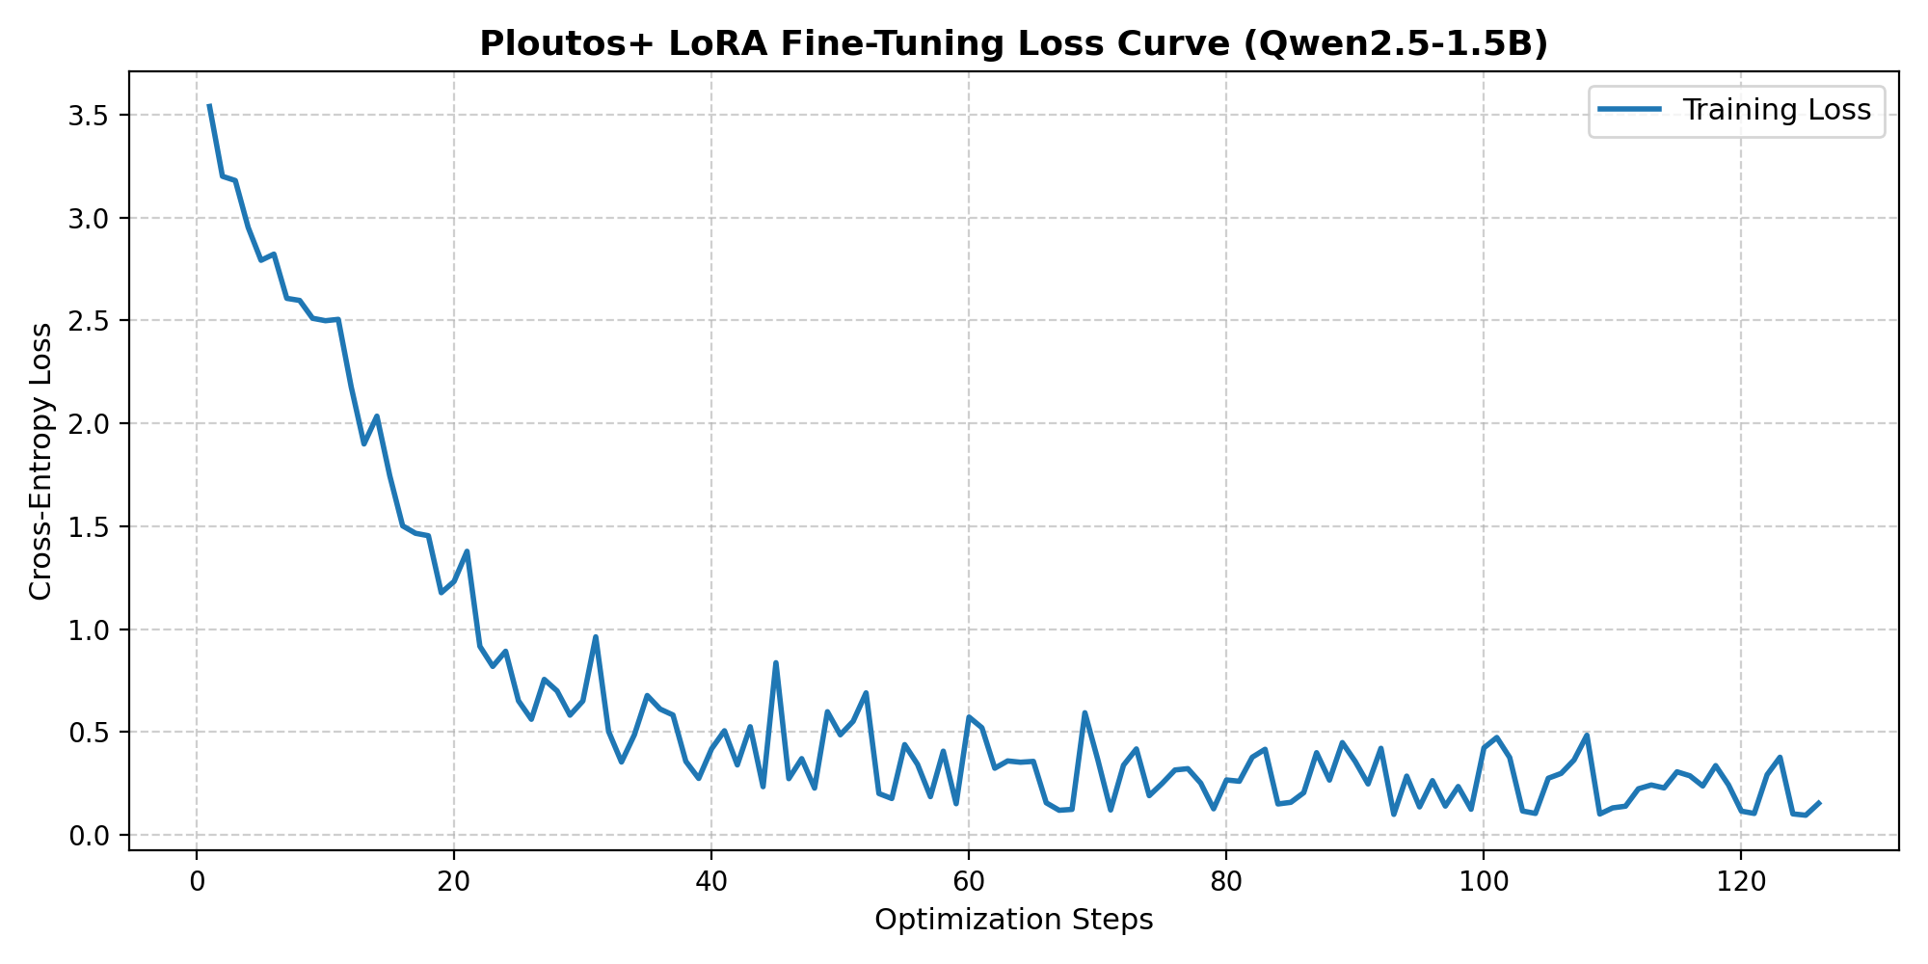
TRAINING CONVERGENCE & RESULTS
Convergence Metrics
Initial Loss
3.54
Final Train Loss
0.274
Epoch 1 Val Loss
0.432
Epoch 2 Val Loss
0.381
Total Steps
126
Training Time
~6 min
✓ Loss dropped 96% (3.54→0.095)
✓ Validation loss confirms generalization
✓ No overfitting detected
✅ 30/30 Automated Pytest Tests PASSED — All Phases 1-7 Verified

Slide 12
LIVE INFERENCE DEMONSTRATION
$ python src/inference/predict.py --sample --ticker AAPL
Inference Pipeline
1
Load Test Sample
Reads from pre-generated test prompts (JSONL)
2
Load Model
Base Qwen2.5-1.5B + LoRA adapter from checkpoint
3
Build Prompt
Formats multi-expert evidence into chat template
4
Generate
Model produces prediction (UP/DOWN) + rationale
5
Evaluate
Compares against ground truth label
Output: >>> MODEL PREDICTION: UP <<< | Ground Truth: UP | Status: [CORRECT]

Slide 13
FUTURE WORK: PHASES 8–12
Phase 8
Adaptive Expert Router
Core Contribution
Context-gated MLP dynamically weighting experts based on market regime indicators
Phase 9
Visual Financial Expert
Extension
Price chart generation & visual evidence integration as a 4th expert modality
Phase 10
Market-Regime Robustness
Analysis
Stress testing across Bull / Bear / Sideways / High-Volatility regimes
Phase 11
Ablation Studies
Evaluation
Comprehensive metric matrix: accuracy, F1, MCC per expert combination
Phase 12
Final Deliverables
Delivery
Research paper, defense slides, reproducible repository, figures

Slide 14
SUMMARY & KEY CONTRIBUTIONS
7/12
30/30
96%
6 min
Phases
Completed
All Tests
Passed
Loss
Reduction
GPU Training
Time
Key Contributions So Far
▸ Established a rigorous, leakage-free evaluation pipeline on the StockNet benchmark (87 S&P 500 stocks)
▸ Built a modular 3-expert evidence system (Technical, Sentiment, Human) generating structured prompts
▸ Fine-tuned Qwen2.5-1.5B-Instruct with LoRA on a consumer GPU (RTX 4050, 6 GB) in ~6 minutes
▸ Achieved strong convergence: training loss 3.54 → 0.095 with validation loss confirming generalization
▸ Created an interactive inference CLI producing interpretable predictions with grounded rationales
▸ Developed comprehensive automated test suites: 30/30 tests passing across all phases
▸ Designed modular, extensible codebase ready for the Adaptive Expert Router (Phase 8)

Slide 15
Thank You
Questions & Discussion
Rishikesh (24BDS030) • Vineel (24BDS010) • Arjun (24BDS039) • IIIT Dharwad
LLM Applications in Finance | October 2026

