Slide 1

SOIL SCIENCE DEPARTMENT · PROGRESS REPORT
Automated Boll Sizing
from RGBD video
Detection, pose, occlusion, and confidence — combined per boll, across every frame.
Rishikesh Rishikesh · Computer Vision Lab
June 2026

Slide 2
Why we're doing this
Replace hand-measured boll sampling with a per-recording, per-boll automated pipeline.
TODAY
WHAT THE PIPELINE WILL DO
Manual measurement
Automated, non-destructive
A few bolls per plot, sampled by hand at the end of season
Destructive — sampled bolls can't be re-measured for growth
Labor-bound: can't scale to hundreds of plants across many trial blocks
No within-season tracking of size change
Every visible boll in every frame, every recording pass
Per-boll size estimate with a confidence score the agronomist can trust
Re-measurable: walk the row again next week and track growth
Scales: same pipeline runs on any greenhouse or field recording
Cotton Boll Sizing · Soil Science Progress Report
2

Slide 3
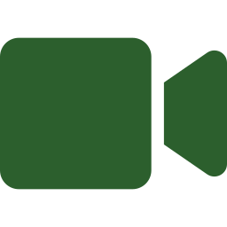





From video to per-boll size
Five-stage pipeline. Each stage produces a structured record the next stage can use.
STEP 1
STEP 2
STEP 3
STEP 4
STEP 5
RGBD video
Detect + segment
Track
3D fusion
Per-boll record
RealSense color + depth, ~30 fps
Find each boll, draw its outline
Same boll across frames gets one ID
Lift outline + axis into 3D via depth
Size + confidence per recording
STATUS
Steps 1–3 are working end-to-end on real recordings. Step 4 (3D fusion) is the active milestone. Step 5 is downstream of it.
Cotton Boll Sizing · Soil Science Progress Report
3

Slide 4



Every measurement has confidence
Six signals together tell the agronomist how much to trust each per-boll size estimate.
Boll location + outline
DONE
Where the boll is on screen, and its exact shape
Tip + base keypoints
DONE
The two ends of the boll, each with its own confidence
What is occluding the boll
DONE
Nothing, a leaf, a stem, or other — color-coded
How much is visible
DONE
Fraction in [0, 1] — how much of the boll the camera sees
Depth measurement validity
NEXT
How reliable the depth reading is for this specific boll
Multi-frame aggregation
NEXT
Combine all frames showing the same boll into one estimate
4 of 6 in production today. The remaining 2 are this and next month's work.
Cotton Boll Sizing · Soil Science Progress Report
4

Slide 5
Two iterations of annotated data
Each round expanded the dataset and made validation more honest.
V3 · PILOT
Apr 2026
V4 · COMBINED
Jun 2026
First end-to-end proof
First trustworthy validation
46 images · 274 boll annotations
Two camera angles (back + front)
Random val split (6 images / 32 anns)
Single-point tip + base keypoints
Goal: prove the three models can be trained at all
127 images · 734 boll annotations (3× more data)
Three camera angles (back, front, track-side)
Sequential val split (63 images / 264 anns)
Richer keypoint shapes: polygon for tip, rectangle for base
Goal: honest val numbers we can publish
Cotton Boll Sizing · Soil Science Progress Report
5

Slide 6
Three models running in one pass
Each contributes to one combined per-boll record. They share one input frame.
Segmentation
Pose
Aux head
Bounding box + shape
Tip + base keypoints
Occlusion + visibility
0.71
0.99
0.019
mask mAP₀.₅–₀.₉₅
keypoint mAP₀.₅–₀.₉₅
visibility error
Per-frame output is one JSON record per boll: box, polygon, two keypoints with confidence, occlusion class, visibility fraction, and a stable track ID.
Cotton Boll Sizing · Soil Science Progress Report
6

Slide 7

Where we are, in numbers
Validation set: 63 frames / 264 instances held out from the end of the recording timeline.
Metric
v3 val
v4 val
What this tells us
Segmentation — mask mAP₀.₅
0.96
0.995
Boll outlines match annotation almost exactly
Segmentation — mask mAP₀.₅–₀.₉₅
0.69
0.71
Tight quality threshold; modest gain on 3× more data
Pose — keypoint mAP₀.₅
0.92
0.99
Tip + base nearly always localized within tolerance
Pose — keypoint mAP₀.₅–₀.₉₅
0.85
0.99
Strict OKS threshold; v4 is essentially saturated
Occlusion classifier — accuracy
—
0.77
v3 had no usable val for this — first real number
Visibility fraction — mean error
—
0.019
1.9% error in 'fraction visible' — well below the noise floor
One open issue: aux head correctly flags leaf occlusions only 9% of the time on val. The training set has few leaf-occluded examples relative to other classes. We have a fix in mind.
Cotton Boll Sizing · Soil Science Progress Report
7

Slide 8
Why these numbers are trustworthy
The validation discipline matters as much as the model.
Frames in time order
WHAT THIS MEANS
Random split (avoid)
Held-out frames are scenes the model has never seen — different camera angles, lighting moments, plant moments.
The numbers on the previous slide reflect real generalization, not memorization of nearby frames.
Side benefit: this is the same regime the downstream RGB-D fusion will operate on — measuring bolls in new recording passes.
Val frames touch training frames in time → inflated mAP
Sequential split (what we did)
Val is a clean block of unseen scenes from the end of the timeline
training
random val
sequential val
Cotton Boll Sizing · Soil Science Progress Report
8

Slide 9
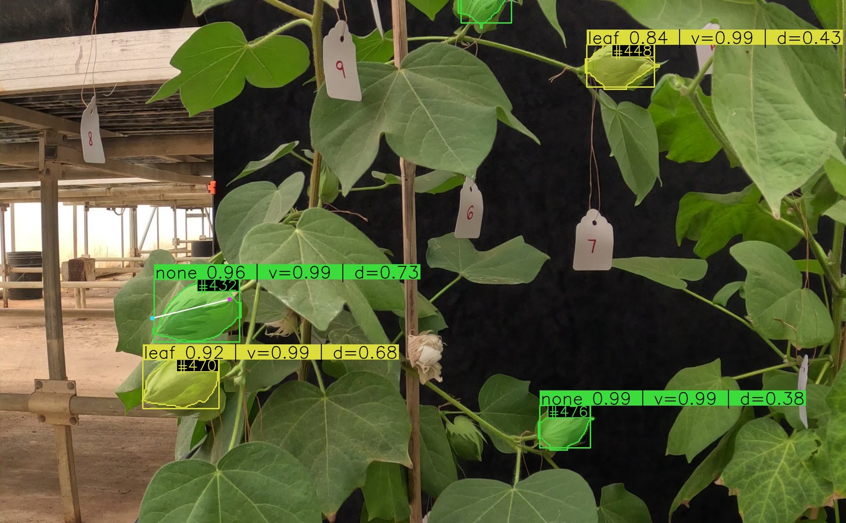
Interactive viewer — live demo
Toggle every overlay on or off, scrub through frames, click any boll for its full record.
WHAT YOU CAN DO
Toggle every overlay — box, mask, keypoints, axis, labels
Filter by occlusion class or confidence
Adjust per-keypoint confidence threshold live
Centroid trails show each boll across recent frames
Mouse wheel zoom, click + drag to pan
Click any boll for its full numeric record
▶ Switching to live demo — send the same HTML viewer + frames + JSONs to your team and they can browse it locally
Real frame · 4 bolls detected · color-coded by occlusion · per-boll track IDs
Cotton Boll Sizing · Soil Science Progress Report
9

Slide 10
One boll, many measurements
Tracking lets us average across frames — but weighted by confidence so blurry or occluded views count less.
Same boll across 5 consecutive frames:
Frame 1
Frame 2
Frame 3
Frame 4
Frame 5
size = 38 mm
size = 39 mm
size = 32 mm
size = 38 mm
size = 35 mm
conf = 0.94
conf = 0.91
conf = 0.42
conf = 0.88
conf = 0.65
clear view
clear view
leaf in the way
clear view
partial occlusion
Confidence-weighted average → 38 mm ± 1 mm (frame 3 down-weighted; partial occlusion contributes proportionally)
Cotton Boll Sizing · Soil Science Progress Report
10

Slide 11

Next: from detections to 3D size
Use the depth channel + the principal axis of each boll to estimate physical size in millimeters.
2D outline + axis
Lift into 3D
Fit a 3D shape
From the models you just saw
Use depth at each pixel of the outline
Prolate spheroid → length × width → size in mm
WHY THIS IS THE RIGHT NEXT STEP
Everything upstream is now stable and structured. The same per-boll JSON record carries every measurement we need — bounding shape, principal axis, occlusion class, and a confidence per piece. Adding the depth lift is incremental, not a rewrite.
Cotton Boll Sizing · Soil Science Progress Report
11

Slide 12
What would help most
Three specific gaps in the annotated data would directly unblock the next iteration.
More stem-occluded examples
HAVE: 7 in train · 60 in val
ASK: ~50 additional stem-occluded annotations in training
Right now the model rarely sees stems in training but is tested on many — the recall numbers reflect that gap directly.
Front-camera annotations
HAVE: 29 frames on disk · 0 annotated
ASK: Even a small batch (~15-20 frames) of front-camera annotations
We currently train on two angles but the field deployment will include front view. Closing this gap proves the model generalizes across all three cameras.
More “other”-class examples in val
HAVE: 0 in val (the sequential tail had none)
ASK: Sprinkle frame-edge / boll-on-boll cases into the next annotation pass
We can't put a number on how well we detect “other” until val has some — even 5–10 examples would make the next report meaningful.
Cotton Boll Sizing · Soil Science Progress Report
12

Slide 13
WHERE WE ARE
Three trained models · honest validation · interactive viewer.
DONE
IN PROGRESS
DEPENDS ON YOU
Annotation pipeline, three models, sequential validation, end-to-end inference, interactive viewer.
RGB-D fusion to turn 2D detections + depth into per-boll size in millimeters.
More annotated frames in three specific gaps (previous slide). Each gap directly unblocks one downstream metric.
Questions, requests, ideas: Rishikesh Rishikesh · rishikesh3304@gmail.com

