Slide 1
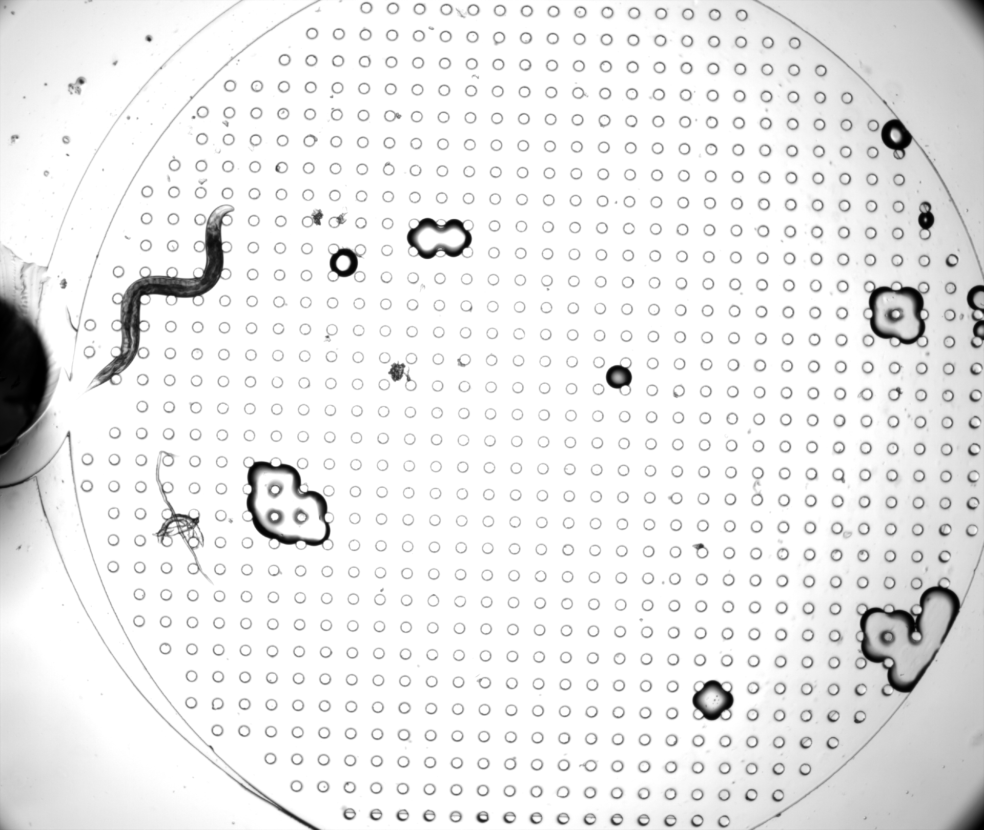
Image Processing Project 5 Presentation
Segmentation and Straightening of C. Elegans
By Rishikesh & Joseph Palacios
December 7th, 2024
Texas Tech University

Slide 2
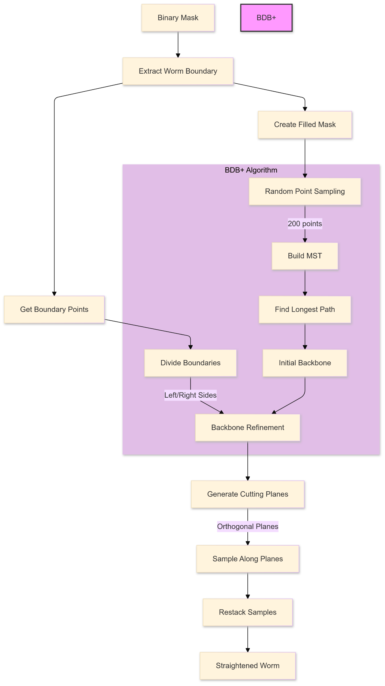
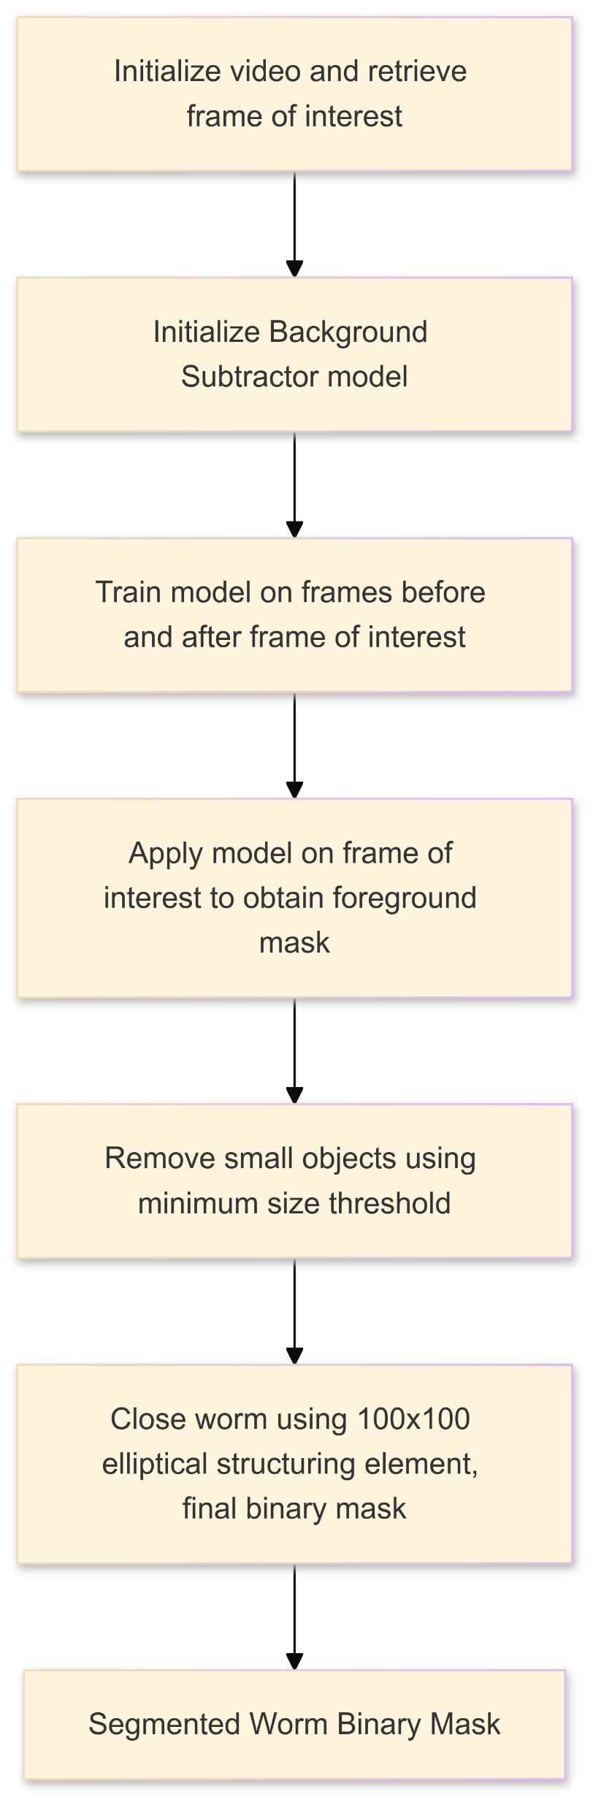
1. Project Flowchart

Slide 3
Worm Segmentation

Slide 4

1. Frame of Interest
Frame 14 of BZ33C_Chip1D_Worm27.avi

Slide 5
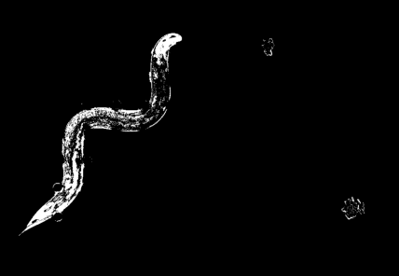
2. Background Subtractor
Identifies moving objects by subtracting the background.
OpenCV’s cv2.createBackgroundSubtractorMOG2 is used.
Function can process both BGR and grayscale images.
Uses pixel intensity values.
Outputs a binary mask with the foreground regions being white (255) and the background being black (0).
Training involves passing multiple frames to the background subtractor to model the background.
Define a range of frames around the frame of interest
Apply the model on the frame of interest to obtain foreground mask.
Raw Foreground Mask

Slide 6
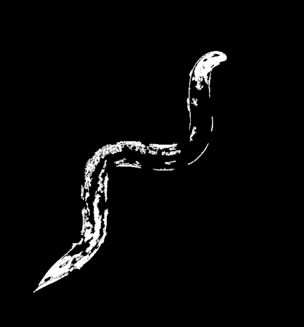
3. Removing Small Objects
From scikit-image package, remove_small_objects was used to remove small connected components from the binary mask that are smaller than a specific size.
Size threshold had to be selected carefully.
Too big would result in the worm losing too much structure
Too low would result in the pegs appearing in the image
Problems arise in the next step for both these cases
Output would be a cleaned-up mask where extraneous small noise left over from the background subtractor would be removed.
Mask After Removing Small Objects

Slide 7
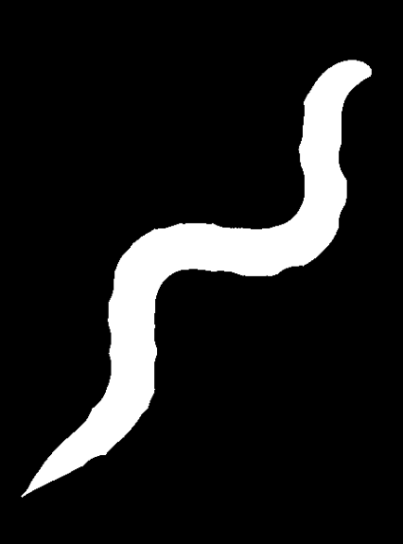
4. Binary Image Morphology: Close
Worm mask contains small gaps and holes due to previous two steps.
Closing is performed using an elliptical 100x100 kernel.
Restored disconnected parts.
Ensured worm’s structure remained smooth.
Mask must not have any “peg noise” around body otherwise it will make protrusions.
Mask After Closing

Slide 8
Worm Straightening

Slide 9
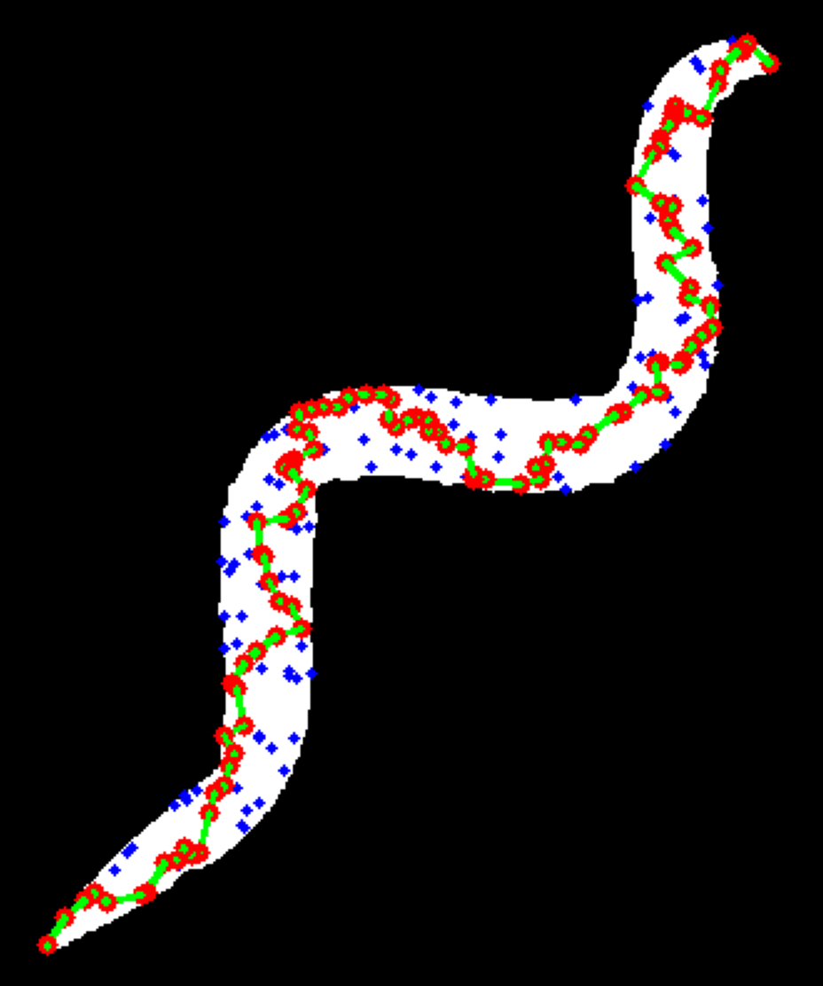
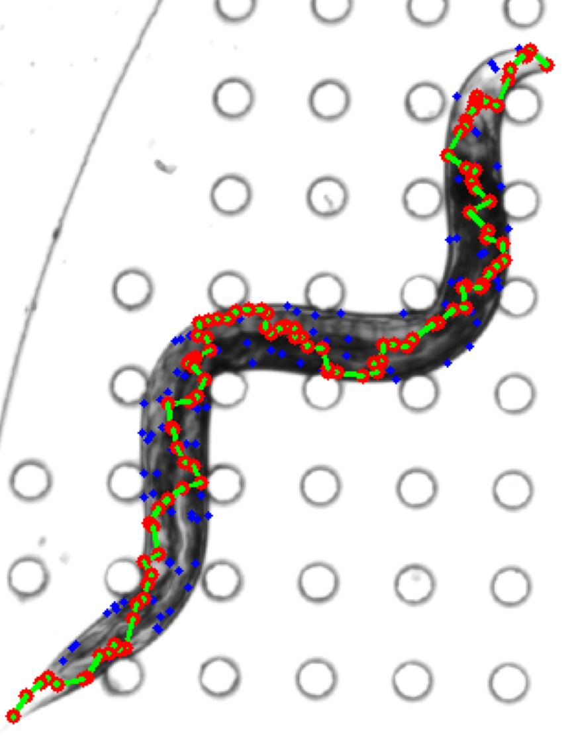
5. Backbone Detection (BDB+)
Initial Path (Binary Mask)
Initial Path (Original Frame)
Random Point Sampling:
Sample Points within Worm Mask
Include Extreme Points using worm skeleton
200 Points
Initial Backbone:
Build Minimum Spanning Tree (MST)
Find Longest Path Through MST
Forms Initial Control Points
Color Legend:
Blue dots: 200 randomly sampled points within worm body
Red dots: Control points from longest MST path
Green lines: Minimum Spanning Tree connections

Slide 10
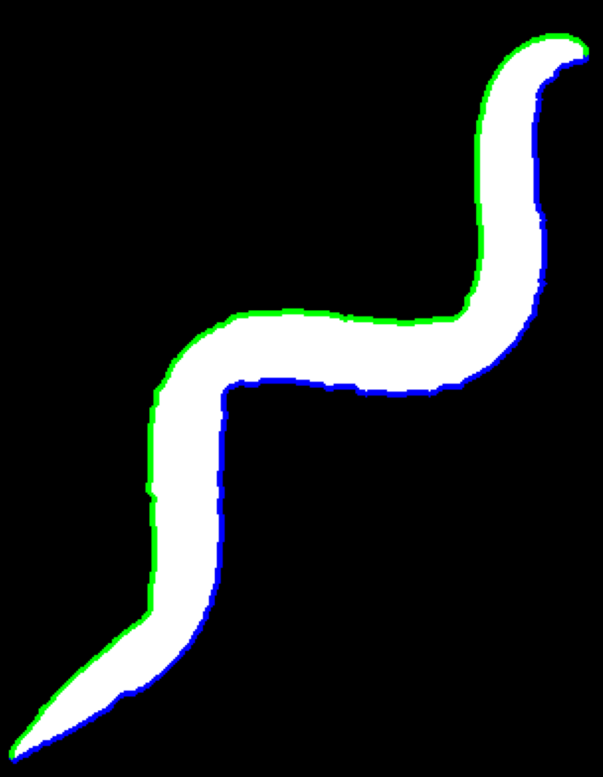
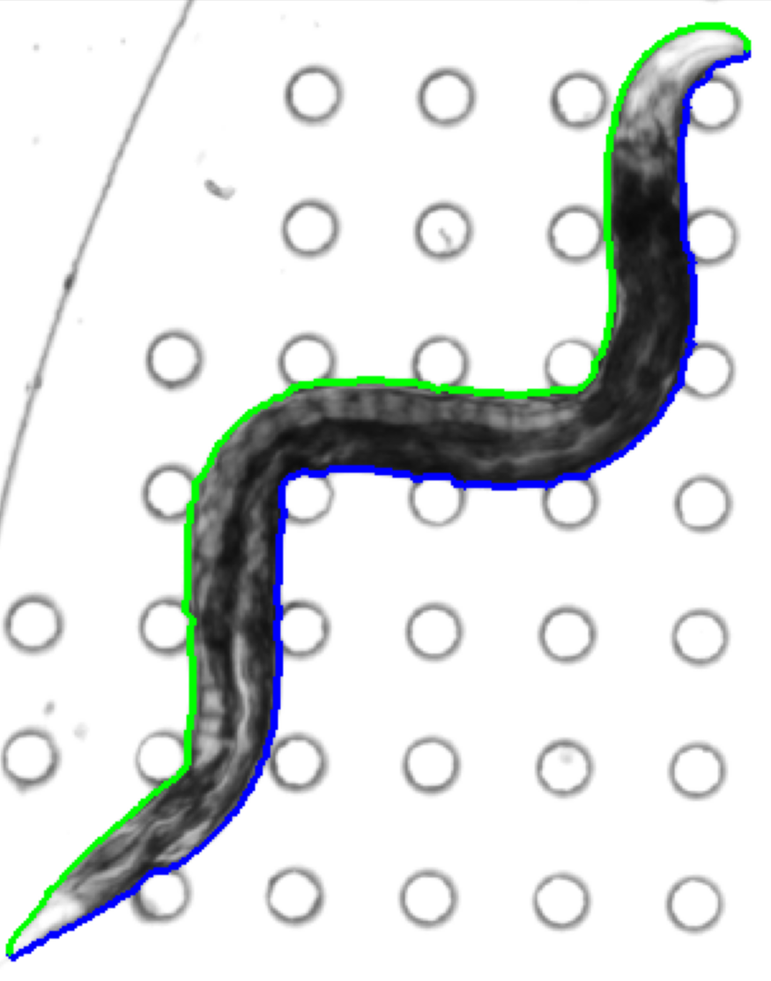
6. Backbone Detection (BDB+): Divide Boundaries
Boundary Division (Binary Mask)
Boundary Division (Original Frame)
Boundary Division:
Split worm boundary into left (green) and right (blue) sides
Use first and last control points as division markers
Process enables midline detection by tracking both sides

Slide 11
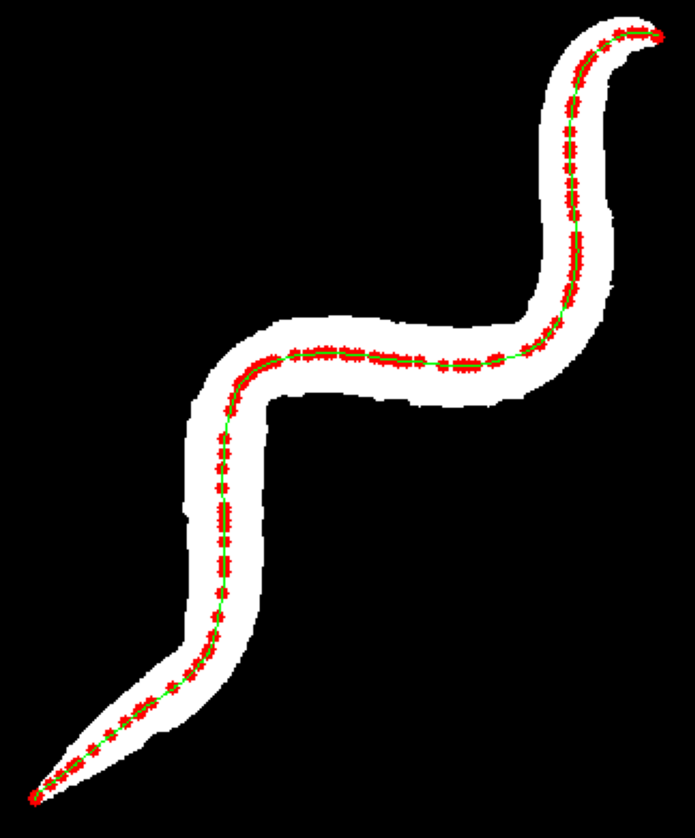
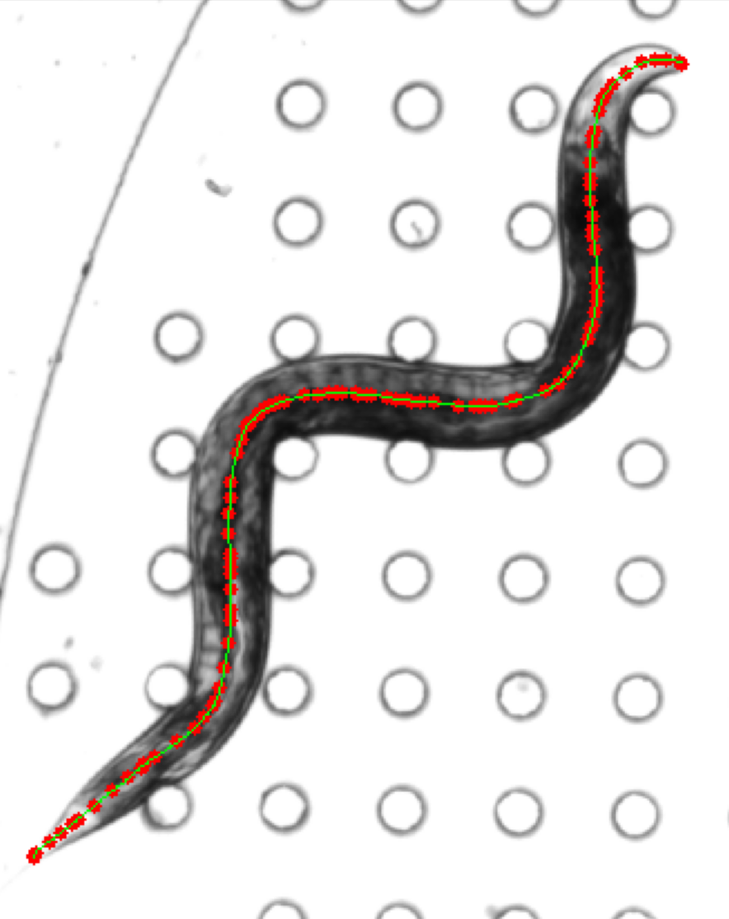
7. Backbone Refinement
Refined Backbone (Binary Mask)
Refined Backbone (Original Frame)
Backbone Refinement:
Iteratively adjust control points to be equidistant from boundaries
Each point moves to weighted average of:
Midpoint between nearest left and right boundary points (70%)
Average position of neighboring control points (30%)

Slide 12
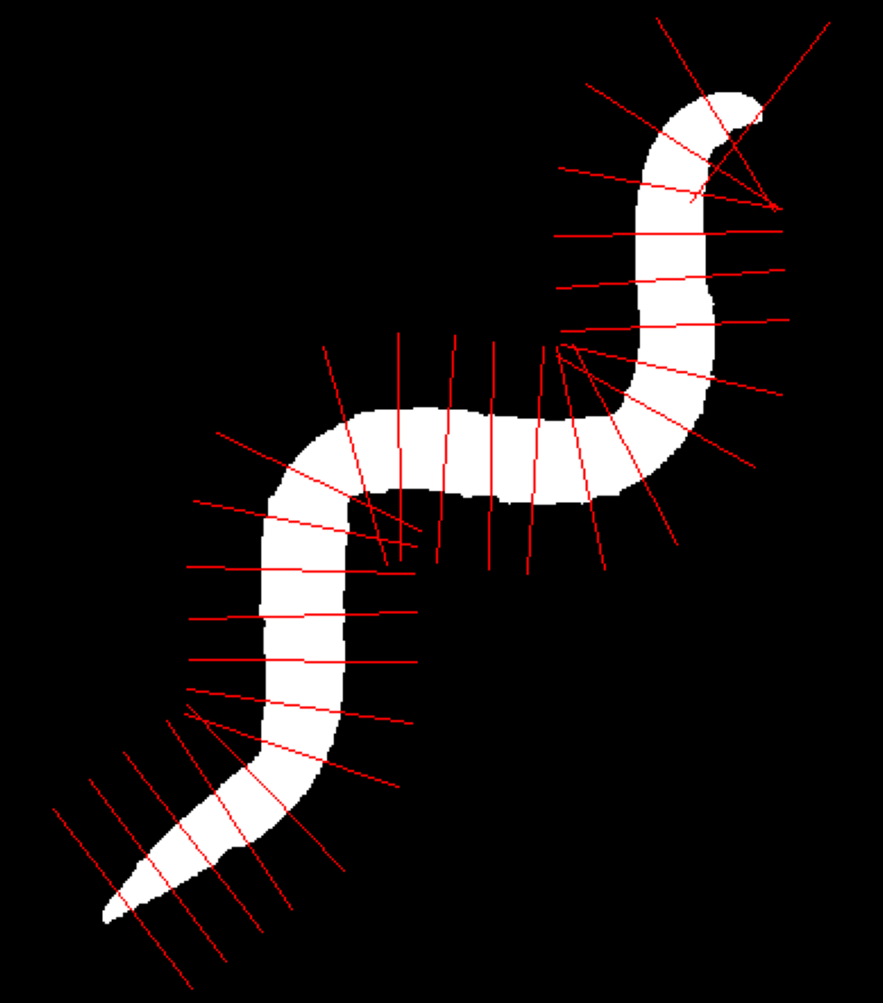
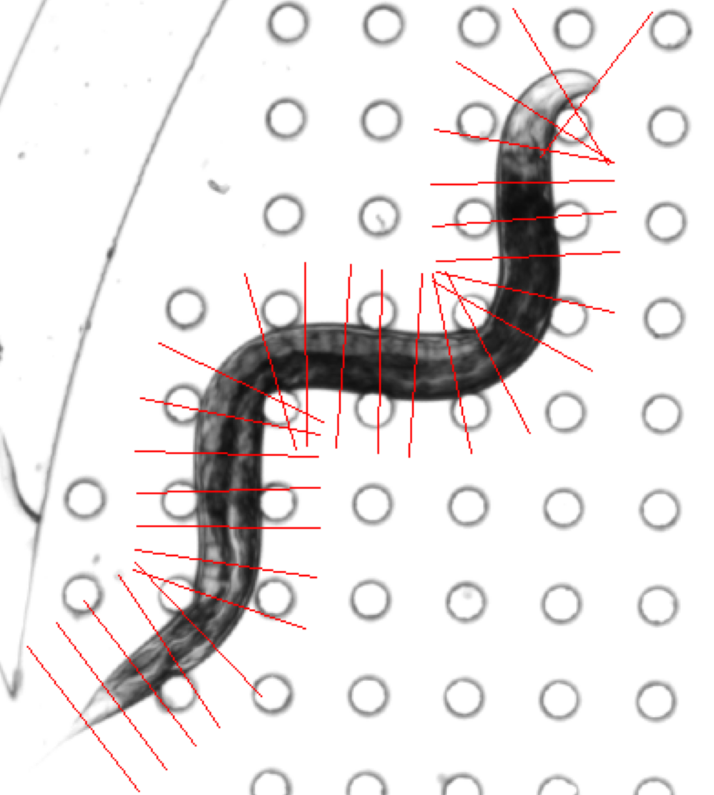
8. Cutting Planes
Cutting Planes Generation:
Generate cubic spline through refined control points
Calculate orthogonal planes along the backbone:
Spacing: 1 pixel between planes
Width: Based on worm thickness
Cutting Planes (Binary Mask)
Cutting Planes (Original Frame)

Slide 13
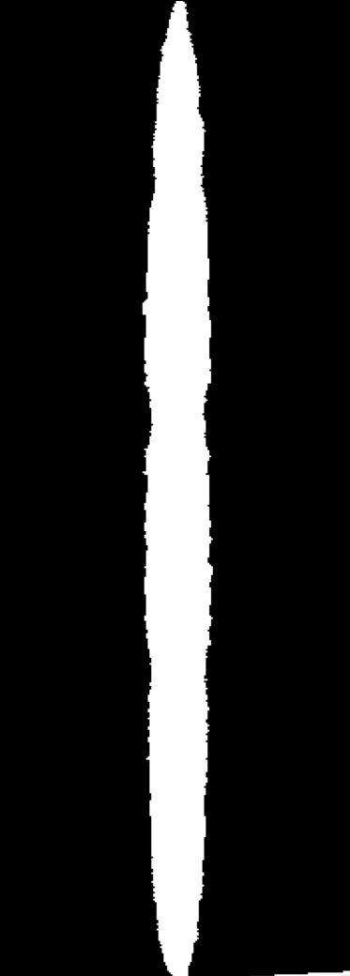
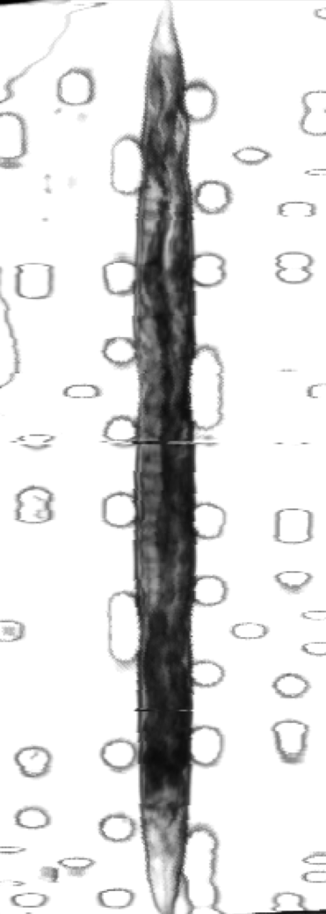
9. Straightening the Worm
Sample pixels along each cutting plane
Restack samples into straight
Width determined by maximum worm thickness
Image size:
Height = number of backbone points
Width = 2 * maximum sampling width
Straightened Worm (Binary Mask)
Straightened Worm (Original Frame)

Slide 14
10. Limitations and Edge Cases
Segmentation
Straightening
Requires playing with thresholds in both functions Background Subtractor and Remove Small Objects.
Closing can make the image worse by make protrusions from the pegs.
Closing will be insufficient if too many small objects were removed from the worm’s inside.
The sampling misses the extreme points of the worm. (Head & Tail)
The MST does not go from head to tail.

