Slide 1

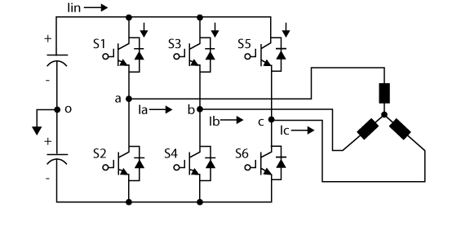
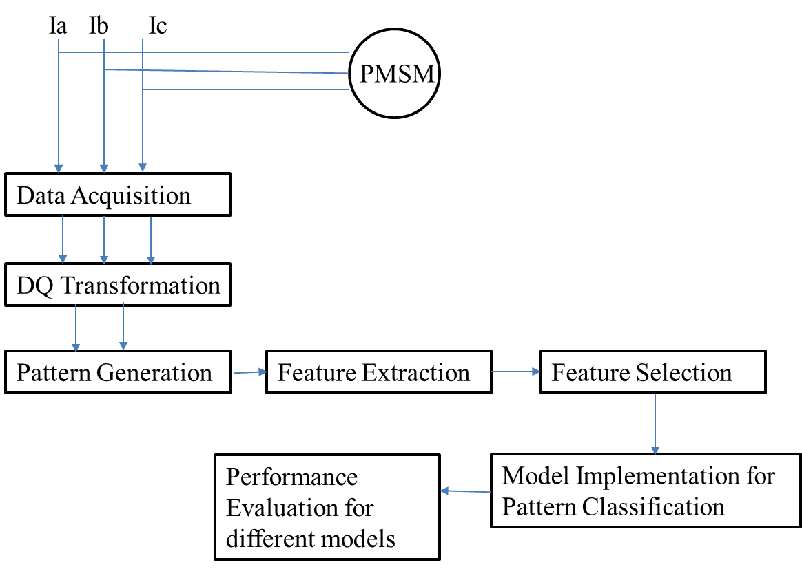
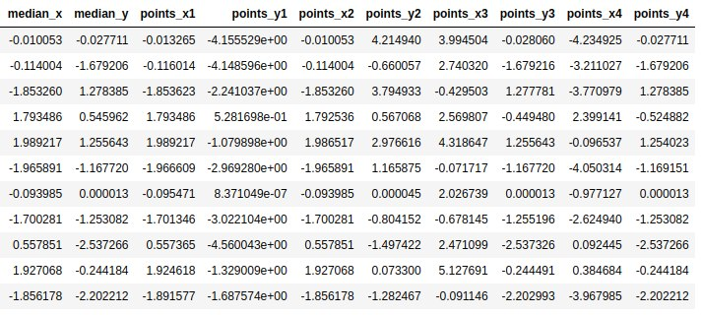
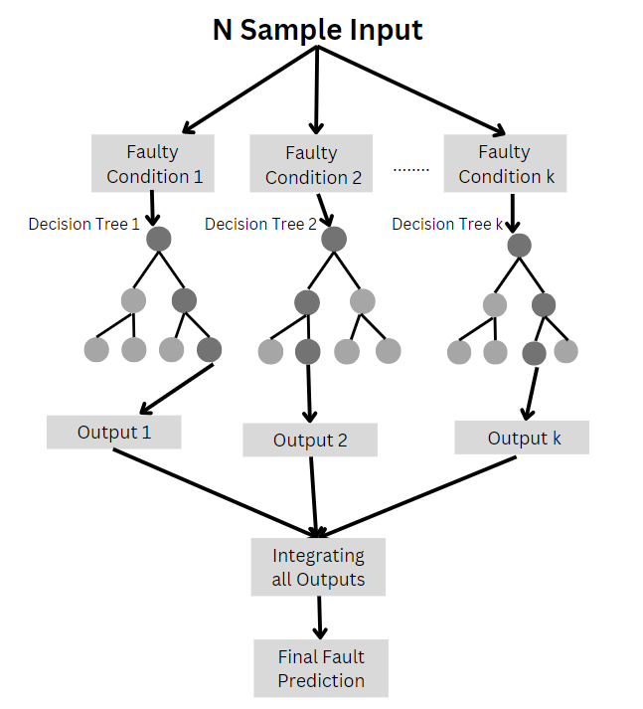
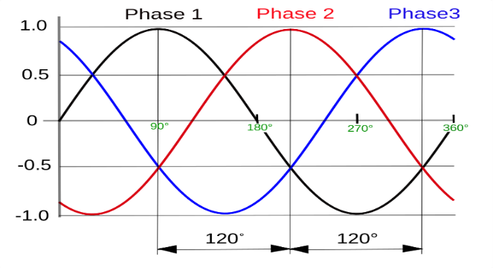
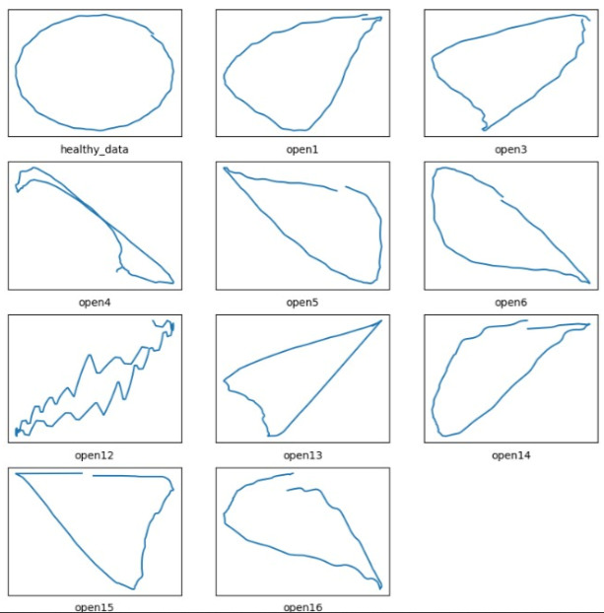
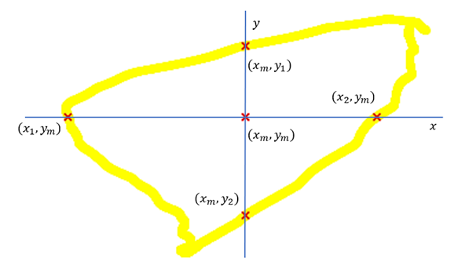
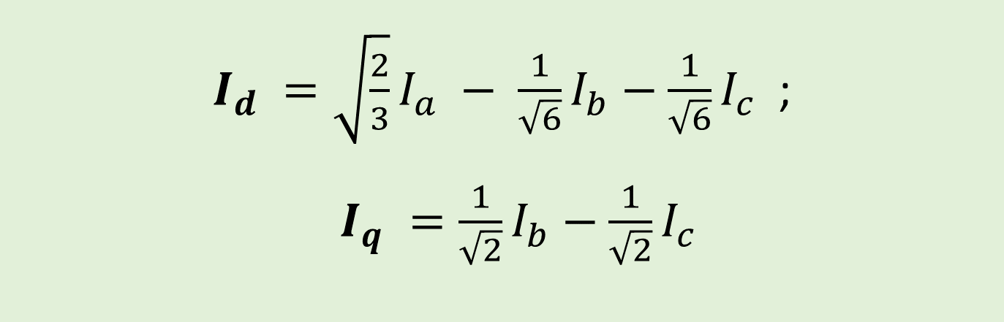
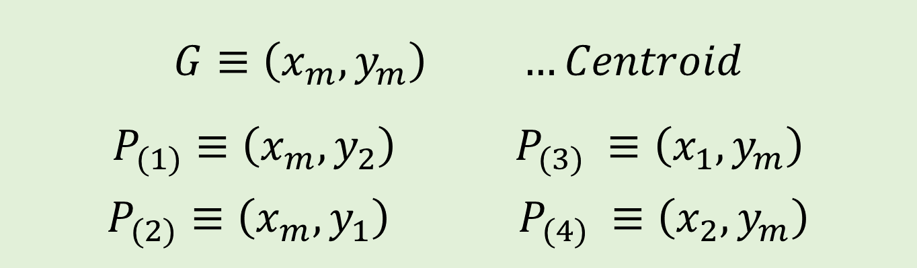
Empowering Society through Industry 5.0 : Advancements in Voltage-Fed Inverter Drive Circuits
INTRODUCTION
DIAGRAM BLOCK DIAGRAM
FEATURES
The society needs affordable device maintenance and clean energy. The conditional-based maintenance paradigm has become a game-changer in Industry 5.0 as manufacturers strive for greater dependability and sustainability. 3Φ Voltage Source Inverter (VSI) is a prime tool, enabling precise control of electric motors and grid voltage stability. Open Switch Faults (OSFs) in VSI cause damage to the system which reduces efficiency and increases maintenance costs. The project applies Machine Learning based Pattern Recognition approach for OSF diagnosis. The results include an improved ability to diagnose multiple OSFs with shorter diagnosis times, decreased implementation effort, and increased fault diagnosis effectiveness.
Fig : Block Diagram
MACHINE LEARNING MODEL
Fig : Three Phase Voltage Source Inverter (3Φ VSI) for Induction Motor (IM)
GRAPHS
AIM
AIM
To propose a robust & effective method for open-switch fault diagnosis in 3 phase voltage source inverters using pattern recognition techniques.
Fig : Healthy Curves of Output Current in
3Φ VSI
Fig : Distorted Curves of Output Current in Faulty 3Φ VSI
DQ TRANSFORMATION
OBJECTIVES
CONCLUSION
To collect current samples for various faulty conditions.
To generate patterns for different faulty conditions using Direct Quadrant (DQ) Transformation.
To collect features for fault conditions diagnosis.
To evaluate performance of different classification techniques of Pattern Recognition.
By using pattern recognition techniques propose a robust & effective method for multiple OSF diagnosis in 3 phase VSIs with minimum implementation efforts, Low threshold dependencies and high resistivity to load variations. Applications of this project further extends to uninterrupted power supplies, Industrial Induction motors as well as power generation methods like solar energy systems and wind energy turbines.
$I_{d} =\sqrt{\frac{2}{3}}I_{a} − \frac{1}{\sqrt{6}}I_{b}−\frac{1}{\sqrt{6}}I_{c}$;
$I_{q} =\frac{1}{\sqrt{2}}I_{b}−\frac{1}{\sqrt{2}}I_{c}$
$$G≡\left(x_{m},y_{m}\right) …Centroid \\ P_{(1)}≡\left(x_{m},y_{2}\right) P_{(3)} ≡\left(x_{1},y_{m}\right)$$
$$P_{(2)}≡\left(x_{m},y_{1}\right) P_{(4)} ≡\left(x_{2},y_{m}\right)$$

