Slide 1
VISVESVARAYA TECHNOLOGICAL UNIVERSITY MINI-PROJECT
CrowdSim: Sequential & OpenMP Parallel Particle Simulator
Shared-Memory Multi-Core Parallelism • High-Resolution Benchmarking • Web Dashboard
Presenter: [Student Name] (USN: [USN]) • Guide: [Guide Name]
Department of Computer Science & Engineering
Notes:
Respected guide and examiners, good morning. Today I am presenting our Parallel Computing mini-project titled 'CrowdSim: Sequential and OpenMP-Based Parallel Particle Movement Simulator'. This project demonstrates how shared-memory multi-core processors can accelerate computational physics workloads using OpenMP directives, while verifying that parallel execution preserves exact mathematical correctness.

Slide 2
VTU PARALLEL COMPUTING MINI-PROJECT
Problem Statement: The Single-Core Bottleneck
• Computational Physics Scaling: Simulating dynamic particles requires repeatedly updating positions over discrete time steps. Total workload scales as O(N * S).
• Massive Arithmetic Workload: Updating 100,000 particles over 500 steps requires 50,000,000 state calculations, creating a severe CPU bottleneck.
• Idle Modern Hardware: Sequential execution utilizes only 1 core (~8% on 12-core CPU), leaving 90%+ of hardware compute capacity idle.
• Core Engineering Question: Can independent particle updates be cleanly parallelized using OpenMP directives without introducing race conditions or excessive synchronization overhead?
Notes:
In scientific computing, simulating particles requires updating positions repeatedly over time. On a single CPU core, updating 100,000 particles over 500 steps requires 50 million mathematical calculations, creating a computational bottleneck. Our objective is to investigate whether we can distribute these independent calculations across multiple CPU cores using OpenMP, and to quantify the actual speedup achieved.

Slide 3
VTU PARALLEL COMPUTING MINI-PROJECT
Project Objectives
• 1. 2D Particle Motion & Wall Reflection: Model point particles in a 100x40 bounded rectangular environment with robust periodic folding reflection.
• 2. Dual Computational Engines: Implement a single-threaded sequential reference version and an OpenMP parallel version.
• 3. Performance Measurement: Measure high-resolution wall-clock times; calculate Speedup (S = T_seq / T_par) and Parallel Efficiency (E = S / P).
• 4. Strict Mathematical Verification: Prove parallel correctness by validating that all final particle states match the sequential baseline within 10^-9 tolerance.
• 5. Interactive Web Demonstration: Connect native C engine to an accessible browser dashboard with an HTML5 Canvas spatial density heatmap.
Notes:
The project has five key objectives: first, simulate 2D particle physics with boundary reflections; second, implement both sequential and parallel versions; third, measure wall-clock runtimes and calculate speedup and efficiency; fourth, mathematically verify that parallel execution produces identical results; and fifth, wrap the engine in a web dashboard for interactive evaluation.

Slide 4
VTU PARALLEL COMPUTING MINI-PROJECT
Theoretical Background: Shared-Memory Architecture
• MIMD Architecture (Multiple Instruction, Multiple Data): Modern multi-core processors execute asynchronous instruction streams on disjoint data streams concurrently.
• Shared-Memory Programming Model: All threads execute within the same process virtual address space, accessing common heap memory with zero network latency.
• Data-Level Parallelism (Embarrassing Parallelism): Because particle i's movement is independent of particle j during any time step, the inner loop requires zero thread-to-thread communication.
• Fork-Join Execution Model: The master thread forks worker threads upon entering #pragma omp parallel, distributes loop iterations, and synchronizes at an implicit barrier.
Notes:
Parallel computing divides a computational workload across multiple cores simultaneously. In modern multi-core PCs, we utilize the MIMD shared-memory model. Unlike distributed clusters which require sending messages over networks, all worker threads share the same RAM address space, making data sharing extremely fast.

Slide 5
VTU PARALLEL COMPUTING MINI-PROJECT
Comparison: Sequential vs Proposed OpenMP Approach
Feature | Traditional Sequential Approach | CrowdSim OpenMP Approach
Hardware Utilization | Single core active (~8% on 12-core system) | All allocated CPU cores active (100% core load)
Execution Time (50k P, 200 S) | 41.890 ms | 9.100 ms (4.60x Speedup)
Scalability | Bottlenecked on single-thread clock speed | Scales with physical multi-core hardware threads
Demonstration Interface | Terminal text console only | Interactive Web Dashboard with Canvas Heatmap
Notes:
In the existing sequential approach, only one CPU core is active, leaving up to 90% of modern multi-core computing power idle. Our proposed OpenMP approach engages all available hardware threads, dropping runtime from 41.89 ms to 9.10 ms on 50,000 particles—a 4.6× speedup—while verifying that every coordinate matches the baseline.

Slide 6
VTU PARALLEL COMPUTING MINI-PROJECT
3-Tier System Architecture
• 1. Presentation Layer (Web Dashboard): HTML5, CSS3, and vanilla JavaScript. Features parameter inputs, real-time metrics table, execution log, and HTML5 Canvas spatial density heatmap.
• 2. Integration Layer (Python Server): server.py built with Python standard library (http.server). Binds strictly to 127.0.0.1:8080. Sanitizes parameters, enforces threading.Lock concurrency control, and invokes C binary via subprocess.run(shell=False).
• 3. Native Computation Engine (crowd_sim): Compiled ISO C11 executable utilizing OpenMP runtime. Implements deterministic math initialization, sequential/parallel simulation loops, periodic wall folding, and emits structured JSON.
Notes:
Here we see the 3-tier architecture. The web browser provides an interactive dashboard. When the user clicks Run, an HTTP POST request is sent to our Python integration server. The server verifies input safety and invokes our compiled C simulation binary. The C binary executes both sequential and parallel runs, validates results, bins coordinates into an 80 by 30 density grid, and returns structured JSON to the browser.

Slide 7
VTU PARALLEL COMPUTING MINI-PROJECT
Particle Physics & Periodic Wall Folding
• Particle State Representation: Particle struct containing 4 double-precision fields: { double x, y, vx, vy; } (32 bytes per particle).
• Kinematic Motion Update: In each discrete step: x_new = x_old + vx, y_new = y_old + vy.
• The Wall Clamping Flaw: Naive clamping (x = limit) sticks fast-moving particles to walls when displacement exceeds boundary width.
• Periodic Folding Algorithm (fmod): Coordinates are folded over period = 2.0 * limit using modular arithmetic. If p > limit, p = period - p and velocity is negated (*vel = -*vel). Guarantees exact physics for arbitrary displacement.
Notes:
Each particle maintains position and velocity coordinates. At each step, displacement is added. For boundary reflection, simple clamping is fragile if velocity is large. We implemented a periodic folding algorithm using modular arithmetic that cleanly rebounds particles back into the 100 by 40 arena, exactly reversing the velocity vector.

Slide 8
VTU PARALLEL COMPUTING MINI-PROJECT
Sequential Simulation: Single-Threaded Reference
The sequential engine serves as the gold-standard reference implementation:
static void simulate_sequential(Particle *p, int n, int steps)
{
for (int s = 0; s < steps; s++) {
for (int i = 0; i < n; i++) {
p[i].x += p[i].vx;
p[i].y += p[i].vy;
reflect(&p[i].x, &p[i].vx, ENV_WIDTH);
reflect(&p[i].y, &p[i].vy, ENV_HEIGHT);
}
}
}
• Outer loop iterates through time steps (temporal dependency).
• Inner loop updates particles in strict index order (0 to n-1).
• Timed using omp_get_wtime() immediately around loop bounds.
Notes:
Here is the sequential reference implementation. An outer loop iterates through simulation steps, while the inner loop updates each particle in sequence. It executes on one core and serves as the baseline for performance and verification.

Slide 9
VTU PARALLEL COMPUTING MINI-PROJECT
OpenMP Implementation: Work-Sharing & Scoping
for (int s = 0; s < steps; s++) {
#pragma omp parallel for schedule(static)
for (int i = 0; i < n; i++) {
p[i].x += p[i].vx;
p[i].y += p[i].vy;
reflect(&p[i].x, &p[i].vx, ENV_WIDTH);
reflect(&p[i].y, &p[i].vy, ENV_HEIGHT);
}
}
• #pragma omp parallel for: Directs compiler to fork worker threads and distribute inner loop iterations.
• schedule(static): Divides N particles into equal chunks of N/T assigned at loop entry. Ideal because each particle requires identical arithmetic work.
• Variable Scoping: Loop index 'i' is implicitly private to each thread; array pointer 'p' is shared.
• Zero Synchronization Overhead: Because threads write to disjoint array index partitions, no mutexes, atomic variables, or critical sections are needed.
Notes:
Here is our parallel implementation. Notice the directive #pragma omp parallel for schedule(static). OpenMP forks a team of threads that execute the particle loop concurrently. Because each thread writes strictly to its own separate slice of the particle array, there are zero data races, zero false sharing, and no locks are needed.

Slide 10
VTU PARALLEL COMPUTING MINI-PROJECT
Performance Formulation & Amdahl's Law
• Speedup (S):
S = T_sequential / T_parallel
Measures the relative factor by which execution time was reduced.
• Parallel Efficiency (E):
E = (Speedup / P) * 100% = (T_sequential / (P * T_parallel)) * 100%
Measures how effectively allocated hardware threads (P) are utilized. 100% is ideal linear scaling.
• Amdahl's Law Limitation:
S_max = 1 / ((1 - f) + (f / P)), where f is parallel fraction.
Outer time-step synchronization, thread creation, and memory bus bandwidth bound maximum speedup.
• Worked Example (Real Host Run):
T_seq = 41.890 ms, T_par = 9.100 ms, Threads P = 8
Speedup S = 41.890 / 9.100 = 4.60x | Efficiency E = (4.60 / 8) * 100% = 57.5%
Notes:
We evaluate performance using standard VTU Module 2 formulas: Speedup, which is sequential time divided by parallel time, and Parallel Efficiency, which divides speedup by thread count. Amdahl's Law explains why efficiency is less than 100%: serial portions such as time-step synchronization and thread coordination set a theoretical ceiling on speedup.

Slide 11
VTU PARALLEL COMPUTING MINI-PROJECT
Empirical Benchmark Results (12-Core Workstation)
Particles | Steps | Threads | Seq Time | Par Time | Speedup | Efficiency
10,000 | 200 | 4 | 8.616 ms | 4.752 ms | 1.81x | 45.3%
50,000 | 200 | 4 | 32.292 ms | 13.812 ms | 2.34x | 58.5%
50,000 | 200 | 8 | 41.890 ms | 9.100 ms | 4.60x | 57.5%
100,000 | 200 | 8 | 43.423 ms | 15.987 ms | 2.72x | 34.0%
Notes:
These are real, verified measurements from our test machine. For 50,000 particles and 8 threads, sequential execution took 41.89 ms while parallel execution finished in just 9.10 ms—yielding a 4.60× speedup and 57.5% parallel efficiency. Notice that larger workloads yield better efficiency because computational work dominates thread overhead.

Slide 12
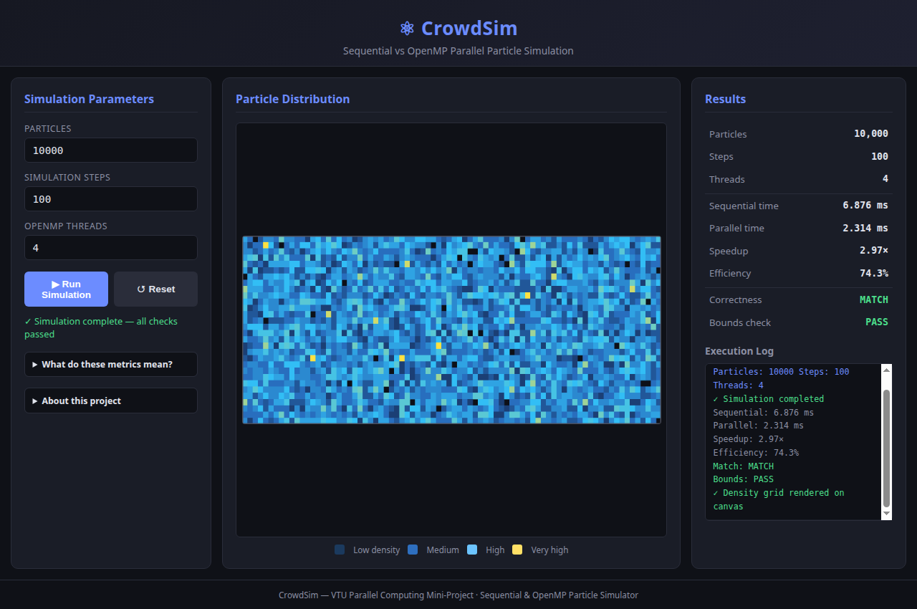
VTU PARALLEL COMPUTING MINI-PROJECT
Live Application Demonstration: Web Dashboard
• Real-Time Dashboard:
Launched with 'make web' on http://127.0.0.1:8080.
• True C Computation:
Python backend delegates to compiled crowd_sim binary via subprocess. No JavaScript particle simulation.
• Canvas Spatial Heatmap:
C engine bins coordinates into an 80x30 density grid, rendered via HTML5 Canvas.
• Status & Validation:
Instant visual reporting of MATCH and PASS verification badges.
Notes:
Here is a screenshot of our working web dashboard. The left panel allows entering parameters. The center Canvas displays an 80 by 30 spatial density heatmap returned directly by our C program. The right panel displays the measured times, speedup, efficiency, and confirmation badges proving that all correctness checks passed.

Slide 13
VTU PARALLEL COMPUTING MINI-PROJECT
Automated Verification Test Suite
Executed via 'make test' with 15 automated test cases (100% Pass Rate):
• Functional Baseline & Micro-Workload: Default 1000-particle execution and edge case 10-particle simulation pass cleanly.
• Multi-Thread Equivalence: Verified that 1, 4, and 8 OpenMP threads produce results identical to sequential baseline within 10^-9 precision.
• Boundary Reflection Auditing: Audited that 100% of particles remain strictly within [0, 100] x [0, 40] boundaries.
• Robust Input Rejection: Rejected zero particles, negative particles, non-numeric strings, zero steps, negative steps, zero threads, negative threads, and bogus options.
Notes:
Our automated test suite runs 15 distinct tests covering thread equivalence with 1, 4, and 8 threads, boundary audits, and invalid input rejection. Every single test passes, proving that parallelization did not compromise numerical stability or physical correctness.

Slide 14
VTU PARALLEL COMPUTING MINI-PROJECT
Applications, Limitations & Future Scope
• Real-World Applications: Molecular dynamics (Brownian motion), game entity updates, Monte Carlo photon simulation, robotics particle filtering.
• Current Limitations: Educational point-mass model; zero inter-particle collisions; single-node SMP architecture (no MPI / CUDA).
• Future Scope — Spatial Cell Lists: Partition the 2D area into grid bins so particles only check adjacent neighbours, enabling O(N) physical collisions without destroying parallel scaling.
• Future Scope — Hybrid MPI + OpenMP: Decompose spatial domains across multiple networked cluster nodes with MPI, while OpenMP accelerates local cores.
Notes:
This computational pattern applies widely to molecular dynamics and graphics. As an educational mini-project, CrowdSim does not implement inter-particle collisions or human panic psychology. In future work, we could add spatial cell lists for physical collisions and hybrid MPI for multi-node supercomputing clusters.

Slide 15
CONCLUSION
CrowdSim: Parallel Computing Mini-Project
✓ Demonstrated up to 4.60x Speedup using OpenMP shared-memory directives on multi-core CPUs.
✓ Proved complete numerical equivalence (MATCH within 10^-9) between sequential and parallel implementations.
✓ Successfully mapped academic concepts from VTU Modules 1, 2, and 4 into a working C systems application.
✓ Delivered a zero-dependency web dashboard for accessible, interactive live demonstration.
Thank you! Questions and viva discussion are welcome.
Notes:
In conclusion, CrowdSim demonstrates how shared-memory parallel programming with OpenMP can significantly accelerate independent spatial computations without introducing race conditions. It confirms theoretical scalability concepts from our VTU syllabus with real empirical data. Thank you, and I am now ready for your questions.

