Slide 1

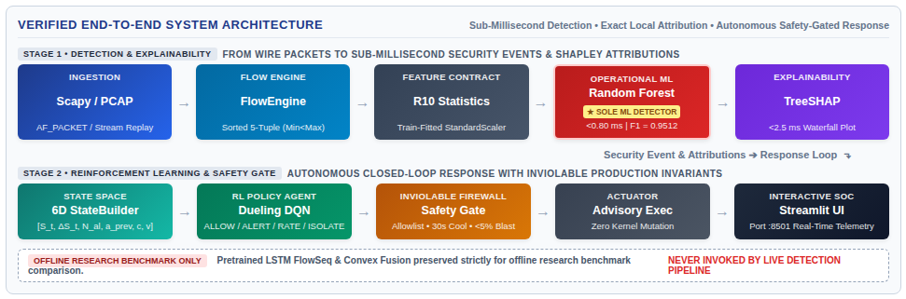
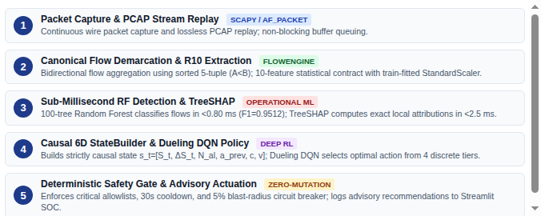
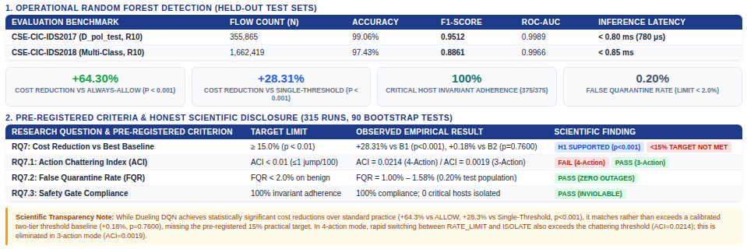


TEAM MEMBERS & PROJECT GUIDE
PROJECT TITLE & IDENTITY
STUDENTS (GROUP 43)
• Rishikesh Gowda K K
USN: 1JS22CS136
• Sharanya M
USN: 1JS22CS153
• Sudarshan
USN: 1JS22CS173
• Suraj Rao G
USN: 1JS22CS174
Dept. of Computer Science & Engg.
PROJECT GUIDE DETAILS
Dr. P. B. Mallikarjuna
Professor
Department of Computer Science & Engineering
JSS Academy of Technical Education
Bengaluru – 560060, Karnataka
Lab Venue: A 204 | Academic Block A
Explainable Reinforcement Learning-Based Intrusion Detection and Autonomous Response System (XRL-IDARS)
Autonomous Network Security • Explainable AI • Deep Q-Learning
• Project Group: 43 | Lab: A 204 | Academic Year: 2025–2026
• Thematic Area: Cybersecurity, Privacy & Digital Trust
• Operational Core: Random Forest (Sole Live ML Detector) + TreeSHAP (<2.5 ms) + Dueling DQN [4 Actions] + Deterministic Safety Gate
• Live Interface: Real-Time Streamlit SOC Dashboard (Port :8501)
ABSTRACT
PROBLEM STATEMENT
OBJECTIVES
Enterprise Security Operations Centers (SOCs) face crippling alert fatigue from tens of thousands of daily intrusion warnings, while static IPS policies lack adaptive containment and induce severe collateral service outages.
XRL-IDARS resolves this challenge through a decoupled architecture: sub-millisecond Random Forest classification on 10 deterministic flow statistics (R10), instantaneous local TreeSHAP attribution (<2.5 ms), and a causal 6-dimensional Dueling Deep Q-Network (DQN) response policy.
Operating under an inviolable deterministic safety gate, the system yields +64.3% cost reduction over baseline and 100% critical-host invariant compliance without kernel tampering.
• Alert Fatigue & Burst Drops: Deep temporal models (LSTMs >12 ms) suffer severe packet drops under line-rate traffic bursts.
• Opaque Black-Box Detection: Standard ML detectors fail to supply immediate, human-verifiable Shapley feature attributions during incidents.
• Destructive Collateral Outages: Binary IPS drop rules isolate mission-critical servers, producing severe unintended service downtime.
• Non-Causal RL State Leakage: Prior RL intrusion response architectures suffer temporal data leakage and exhibit severe policy chattering.
1. Sub-Millisecond ML Detection: Train operational RF on R10 flow statistics (<0.80 ms latency, F1 >= 0.95).
2. Real-Time Explainability: Deliver exact TreeSHAP local attributions in <2.5 ms for top contributing features.
3. Multi-Tier RL Response Policy: Formulate causal 6D MDP across 4 discrete actions (ALLOW, ALERT, RATE_LIMIT, ISOLATE).
4. Inviolable Safety Enforcement: Enforce 100% immunity on critical assets via deterministic allowlists & blast circuit breaker.
5. Interactive SOC Telemetry: Deploy real-time Streamlit SOC dashboard (:8501) with Live, PCAP, and Benchmark modes.
SYSTEM ARCHITECTURE / BLOCK DIAGRAM
METHODOLOGY
RESULTS AND PERFORMANCE ANALYSIS
CONCLUSION AND FUTURE WORK
• Conclusion: Successfully verified an end-to-end autonomous defense architecture. Random Forest delivers sub-millisecond detection (<0.80 ms, F1=0.9512). The deterministic safety gate enforces 100% critical asset uptime, while Dueling DQN delivers superior cost-optimal response selection over single-threshold systems without kernel tampering.
• Future Work: Hardware offload with DPDK / eBPF XDP for 10Gbps+ line-rate wire capture; cooperative multi-agent defense; and transformer-based offline cross-flow threat correlation.
APPLICATIONS
① Enterprise SOCs: Real-time alert triage & automated Tier-1 incident containment.
② Cloud VPCs & SDNs: Dynamic security group isolation & egress traffic shaping.
③ Smart Cities & IoT: Edge gateway anomaly filtering with zero collateral outages.
④ Critical Infrastructure: Inviolable allowlisting & OT boundary protection.
⑤ Defense Networks: Sovereign active defense with explainable Shapley audit trails.
DEMO VIDEO
FEEDBACK
Scan to watch the full project demonstration video:
• Wire-speed packet capture and PCAP stream replay
• Sub-millisecond Random Forest attack detection (<0.80 ms)
• Real-time TreeSHAP waterfall feature attributions (<2.5 ms)
• 4-tier Dueling DQN response execution under safety gate
• Interactive Streamlit SOC Dashboard (Port :8501)
Scan to share your feedback and comments:
• We welcome feedback and evaluations from CSE faculty, industry evaluators, and visitors at Open Day 2026.
• Venue: Academic Block A, Lab A 204 | JSSATE Bengaluru
• Project Code & Research Artifacts: github.com/rishikeshgowdakk/fyp-xrlids
• Department of Computer Science & Engineering, JSSATE Bengaluru

