Slide 1

Building Intelligent Developer Workflows with MCP Server
How MCP + Agent Mode Accelerates Productivity
Presented by:
Rishikesh Kumar
Pawan Mishra

Slide 2
Agenda
What is MCP? Standardized AI Tool Connectivity
Demo: Setting up GitHub & MongoDB MCP Servers
Demo: Unified Workflow - Automating GitHub Issues
Q&A
Appendix

Slide 3
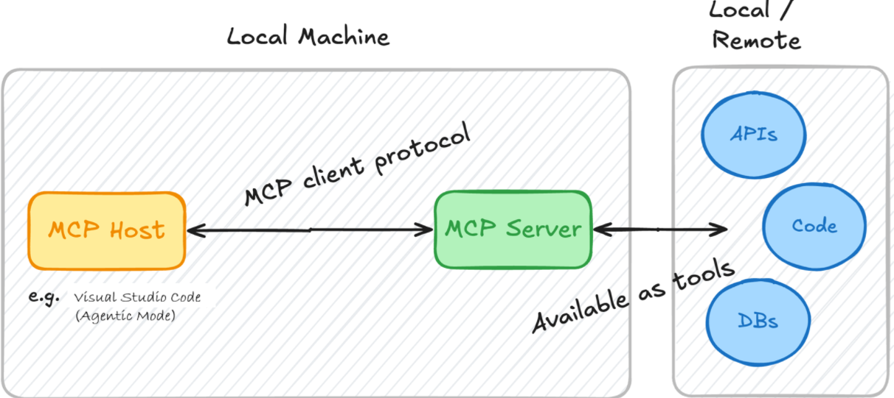
What is MCP (Model Context Protocol)?
Standardized Connection
MCP standardizes how AI tools like Copilot access external data sources securely and efficiently.
IDE( E.g., VS Code) acts as the MCP Host
that runs Copilot Agent Mode.
The Agent uses an LLM (Copilot model)
and connects to MCP Servers

Slide 4

Demo – Connecting MCP Servers
GitHub MCP Server Setup
MongoDB MCP Server Setup
Run → mcp: add server → choose HTTP
URL → https://api.githubcopilot.com/mcp/
"MongoDB": { "command": "npx", "args": [ "-y", "mongodb-mcp-server", "--connectionString", "mongodb://localhost:27017/myDatabase" ]}
Authorize via GitHub OAuth
✅ Confirm both connections appear in .vscode/mcp.json

Slide 5



Demo – Unified Workflow
Query MongoDB
[Action: Mongo MCP] Find tasks where status = "OVERDUE"
Process Results
Agent Mode analyzes overdue tasks and prepares GitHub issue creation
Auto-Create Issues
"Create GitHub issues for overdue tasks" - executed automatically
Outcome: Copilot automates end-to-end task management from database → GitHub, eliminating manual workflow steps.

Slide 6

Key Takeaways
Dynamic Context
Smarter Development
MCP empowers AI tools to access real-world context dynamically, making intelligent decisions.
GitHub + MongoDB MCP = Smarter code with fewer manual steps and enhanced productivity.
Unified Workflows
Agent Mode bridges code + data + collaboration into seamless developer experiences.

Slide 7
Q & A

Slide 8
Appendix
What is the Model Context Protocol (MCP)? - Model Context Protocol
Use MCP Servers - Visual Studio (Windows) | Microsoft Learn
GitHub Copilot Plugin for JetBrains IDEs | JetBrains Marketplace
modelcontextprotocol/servers: Model Context Protocol Servers
registry/docs at main · modelcontextprotocol/registry

Slide 9
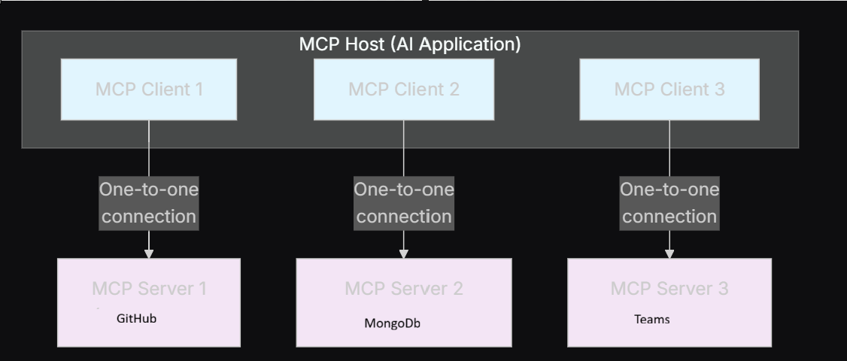
Appendix(continue…)
MCP Host: The AI application(E.g., VS Code) that coordinates and manages one or multiple MCP
MCP Client: A component that maintains a connection to an MCP server and obtains context from an MCP server for the MCP host to use.
The Visual Studio Code runtime instantiates an MCP client object(based on configuration in mcp.json) that maintains the connection with mcp server
MCP Server: A program that provides context to MCP clients. Can be Remote or Local. MCP servers are programs that expose specific capabilities to AI applications through standardized protocol interfaces.

Slide 10
Appendix(MCP detailed architecture)
MCP Host: The AI application(E.g., VS Code) that coordinates and manages one or multiple MCP
MCP Client: A component that maintains a connection to an MCP server and obtains context from an MCP server for the MCP host to use.
The Visual Studio Code runtime instantiates an MCP client object(based on configuration in mcp.json) that maintains the connection with mcp server
MCP Server: A program that provides context to MCP clients. Can be Remote or Local. MCP servers are programs that expose specific capabilities to AI applications through standardized protocol interfaces.

Slide 11
Appendix(RAG vs MCP servers)
RAG focuses on enriching an AI model's answers with up-to-date, relevant external information. It works by retrieving relevant documents or data (usually via vector databases and embeddings) and augmenting the model's prompt with that data before generating a response. RAG is ideal for tasks like enterprise knowledge search and Q&A systems.
MCP servers, on the other hand, provide a standardized protocol and a client-server architecture that let AI models interact with external tools, APIs, and data sources in real-time. MCP servers expose capabilities such as file access, API calls, database queries, or task executions. The LLM uses these by calling the MCP server tools as needed to perform actions or retrieve live data, enabling automation and dynamic workflows.

