Slide 1
RISHIKESH MORE
ShopSphere ETL Project
PostgreSQL • Data Quality • Dimensional Modeling • Analytics • Optimization
End-to-end pipeline: RAW → STAGING → CURATED → ANALYTICS → BI
ShopSphere Data Engineering Capstone | 1

Slide 2
1. Project Objective
Transform imperfect e-commerce source data into a trusted analytics layer.
Business Need
ShopSphere needs reliable customer, order, product, payment and shipment data for reporting and decision-making.
Engineering Goal
Profile raw data, clean and validate it, build dimensions and a fact table, then expose reusable analytics.
Quality Goal
Make anomalies visible instead of silently hiding them, while preventing invalid records from contaminating curated facts.

Slide 3
2. Source Data & Profiling
Eight raw tables were loaded into the shopsphere_raw schema.
customers
12 rows
customer_addresses
12 rows
categories
7 rows
products
14 rows
orders
13 rows
order_items
19 rows
payments
12 rows
shipments
12 rows
Profiling findings
Examples include inconsistent email formatting and an orphan order item: order_item_id 19 references order_id 5014, which does not exist in the orders table.

Slide 4
3. Pipeline Architecture
Layered design separates source preservation, data quality, trusted modeling and reporting.
RAW
Source-preserving
8 tables
STAGING
Clean • Standardize
Deduplicate • Flag
CURATED
Dimensions +
fact_order
ANALYTICS
Reusable business
metrics
BI
Charts &
presentation

Slide 5
4. Preprocessing & Data Quality
The staging layer keeps cleaning logic explicit and auditable.
TRIM() removes leading/trailing whitespace from names, emails and text fields.
LOWER() standardizes email addresses; UPPER() standardizes status fields.
ROW_NUMBER() OVER (PARTITION BY … ORDER BY updated_at DESC) keeps the latest duplicate.
CASE expressions classify missing/invalid emails, order items, payments and shipments.
Order-item prices are corrected when they differ materially from the product master.
Invalid order items remain visible in staging but are excluded from curated facts.

Slide 6
5. Curated Dimensional Model
fact_order grain: one row per valid order item.
dim_customer
customer_key
customer_id
full_name • email
dim_product
product_key
product_id
product_name • category_key
fact_order
order_id • order_item_id
customer_key • product_key • address_key
quantity • unit_price • discount • net_revenue
dim_address
address_key
address_id
state • country
dim_category
category_key
category_id
category_name

Slide 7
6. SQL Analytics
The analytics layer demonstrates both business logic and advanced SQL.
Aggregations
Monthly/daily revenue, order counts, average order value, product/category revenue.
Window Functions
Running revenue, 7-day rolling revenue, RANK(), DENSE_RANK(), and LAG().
Business Analysis
Customer lifetime value, top products by category, state revenue and previous-order analysis.
Reusable outputs
shopsphere_analytics.monthly_revenue • daily_revenue • product_performance • customer_lifetime_value

Slide 8
7. BI / Visualization Layer
Five reporting views were prepared from curated and analytics data.
Daily Revenue Trend
Line chart • Revenue over time
Product Revenue
Bar chart • Highest-revenue products
Category Revenue
Bar chart • Category contribution
Top Customers
Bar chart • Lifetime revenue
Revenue by State
Bar chart • Geographic performance

Slide 9
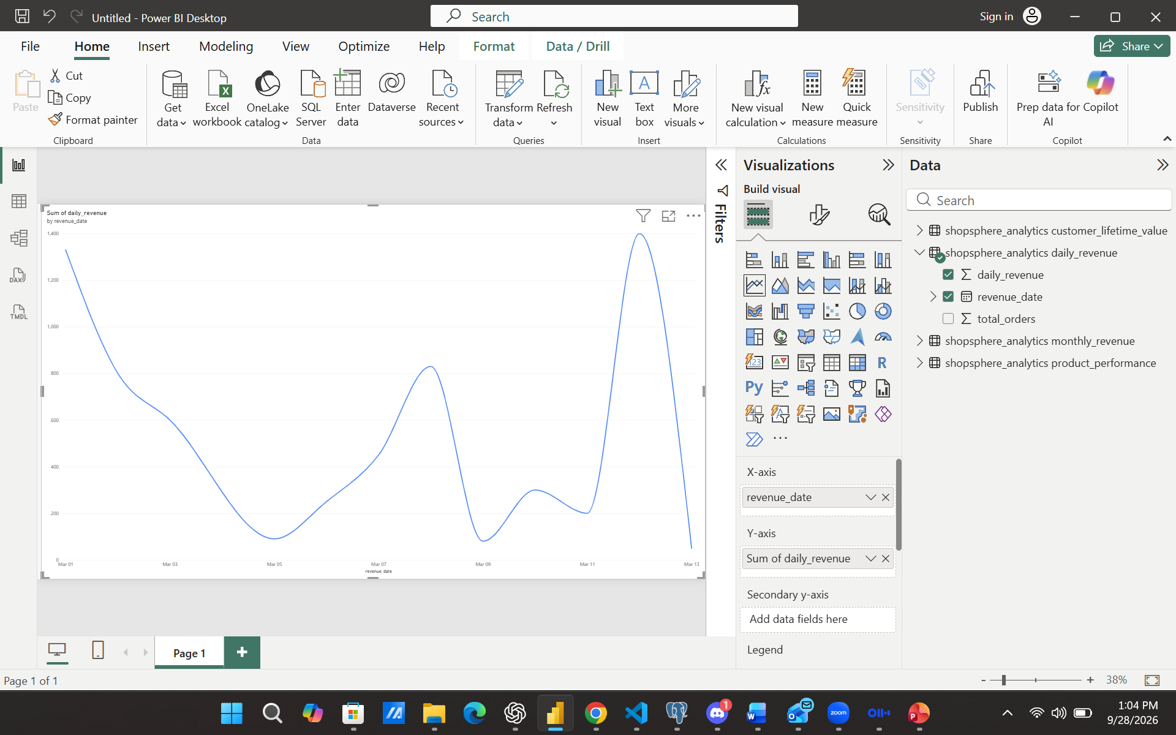

Slide 10
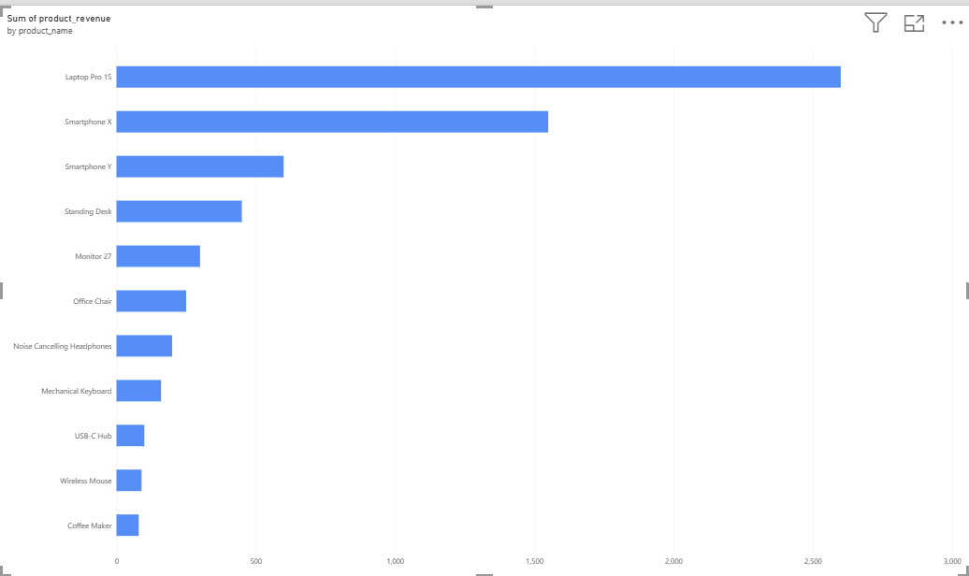

Slide 11
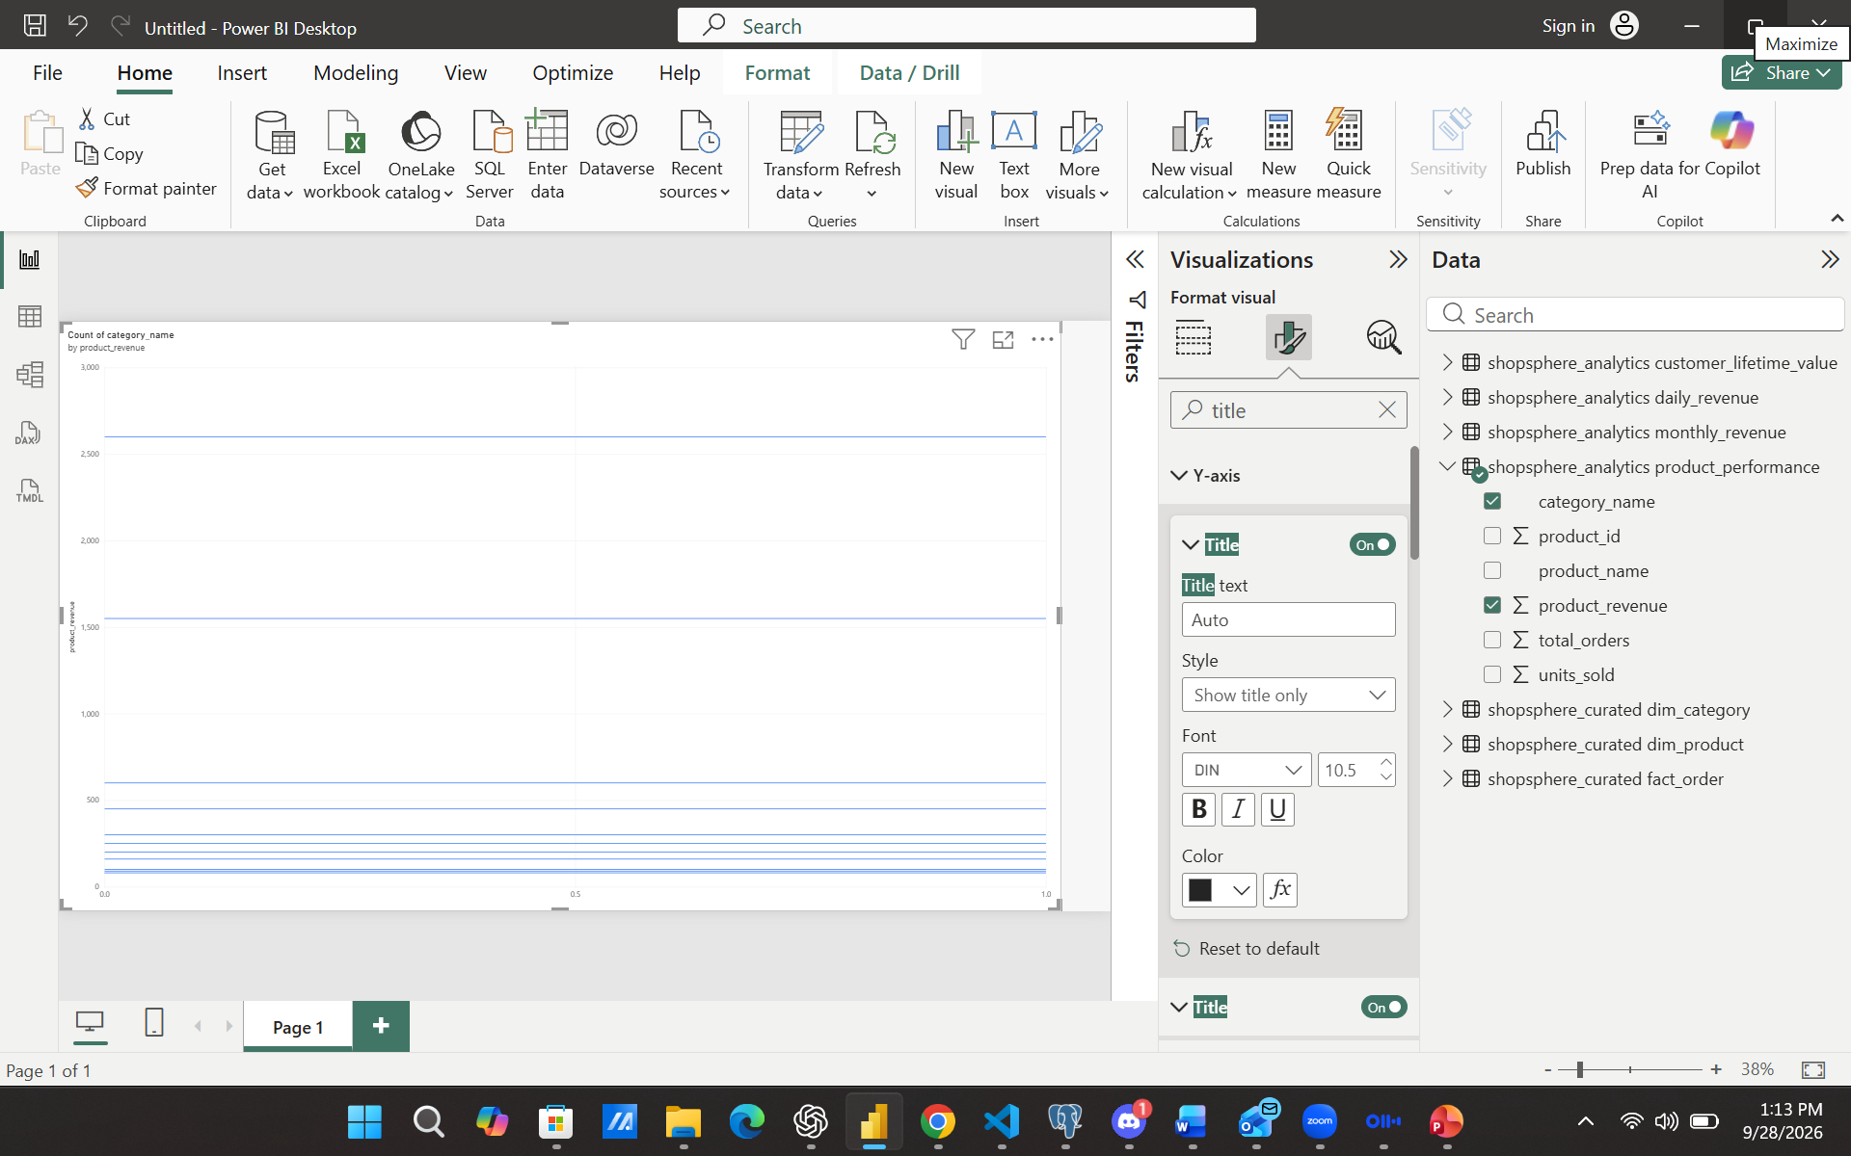

Slide 12
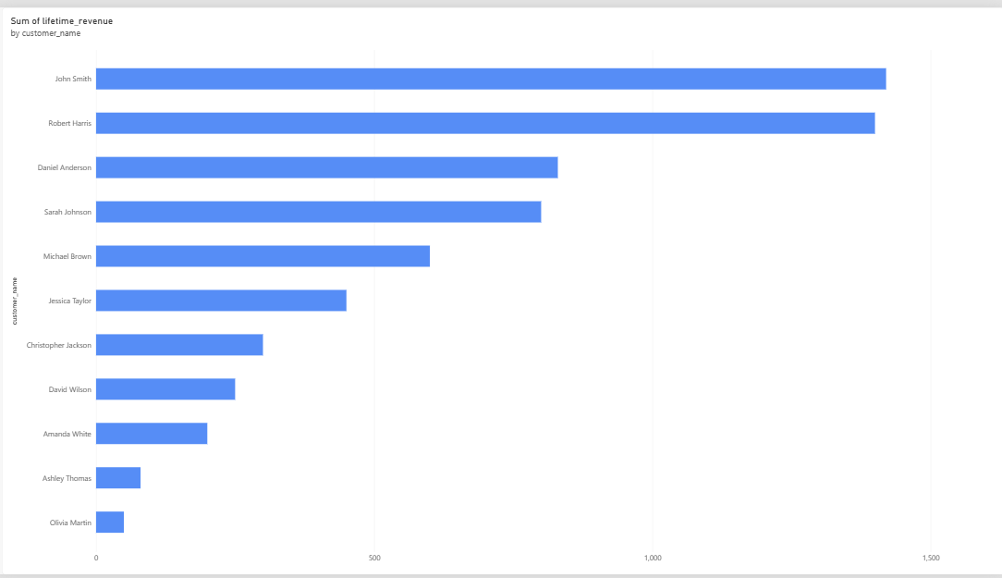

Slide 13
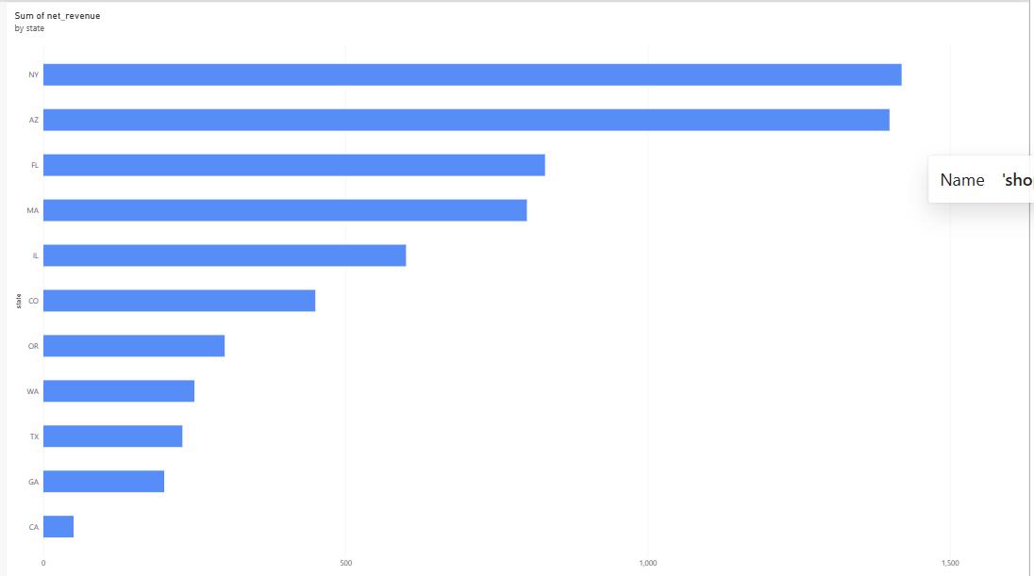

Slide 14
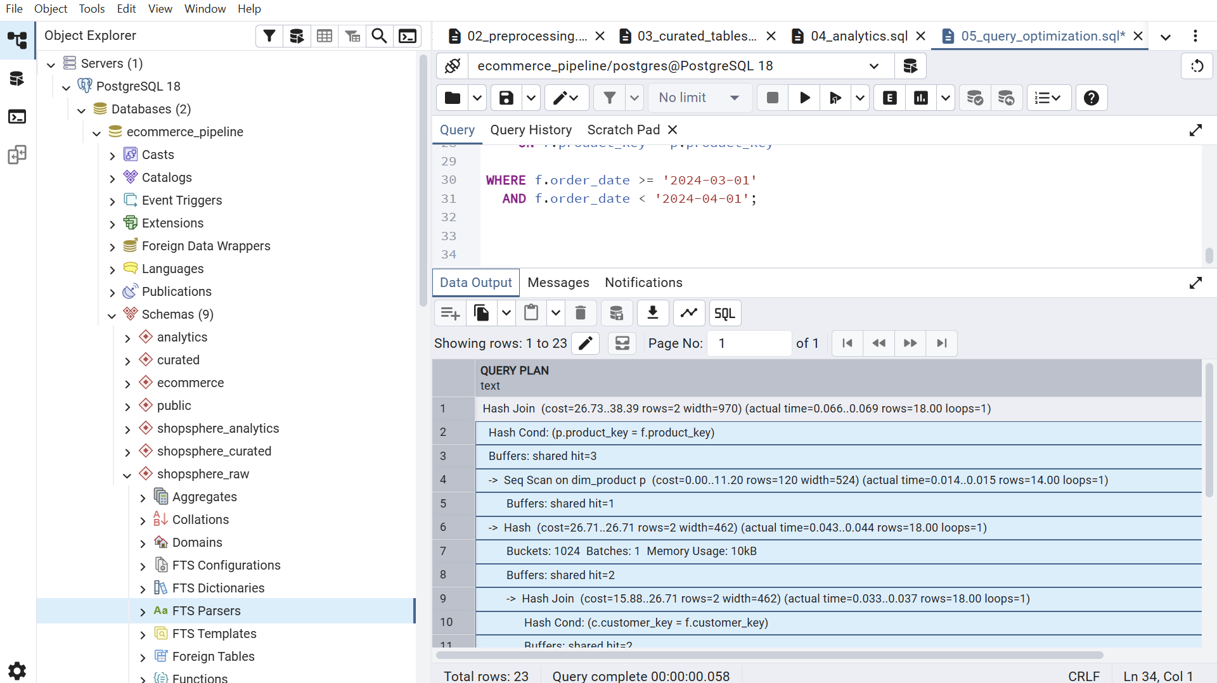
8. Query Optimization
EXPLAIN (ANALYZE, BUFFERS) was used to inspect real PostgreSQL execution plans.
Observed plan
The small sample uses Hash Joins and Sequential Scans; this is reasonable when tables contain only a handful of rows.
Indexes added
order_date, customer_key, product_key, address_key plus staging join keys.
Important interpretation
Indexes are production-oriented; a tiny table can be faster to scan sequentially than to traverse an index.
ShopSphere Data Engineering Capstone | 9

Slide 15
9. Production Scaling Strategy
How the same design can evolve beyond the classroom-sized dataset.
Partition very large fact tables by order_date to reduce scanned data.
Use selective indexes on common filters and foreign-key join columns.
Move from full refreshes to incremental ETL using updated_at watermarks.
Use idempotent upsert/merge patterns so reruns do not create duplicates.
Batch large transformations and pre-aggregate high-frequency BI metrics.
Maintain planner statistics and regularly inspect expensive queries with EXPLAIN ANALYZE.

Slide 16
10. Project Deliverables
The implementation is organized so each phase can be reviewed independently.
01_data_profiling.sql
Row counts, duplicates, email quality, orphan detection
02_preprocessing.sql
Cleaning, standardization, validation, staging tables
03_curated_tables.sql
Dimensions, keys, constraints and fact_order
04_analytics.sql
Business queries, CTEs, aggregations and window functions
05_query_optimization.sql
Indexes, EXPLAIN ANALYZE, statistics and scaling

Slide 17
Conclusion
Built an end-to-end PostgreSQL data pipeline from raw source tables to BI-ready analytics.
Applied explicit data-quality checks, deterministic deduplication logic and referential validation.
Created a dimensional curated layer with surrogate keys and one-row-per-valid-order-item fact grain.
Used advanced SQL for customer, product, revenue and time-series analytics.
Added performance instrumentation and a practical production scaling strategy.
ShopSphere Data Engineering Capstone | 12

