Slide 1

Presentation on
Chatbot For HR Department
Presented By:
Ajaykumar Kushwaha (41)
Damini Pandare (57)
Rishikesh Nanaware (52)
Guided By:
Prof. Nileema Pathak
Department of Information Technology
Atharva College of Engineering
Mumbai.

Slide 2
ABSTRACT
It is challenging task for HR people to find accurate data in huge databases regarding their queries. It is also tedious task to get suggestions for their problems. To simplify these, problems, we have designed a Chatbot for HR department, which will be able to answer FAQs related to HR department. In, this paper we have proposed a chatbot which can give response in different patterns like tables, graphs, etc. It can understand the meaning of different queries searching for same response and gives response according to that.

Slide 3
INTRODUCTION
Chat-bot For HR department will be able to answer questions, query results. Chatbot will be able to answer questions related to salary, attendance,it will give suggestions if it doesn't get proper answers for the user's query. Chatbot will have full HR data. Chatbot will be able to answer questions based on attendance like getting the attendance of a particular Chatbot gives response in various formats like text, tables, graphs, etc.

Slide 4
Literature Surveyed
Sr.no | Title | Author | Publication | Approach
1 | Chatbot for University Related FAQs | Bhavika R. Ranoliya , Nidhi Raghuwanshi and Sanjay Singh | International Conference on Advances In Computing Communications and Informatics 2017 | They developed a interactive chatbot for University related Frequently Asked Questions (FAQs). User discussion as a rule begins with welcome or general questions. User inquiries are first taken care by AIML check piece to check whether entered inquiry is AIML script or not. AIML is characterized with general inquiries and welcome which is replied by utilizing AIML formats.
2 | Automated Thai-FAQ Chatbot using RNN-LSTM | Panitan Muangkammuen,Narong Intiruk ,Kanda Runapongsa Saikaew | 22nd International Computer Science and Engineering Conference 2018 | They proposed and developed a Frequently Asked Questions (FAQs) Chatbot which automatically responds to customers by using a Recurrent Neural Network (RNN) in the form of Long ShortTerm Memory (LSTM) for text classification.
3 | Intelligent Chatting Service Using AIML | Saqib G, Faizan , Ghatte N | IEEE International Conference on Current Trends toward Converging Technologies, 2018 | AIML limits the bots to perform mathematical calculations, provide information about weather, news, recent updates etc. This paper describes the development of chat bots hosting service. This hosting website also provide API’s for Weather, News, Dictionary, web encyclopedia, Mathematical Calculations and much more and a global file to keep all bots updated that are hosted on the website.

Slide 5
PROBLEM STATEMENT
HR department is not able to get quick response to most of their queries , related to their employee. Due to which the productivity and efficiency of the company is affected. There is a need of user friendly virtual assistant that can make the HRs job easier.

Slide 6
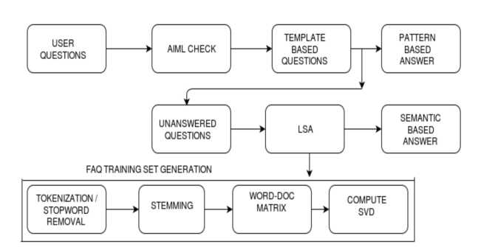
Block diagram

Slide 7
CONCLUSION
This project will definitely simplify the work of HR department by finding accurate answers to their questions. Chatbot developed will be continuously developing and learning from the data which is new to the system. Using this system HR department will no longer have to search in huge databases for their questions.

