Slide 1

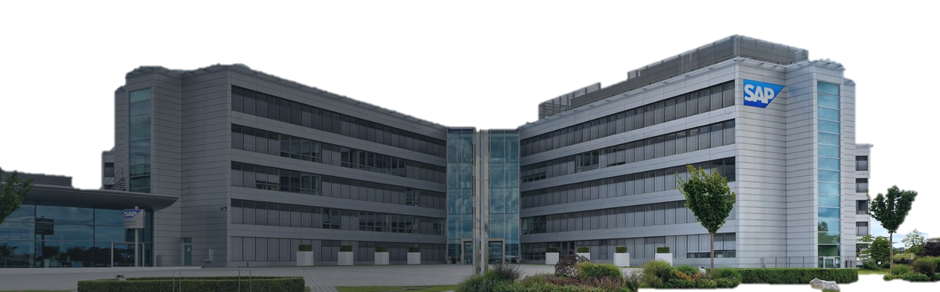

SAP

Slide 2

SAP
Exploring SAP Labs
Join us on a journey through the technology hub of SAP - SAP Labs, where innovation knows no bounds.

Slide 3



SAP
Small-Medium Enterprise (SME)
using SAP tool in Automobile Industry

Slide 4



Small-Medium Enterprise (SME)
using SAP tool in Automobile Industry
MASTER OF BUSINESS ADMINISTRATION OF GALGOTIAS UNIVERSITY
Submitted to :-
Project submitted by :- Rishikesh Pandey-

Slide 5

INTRODUCTION
The automotive sector can integrate and optimize various facets of their operations, including supply chain management, production planning, and financial processes.
The SAP tool facilitates real-time data access, fostering informed decision-making and enabling SME to respond swiftly to market demands.
This technology not only enhances operational efficiency but also promotes agility, positioning SMEs in the automobile industry to navigate challenges and capitalize on emerging opportunities in a highly competitive environment.
Efficient processes help SMEs gain a competitive edge in the fast-paced automobile industry.
Improving efficiency leads to reduced waste and optimized resource utilization, resulting in cost savings for SMEs.
Efficient processes enable SMEs to deliver products and services with quicker turnaround times, ensuring higher customer satisfaction.

Slide 6

Importance of Efficient Processes
1
Streamlined operation and
cost efficiency
Integration across function
Real-time visibility
Adaptability and compliance
2
Adaptability to industry changes
Regulatory compliance
3
Enhanced customer Satisfaction
Faster Response times
Quality management

Slide 7
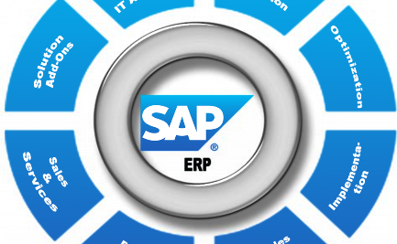

1
3
4
2
Streamlined operation and
cost efficiency
Product Development & Engineering
Application Development & Maintenance
Localization
Integration Across Functions: SAP tools enable seamless integration of various business functions such as finance, procurement, manufacturing, and supply chain.
Real-time Visibility:the automobile industry, having up-to-date information is crucial for decision-making. Real-time data helps in identifying bottlenecks, optimizing inventory levels, and making informed decisions to reduce costs.
Importance of Efficient Processes
Drive innovation - from idea to market-ready product - with the help of cutting-edge technology and engineering practices, fueled by our partner ecosystem
Bringing in diverse expertise in organizational, technological, and process operations to develop and maintain mission-critical applications
Deliver software products that meet global regulatory requirements, linguistic preferences, and cultural nuances in your local markets.

Slide 8


4
1
3
2
Streamlined operation and
cost efficiency
Enhanced Customer Satisfaction:
Application Development & Maintenance
Product Development & Engineering
Integration Across Functions: SAP tools enable seamless integration of various business functions such as finance, procurement, manufacturing, and supply chain.
Real-time Visibility:the automobile industry, having up-to-date information is crucial for decision-making. Real-time data helps in identifying bottlenecks, optimizing inventory levels, and making informed decisions to reduce costs.
Faster Response Times: the automobile industry to respond more quickly to customer demands and market changes. Quality Management: Ensuring the quality of automotive products is paramount for customer satisfaction and brand reputation. Streamlined processes for quality assurance, backed by SAP, can help SMEs in maintaining and improving product quality.
Importance of Efficient Processes
Bringing in diverse expertise in organizational, technological, and process operations to develop and maintain mission-critical applications
Drive innovation - from idea to market-ready product - with the help of cutting-edge technology and engineering practices, fueled by our partner ecosystem

Slide 9

1
2
4
3
Streamlined operation and
cost efficiency
Enhanced Customer Satisfaction
Adaptability and Compliance
Application Development & Maintenance
Integration Across Functions: SAP tools enable seamless integration of various business functions such as finance, procurement, manufacturing, and supply chain.
Real-time Visibility:the automobile industry, having up-to-date information is crucial for decision-making. Real-time data helps in identifying bottlenecks, optimizing inventory levels, and making informed decisions to reduce costs.
Adaptability to Industry Changes:The automobile industry is dynamic, with frequent changes in regulations, market demands, and technological advancements.
Regulatory Compliance: The automobile industry is subject to numerous regulations, both in terms of manufacturing standards and environmental considerations.
Importance of Efficient Processes
Faster Response Times: the automobile industry to respond more quickly to customer demands and market changes. Quality Management: Ensuring the quality of automotive products is paramount for customer satisfaction and brand reputation. Streamlined processes for quality assurance, backed by SAP, can help SMEs in maintaining and improving product quality.
Bringing in diverse expertise in organizational, technological, and process operations to develop and maintain mission-critical applications

Slide 10

Case studies : successful implementation
A small to medium enterprise successfully implemented efficient processes through the integration of SAP tools. By leveraging SAP comprehensive suite of solutions, the SME streamlined various aspects of its operations, including supply chain management, production planning, and customer relationship management. This implementation led to improved visibility across the entire value chain, enabling real-time data analysis and informed decision-making. The automation of key processes not only enhanced operational efficiency but also facilitated better resource allocation and cost control. As a result, the SME experienced increased productivity, reduced lead times, and heightened overall competitiveness in the dynamic landscape of the automobile industry.

Slide 11

SAP Modules for Automobile SME
The automobile industry, utilizing SAP tools can greatly enhance efficiency across various processes.
SAP offers a range of modules tailored to meet the specific needs of the automotive sector. Key modules for an SME in the automobile industry may include SAP ERP to streamline and integrate core business processes such as finance, procurement, and supply chain management.
The SAP Product Lifecycle Management module can aid in managing product development and lifecycle processes, ensuring seamless collaboration among different departments. Additionally, SAP Customer Relationship Management can be employed to enhance customer engagement and satisfaction.
The automobile industry can achieve greater operational efficiency, improved data visibility, and enhanced decision-making capabilities.

Slide 12
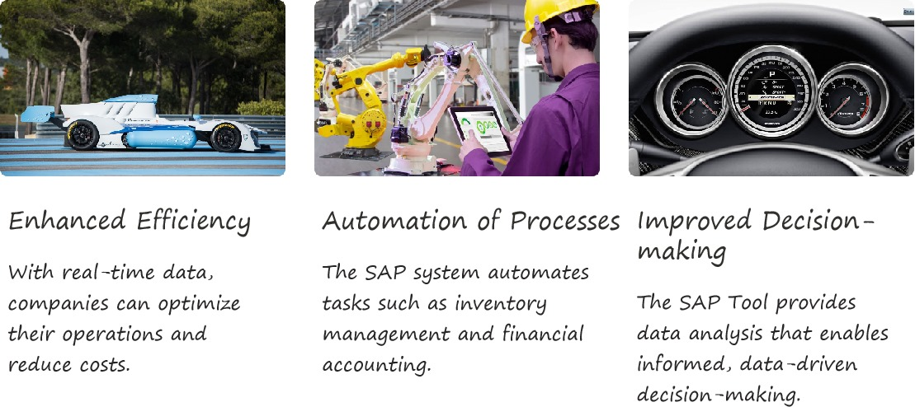

Benefits of Using SAP Tool in the Automobile Industry

Slide 13



Challenges and solutions
SME often face resource constraints, both in terms of financial investments and skilled personnel, making the initial adoption of SAP tools challenging. Adapting existing processes to align with SAP integrated approach can lead to resistance from employees accustomed to traditional workflows.
Training programs are essential to upskill the workforce and ensure a smooth transition. Furthermore, leveraging cloud-based solutions within SAP can alleviate the burden of infrastructure costs for SME. Continuous monitoring and feedback loops help refine the system over time, ensuring it aligns seamlessly with the unique needs of the SME in the dynamic automobile industry.
Training programs are essential to upskill the workforce and ensure a smooth transition. Furthermore, leveraging cloud-based solutions within SAP can alleviate the burden of infrastructure costs for SME. Continuous monitoring and feedback loops help refine the system over time, ensuring it aligns seamlessly with the unique needs of the SME in the dynamic automobile industry.

Slide 14

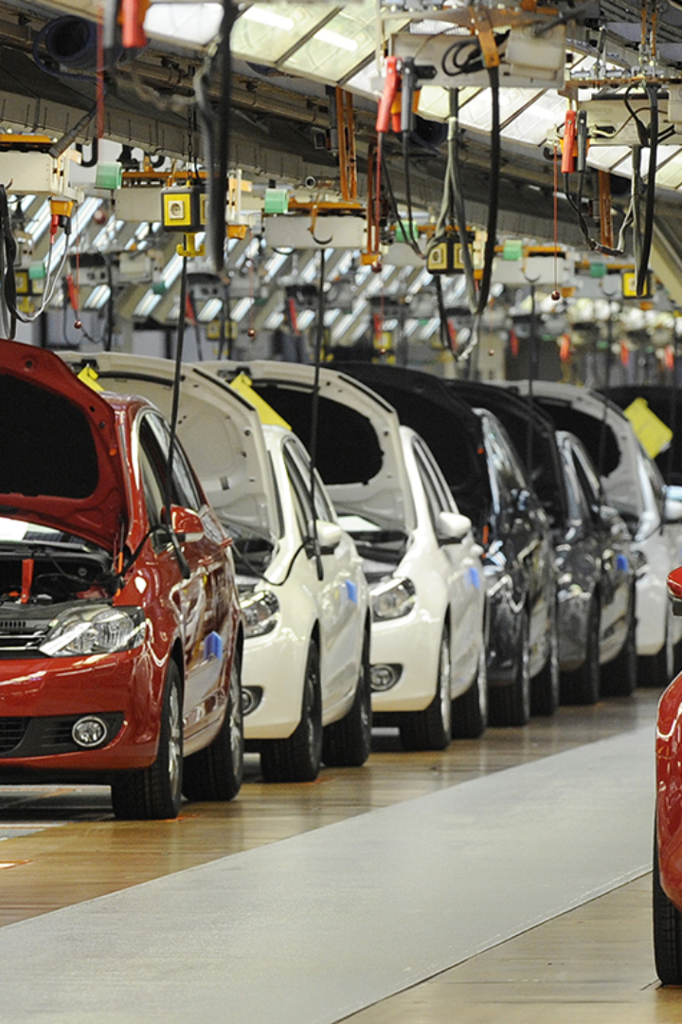

interconnected workflow
conclusions
Conclusion
1
Driving Success 🚀
The Automobile Industry has proven to be a transformative and highly efficient solution. By integrating SAP systems, SME can streamline their processes, enhance overall operational efficiency, and gain a competitive edge in the dynamic automotive sector. The SAP tool enables effective management of various business functions, from supply chain and inventory management to finance and customer relations, fostering a seamless and interconnected workflow. This not only reduces operational complexities but also improves decision-making processes through real-time data insights. As SMEs in the Automobile Industry continue to embrace SAP tools, they are well-positioned to adapt to evolving market demands, enhance productivity, and achieve sustainable growth in the highly competitive landscape of the automotive sector.
Efficiency is paramount in the constantly evolving automobile industry. SMEs can leverage SAP to streamline their operations, reduce costs, and drive sustainable growth.
2
Take Action Today
Join the league of successful SMEs utilizing SAP to enhance efficiency. Explore the potential of SAP for your business and unlock a world of opportunities.
3
Take Action Today
The SAP tool enables effective management of various business functions, from supply chain and inventory management to finance and customer relations, fostering a seamless and interconnected workflow.

Slide 15


THANK YOU

