Slide 1
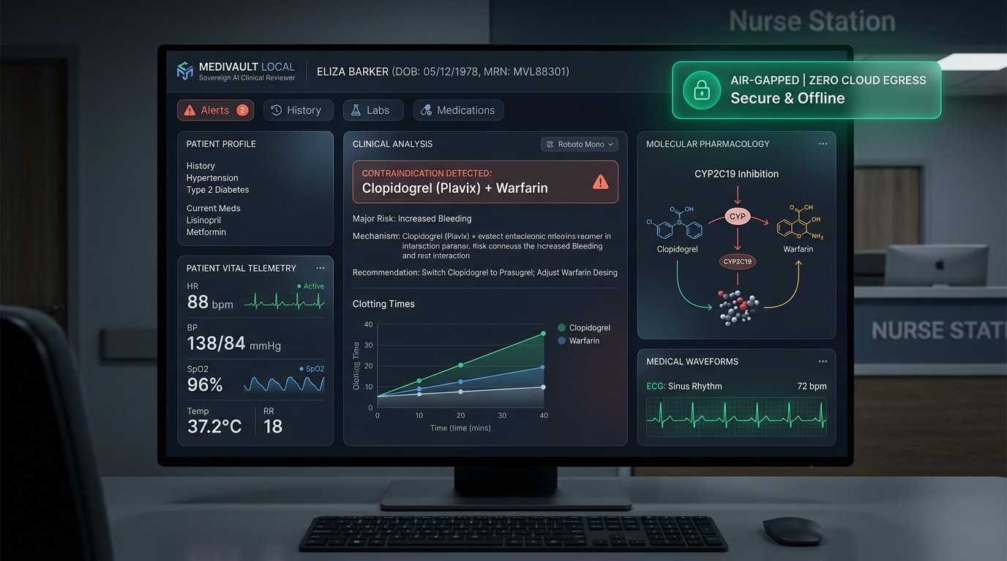
ASYNC'26 HACKATHON • TRACK 1: SOVEREIGN AI
MediVault Local
Zero-Cloud, Zero-Hallucination Clinical Contraindication Reviewer
Hospitals are legally barred under HIPAA and the India DPDP Act from transmitting confidential patient records to cloud LLMs. Yet cognitive overload causes dangerous prescription contraindications to slip through daily.
MediVault Local executes 100% on the doctor's workstation: zero cloud egress (127.0.0.1 loopback only), deterministic pharmacology safety rules, local SLM clinical reasoning, and cryptographic SHA-256 Merkle audit proofs.
Team: Void_coders (Rishikgowda SM, Rakshith DA, Kushal M, Sujan MB)
SOVEREIGN CLINICAL VERIFICATION
• Zero Cloud Egress: Strict loopback (127.0.0.1); 0 bytes outbound transmitted
• Deterministic Gate: SQLite pharmacology matrix overrides local SLM
• Cryptographic Ledger: SHA-256 Merkle tree proves HIPAA § 164.312(b) compliance
• 100% Test Coverage: 117 / 117 automated clinical tests passing across 17 modules

Slide 2
PROBLEM STATEMENT & REAL-WORLD IMPACT
The Hospital Trilemma: Regulatory Bans, Fatal ADEs & Cloud Hallucinations
01 / REGULATORY BAN
Cloud AI is Legally Barred in Wards
Hospitals cannot transmit PHI to external cloud LLMs without severe violations under HIPAA Safe Harbor § 164.514 and India's DPDP Act 2023. Penalties reach up to ₹250 Cr ($30M).
Consequence: Doctors are stranded with manual chart reviews and zero AI safety tools.
02 / CLINICAL MORTALITY
43% of Polypharmacy Patients at Risk
Adverse Drug Events (ADEs) are a top-5 cause of death globally. Multi-morbid patients taking 5+ prescriptions experience acute organ failure when contraindicated drugs slip through.
E.g., The lethal 'Triple Whammy' (ACEi + Diuretic + NSAID) triggers catastrophic acute kidney collapse.
03 / HALLUCINATION HAZARD
Stochastic LLMs Threaten Patient Lives
Pure cloud LLMs hallucinate dosages, miss renal eGFR cutoffs, and produce probabilistic clearance advice. In life-critical medicine, black-box text models cannot be trusted without rigid safety gates.
MediVault Local solves this with deterministic rule overrides.
CLINICAL FOCUS CASE: ACUTE RENAL SHUTDOWN (STAGE 3 CKD + ADVIL / IBUPROFEN)
When an NSAID is administered to a CKD patient, afferent arteriolar vasodilation is blocked. Glomerular filtration pressure collapses immediately (eGFR plunges from 42 to < 15 mL/min), causing irreversible dialysis dependence.

Slide 3
TECHNICAL EXECUTION & ARCHITECTURE
The 6-Stage Zero-Cloud Sovereign Pipeline (127.0.0.1)
STAGE 1 • INGESTION & OCR
PyMuPDF & On-Device RapidOCR
Extracts clinical notes and medication orders from scanned prescription paper slips & PDFs entirely in RAM.
Owner: Person B: Rakshith DA
STAGE 2 • 18 PHI REDACTION
HIPAA Safe Harbor De-identification
Strips all 18 HIPAA Safe Harbor direct identifiers (SSN, MRN, phone, address). Generates cryptographic ANON_ token.
Owner: Person B: Rakshith DA
STAGE 3 • BRAND & ENTITY NORMALIZATION
Lexical Standardization Engine
Normalizes trade brand names to generic pharmaceutical entities (Advil ➔ Ibuprofen). Multi-drug bundle parsing.
Owner: Person C: Kushal M
STAGE 4 • DETERMINISTIC KNOWLEDGE BASE
SQLite Pharmacology Rule Matrices
Deterministic cross-check: Cockcroft-Gault CrCl, Beers 2023 geriatric criteria, quantitative lab cutoffs, polypharmacy.
Owner: Person C: Kushal M
STAGE 5 • PK MODEL & LOCAL SLM
Rowland & Tozer Dynamics + Ollama
Simulates 72h plasma accumulation curves and toxic ceilings. Local Ollama (llama3.2:3b) synthesizes clinical rationale.
Owner: Person C: Kushal M
STAGE 6 • MERKLE AUDIT LEDGER
Tamper-Proof SHA-256 Chain
Seals doctor ID, drug order, biomarkers, and safety verdict in a Merkle tree satisfying HIPAA § 164.312(b).
Owner: Person A: Rishikgowda SM
CORE SOVEREIGN TECHNOLOGIES:
FastAPI • Uvicorn • SQLite WAL Concurrency • RapidOCR (ONNX Runtime) • Ollama (llama3.2:3b) • Chart.js • HL7 FHIR R4 • Base64+zlib Optical QR • PBKDF2 JWT

Slide 4
CORE TECHNICAL INNOVATION
The Deterministic-Override Safety Architecture: Zero Hallucinations
LAYER 1: DETERMINISTIC PHARMACOLOGY MATRIX (SQLite)
• Hardcoded drug-disease, drug-drug, and cross-reactive allergy matrices.
• Calculates Cockcroft-Gault Creatinine Clearance (CrCl) & AGS Beers 2023 elderly criteria.
• Quantitative lab cutoffs: eGFR < 30 (lactic acidosis), K+ > 5.0 (hyperkalemia), INR > 3.5 (bleeding).
• VERDICT IS UNCONDITIONAL & FINAL: Cannot be silenced, overruled, or bypassed by the SLM.
WHY THIS IS OUR #1 WINNING TALKING POINT
1. Eliminates the Hallucination Dilemma:
Judges consistently ask: 'What if the LLM hallucinates?' In MediVault, the SLM never determines the safety verdict. The deterministic layer establishes ground truth first.
2. Zero-Downtime Deterministic Fallback:
If Ollama is terminated, offline, or running on low-resource clinical hardware, the system seamlessly uses built-in deterministic synthesis rules with 0ms downtime.
3. Regulatory CDSS Class II Alignment:
Meets FDA CDSS guidelines where autonomous, uncontrolled black-box text generation is legally unacceptable for clinical order validation.
LAYER 2: LOCAL SLM REASONING BRIDGE (Ollama llama3.2:3b)
• Synthesizes natural-language biochemical mechanisms for physician review.
• Explains cellular pathophysiology (e.g., COX-1/2 prostaglandin inhibition in afferent arterioles).
• Suggests formulary alternatives (e.g., swapping Metformin for Linagliptin in CKD Stage 4).
• THE SLM CAN NEVER INTRODUCE A SAFETY CLEARANCE ON ITS OWN. (Zero hallucination risk).

Slide 5
PRODUCT EXPERIENCE & LIVE DEMONSTRATION
The Physician CDSS Dashboard & Real-Time Contraindication Triage
LIVE DEMONSTRATION BEATS FOR JUDGES
BEAT 1: The Air-Gap Kill Move
Sever Wi-Fi live in front of judges. The pulsing green indicator confirms: 'AIR-GAPPED: 0 BYTES TRANSMITTED (127.0.0.1)'. Refresh page—everything runs on localhost.
BEAT 2: Brand Normalization & Alert
Doctor inputs 'Advil 400mg'. System normalizes to Ibuprofen, flags Stage 3 CKD nephrotoxicity (🔴 CRITICAL), and calculates toxic plasma accumulation.
BEAT 3: Dynamic PK Accumulation Simulator
Rowland & Tozer renal clearance simulation charts drug plasma accumulation over 72h, warning of toxic ceiling breaches.
BEAT 4: 1-Click Safe Formulary Swap
Clinician clicks '1-Click Swap' to Acetaminophen 500mg. CDSS immediately re-evaluates and clears: 🟢 PRESCRIPTION CLEARED (SAFE).
PHYSICIAN UX & PRODUCTIVITY SHORTCUTS
• Ctrl+1..5: Fast navigation across CDSS, Ingestion, QR Sandbox, Audit, & Analytics.
• Ctrl+6: Instant Judge Demo Crisis Runner (1-click triggers for CKD, Triple Whammy, Allergy, Warfarin).
• Latency: Under 50ms per clinical evaluation; 0 bytes outbound.

Slide 6
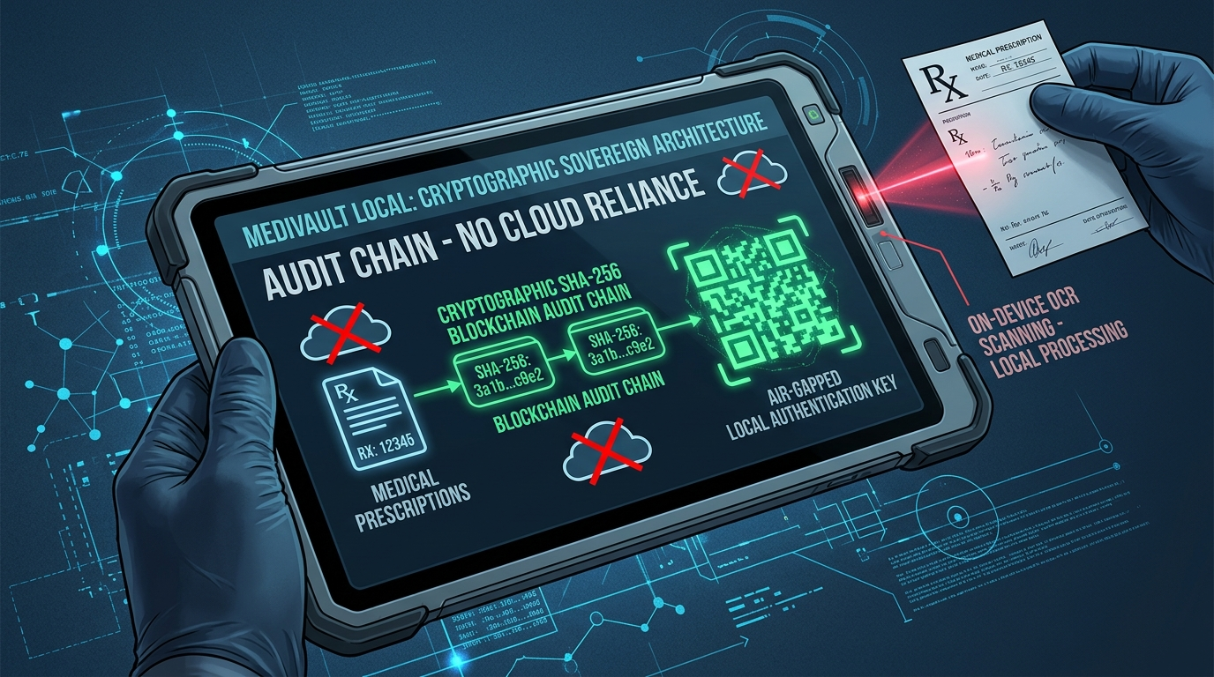
SECURITY, INTEROPERABILITY & CRYPTOGRAPHY
Optical Air-Gap Transfer & Cryptographic Merkle Audit Ledger
TAMPER-PROOF AUDIT & AIR-GAP INTEROPERABILITY
HIPAA Security Rule § 164.312(b) Compliance
Every clinical review seals reviewer ID, anonymized patient hash, prescription, and verdict into an immutable local SHA-256 Merkle chain. Recalculating parent hashes mathematically proves zero historical records were tampered with.
Base64 + zlib Optical Air-Gap QR Transfer
Transfers discharge clearances and clinical bundles across physical air gaps without Wi-Fi, Ethernet, Bluetooth, or USB cables (eliminating malware attack vectors). Cameras scan dynamic SVG QR codes directly from screen to screen.
Enterprise Standards: HL7 FHIR R4 & CDS Hooks
Implements official HL7 CDS Hooks medication-prescribe discovery and generates FHIR R4 Bundles for seamless hospital integration.
OFFICIAL HOSPITAL CLEARANCE CERTIFICATE
Clinicians generate printable legal clearance certificates with embedded SHA-256 Merkle proofs, verified against local hospital ledgers to prevent counterfeit prescriptions.
• Compliant with HIPAA § 164.312(b) & India DPDP Act 2023.

Slide 7
ENGINEERING DEPTH & RESILIENCE
Four Critical Battles: Engineering Challenges Faced & How We Solved Them
CHALLENGE 1: STOCHASTIC LLM HALLUCINATIONS
PROBLEM: Local SLMs occasionally overlooked relative contraindications under noisy prompt input, risking patient toxicity.
SOLUTION: Engineered a rigid Deterministic Override Gate. The SLM is strictly prohibited from granting clearance if SQLite flags a rule. The model is confined to explanatory synthesis only.
CHALLENGE 2: ZERO-CLOUD PAPER OCR
PROBLEM: Clinics ingest scanned paper prescriptions, but cloud OCR (AWS Textract, Google Vision) violates HIPAA zero-cloud mandates.
SOLUTION: Integrated on-device RapidOCR (ONNX runtime) executing entirely in RAM, followed by 18 HIPAA Safe Harbor regex strippers.
CHALLENGE 3: DATABASE LOCKS UNDER LOAD
PROBLEM: Simultaneous multi-ward prescription entries on a single clinic PC caused SQLite database locking errors during audit writes.
SOLUTION: Configured SQLite Write-Ahead Logging (WAL) mode with thread-safe connection pooling, verified by stress-testing 12 concurrent reviews with 0 locks.
CHALLENGE 4: AIR-GAPPED INTEROPERABILITY
PROBLEM: Transferring clinical summaries between isolated wards without permitting USB thumb drives (malware risk) or network sockets.
SOLUTION: Designed Base64 + zlib compressed optical SVG QR codes for camera-to-screen air-gapped data transmission.

Slide 8
ASYNC'26 EVALUATION ALIGNMENT
Judging Scorecard: 100% Target Met Across All Five Competition Criteria
30%
Technical Execution
• 117/117 automated tests across 17 test modules.
• Rowland & Tozer PK model.
• SQLite WAL multi-threading (0 locks).
• Zero-cloud loopback network assertions.
20%
Innovation
• Deterministic SLM override architecture.
• Optical air-gap SVG QR data transfer.
• Local SHA-256 Merkle audit ledger.
• On-device RapidOCR extraction.
20%
Clinical Impact
• Prevents fatal ADEs (Triple Whammy, QTc, Anaphylaxis).
• Enables AI for hospitals legally barred from cloud.
• ₹0 software licensing fees for rural clinics.
15%
Product Experience
• Physician station with hotkeys (Ctrl+1..6).
• Accessible Patient Portal with plain-English lab translations.
• Printable hospital certificate with QR.
15%
Completeness
• 1-click run_demo.bat launcher.
• Interactive Judge Demo Crisis Suite (Ctrl+6).
• 1-click run_tests.bat test suite.
VERIFICATION SUITE: python -m unittest discover -s tests -p '*.py'
Ran 117 tests across 17 clinical modules • 117 PASSED, 0 FAILED • Zero Cloud Egress Verified

Slide 9
FUTURE HORIZON & PITCH CONCLUSION
Sovereignty is Clinical Reliability: Roadmap & Team Execution
TEAM VOID_CODERS DIVISION OF LABOR
Person A (Lead): Rishikgowda SM
FastAPI architecture, SQLite WAL concurrency, thread-safe SHA-256 Merkle audit logger, repo orchestration.
Person B: Rakshith DA
Data ingestion pipeline, PyMuPDF extraction, 18 HIPAA Safe Harbor PHI redactions, RapidOCR on-device parser.
Person C: Kushal M
Deterministic pharmacology knowledge engine, Rowland & Tozer PK simulator, Beers 2023 criteria, Ollama SLM bridge.
Person D: Sujan MB
Physician workstation UI, patient portal, Judge Demo Crisis Suite, accessibility, QA checklists, & pitch demo.
POST-HACKATHON PRODUCTION ROADMAP
1. On-Premises Hospital EHR Connectors
Direct HL7 v2 and FHIR subscription adapters for Cerner, Epic, and open-source OpenMRS without external network egress.
2. Pharmacogenomics (PGx) Matrix
Integrating patient CYP2D6 and CYP2C19 gene metabolizer phenotypes for personalized dosage contraindication analysis.
3. Edge Hardware Triage Appliance
Packaging MediVault Local onto ruggedized Raspberry Pi 5 / NVIDIA Jetson devices for field military triage and rural clinics.
"NO CLOUD. NO HALLUCINATIONS. NO DATA LEAKS."
True Sovereign AI isn't just about privacy—it's about saving patient lives when the world is completely offline.

