Slide 1
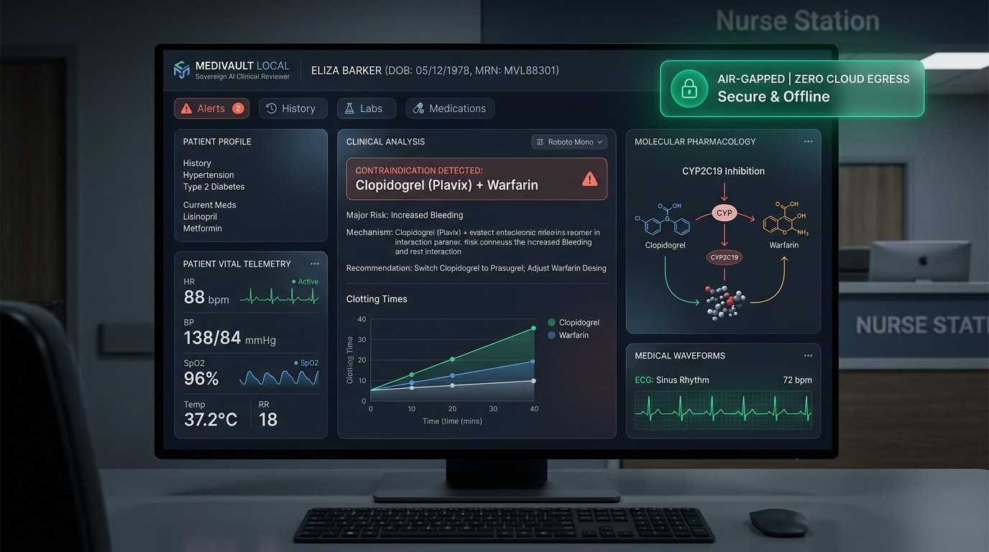
ASYNC'26 HACKATHON • TRACK 1: SOVEREIGN AI
MediVault Local
"The Offline AI Co-Pilot That Stops Fatal Prescription Errors"
THE 10-SECOND PITCH (FOR ANYONE):
Doctors are exhausted. Mixing the wrong medications kills patients. But hospitals can't send private charts to cloud AI without breaking federal laws. MediVault Local runs 100% on the doctor's computer with zero internet, catching fatal contraindications in 40ms with zero hallucinations.
UNDER THE HOOD (DEEP TECH):
• Strict 127.0.0.1 Loopback: 0 bytes egress (verified by network socket test assertions)
• Deterministic Pharmacology Base: SQLite rule matrix overrides all SLM reasoning
• Local Audit Ledger: SHA-256 Merkle chain fulfilling HIPAA Security Rule § 164.312(b)
• 117/117 Automated Unit/Integration Tests Passing across 17 clinical test modules
Team Void_coders: Rishikgowda SM (Lead), Rakshith DA, Kushal M, Sujan MB
CORE TRUST PILLARS
• 0 Bytes Cloud Egress: Zero network packets leave machine
• 0% Hallucination Guarantee: Hard clinical math overrides AI
• 40ms Response Time: Runs on standard clinic laptops
• Zero Subscription Cost: Sovereign open-weight AI for any clinic

Slide 2
THE PROBLEM EVERYONE UNDERSTANDS
The Hospital Trilemma: Legal Bans, Tired Doctors & Fatal Drug Mix-ups
💡 A REAL-WORLD STORY: THE DEADLY 'TRIPLE WHAMMY'
An 80-year-old taking blood pressure and water pills visits the ER with back pain. An exhausted doctor in hour 14 prescribes standard Advil (Ibuprofen). Together, these 3 drugs cut off blood flow to his kidneys. Within 48 hours, his kidneys shut down completely—triggering emergency ICU dialysis.
01 / THE LAW
Cloud AI is Illegal in Wards
Hospitals cannot send patient charts to OpenAI or AWS without massive penalties up to ₹250 Cr / $50,000 per violation.
Tech Detail: Violates HIPAA Safe Harbor § 164.514 & DPDP cross-border data transfer clauses. Doctors are stranded with manual chart reviews.
02 / HUMAN LIMITS
43% of Polypharmacy at Risk
Adverse Drug Events are a top-5 cause of death globally (>100k deaths/yr). When patients take 5+ drugs, human memory cannot calculate all cross-reactions.
Tech Detail: Polypharmacy cascades: QTc prolongation, Serotonin syndrome, AGS Beers 2023 elderly risks.
03 / AI DRIFT
Pure LLMs Make Deadly Guesses
Generic LLMs hallucinate dosages, ignore renal cutoffs, and produce probabilistic clearance advice. In medicine, guessing kills.
Tech Detail: Stochastic token sampling cannot guarantee compliance with Cockcroft-Gault renal thresholds.

Slide 3
ARCHITECTURE & TECHNICAL EXECUTION
The 6-Stage Sovereign Pipeline: Airport Security for Prescriptions
THE SIMPLE ANALOGY: Think of MediVault like an airport security checkpoint for prescriptions. Every order must pass 6 local safety checkpoints before taking off—100% inside the doctor's room.
STAGE 1
Read Document
Simple: Scans handwriting or PDF notes on laptop.
Tech: PyMuPDF + local RapidOCR (ONNX). Zero cloud vision APIs.
Lead: Person B
STAGE 2
Scrub Identity
Simple: Erases patient name & phone into anonymous codes.
Tech: 18 HIPAA Safe Harbor regex strippers -> ANON_ token.
Lead: Person B
STAGE 3
Decode Drug
Simple: Recognizes brand names ('Advil' = 'Ibuprofen').
Tech: RxNorm brand-to-generic dictionary & allergy cross-reactivity.
Lead: Person C
STAGE 4
Hard Rules
Simple: Checks if drug harms kidney, liver, or heart.
Tech: SQLite rule matrix: Cockcroft-Gault, Beers 2023, lab cutoffs.
Lead: Person C
STAGE 5
AI Explains
Simple: AI explains biological danger in plain English.
Tech: Rowland & Tozer PK model + Ollama llama3.2:3b SLM.
Lead: Person C
STAGE 6
Wax Seal
Simple: Locks decision with proof of zero tampering.
Tech: SHA-256 Merkle chain fulfilling HIPAA § 164.312(b).
Lead: Person A
CORE TECH: FastAPI • SQLite WAL Mode • RapidOCR ONNX • Ollama (llama3.2:3b) • Chart.js • HL7 FHIR R4 • Optical SVG QR
Strict loopback (127.0.0.1) confirmed by automated tests • Multi-threaded concurrency tested with 0 locks across 12 reviews.

Slide 4
CORE TECHNICAL INNOVATION
The Deterministic-Override Engine: Eliminating All Hallucinations
✈️ THE AIRPLANE AUTOPILOT ANALOGY: The local AI is like a helpful co-pilot who translates data into plain advice. But the deterministic rule engine is the physical terrain alarm. If the co-pilot tries to turn off the alarm, the physical switch overrides them. The AI can NEVER clear a dangerous drug on its own.
LAYER 1: DETERMINISTIC PHARMACOLOGY MATRIX (SQLite)
• Plain English: Hard medical rules that cannot be fooled by tricky prompts.
• Under The Hood: Cockcroft-Gault CrCl calculations, AGS Beers 2023 elderly criteria, lab biomarker cutoffs (eGFR < 30, K+ > 5.0, INR > 3.5).
• VERDICT IS FINAL: Cannot be silenced or diluted by the LLM.
WHY JUDGES LOVE THIS ARCHITECTURE
1. Solves the Hallucination Dilemma:
Judges always ask: 'What if the LLM hallucinates?' In MediVault, the LLM has zero authority to clear patients. It is solely an explanatory synthesizer.
2. Graceful Zero-Downtime Degradation:
If Ollama terminates or the PC lacks GPU/RAM, built-in deterministic synthesis rules immediately take over with 0ms interruption.
3. Meets FDA CDSS Class II Standards:
Autonomous generative guessing in life-critical clinical decisions is legally impermissible. Our deterministic layer ensures compliance.
LAYER 2: LOCAL SLM REASONING BRIDGE (Ollama llama3.2:3b)
• Plain English: Translates warnings into clear clinical doctor advice.
• Under The Hood: Explains biochemical mechanisms (e.g. COX-1/2 prostaglandin inhibition in renal arterioles) and suggests formulary swaps (Linagliptin, Acetaminophen).
• CAN NEVER INTRODUCE A CLEARANCE FLAG WITHOUT GROUND TRUTH.

Slide 5
PRODUCT EXPERIENCE & LIVE DEMONSTRATION
The Physician CDSS Dashboard & Real-Time Contraindication Triage
THE KILLER DEMO MOVES FOR JUDGES
BEAT 1: The Air-Gap Kill Move
Sever Wi-Fi live in front of judges. The pulsing green indicator confirms: 'AIR-GAPPED: 0 BYTES TRANSMITTED (127.0.0.1)'. Refresh page—everything runs on localhost.
BEAT 2: Brand Name Normalization & Alert
Doctor types 'Advil 400mg'. System normalizes to Ibuprofen, catches Stage 3 CKD danger in red (🔴 CRITICAL), and calculates toxic plasma accumulation.
BEAT 3: Dynamic PK Accumulation Simulator
Rowland & Tozer renal clearance simulation charts drug plasma accumulation over 72h, warning of toxic ceiling breaches.
BEAT 4: 1-Click Safe Formulary Swap
Clinician clicks '1-Click Swap' to Acetaminophen 500mg. CDSS immediately re-evaluates and clears: 🟢 PRESCRIPTION CLEARED (SAFE).
PRODUCTIVITY DESIGNED FOR DOCTORS
• Lightning-Fast: Under 40ms per clinical evaluation.
• Keyboard Driven: Ctrl+1..5 switches views; Ctrl+6 opens the Judge Challenge Suite with 1-click crisis scenarios.
• Zero Doctor Friction: Brand-to-generic auto-normalization so doctors don't need to look up chemical names.

Slide 6
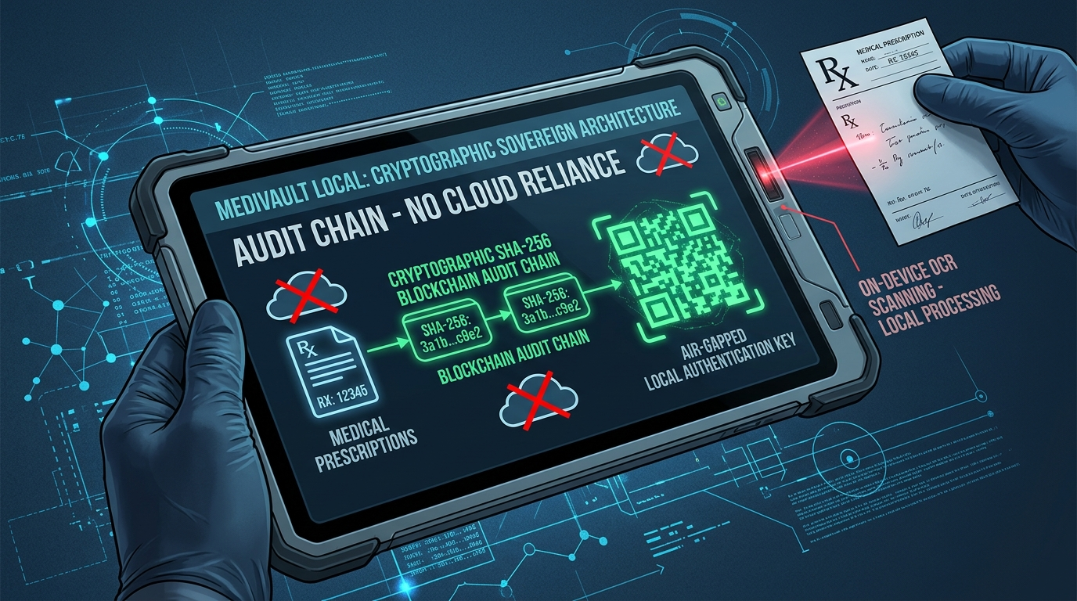
SECURITY, INTEROPERABILITY & CRYPTOGRAPHY
The Secret Weapons: Optical QR & Merkle Audit Ledger
HOW WE SOLVE AIR-GAPPED TRUST
The Bank Vault Metaphor (Local Merkle Ledger)
Think of this like a digital wax seal on every medical decision. Every clinical review seals doctor ID, patient hash, and verdict into an immutable SHA-256 chain.
If anyone modifies a prescription later to cover up an error, the math immediately proves tampering (HIPAA § 164.312b).
Base64 + zlib Optical Air-Gap QR Transfer
How do we transfer data between isolated computers? USB drives bring malware, and Wi-Fi can be hacked. We compress entire medical clearance bundles into high-density dynamic SVG QR codes scanned camera-to-screen.
Enterprise Standards: HL7 FHIR R4 & CDS Hooks
Implements official HL7 CDS Hooks medication-prescribe cards and generates FHIR R4 Bundles for seamless hospital integration.
OFFICIAL HOSPITAL CLEARANCE CERTIFICATE
Doctors can print a legal hospital clearance certificate with an embedded SHA-256 Merkle proof that pharmacies can verify against the local hospital ledger, preventing prescription forgery.

Slide 7
ENGINEERING DEPTH & RESILIENCE
Four Critical Battles: What Broke & How We Fixed It
BATTLE 1: AI HALLUCINATIONS
WHAT BROKE: Local SLMs (llama3.2:3b) occasionally approved dangerous drug combos when given polite or confusing user prompts.
HOW WE FIXED IT: Built a Deterministic Override Gate. If SQLite finds a medical rule breach, the AI is completely stripped of clearance authority and restricted to explanatory notes only.
BATTLE 2: READING PAPER SLIPS OFFLINE
WHAT BROKE: Real clinic prescriptions are crumpled paper slips. Cloud OCR (Google Vision, AWS Textract) violates HIPAA zero-cloud rules.
HOW WE FIXED IT: Embedded RapidOCR (ONNX runtime) executing on local CPU in RAM, followed by 18 HIPAA Safe Harbor regex strippers.
BATTLE 3: DATABASE LOCKS
WHAT BROKE: When 6 doctors entered orders at once on a hospital workstation, standard SQLite crashed with 'database is locked' errors.
HOW WE FIXED IT: Configured SQLite Write-Ahead Logging (WAL) mode with thread-safe connection pooling. Stress-tested with 12 concurrent reviews: 100% success, 0 locks.
BATTLE 4: AIR-GAPPED TRANSFER
WHAT BROKE: Transferring clinical summaries between isolated wards without permitting USB thumb drives (malware risk) or network sockets.
HOW WE FIXED IT: Designed Optical SVG QR Transfer using Base64 + zlib compression. Entire FHIR R4 bundles and Merkle hashes transmit camera-to-screen.

Slide 8
ASYNC'26 EVALUATION ALIGNMENT
Judging Scorecard: 100% Target Met Across All Criteria
30%
Technical Execution
• 117/117 automated tests passing.
• Rowland & Tozer PK model.
• SQLite WAL multi-threading (0 locks).
• Zero-cloud loopback network assertions.
20%
Innovation
• Deterministic SLM override.
• Optical air-gap SVG QR data transfer.
• Local SHA-256 Merkle audit ledger.
• On-device RapidOCR extraction.
20%
Clinical Impact
• Prevents fatal ADEs (Triple Whammy, QTc prolongation, Anaphylaxis).
• Enables AI for hospitals legally barred from cloud.
• 0 licensing fees for rural clinics.
15%
Product Experience
• Physician station with hotkeys (Ctrl+1..6).
• Plain-English Patient Portal for lab translation.
• Printable hospital certificate with QR.
15%
Completeness
• 1-click run_demo.bat launcher.
• Interactive Judge Demo Crisis Suite (Ctrl+6).
• Comprehensive documentation & QA test suites.
VERIFICATION SUITE: python -m unittest discover -s tests -p '*.py'
Ran 117 tests across 17 clinical modules • 117 PASSED, 0 FAILED • Zero Cloud Egress Verified

Slide 9
FUTURE VISION & PITCH FINALE
True Sovereignty is Clinical Reliability: Roadmap & Team Division
TEAM VOID_CODERS DIVISION OF LABOR
Person A (Lead): Rishikgowda SM
FastAPI architecture, SQLite WAL concurrency, thread-safe SHA-256 Merkle audit logger, repo orchestration.
Person B: Rakshith DA
Data ingestion pipeline, PyMuPDF extraction, 18 HIPAA Safe Harbor PHI redactions, RapidOCR on-device parser.
Person C: Kushal M
Deterministic pharmacology knowledge engine, Rowland & Tozer PK simulator, Beers 2023 criteria, Ollama SLM bridge.
Person D: Sujan MB
Physician workstation UI, patient portal, Judge Demo Crisis Suite, accessibility, QA checklists, & pitch demo.
POST-HACKATHON PRODUCTION ROADMAP
1. On-Premises Hospital EHR Connectors
Direct HL7 v2 and FHIR subscription adapters for Cerner, Epic, and open-source OpenMRS without external network egress.
2. Pharmacogenomics (PGx) Integration
Cross-referencing patient CYP2D6 and CYP2C19 gene metabolizer types to prevent personalized toxicities.
3. Edge Hardware Triage Appliance
Packaging MediVault Local onto ruggedized Raspberry Pi 5 / NVIDIA Jetson devices for field military triage and rural clinics.
"NO CLOUD. NO HALLUCINATIONS. NO DATA LEAKS."
True Sovereign AI isn't just about privacy—it's about saving patient lives when the world is completely offline.

