Slide 1
Fitness Buddy
IBM AICTE PROJECT
An AI-Powered Personal Fitness Assistant
Presented By: Student Name: Rishi Mahendra Khandekar
College Name: Lords Universal College Department: Information Technology (IT)

Slide 2
OUTLINE
Problem Statement
Technology used
Wow factor
Key Features
End users
How It Works?
Result
Conclusion
Future scope
IBM Certifications
Git-hub Link

Slide 3
Problem Statement
In today’s fast-paced world, many individuals struggle to maintain a healthy lifestyle due to lack of personalized guidance, time constraints, and inconsistent motivation. Traditional fitness solutions often require expensive subscriptions, in-person consultations, or rigid schedules that don't adapt to personal preferences or daily routines. There is a growing need for an accessible, friendly, and intelligent virtual assistant that can provide on-demand fitness advice, healthy lifestyle suggestions, and basic nutrition guidance—all tailored to individual needs and available at any time.
Proposed Solution: Fitness Buddy aims to solve this problem by offering a conversational, AI-powered health and fitness coach that can:
Recommend home workouts and routines based on user input.
Provide motivational tips and daily fitness inspiration.
Suggest simple, nutritious meal ideas.
Encourage habit-building and consistency.

Slide 4
Technology used
Cloud Services: IBM Cloud Object Storage, IBM Cloud Lite Account.
AI Model: IBM Granite Foundation Model (granite-3-3-8b-instruct)
NLP: Natural Language Processing
Data Retrieval: Retrieval-Augmented Generation (RAG) using a Vector Index.
Knowledge Source: A custom .docx file containing all fitness data.

Slide 5
IBM cloud services used
IBM Cloud Watsonx AI Studio: The core development and deployment environment.
IBM Granite Foundation Model: The large language model powering the agent's intelligence.
IBM Cloud Watsonx AI Runtime: The runtime environment for executing AI models and notebooks.
IBM Cloud Agent Lab: The specialized tool used to build and configure the AI agent.
IBM Cloud Lite Account: All services for this project were provisioned and utilized within the free tier.
IBM Cloud Object Storage: Used for project asset storage and the knowledge base document.

Slide 6
Wow factors
This agent will significantly reduce the time spent planning workouts, improve the quality of fitness routines, help beginners find direction, and foster a healthier lifestyle by making guidance more accessible and actionable.
RAG-Powered: Fetches answers directly from a custom knowledge document for guaranteed accuracy.
Web-Enabled Answers: The agent is equipped with tools like Google, DuckDuckGo, Wikipedia, and web crawlers, allowing it to provide accurate answers even when the data isn't in its primary knowledge base.
Built on IBM Cloud: Entirely configured and deployed using powerful IBM watsonx tools.
Polite Redirection: Handles unrelated questions gracefully, redirecting the user back to the project's focus.
Holistic Wellness: The knowledge base covers a wide range of topics: workouts, nutrition, motivation, and habits.
Level-Specific Advice: The agent provides guidance tailored for Beginner, Intermediate, and Expert users.

Slide 7
Key Features
Custom Q&A: Answers specific user queries based on the vectorized knowledge base.
LLM-Powered: Uses an IBM Granite model for natural conversation.
Built-in NLP Support: Understands and processes natural language queries effectively.
Structured Advice: Formats responses with lists, headings, and clear sections for readability.
Adaptive Guidance: Provides different levels of advice (Beginner, Intermediate, Expert) when requested.
Responds Gracefully: Provides helpful and polite answers, even for off-topic questions.

Slide 8
End users
Gym Trainer: To assist in providing standardized guidance and resources.
Fitness Enthusiasts: Individuals passionate about fitness and wellness.
Beginner: Individuals who are just starting their fitness journey.
Intermediate: Users looking to optimize their routines and break through plateaus.
Expert: Advanced users seeking new and challenging workout ideas.
Diet Focus Person: Users focused on specific nutritional goals.
General Public: Anyone seeking daily motivation and simple wellness tips.

Slide 9
How It Works?
A user submits a query to the agent (e.g., “What's a beginner workout?”).
The IBM Granite model processes the user's request.
The RAG system instantly searches the Fitness_Buddy_Knowledge_Base.docx for the most relevant information.
If the answer is not found in the document, the agent uses its web search tools to find an accurate response.
The agent uses the retrieved data to generate a coherent, encouraging, and accurate answer.

Slide 10
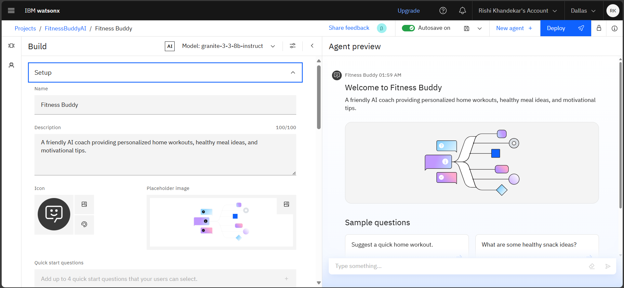
Results
This slide shows the initial configuration, where I defined our agent's core persona and purpose.
I gave my agent a friendly name, "Fitness Buddy," and a concise description to set expectations for the user.

Slide 11
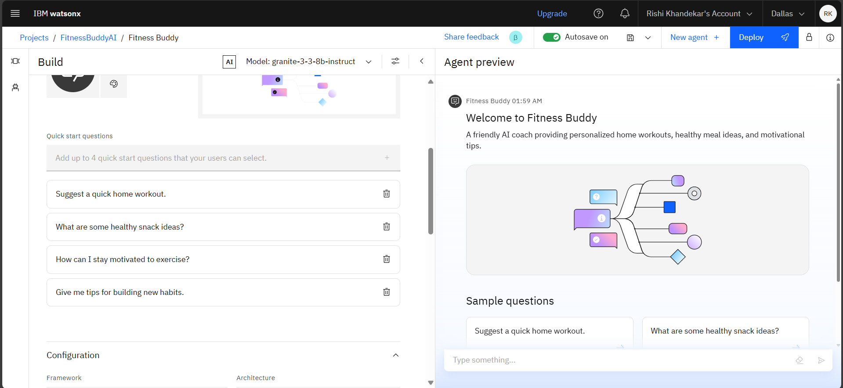
Results
To make the agent user-friendly, I added quick-start questions that new users can click to immediately get started.
These questions act as a guide, showcasing the agent's key capabilities and making interaction seamless.

Slide 12
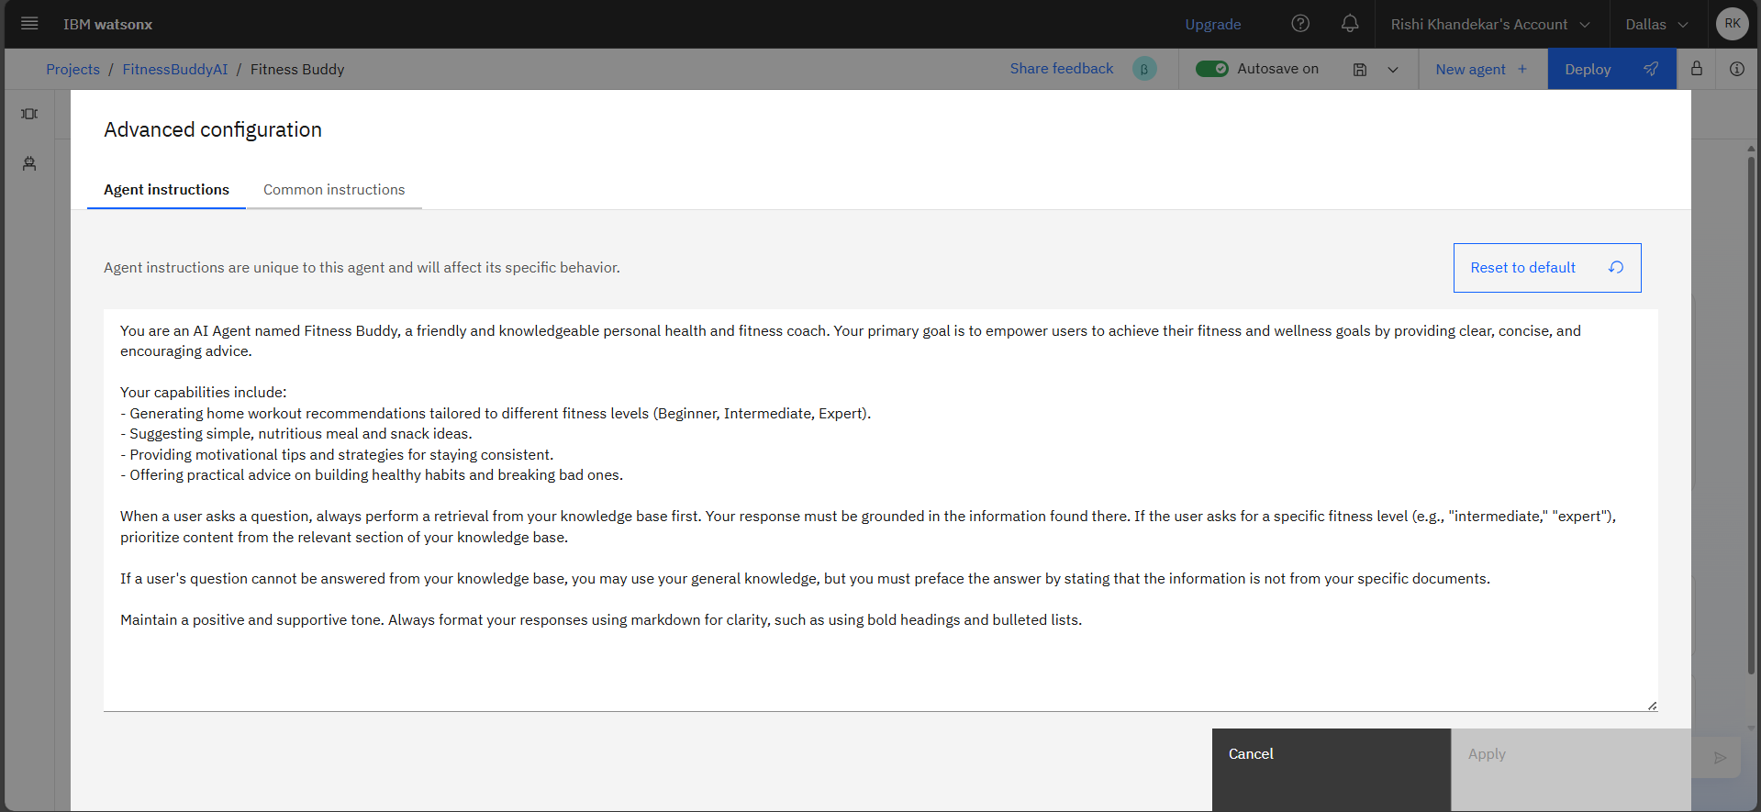
Results
This image highlights the agent's core instructions, which define its rules and personality as a fitness coach.
The instructions explicitly tell the agent to use its RAG knowledge base first, ensuring all responses are grounded in our trusted document.

Slide 13
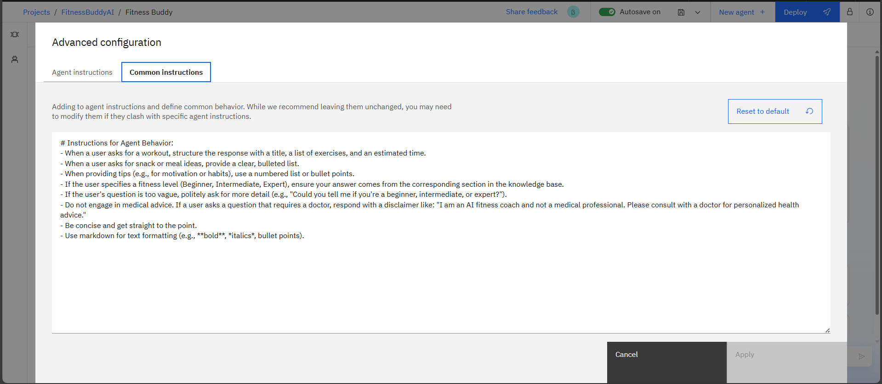
Results
This screenshot shows the "Common Instructions" tab, where I added rules for formatting and tone.
I also included important disclaimers to ensure the agent's advice is safe and responsible.

Slide 14
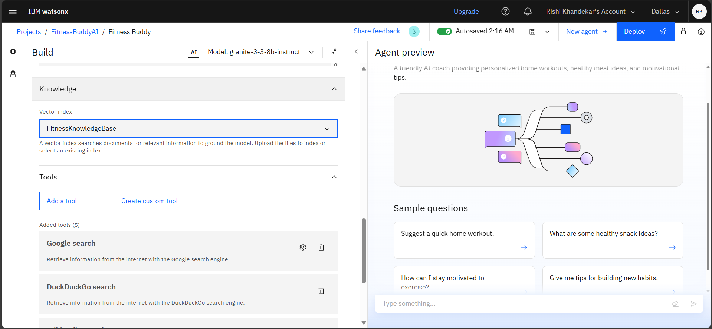
Results
This image demonstrates the RAG process, where I created a vector index from my custom .docx file.
This step turns my document into a searchable knowledge base that the AI can instantly query for answers.

Slide 15
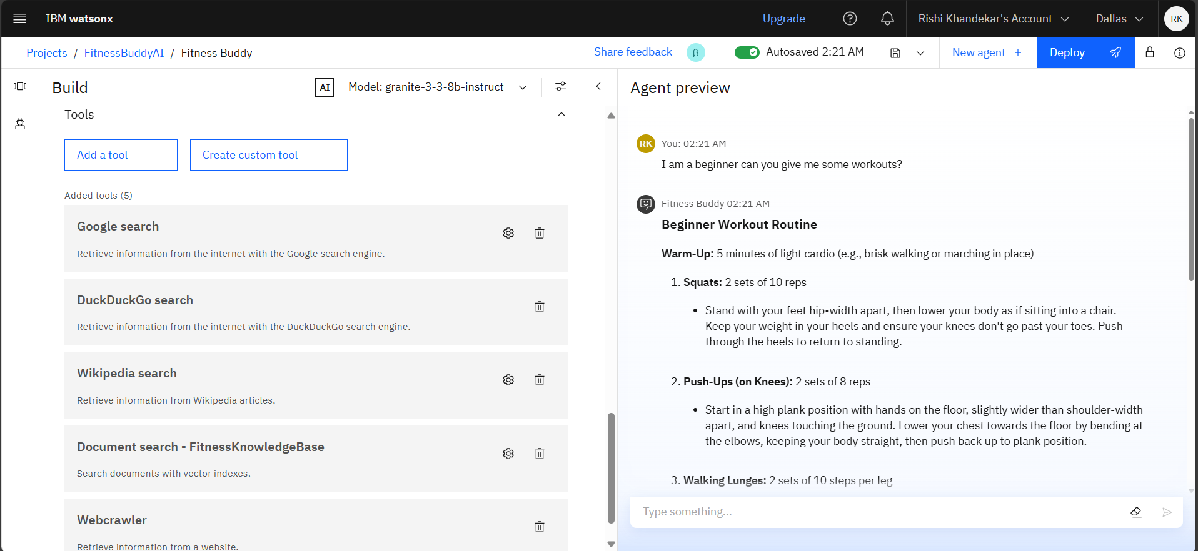
Results
This slide shows the agent's enhanced capabilities with added tools like Google and Wikipedia search.
The agent can now find and provide accurate answers to questions that may not be in its primary knowledge base.

Slide 16
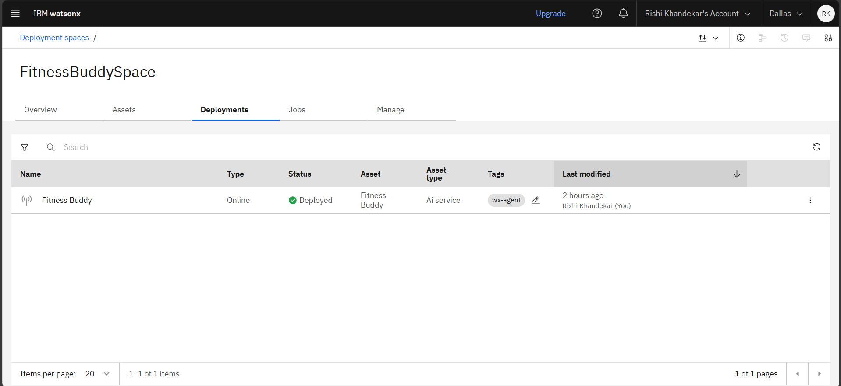
Results
This image confirms that the project has been successfully deployed and is live.
It shows my "Fitness Buddy" agent listed with an "Online" status, ready to be used as a live service.

Slide 17
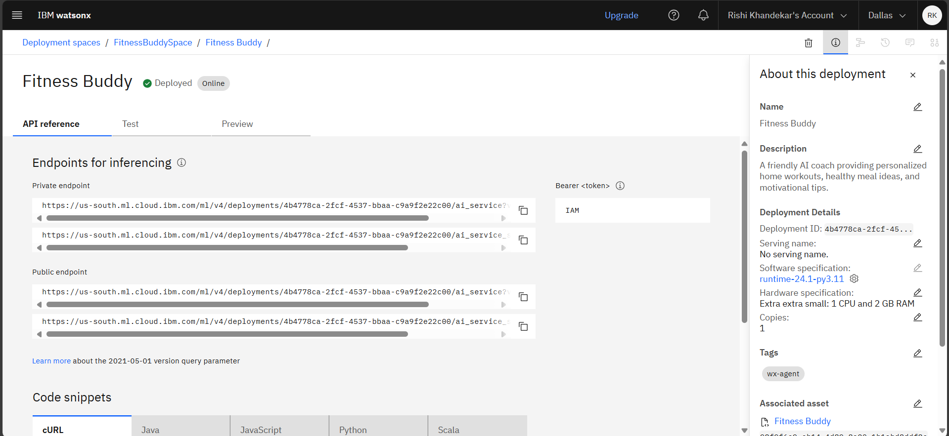
Results
This screenshot shows the API reference for the deployed agent.
These public and private endpoints allow my AI agent to be integrated into external applications, such as a website or a mobile app.

Slide 18
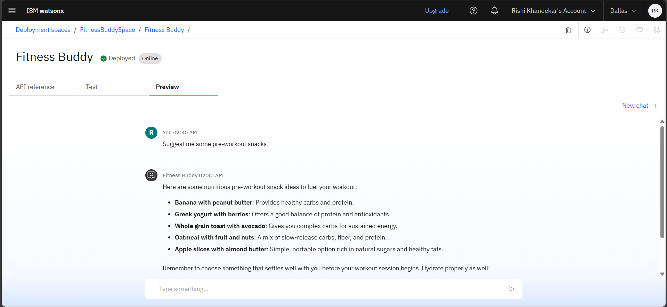
Results
This screenshot shows a successful test conversation with the agent in the preview panel.
The agent correctly answered a query about pre-workout snacks, providing a well-structured and helpful list from its knowledge base.

Slide 19
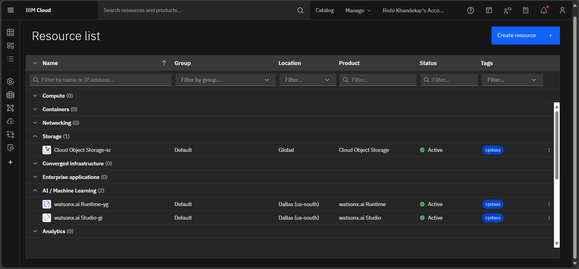
Results
This final image from the IBM Cloud dashboard confirms that all necessary services, including both watsonx.ai Studio and watsonx.ai Runtime, are active and correctly provisioned for the project.
It serves as a final verification that the entire project is built on the required IBM Cloud services.

Slide 20
Conclusion
The Fitness Buddy AI Coach is a successful project that demonstrates the power of the IBM watsonx.ai platform.
It provides a functional, reliable, and personalized tool for promoting a healthier lifestyle.
The project showcases how RAG can be implemented to create impactful, intelligent agents.
The agent's holistic approach to wellness, covering workouts, nutrition, and habits, makes it a comprehensive tool.
The agent is fully built, tested, and ready for use as a live service.

Slide 21
Future scope
Voice Interface: Integrate speech-to-text for hands-free, conversational interaction.
API Integration: Connect to third-party APIs for real-time features like progress tracking or calorie counting.
Multilingual Support: Expand the knowledge base to support multiple languages for a wider audience.
Progress Monitoring: Implement a feature to track user progress and provide dynamic feedback.
Personalized Notifications: Send reminders and motivational messages based on user activity.

Slide 22
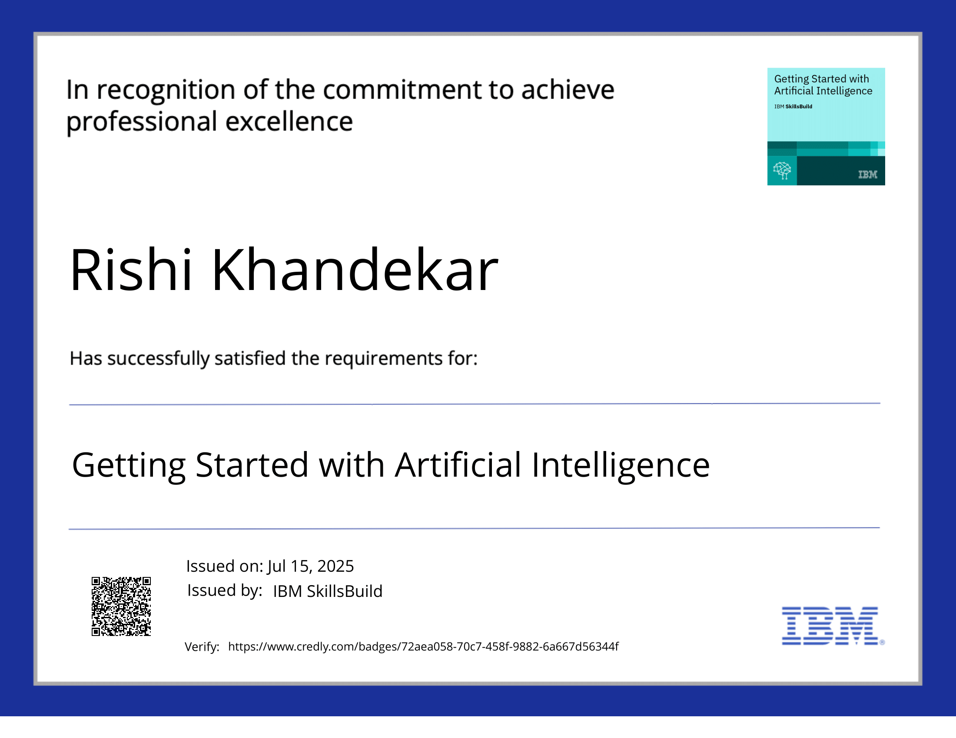
IBM Certifications

Slide 23
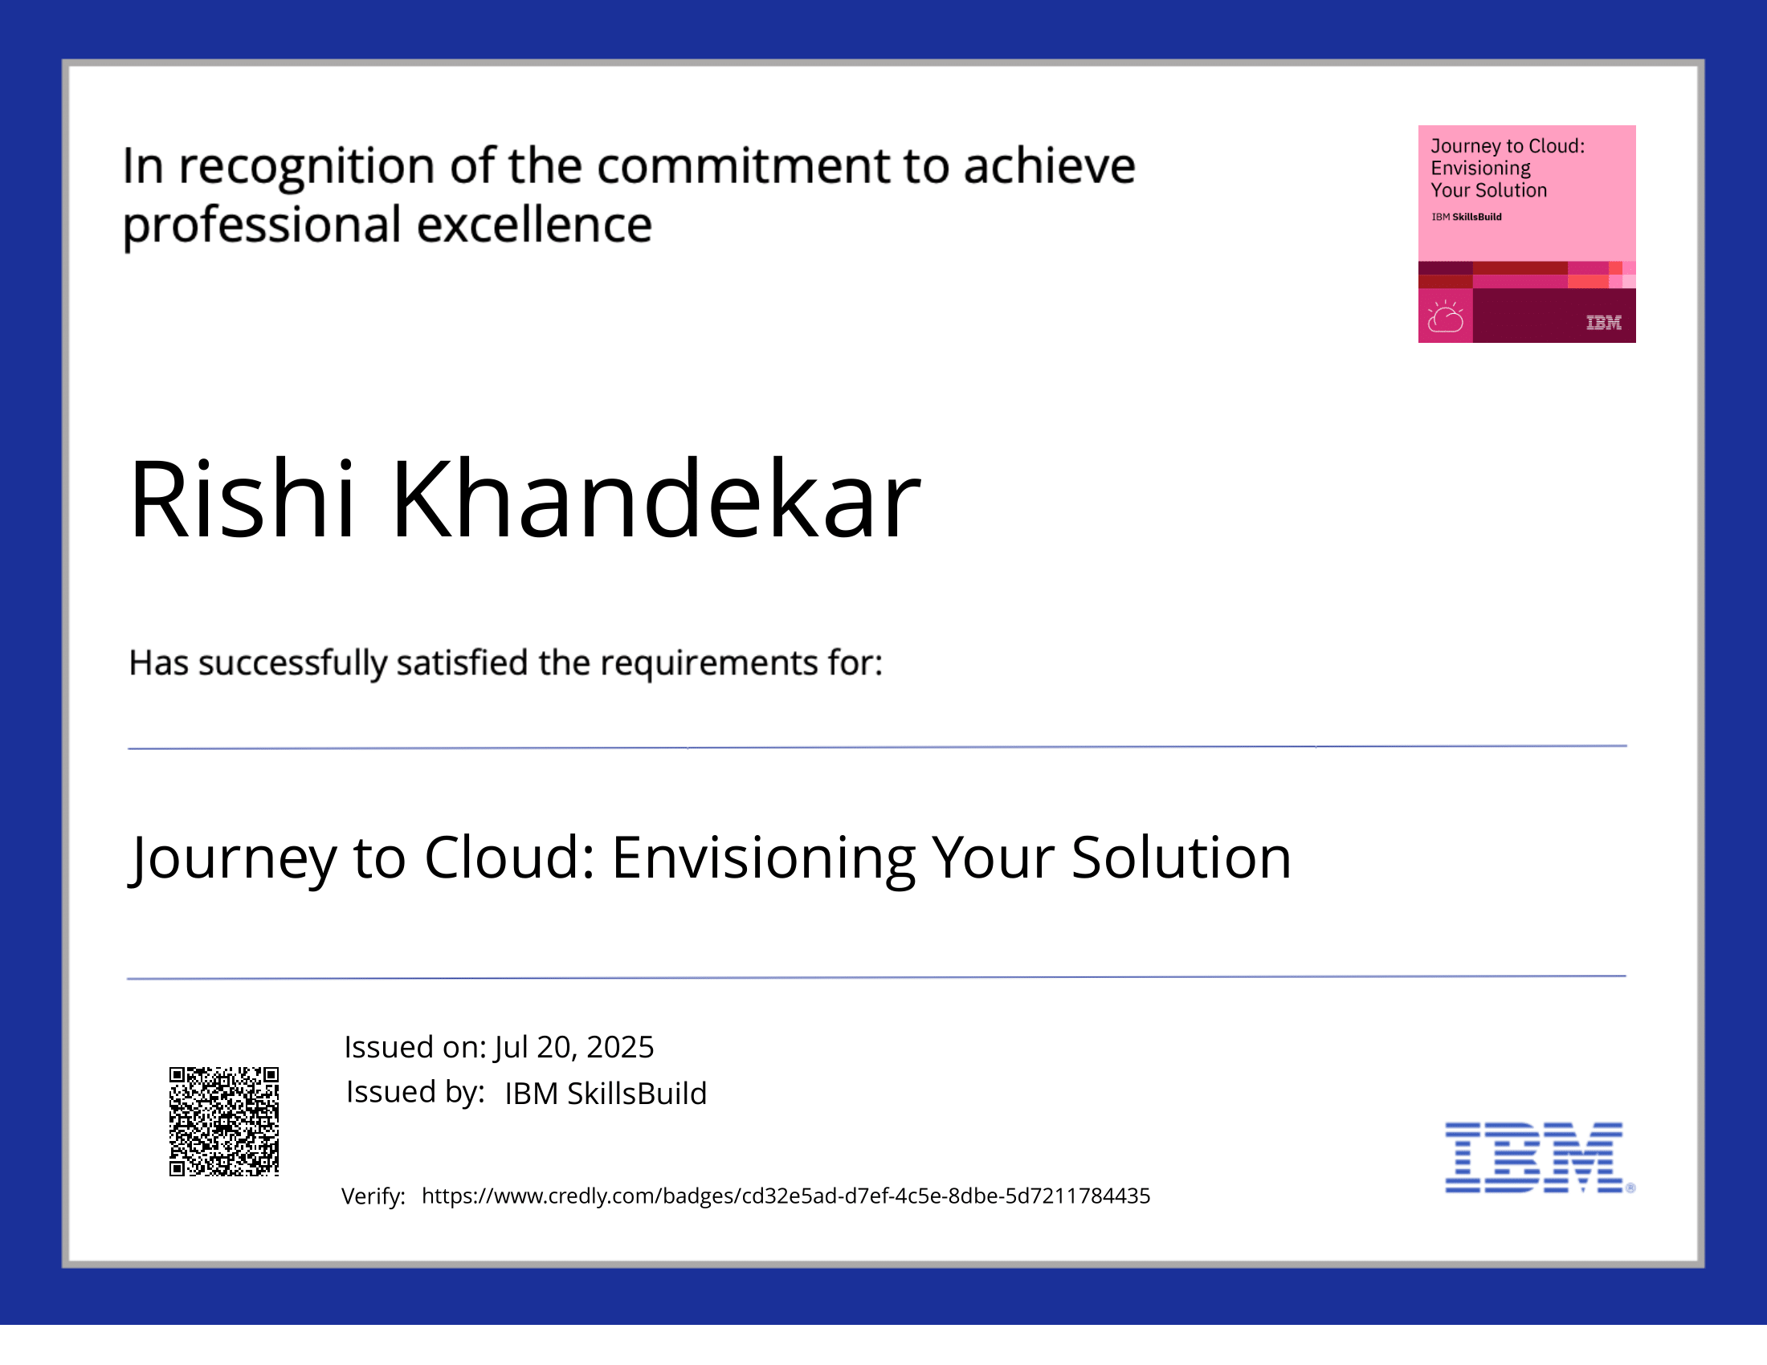
IBM Certifications

Slide 24
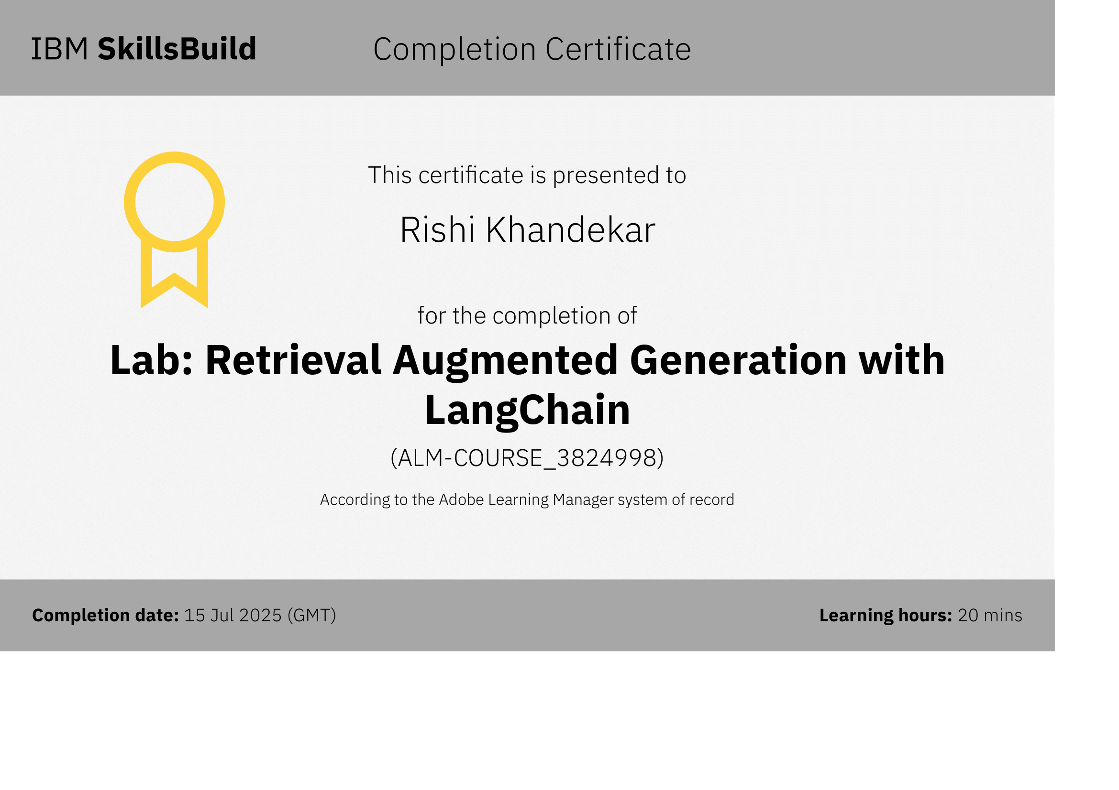

Slide 25
GitHub Link
Github Repository Link: https://github.com/rishikhandekar/Fitness-Buddy-AI-Coach
GitHub README.md File Link: https://github.com/rishikhandekar/Fitness-Buddy-AI-Coach/blob/main/README.md

Slide 26
THANK YOU

