Slide 1
DevOps Assessment
CloudMaven
Rishit Kumar
Presentation

Slide 2
Project Overview
What this assessment covers and what was built
Goal
Scope
Design and deploy a production-ready 2-tier microservice app on AWS EKS with full observability and CI/CD automation.
Cloud infrastructure, containerized app, Kubernetes orchestration, monitoring, logging, and pipeline automation.
Timeline
Deliverables
48-hour technical assessment covering all major DevOps disciplines end to end.
GitHub repository, Terraform code, Helm charts, Dockerfiles, CI/CD pipeline, dashboards, README, and PPT.

Slide 3
Tools & Tech Stack
Technologies used across all layers of the project
Infrastructure
Containerization
Terraform (IaC) · AWS EKS · VPC · S3 Remote Backend
Docker · Dockerfile · Multi-stage builds · DockerHub
Orchestration
CI/CD
Kubernetes · Helm Charts · Nginx Ingress · HPA · CronJob
GitHub Actions · Terraform Validate/Plan/Apply · Docker Build & Push · Smoke Tests
Monitoring
Logging
Prometheus · Grafana · Pod/Node CPU-Memory · API Latency
Elasticsearch · Kibana · FluentBit · JSON Structured Logs

Slide 4
Architecture Diagram
End-to-end system design based on the project implementation
GitHub Repo
Terraform
validate/plan/apply
GitHub Actions (CI/CD)
Docker
build & push
AWS
Amazon VPC — Public & Private Subnets | NAT Gateway | Route Tables | Security Groups
Service | ConfigMap | Secrets | HPA | CronJob | Ingress (Nginx)
Amazon EKS
Docker Containers
Frontend
(Node.js)
Backend API
/health /metrics
Prometheus & Grafana | Elasticsearch + Kibana + FluentBit

Slide 5
Terraform Infrastructure
Provisioning production-ready AWS infrastructure with IaC
VPC
Custom VPC with DNS hostnames & support enabled
Modules Used
Subnets
clouddrove/eks/aws
Public subnets (load balancers) + Private subnets (EKS nodes)
Community EKS module
(assessment requirement)
Networking
Internet Gateway, NAT Gateway, Route Tables, EIPs
modules/custom-vpc
Security
Custom-written VPC module
with full subnet + routing
Security Groups for EKS nodes with controlled ingress/egress
Run Commands:
EKS Cluster
Kubernetes 1.29 on t3.medium nodes, autoscaling 1–3
terraform init
terraform validate
terraform plan
terraform apply
Remote State
S3 bucket + DynamoDB table for safe Terraform state locking

Slide 6
Docker + Kubernetes Deployment
2-tier containerized app deployed on EKS via Helm charts
Docker
Kubernetes / Helm
Frontend: Node.js application
Helm charts for Frontend + Backend(their deployment & service)
Backend: API with /health & /metrics
Nginx Ingress Controller
ConfigMaps + Secrets
JSON structured logs from both services
Liveness & Readiness Probes
Dockerfiles for each service
HPA (Horizontal Pod Autoscaler)
Images pushed to DockerHub
Resource limits (CPU/Memory)
Tested it also
Rolling update strategy
CronJob for periodic API calls

Slide 7
CI/CD Pipeline
Two-job GitHub Actions workflow — automated on every PR and main branch push
Pull Request Trigger
Main Branch Push
Job 1 — CI (Pull Request)
Job 2 — CD (Main Branch)
1. Terraform fmt & validate
1. Terraform plan & apply
2. Docker build & push to DockerHub
2. Docker build test (no push)
3. Helm deploy to EKS cluster
3. Kubernetes manifest lint
4. Rollout status verification
4. Upload build artifacts
5. Smoke test: curl /health endpoint

Slide 8
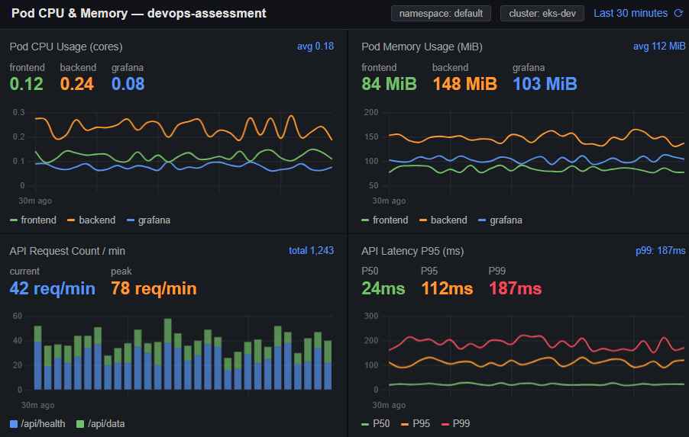
Grafana Monitoring
Metrics pipeline: Backend /metrics → Prometheus → Grafana Dashboards
Backend
/metrics
Prometheus
Scrape
Grafana
Dashboard
Installed via Helm
Prometheus + Grafana stack
Pod CPU & Memory
Node CPU & Memy
API Request Count
API Latency

Slide 9
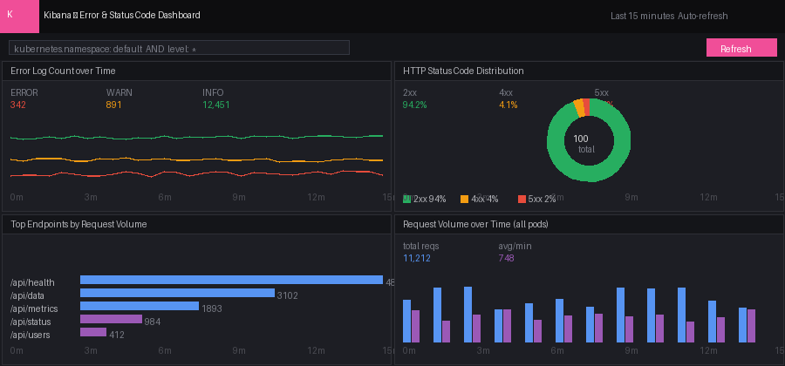
Kibana
Log pipeline: All pods → FluentBit → Elasticsearch → Kibana Dashboards
All Pod
Logs
FluentBit
Collector
Elasticsearch
Index
Kibana
Dashboard
Error Log Dashboard
HTTP Status Codes
Top Endpoints
Request Volume

Slide 10
Key Learnings & Challenges
Reflections, issues faced, and the improvements roadmap
Challenges Faced
Key Learnings
Faced difficulties integrating the CloudDrove EKS module due to incorrect input variables and module configuration.
Writing reusable Terraform modules for real AWS infra
Experienced Kubernetes pod scheduling failures due to AWS VPC CNI pod limits on a `t3.micro` node.
Structuring Helm charts for multi-service K8s deployments
Encountered monitoring stack deployment constraints as Prometheus and Grafana required additional cluster resources beyond the available free-tier capacity.
Setting up the full Prometheus → Grafana metrics pipeline
Improvements Roadmap
Setting up remote state with S3 backend and DynamoDB state locking
Add Alertmanager for Grafana alert rules
Configuring liveness and readiness probes for zero-downtime rolling updates
Implement GitOps with ArgoCD
Managing GitHub Secrets for AWS credentials and DockerHub tokens securely
Multi-environment (dev/staging/prod) Terraform workspaces
Add Vault for secrets management

Slide 11
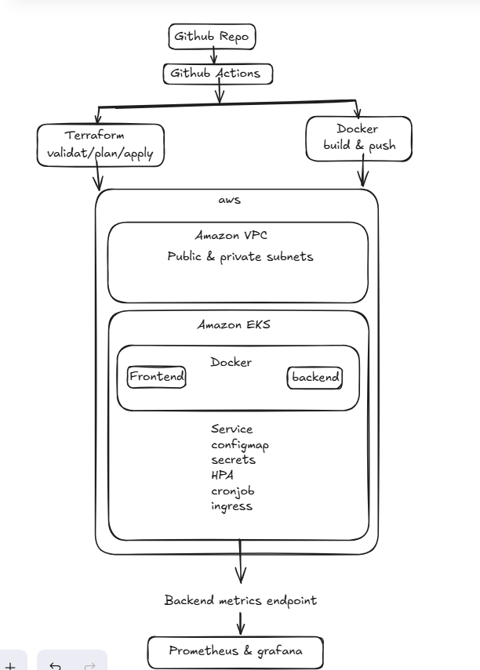

Slide 12
Thank You

