Slide 1
Book Review Website
By
Shashi Prakash a
Rishik ts
Naveen r

Slide 2
Agenda
Introduction
Literature Survey
Outcome of Literature Survey
Motivation
Problem Statement
Objectives
Proposed Work
Conclusion
Timeline of Project
Individual Contribution
References

Slide 3
Introduction
Review of a book means to evaluate the work in question based on its strong and weak points, sometimes ending with a recommendation.
Book review gives the user the opportunity to get an idea about what the author wants to convey and how efficient he was.
We humans are interested to know pros, cons of a product before buying it. We want to know the good qualities and bad qualities of a product to figure out whether it suits us or not.

Slide 4
Literature Review
Authors | Methodology | Advantages | Limitations
Hapnes | Using long answers and text information to find experts | Knowledgeable experts are chosen | User profiles are not considered
Chirag | Number of likes received are used to find expert answers | Most people might like the answer | Review information is not considered
Momtaz | analyze the centrality, structural holes, and indegree to identify experts. | It focuses on network structure and relationship among users | It is not good enough for expert identifiation
Zhang | Considering the number of followers for a user | Famous writers answers are chosen. | Depending only on followers does not produce expert answers.

Slide 5
Outcome of Literature Review
By only considering the likes of the reviews given by users we cannot decide an expert answer or by only considering the number of followers of a reviewer we cannot decide upon the experts.
So we should consider both the likes given to review and the number of followers for the reviewer to find the expert review from the large number of reviews.

Slide 6
Motivation
Unlike traditional book reports that are often written only for the teacher as an audience, online book reviews offer students an engaging way to connect with other readers within and beyond the four walls of their classroom. With the continued influx of the Internet and wide range of digital tools, creating and sharing book reviews with a wider audience is easier than ever.
The idea of having students create online book reviews can foster their motivation and interest as readers and writers while encouraging them to connect with a broader community of readers.

Slide 7
Problem Statement
Building a Book review website where a user can read, post reviews, react to the reviews and get to know the expert review out of given reviews.

Slide 8
Research Objectives
To find an expert review from the given thousands of reviews.
To build a user friendly and responsive website.
To build an online platform where the readers can share their opinions and experience about the book.

Slide 9
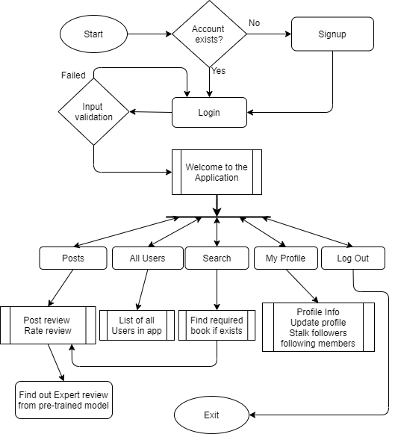
Proposed Model
Reviews are ordered in the order of their expertivity which is fetched by predictions by pre-trained model.
Model is trained and saved to improve efficiency of the application.

Slide 10
Methodology
Backend basically consists of database which was builtusing SQLite, Machine Learning concepts to figure out expert reviews.
Work regarding Database:
In the Backend part, Django's default 'dbsqlite3' is used.
Tables like Profile, Relationship, Post (All posts), Review (All reviews), Post_like (which user is liking which post), Review_like (which user is liking which review) are created.
User authentication:
User Authentication is provided so that we can keep track on the number of users liking the review with no duplicate likes from a single user which can lead to false outputs for the reviews' expertivity variable.

Slide 11
Methodology
3 Django apps were created:
1) Mini project: When we launch the server, this miniproj app is executed first and it renders a home page where user is greeted and asked to login or signup.
2) Posts: Posts app has all the code for the posts page, search bar and its results page. main.html in posts app is the web page which consists the code for this posts page. for loop, if statements are used to display all the posts, reviews.Objects of classes are used which stores the info of each review (no. of likes, book name, review, review by which user) etc.Appropriate functions are defined in views.py belonging to posts app which gets executed when user searches something or likes or dislikes.
3) Profile:

Slide 12
Methodology
Work regarding Expert review prediction:
Got dataset from the research paper, pre processed it so that it can be used for our database in the web application. We considered follower_count, total no. of upvotes that user received as the attributes in the ML model.
Standard scalar is used to standardize the data to ensure data is consistent.
Model is trained and saved using pickle.
When a new review is posted by a user, pre trained model is used to predict the expertivity of the user using his personal details (attributes described above).
Now the reviews are sorted based on this.
So, Finally reviews are presented in decreasing order of their expertivities

Slide 13
Proposed modifications
Dataset can be modified by adding more attributes regarding the user’s personal information which increases the efficiency of the prediction made by the model.
This website can be posted on the globe so that people from all over the world can enjoy the benefits.
Chat option can be introduced where people with similar interests on books can come together and discuss the things about the books.

Slide 14
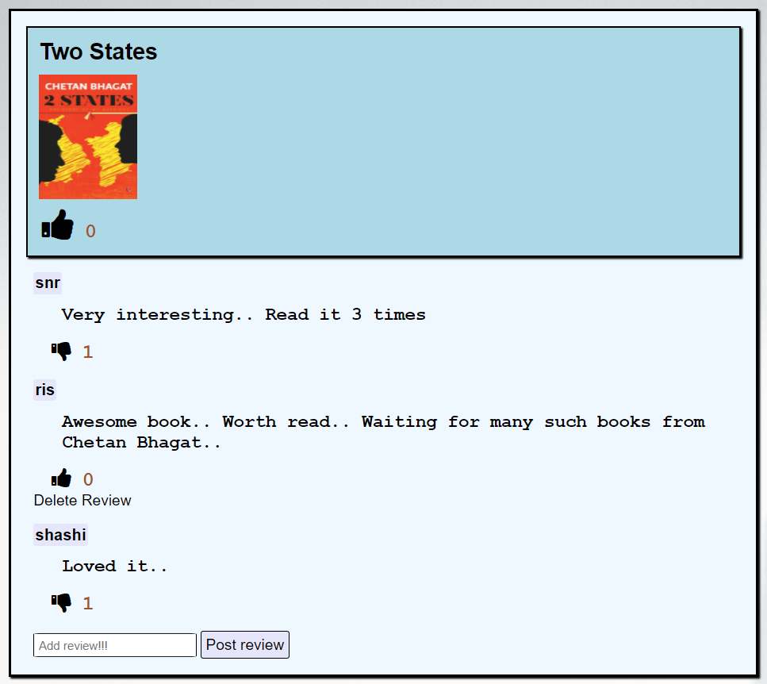
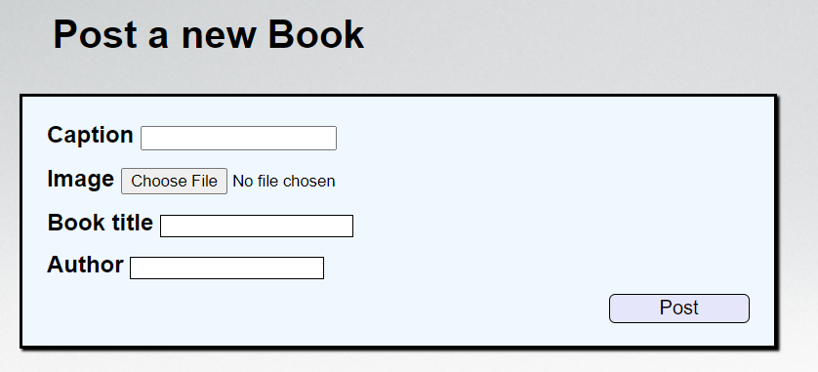
Work Done
User can signup (if he is not having an account) and login to enjoy the experience of
1) Posting reviews onto existing book
2) Admin can create new post

Slide 15
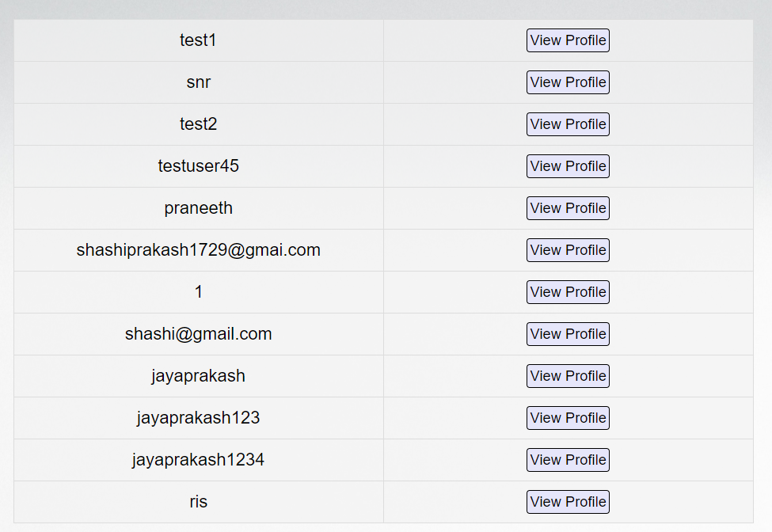
Work Done
2) Stalk others who are following them or the users who posted the review
3) Can update their profile, add bio, upload profile picture

Slide 16
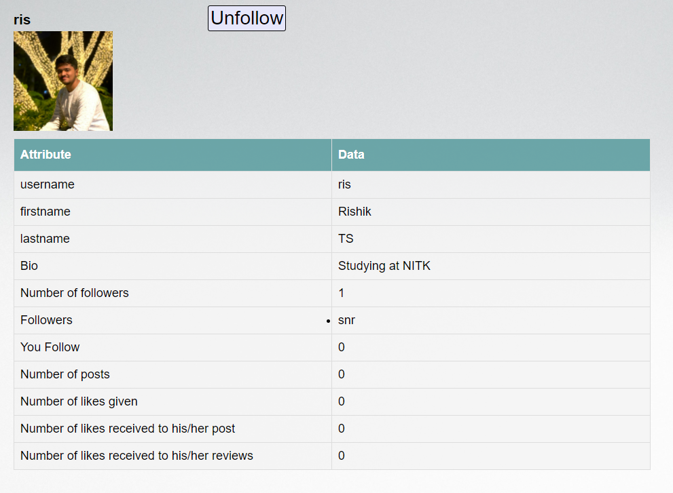
Work Done
Only admin can post a new book. All webpages are responsive to all devices.
All users are allowed to post reviews then after.
Any user can open anyone’s
profile and follow him/her.

Slide 17

Results and Analysis
Efficiency of Machine Learning model on the test set (20% of actual dataset):
Dataset consists of around 31,000 samples which was extracted from research paper.
If more attributes are included in the dataset, then efficiency will be good.

Slide 18
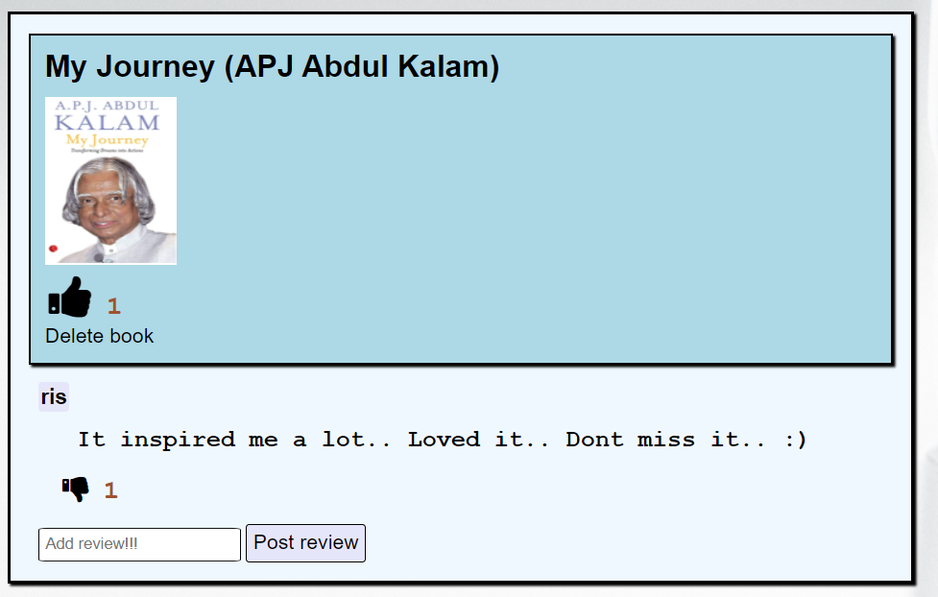
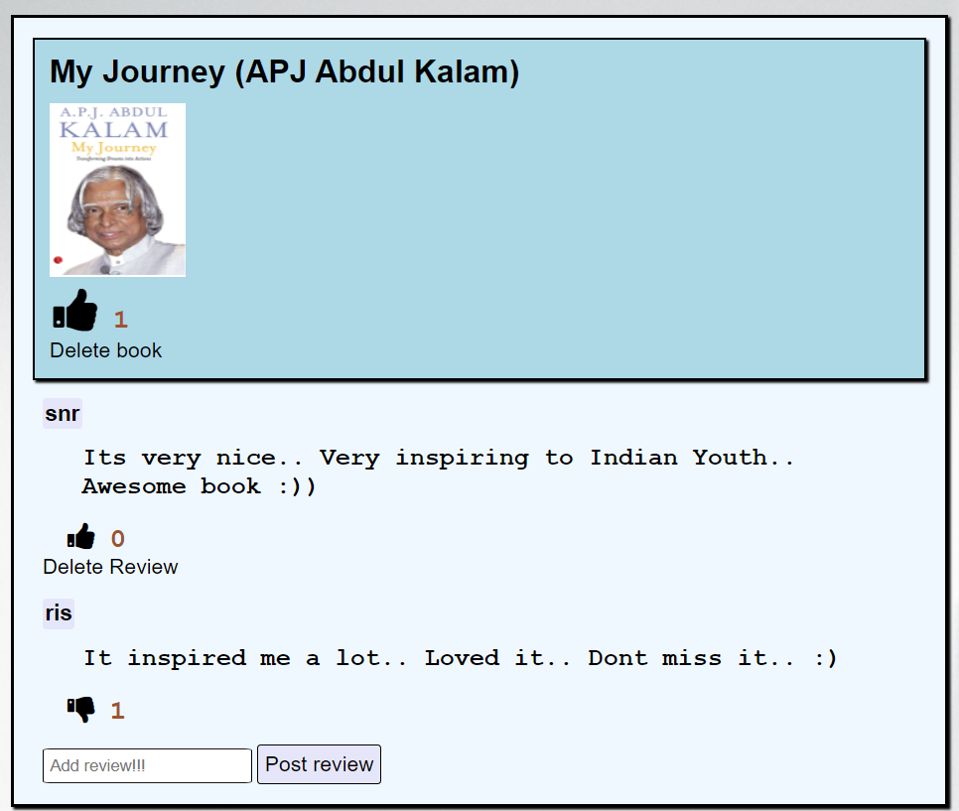
Results and Analysis
When a new review was posted by “SNR”, it placed it at first place because its expertivity is high. SNR’s followers and total upvotes are relatively high. So, ML model had predicted its experitivity higher than review posted by ris.

Slide 19

Time Line of Project
Milestones | Jan 2021 | Feb 2021 | Mar 2021 | April 2021
Setting up Database
ML work
Front end
Linking everything
Errors handling
Testing

Slide 20
Individual Contribution
Database management – Shashi Prakash
Django backend – Shashi Prakash & Rishik
Front end HTML & CSS – Naveen R & Rishik
Machine Learning – Rishik & Naveen
Errors management – Everyone

Slide 21
References
(Other Related References)
W3 Schools
Django documentation
Django tutorials
Udemy ML tutorials
Selected Base Paper
Identifying Experts in Community Question Answering Website

