Slide 1
Voice Control
For an OS
By
G Praneeth - 191IT117
Rishik TS - 191IT254
Shashi Prakash A - 191IT204
Naveen R - 191IT133

Slide 2
Introduction
A voice control which works like an OS
Can handle many tasks which an OS will
Can handle some tasks which a voice assistant can’t
Sounds like Human but works like a machine

Slide 3
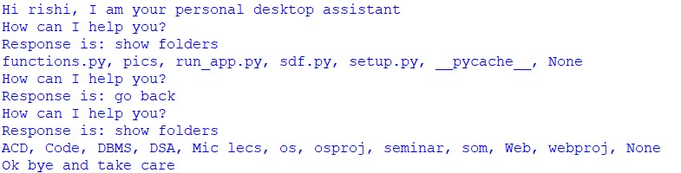
Functions that it can handle
Folders / Directories:
Create, Delete, Open
Change, Go Back, Rename
List directories, files
Files:
Create, Open, Delete, Edit, Run, Rename
Search:
Google, Wikipedia, Youtube

Slide 4

Continuation
Shut down in __ minutes
Close all apps
Tell the Time
Fill a form:
Input a url in UI
Fill form by Voice control
Exit

Slide 5
Work Done
Voice Control:
Made “functions.py” which has shell commands for each operation that we were planning to do
Made “voice.py” which basically calls the functions in “functions.py” based on the voice commands given by the user
Form Filling:
Made a UI which appears when user asks for “Form filling” which asks the URL of the form, it redirects to that URL & user can fill the form by his/her voice.

Slide 6
Methodology
Voice control
Shell commands are written in separate file which will be imported & appropriate function will be called when needed.
talk() function will ask the user for command, it will convert into text & it will pass it to check for required function.
respond() function is used to reply the user about his/her commands
Form filling basically involves checking for all the fields having <input> tag in the html (except for passwords).
Tech stack: os, selenium, tkinter, gTTs libraries are used

Slide 7
Error handling
Incase user’s voice is not recognisable properly, after trying 2 times, it asks for user to type his command.
Form filling
If input type is email then appropriate replace commands are written to replace it with “@”
Due to privacy issues, if input type is password, then voice input is not accepted.
Only lowercase letters are considered to remove the ambiguity since a voice doesn't know capital or small.
Can run only Python, C, C++ files.

Slide 8
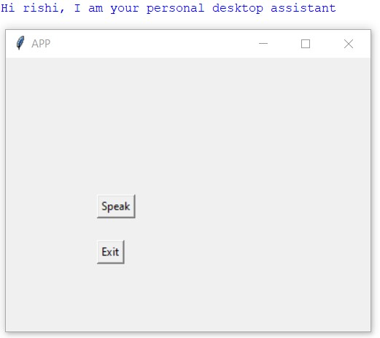
Results
It opens a console where the conversation of the user will be printed.
It opens a UI where user has to select “Speak” or “Exit”
If user has no query after one or two tasks, he can click “Exit”

Slide 9
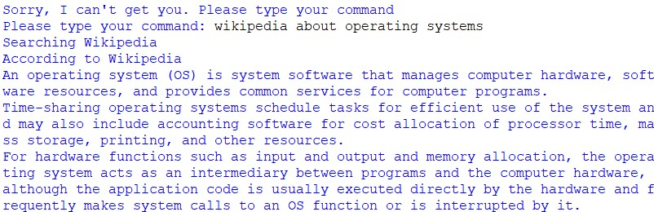
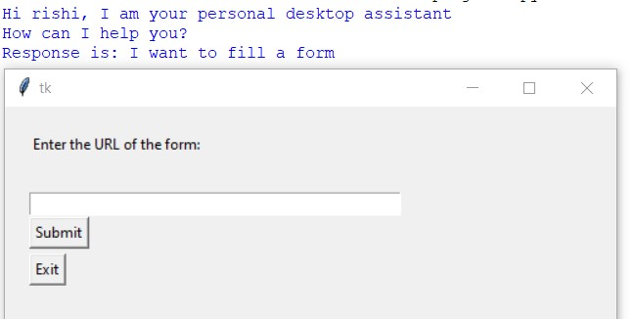
Incase the voice control is unable to understand the user even after 2 times, it asks for user to type his request
Searching in Wikipedia & Reporting the answer
Filling a form by Voice
URL of the form must be pasted here & click Submit

Slide 10
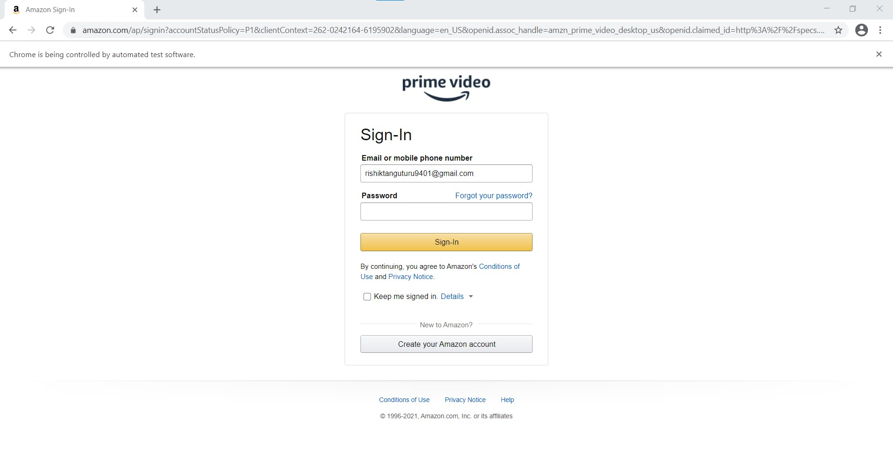
After clicking submit, a new window opens like this where user can fill the form
We can use it only for non password fields for privacy purposes

Slide 11

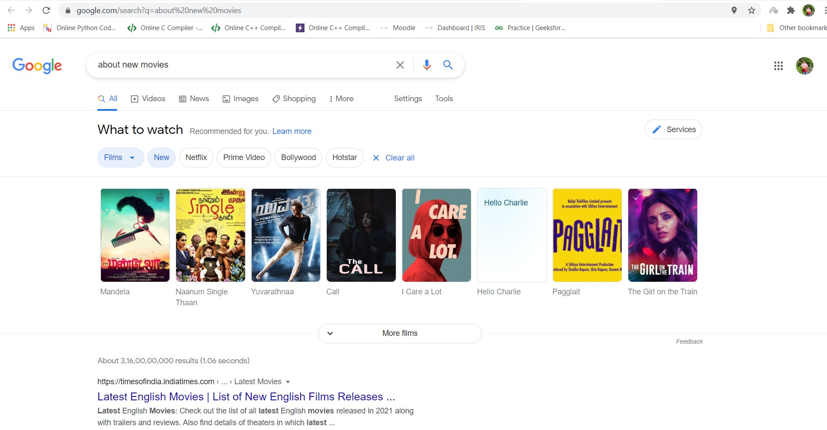
Searching in google about new movies

Slide 12
Individual Contribution
Voice control - Rishik TS & Gosu Praneeth
Developing Shell commands code for all the functionalities - Shashi Prakash A & Naveen R
Form filling - Naveen R & Gosu Praneeth
GUI - Naveen R & Shashi Prakash A
Error handling - Rishik TS
PPT, Report - Everyone

Slide 13
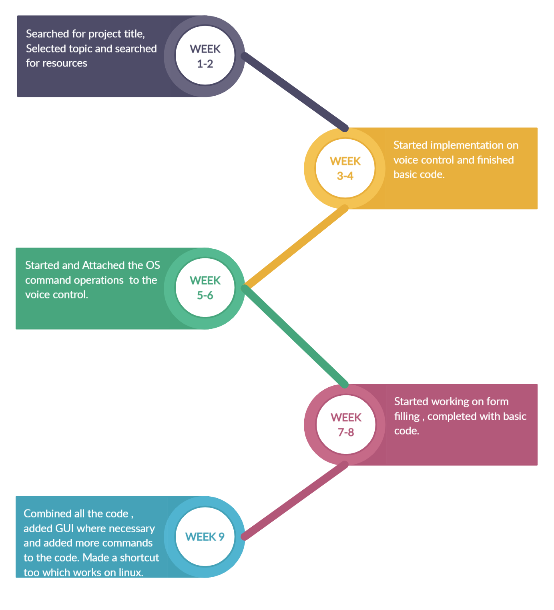
TIMELINE

Slide 14
Thank You

