Slide 1
Distributed Image Processing using PySpark in HDFS
Vishwaksen Jalagam
Pooja Ravindra
Rishil Shah

Slide 2
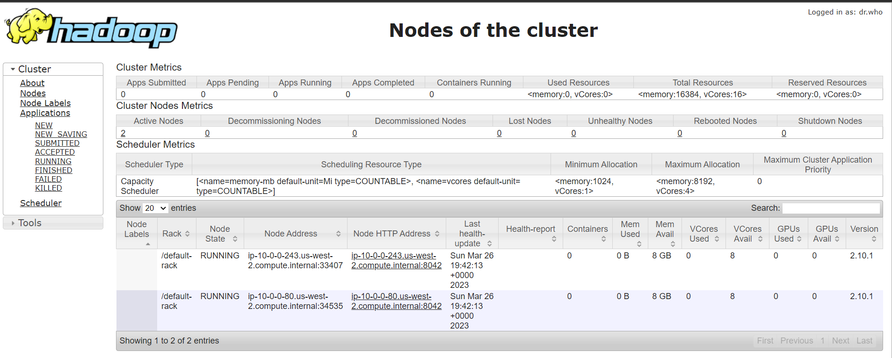
Hadoop Cluster

Slide 3
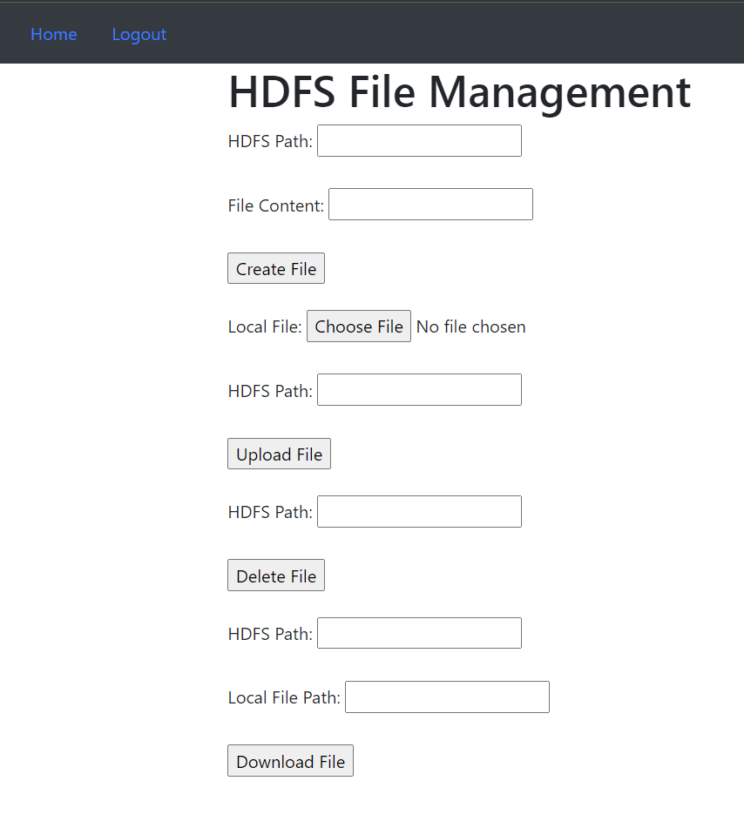
Web Integration
We have created a web application that allows users to sign up, login and upload image or text files into the Hadoop Distributed File System (HDFS). After a user successfully logs in, upon authentication, they can upload, download or delete a file into the HDFS Cluster.

Slide 4
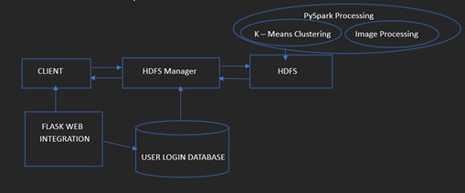
Workflow

Slide 5
Main.py and INIT.PY
We have created a web application that allows users to sign up, login and upload image or text files into the Hadoop Distributed File System (HDFS).
In main.py, create_app() is used to create the Flask application instance and initialize the required extensions such as SQLAlchemy and Flask-Login.
SQL Alchemy is used to set up the database connection and creates all the required tables if they do not exist.
Flask-Login makes it easier to handle user authentication and session management in Flask applications.

Slide 6
Models.py and Views.py
It has been structured using the Model-View-Controller (MVC) pattern, with separate files for each component
models.py: This file defines the data models for the database, including the User and Note models. It sets up the relationships between these models and defines the fields for each one.
views.py: This file defines the routes for the web pages, such as the home page and the login page. It uses the Flask-Login extension to manage access to these pages, so only authenticated users can view them.

Slide 7
Auth.py
auth.py is a module that contains the authentication functionality for the Flask application.
It defines routes for the login and logout pages, as well as a custom user loader function to load users from the database.
The module uses the Flask-Login extension to handle user authentication.
When a user logs in, Flask-Login sets a cookie in the user's browser with a secure token, which is used to verify subsequent requests from the same user.

Slide 8
Color_quantizer.py
This code performs color quantization on an image using K-means clustering in PySpark.
The goal of color quantization is to reduce the number of colors in an image while preserving its visual appearance.
This can be useful for applications like image compression, where reducing the number of colors can significantly reduce the size of the image file.
To start, the code reads an image and converts it to a 2D array of pixels using the imread() function from the matplotlib library. Then, it creates a PySpark DataFrame with a single column named "features" containing the flattened image pixels.
This DataFrame is then transformed using a VectorAssembler to convert the "features" column to a vector column named "feature_vector".

Slide 9
Color_quantizer.py
Next, the code uses the elbow method and silhouette score to determine the optimal number of clusters for the K-means algorithm. It iteratively fits K-means models with different values of K and computes the silhouette score for each model.
After determining the optimal number of clusters, the code fits a K-means model with that number of clusters to the DataFrame.
It uses the model to assign each pixel in the original image to one of the clusters based on its RGB values.
The RGB values of the cluster centers are then used to produce a quantized version of the original image, where each pixel is replaced with the RGB values of its assigned cluster center.
The quantized image is displayed using the imshow() function from matplotlib.

Slide 10
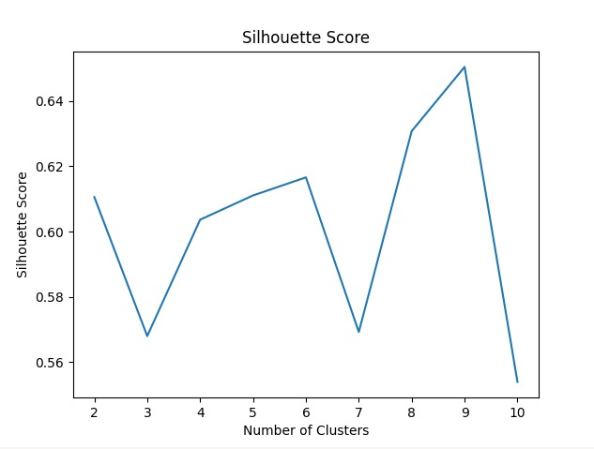
Color_quantizer.py

Slide 11
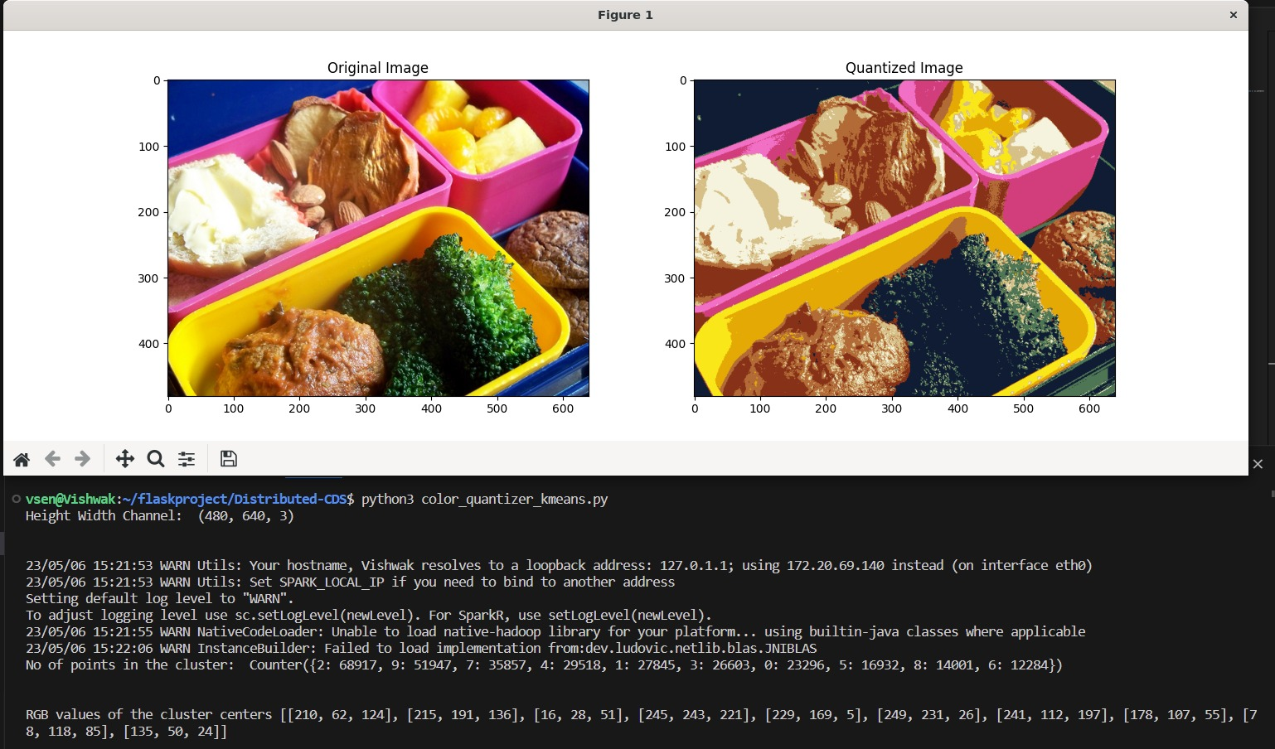
Color_quantizer.py

Slide 12
Image processing using C++
Image processing using C++ involves the use of C++ programming language to manipulate digital images. It is a widely used language in computer vision and image processing due to its high performance and low-level control of hardware resources.
Image data compression using quantization is a technique that reduces the amount of storage required to represent an image while maintaining an acceptable level of visual quality. The basic idea behind this technique is to reduce the number of colors in the image by grouping similar colors together and representing them with fewer bits.

Slide 13
GITHUB LINK
https://github.com/rishilss99/Distributed-CDS

