Slide 1
BECE 351E-INTERNET OF THINGS
PROJECT REPORT
Automatic Pet Feeder with Mobile Application
Done by:
Krupa Srinivasan- 21BA11532
Rishitha - 21BAI1279
Vandhana S- 21BPS1172
Submitted to: Dr.D.Saraswathi

Slide 2
Abstract
Includes a pet feeder device and a mobile application
Introduces an Automatic Pet Feeder IoT system
Combines interconnected devices and smart automation to provide a convenient feeding solution for pet owners
The pet feeder device incorporates sensors, actuators, and communication modules, allowing interaction with the mobile application
The mobile application serves as the user interface for managing the pet's feeding schedule, offering customizable settings, real-time notifications, and status updates

Slide 3
Automatic Pet Feeder with Mobile Application
This project report introduces an Automatic Pet Feeder IoT system that combines interconnected devices and smart automation to provide a convenient feeding solution for pet owners. The system includes a pet feeder device and a mobile application. The pet feeder device incorporates sensors, actuators, and communication modules, allowing interaction with the mobile application. The mobile application serves as the user interface for managing the pet's feeding schedule, offering customizable settings, real-time notifications, and status updates.

Slide 4
Introduction
Highlights the integration of IoT technology with pet care, addressing the challenges associated with manual feeding methods
The Pet Feeder IoT project aims to automate the feeding process, provide remote control capabilities, and enhance the overall pet care experience
The advantages of IoT-enabled pet feeding include flexibility in feeding schedules, portion control, convenience, and real-time monitoring

Slide 5
Components
Hardware: ESP32 WiFi Development Board, 90 degree rotation servo motor
Software: Arduino ide, firebase, mit app inventor

Slide 6
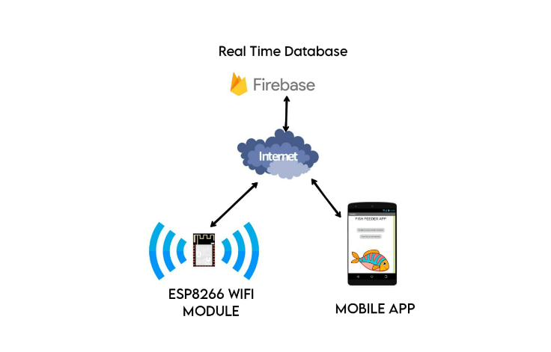
System architecture

Slide 7
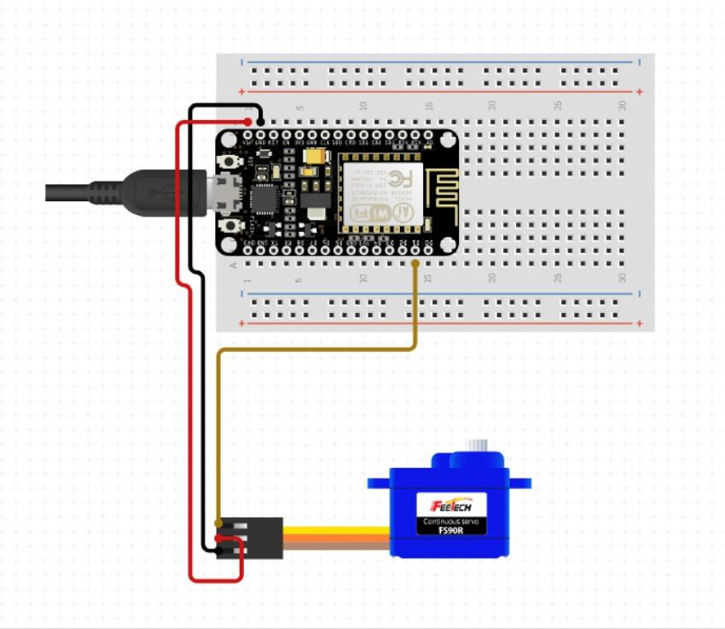
Pin diagram

Slide 8
Conclusion
The Pet Feeder IoT system exemplifies the convergence of technology and pet care, offering convenience, peace of mind, and improved well-being for both pets and owners
The report emphasizes the potential for future enhancements, such as incorporating machine learning algorithms for personalized feeding recommendations
The project contributes to the field of IoT applications in the pet care industry and fosters a stronger connection between pets and their owners, even when physically apart
Overall, the project showcases the innovative possibilities of IoT technology in optimizing pet care and attention

Slide 9
Thank you for your time and attention 🙂

