Slide 1


Target Brazil: Executive Overview
Sanjit Kangovi
Siddhartha Sumant Mysore
Rishikumar Mathiazhagan
Krithika Suwarna
Hamsavi Krishnan

Slide 2
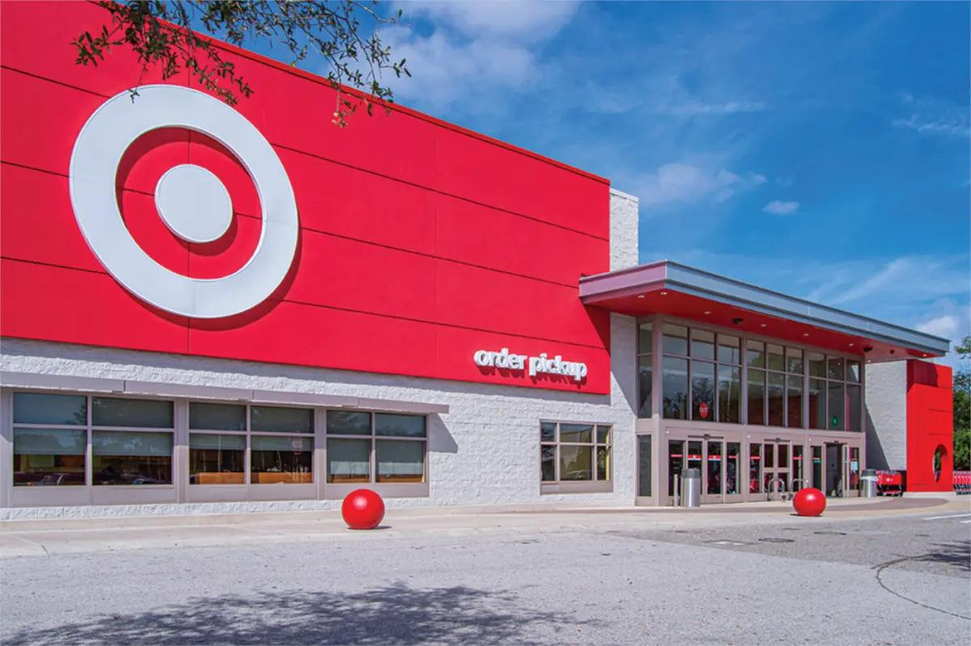
Project Overview
  Provide a comprehensive analysis of Target's operations in Brazil, focusing on sales performance and delivery efficiency for the period 2016-2018.
  Highlight key insights to support strategic decision-making in logistics, operations, and revenue optimization.

Slide 3


Intended Users
Delivery Dashboard | Revenue Dashboard
Logistics Team | Finance Team
Operations Managers | Sales and Marketing Team
Senior Management | Senior Management

Slide 4
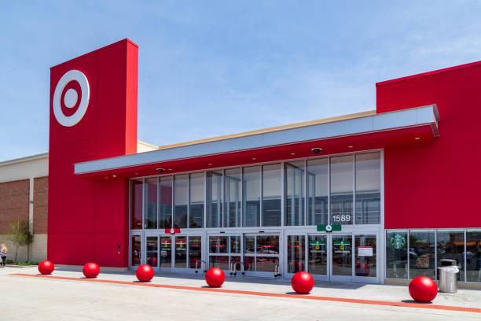
Dataset Overview
TARGET : BRAZIL
ORDER DETAILS
Includes data on order status, pricing, payment, and shipping performance
100,000 orders from 2016 to 2018
CUSTOMER AND PRODUCT INSIGHTS
DATASET STRUCTURE
Covers customer locations, product details, and customer reviews.
Seven data files, different aspects of operations

Slide 5
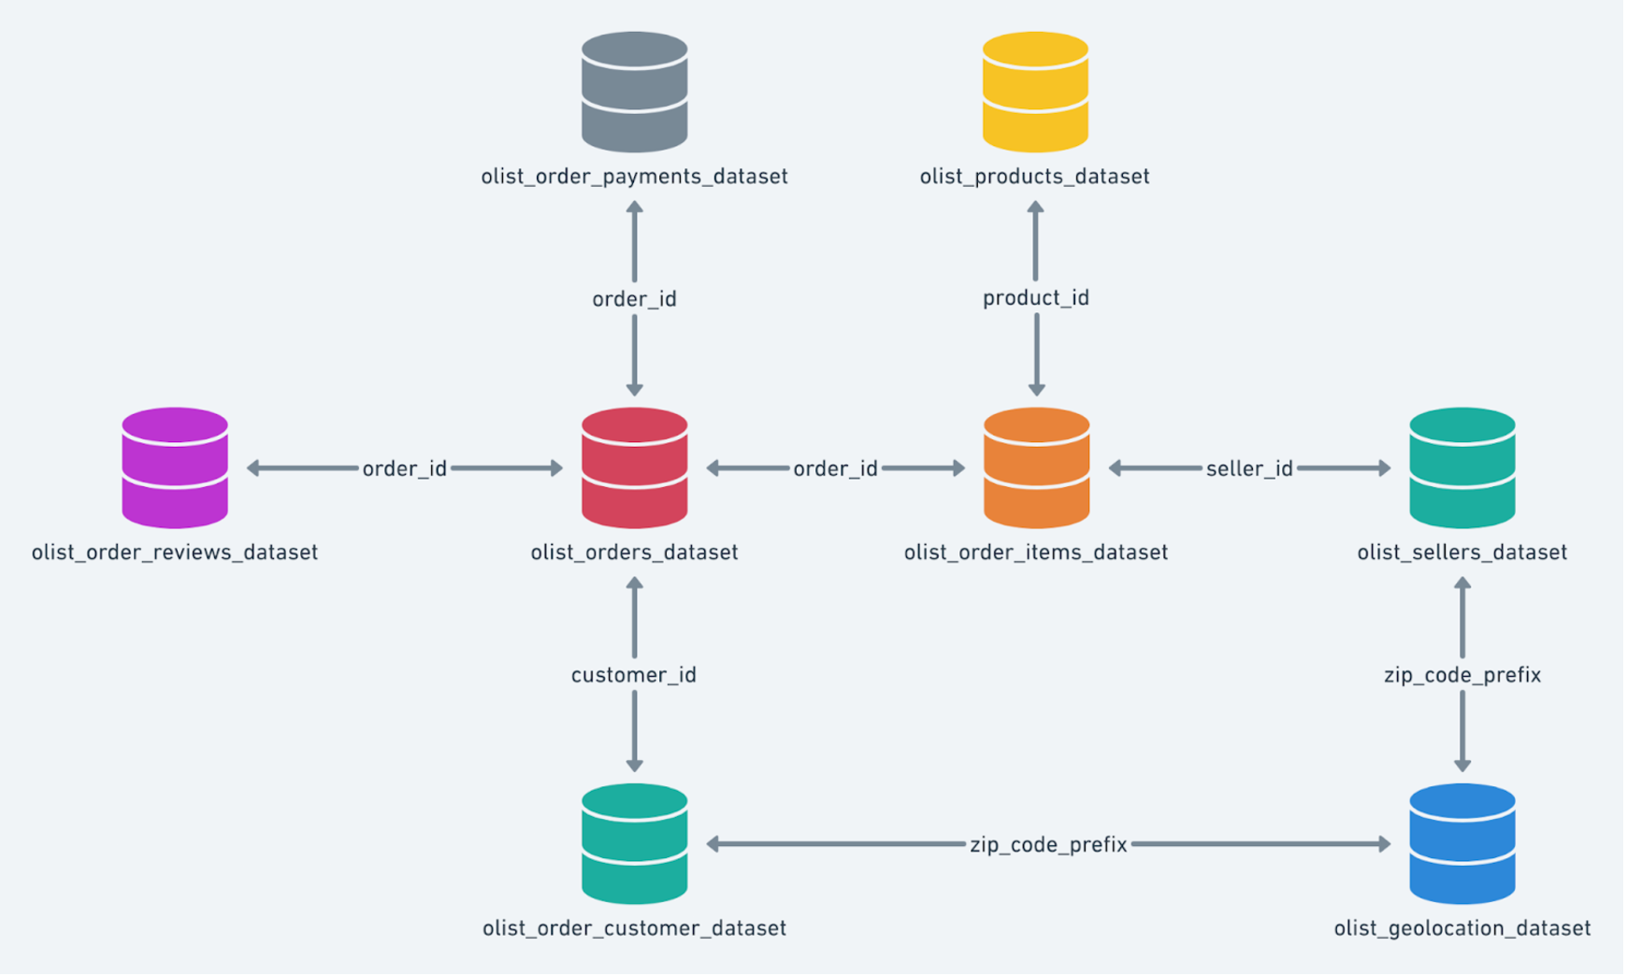
Database Schemas

Slide 6

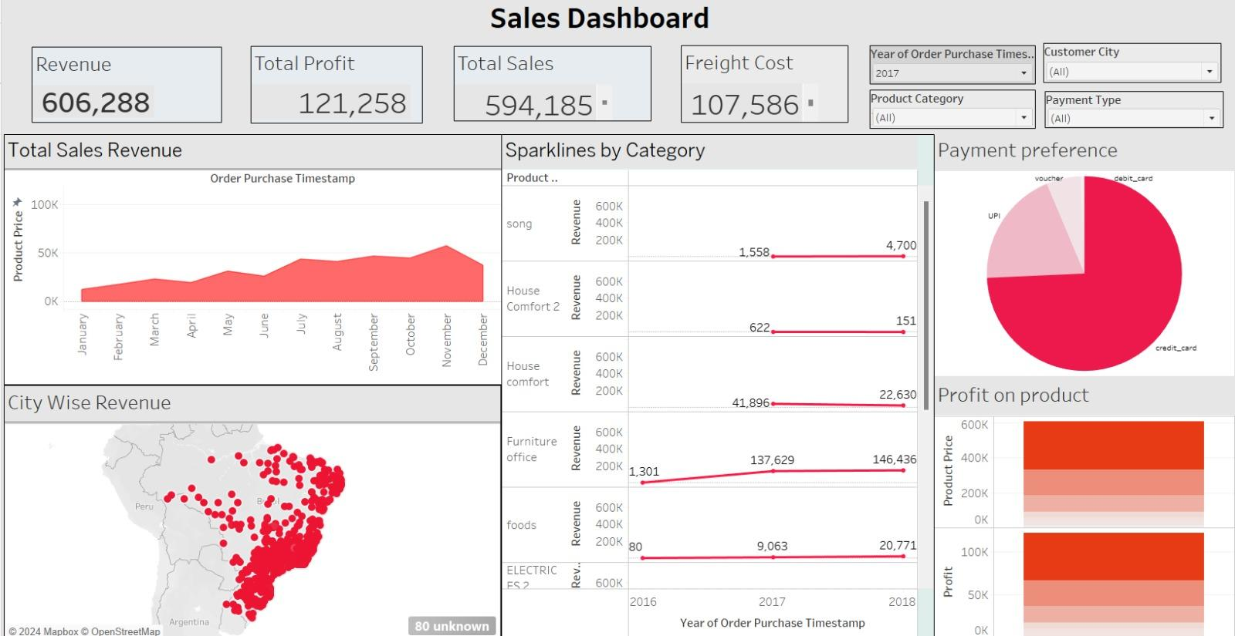
DASHBOARD 1
Revenue Analysis

Slide 7
Insights:
Finance Managers
Revenue and Profitability: Assess total revenue and profit margins to evaluate financial performance and identify high-performing regions and product categories.
Cost Efficiency: Analyze freight costs to understand their impact on overall profitability and identify areas for optimization in logistics expenses.
Customer Payment Preferences: : Examine customer payment trends to develop targeted financial strategies, including promotions and loyalty programs.
Sales Trends: Track revenue patterns over time to identify peak and low-performing periods, enabling better sales forecasting and resource allocation.

Slide 8
Recommendations:
Finance Managers
Optimize Freight Costs: Focus on high-revenue cities like São Paulo and Rio de Janeiro to streamline logistics and reduce freight expenses.
Enhance Profit Margins: Allocate resources to high-performing product categories (e.g., Furniture Office, House Comfort) to maximize profitability.
Strategize Payment Options: Encourage dominant payment methods observed in customer trends through targeted promotions and discounts.

Slide 9
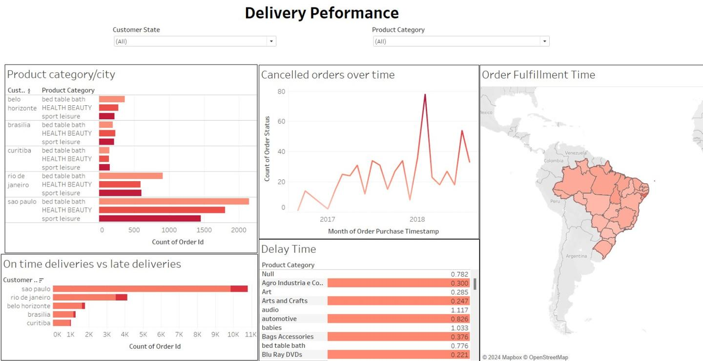
DASHBOARD 2
Delivery Performance

Slide 10
Insights:
Operation Managers
Delivery Efficiency: Analyze on-time versus late deliveries by city and product category to identify logistical inefficiencies.
Delay Analysis: Understand delay times for specific product categories to optimize the supply chain.
Order Fulfillment Trends: Monitor fulfillment times geographically to pinpoint regions with prolonged delivery times.
Cancelled Orders: Observe trends in canceled orders to identify recurring issues in the operational process

Slide 11
Recommendations:
Operation Managers
Prioritize resources in cities with high late deliveries (e.g., São Paulo) to enhance delivery timelines.
Optimize the supply chain for categories with the highest delays, such as "Automotive."
Implement strategies to reduce cancellations by addressing identified problem areas in the order lifecycle.

Slide 12

Thank You!

