Slide 1
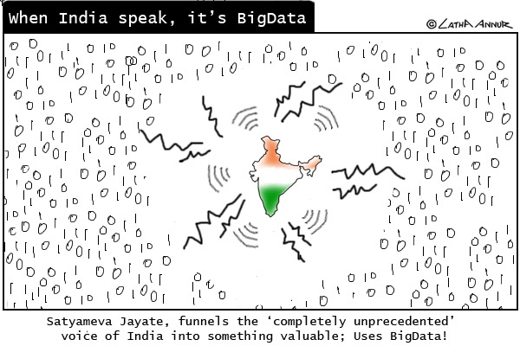

Slide 2
Data Storage

Slide 3
Databases
How much data?
Variety of data.

Slide 4
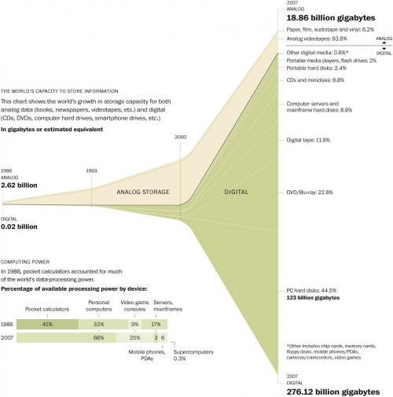
One take!

Slide 5
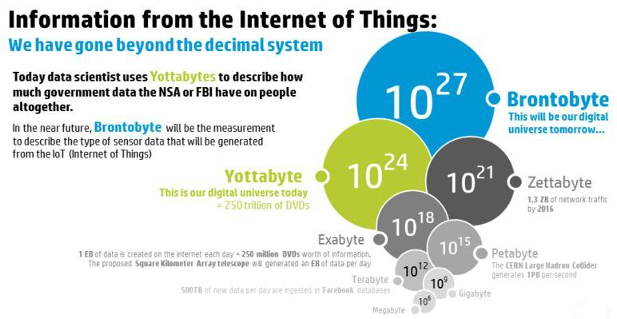

Slide 6
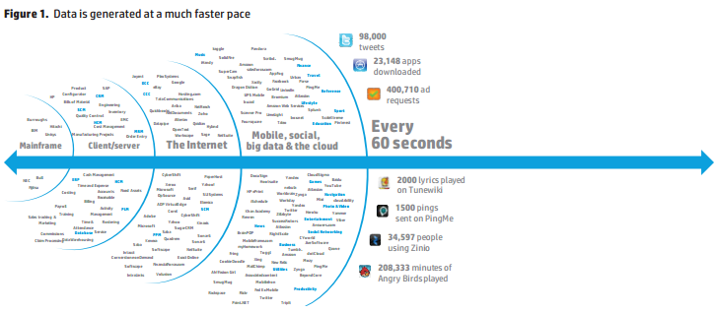

Slide 7
Databases
How much of this data is in databases?
Does the definition of database change?
Does the functionality of database system change?

Slide 8
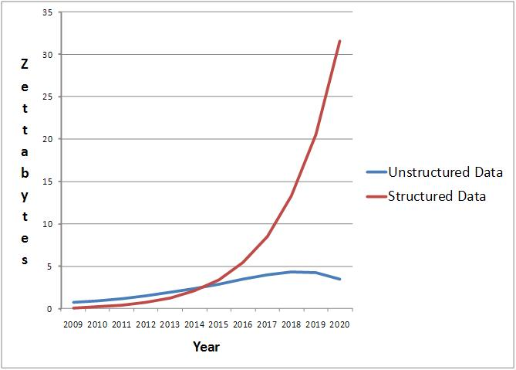
Another take!

Slide 9
What does a database system do?
Image taken from Jignesh Patel course Slides

Slide 10
Image taken from Jignesh Patel course Slides

Slide 11
Image taken from Jignesh Patel course Slides

Slide 12
Image taken from Jignesh Patel course Slides

Slide 13
Where to store? non-volatile
Disk
SSD

Slide 14
Disks
Most popular and widely used secondary storage device – remaining life time about 10 years
Data is stored and retrieved in units called disk blocks or pages
Elector-Magnetic-Mechanical device
Time to retrieve a disk page varies depending upon location on disk
Therefore, relative placement of page on disk has major impact on DBMS performance.

Slide 15
Image taken from Jignesh Patel course Slides

Slide 16
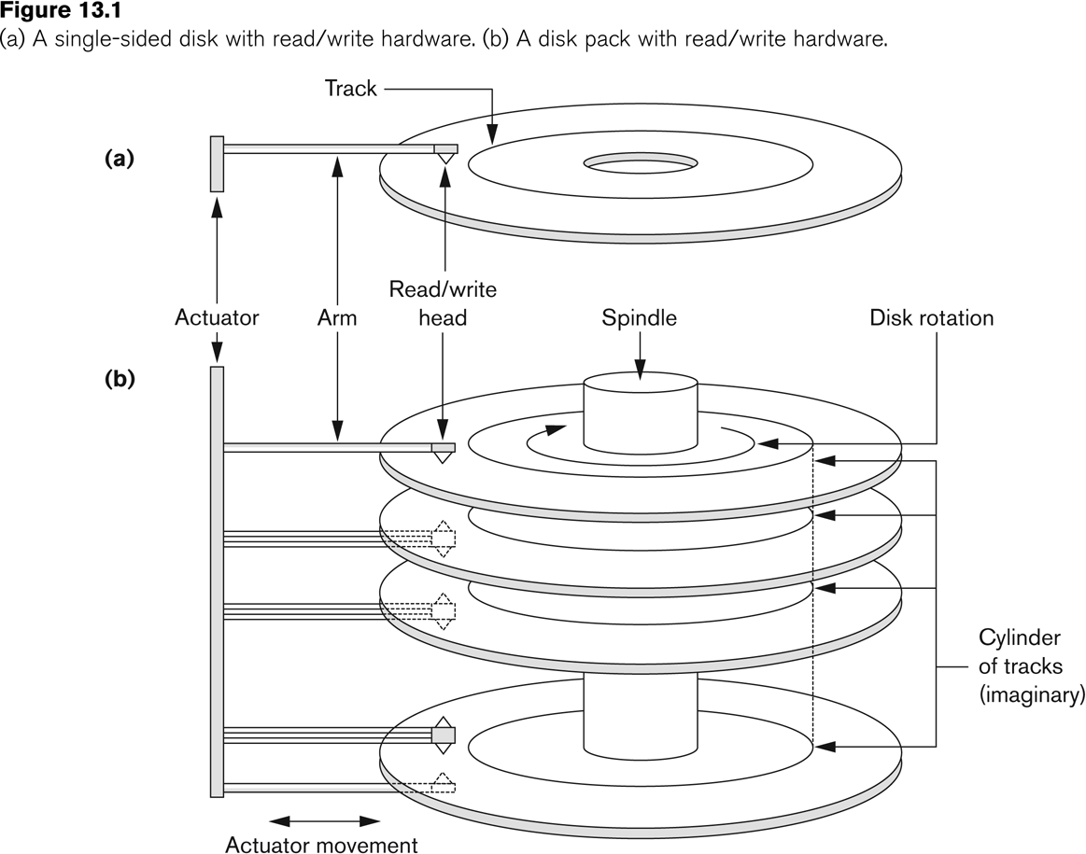

Slide 17
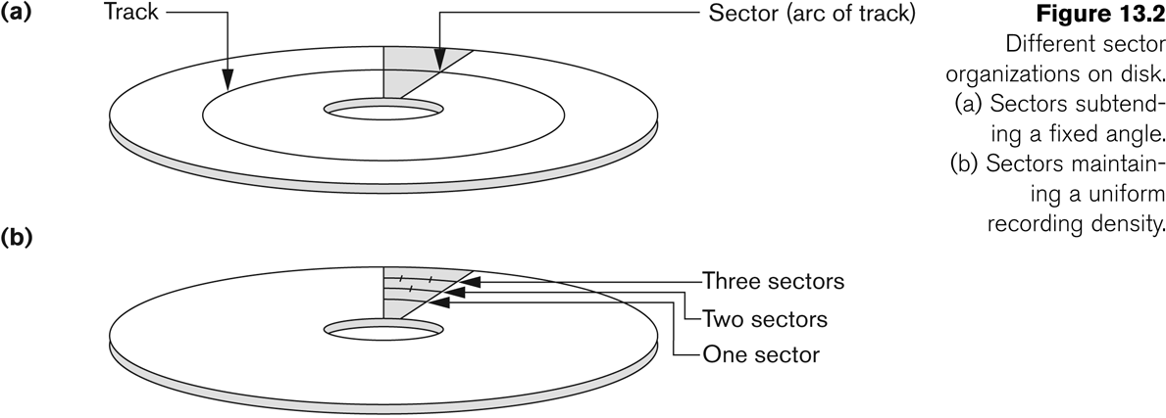

Slide 18
Disks
Disks are divided into concentric circular tracks on each disk surface. Track capacities vary from 4 to 100 Kbytes
A track is divided into blocks. The block size B is fixed for each system. Typical block sizes range from 512 to 8192 bytes (mostly 4096 bytes). Whole blocks are transferred between disk and main memory for processing
A physical disk block address consists of a surface number, a track number (within surface), and a block number (within track).
Reading or writing a disk block is time consuming because of the seek time s and rotational delay (latency) rd.

Slide 19
Disk block access
How much time does it take on an average to perform disk block access?
Best case
Worst case
Average case
What about accessing a set blocks rom disk?
Best case
Worst case
Average case

Slide 20
Specific Example Megatron Disk
4 platters – 8 surfaces
2¹³ = 8192 tracks per surface
Average 2⁸ = 256 sectors per track
2⁹=512 bytes per sector
Capacity = 8*8192*256*512 = 2³³ bytes = 8 Gigabytes
Track holds 256*512 = 128 K bytes – average
If disk block size is 4096 bytes – 1 block = 8 sectors => 256/8 = 32 blocks per track
Densities can vary a lot from inner to outer track – to keep the density variation small number of sectors per track vary form inner track to outer track.

Slide 21
Seek, Latency and transfer time
10 ms to 40 ms for this disk
In general 3x to 20x depending on distance in terms of number tracks to travel
One rotation of disk on average 10 ms. On average half a circle.
Transfer time as disk rotates it can read blocks under the head
Since the disk rotates once in about 10 ms, we can read about 10 megabytes per second
Transfer time for a 4096 bytes block is about 0.5 ms
Minimum = 0.5ms, Maximum = 33.5 ms, 14.8ms – check text book example

Slide 22
SSD
Faster than disks
Almost uniform access
Can get up to 512 GB
Long term cheaper than disks – farms of SSDs – Facebook.
End is near for disks

Slide 23
SSHD
Major disk – 1-4TB
Minor SSD – 8 GB
SSD as cache
Single device
Both for reads and also to map DRAM to NAND cache

Slide 24
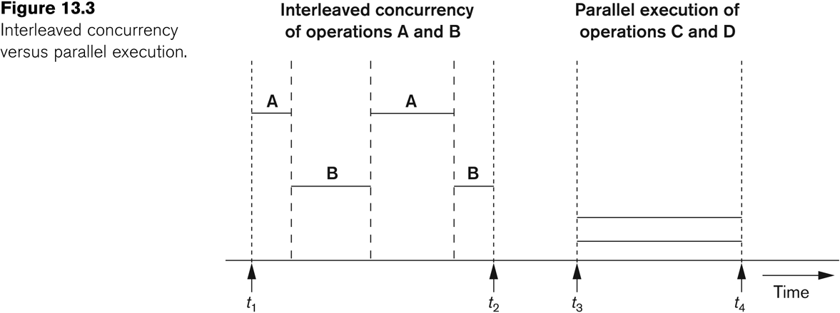

Slide 25
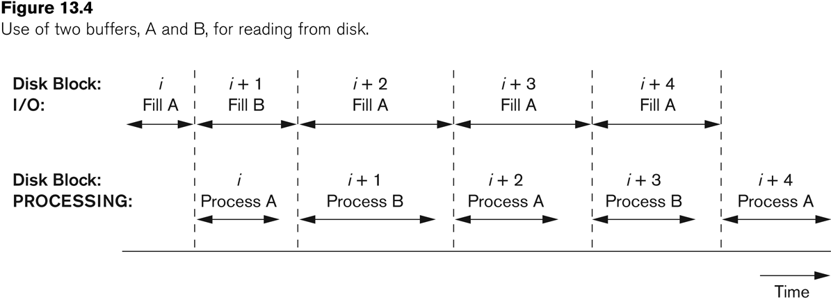

Slide 26
The data in the database is stored in files on the disk. Therefore, the organization of files, and indexes to access these files determine the performance of the database system.
That is, performance of queries and transactions.

Slide 27
Image taken from Jignesh Patel course Slides

Slide 28
Total time to execute Database Query/Update Operation
From start of initiation of the database operation till getting of final result/non-result
Consists of
Time taken to preprocess operation – legal
Time taken to find best possible way of performing the operation
Time taken to execute sub-operations of the operation
Time taken to wait for synchronization
Time taken to complete recovery related operations
Time taken to generate and send final result to user
Total time = a + b + c + d + e +f
How much CPU, How much Secondary Storage Access, How much Waiting, How much data transfer time.

