Slide 1
Database Systems Spring 2014
Kamalakar Karlapalem
A5 301 Vindhya Building
kamal@iiit.ac.in

Slide 2
Prerequisites
Introduction to Databases
ER, Relational, SQL, Normalization, Relational Algebra, Tuple Relational Calculus
Data Structures
Algorithms
Operating Systems

Slide 3
Topics Covered
Data storage
Representing Data Elements
Index Structures
Multidimensional Indexes – briefly
Query Execution
Query Compiler – Optimization
Concurrency control
Coping with system failures
Modern Database Systems

Slide 4
Book
Database System Implementation – Hector Garcia-Molina, Jeffery D. Ullman, Jennifer Widom
Or
Database Systems – The complete book - Hector Garcia-Molina, Jeffery D. Ullman, Jennifer Widom
Indian editions available

Slide 5
Evaluation & Grading
Project 30%
Midterms – 25%
Final – 25%
Assignments – 20%
No copying – if found direct ‘F’ in course.
Variance proportional grading

Slide 6
Project
Will be announced in next class
Will involve working as group of two students
Implement core database system functionality
Deliverable almost every two weeks
Prepare for solid implementation work.

Slide 7
Assignments
About five
Once in three weeks
Give you one week to do it.

Slide 8
Background

Slide 9
What is a database?
Data: factual (undoubted) information used as a basis for reasoning, discussion, or calculation.
A database is a collection of related data.

Slide 10
Implicit properties of a database
Database represents some aspect of the real world (mini-world or Universe of Discourse (UoD))
A database is a logically coherent (associated, related) collection of data with some inherent meaning
A database is designed, built and populated with data for a specific purpose
It has an intended group of users and some preconceived (already thought of) applications in which these users are interested.

Slide 11
Simplified Database System
USERS/PROGRAMMERS
DATABASE
SYSTEM
APPLICATION PROGRAMS/
QUERIES
DBMS
SOFTWARE
SOFTWARE TO PROCESS QUERIES/ PROGRAMS
SOFTWARE TO ACCESS
STORED DATA
Stored Database
Definition
(Meta-Data)
Stored Database

Slide 12
Example of a Database
Consider a part of a university environment
We need data about
STUDENTs
COURSEs
SECTIONs (of COURSEs)
(academic) DEPARTMENTs
INSTRUCTORs
The university data is related as follows
SECTIONs are of specific COURSEs
STUDENTs take SECTIONs
COURSEs have prerequisite COURSEs
INSTRUCTORs teach SECTIONs
COURSEs are offered by DEPARTMENTs
STUDENTs major in DEPARTMENTs

Slide 13
Example Database

Slide 14
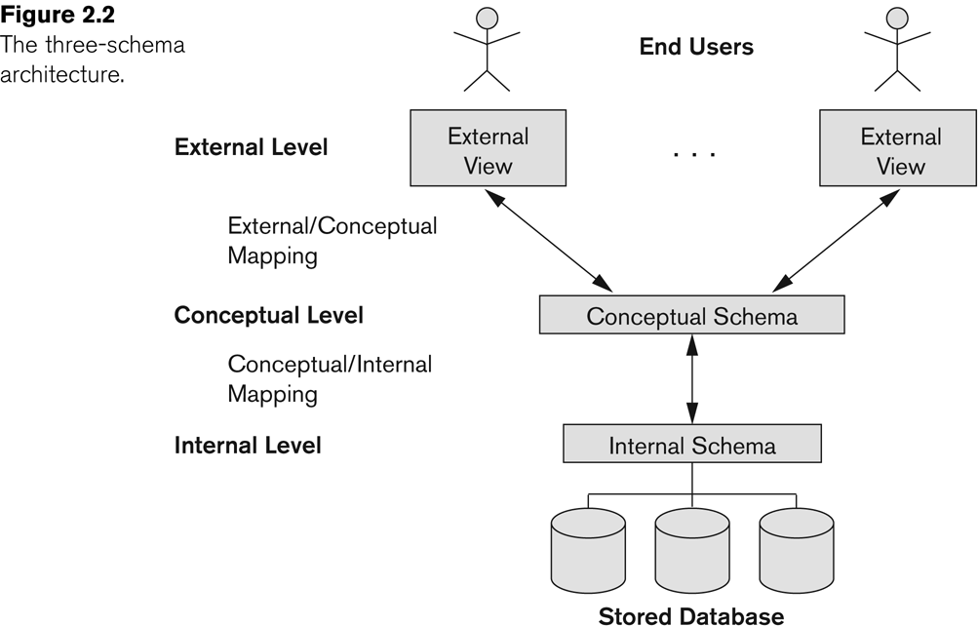
The three-schema architecture

Slide 15
Database Design Process
Mini World
REQUIREMENTS COLLECTION AND ANALYSIS
Functional Requirements
Database requirements
FUNCTIONAL ANALYSIS
CONCEPTUAL DESIGN
High-level Transaction Specification
Conceptual Schema
(in a high-level data model)
DBMS independent
LOGICAL DESIGN
(DATA MODEL MAPPING)
DBMS specific
Logical (Conceptual) Schema
(in the data model of specific DBMS)
APPLICATION PROGRAM DESIGN
PHYSICAL DESIGN
TRANSACTION IMPLEMENTATION
Application Programs
Internal Schema (For the same DBMS)

Slide 16
ER Data Model
Number
Fname
Minit
Lname
Locations
Name
Address
(1,1)
WORKS_FOR
(4,N)
Name
Sex
Salary
employee
department
Ssn
EMPLOYEE
Startdate
Number Of Employees
DEPARTMENT
Bdate
(0,1)
(1,1)
Controlling-department
(0,N)
(0,N)
(0,1)
manager
MANAGES
supervisor
Department- managed
CONTROLS
supervisee
(1,N)
worker
Hours
Controlled-project
(1,1)
1
SUPERVISION
(0,N)
(1,N)
employee
WORKS_ON
project
PROJECT
Name
DEPENDENTS_OF
Location
Number
dependent
(1,1)
DEPENDENT
Name
Sex
Birthdate
Relationship

Slide 17
Relational Data Model Concepts
Relation (informally): A table of values. Each column in the table has a column header called an attribute. Each row is called a tuple
Formal Relational Data Model Concepts
Domain: A set of atomic (indivisible) values).
Attribute: A name to suggest the meaning that a domain plays in a particular relation. Each attribute A_{i} has dom(A_{i})
Relational Schema: A relation name R and a set of attributed Ai that define the relation
Denoted by: R(A₁, A₂, …, A_{n})
Example: STUDENT(Name, Student-id, Age GPA)

Slide 18
Example
Relation/Table Name
Attributes/Columns
Tuples/Rows

Slide 19
Integrity Constraints
Constraints are conditions that must hold on all valid relation instances. These constraints are
Domain constraints,
Key constraints,
Entity integrity constraints, and
Referential integrity constraints

Slide 20
Example Database

Slide 21
Relational Algebra
For those students who received Grade ‘A’ in a course, get the student name and course name
Π_{Name, Course Name}(σ_{Grade = `A’}(STUDENT*GRADE-REPORT *SECTION* COURSE))

Slide 22
SQL
A query in SQL can consist of up to six clauses, but only the first two are mandatory
SELECT <attribute list>
FROM <table list>
[WHERE <condition>]
[GROUP BY <grouping attributes>]
[HAVING <grouping condition>]
[ORDER BY <attribute list>]
A query is evaluated by first applying the WHERE clause, then GROUP BY and HAVING, and finally the SELECT-clause

Slide 23
UPDATE
Give all employees in the ‘Research’ department a 10% raise in salary
UPDATE EMPLOYEE
SET SALARY = SALARY*1.1
WHERE DNO IN ( SELECT DNUMBER
FROM DEPARTMENT
WHERE DNAME = ‘Research’);

Slide 24
Inference Rules for FDs
F denotes the set of FDs specified for R
Other FDs may also hold on all legal instances that satisfy F
The set of all such FDs is called closure of F denote dby F+
A FD X→Y is inferred from F if X→Y holds in every legal instance r of R
Need a set of inference rules that can systematically infer new FDs from a given set of FDs
Reflexivity, Augmentation, Transitivity

Slide 25
Normalization
A systematic process of decomposing unsatisfactory relation schemas into smaller relations schemas that process desirable properties
Provides a series of tests for relation schemas
Expressed in terms of normal forms
first four: only use FDs
additional: use other types of dependencies
Not necessary to normalize to highest form!
Normal forms do not guarantee good design
also need to consider
loss less join property
dependency preserving property

Slide 26
Normal Forms
Normal Form | Test | Normalization (Remedy)
First (1NF) | Relation should have no non-atomic attributes or nested relations. | Form new relations for each non-atomic attribute or nested relation.
Second (2NF) | For relations where primary key contains multiple attributes, no non-key attributes should be functionally dependent on a part of primary key. | Decompose and set up a new relation for each partial key with its dependent attribute(s). Make sure to keep a relation with the original primary key and any attributes that are fully functionally dependent on it.
Third (3NF) | Relation should not have a non-key attribute functionally determined by another non-key attribute ( or by a set of non-key attributes.) That is, there should be no transitive dependency of a non-key attribute on the primary key. | Decompose and set up a relation that includes the non key attribute(s) that functionally determine(s) other non-key attribute(s).

Slide 27
Algorithm for computing X+
Algorithm X+ (closure of X under F)
X+ := X
while (changes to X+) do
for each FD Y →Z
if Y⊆X+ then X+ = X+ ∪Z
Does F |= X →Y?

Slide 28
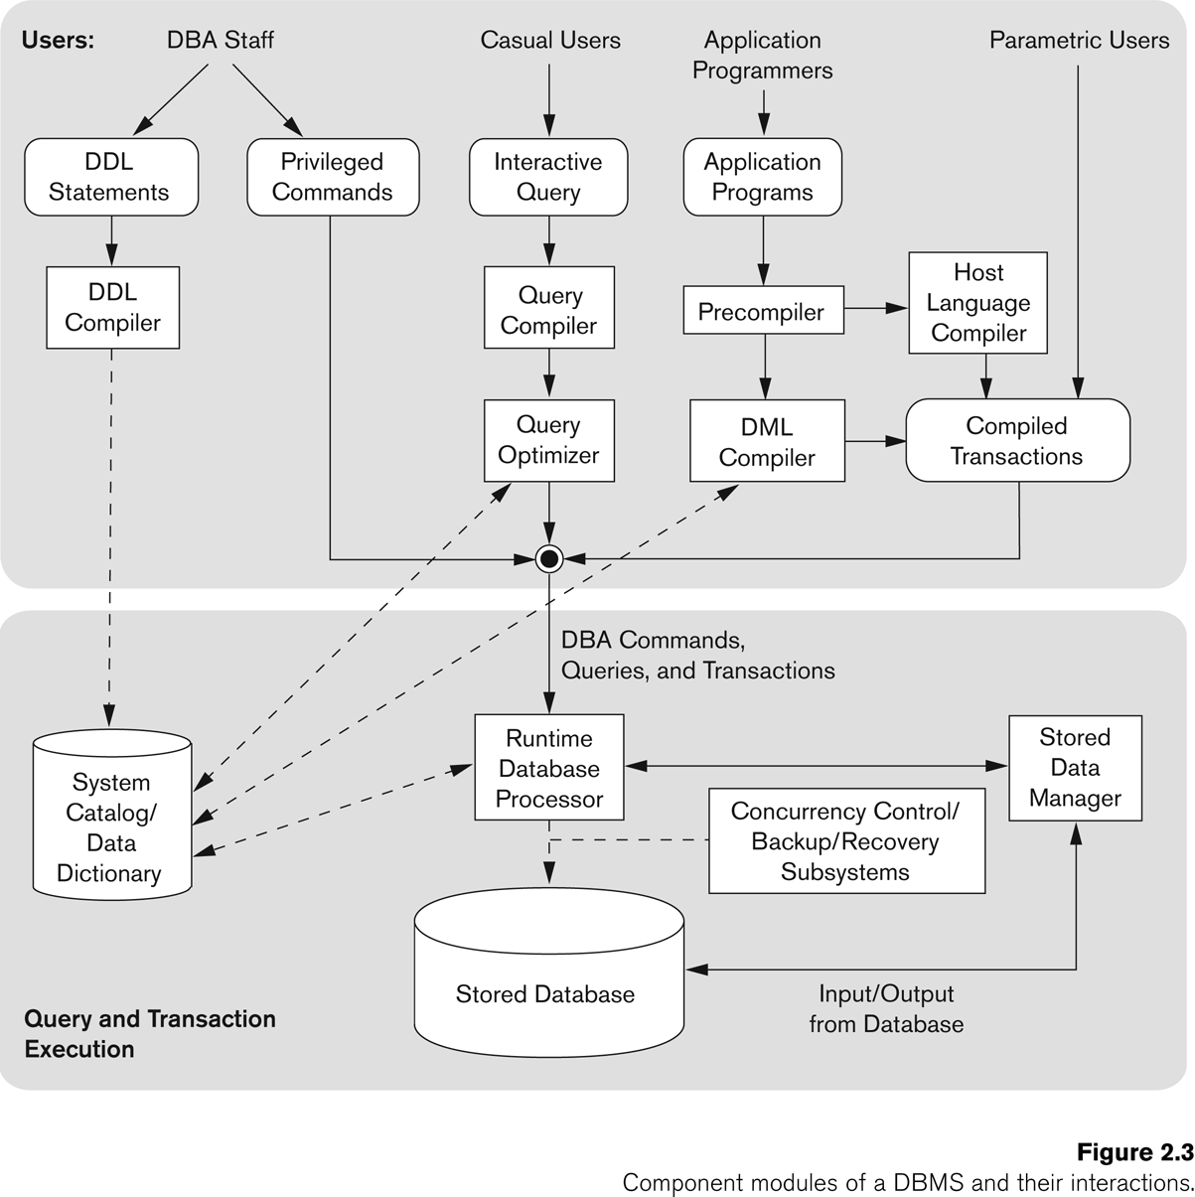

Slide 29
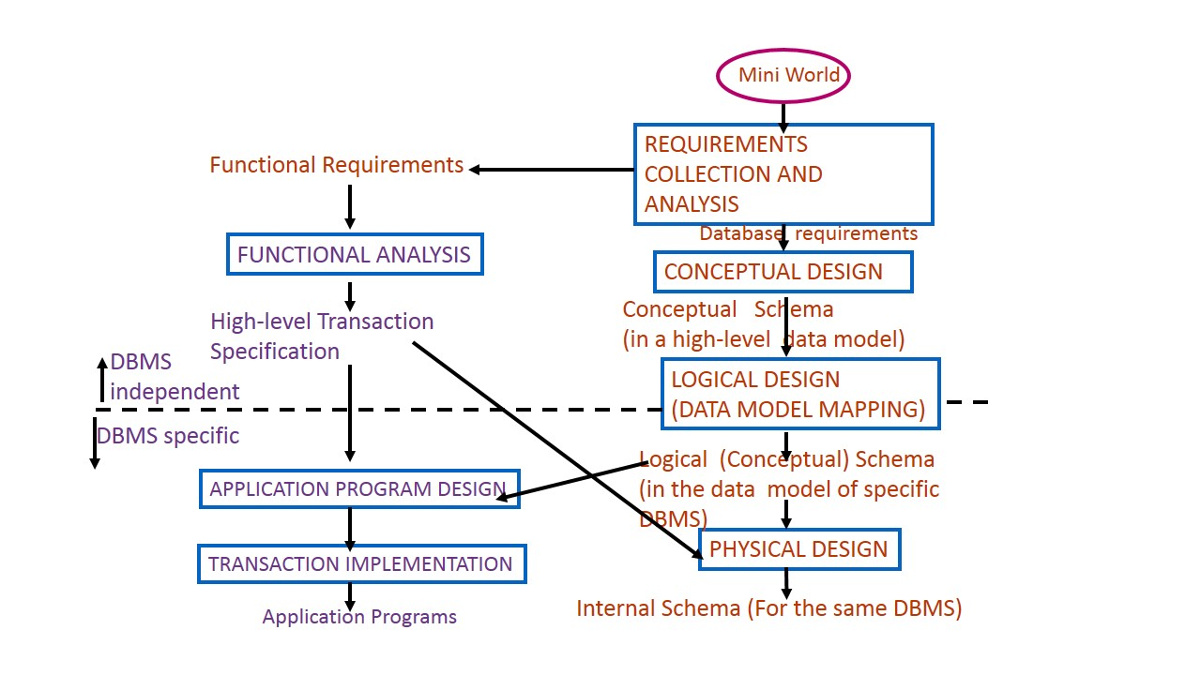
Is there connection between mini world and database system design?

