Slide 1
Wildfires: Case Study
---- Group 4 (New York)

Slide 2
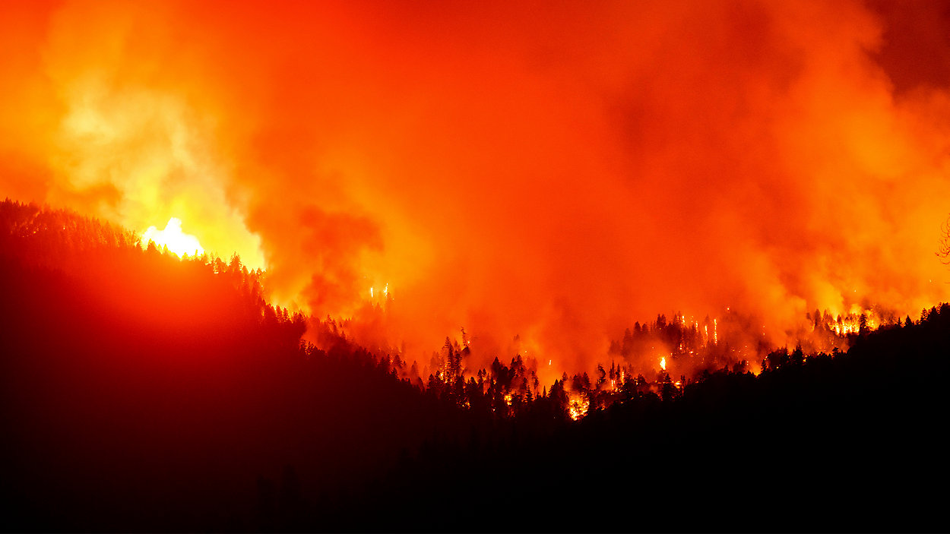
Outline
Introduction to the problem
Graphs
Maps
Challenges
Conclusions
Bonus
BY NICK REISMAN CITY OF ALBANY
PUBLISHED 4:42 PM ET SEP. 25, 2020

Slide 3
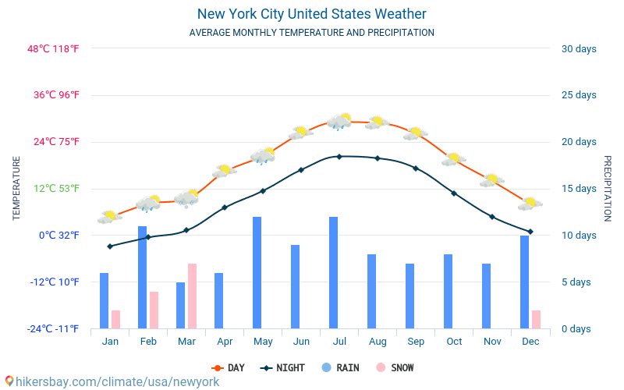
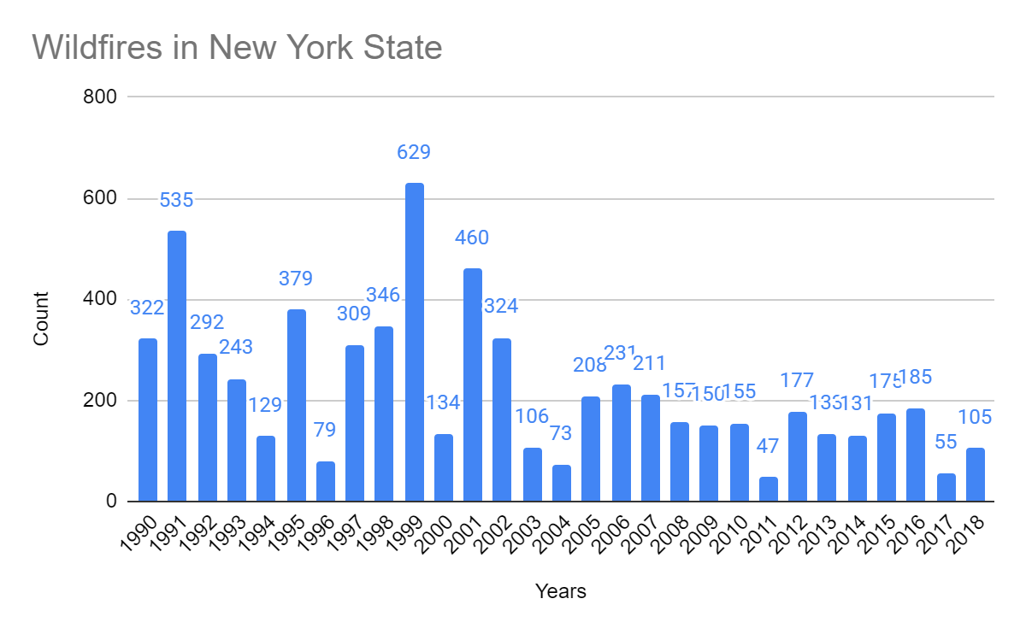
Introduction to the problem
New York is a state in the Mid-Atlantic and Northeastern regions in the United States.
Humid subtropical climate
An average of more than 200 wildfires per year in the past 30 years

Slide 4
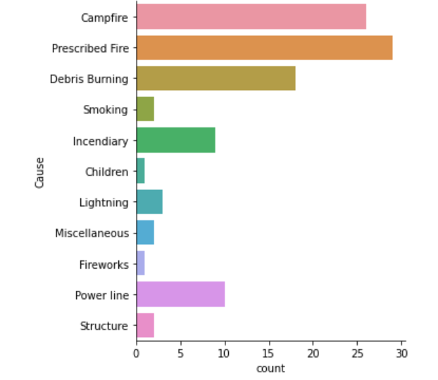
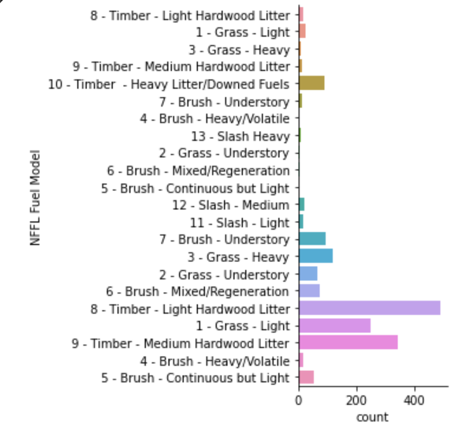
Graphs

Slide 5
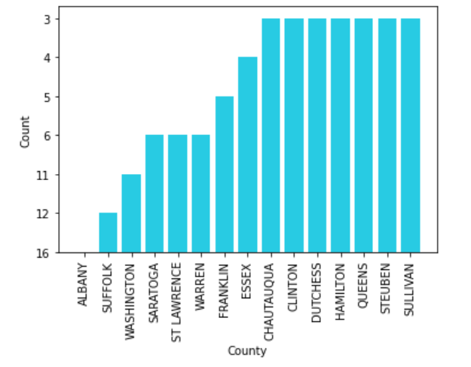
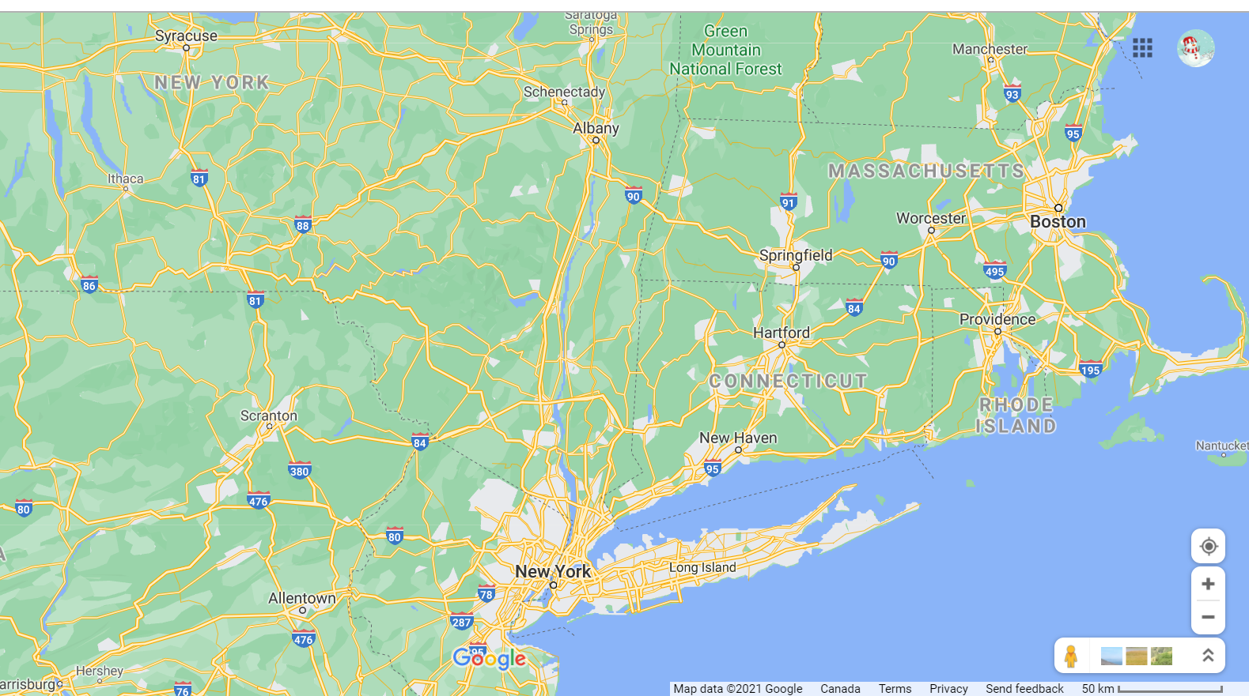
Graphs

Slide 6
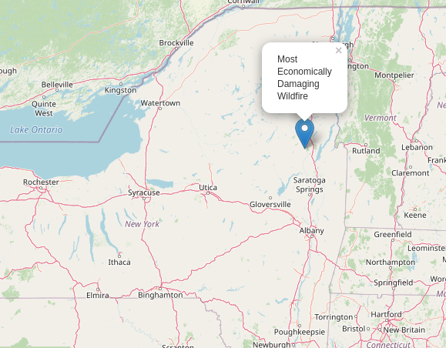
Maps
Thurman Fire
Date: August 5, 2019
Non-Personal Expenses: 500
Fuel: Miscellaneous
Type: Slash Heavy
County: Waren
Municipality: Thurman
Location: Private Property
Most Economically Damaging Wildfire in New York (2019)

Slide 7
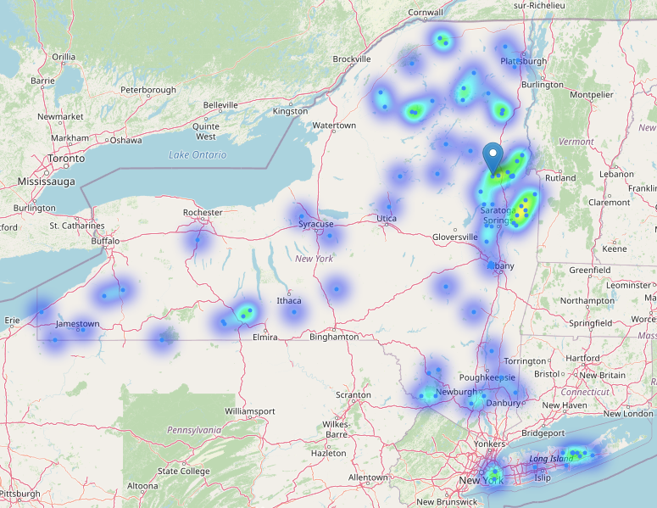
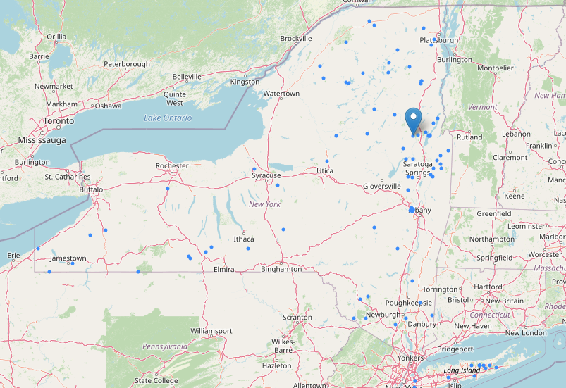
Maps
Heat Map of Wildfires in New York (2019)
Locations of Wildfires in New York (2019)

Slide 8


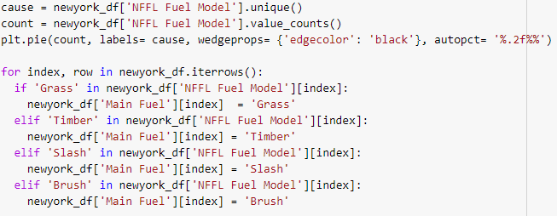
Challenges
As a group we did not face many challenges or issues while coding. I think that the biggest problem was coordinating what each person’s role was in either the data cleaning or the slideshow.
My issue

Slide 9
Work Cited
Our Colab link: https://colab.research.google.com/drive/16mshO0EmyLFZDo5BoMVuqazuc25c6Haa?usp=sharing
“Wildfires.” Wildfires, www.dec.ny.gov/lands/4975.html. Accessed 25 Aug. 2021.
REISMAN, NICK. “A Western Wildfire Unlikely in New York, But ADKs Still Face Risk.” Spectrumlocalnews [ALBANY, New York], 25 Sept. 2020, p. spectrumlocalnews.
“What Is the Weather like in New York City? New York City United States Weather. Climate and Weather in New York City 2021.” Hikersbay, hikersbay.com/climate/usa/newyork?lang=en. Accessed 25 Aug. 2021.

