Slide 1
Sentence Structure:
Sentence Types

Slide 2
Sentence Types
Simple
Compound
Complex
Compound-Complex

Slide 3
Basic Elements of Every Sentence
SUBJECT
PREDICATE

Slide 4

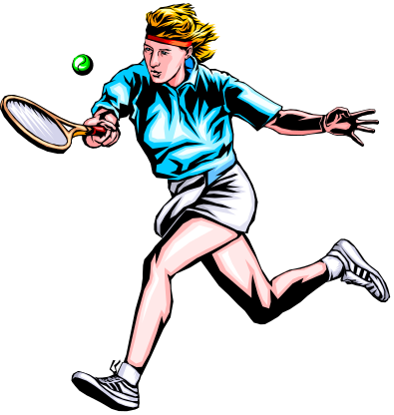
Basic Elements
SUBJECT
PREDICATE
Mary
plays tennis.

Slide 5
Simple Sentence

Slide 6

Simple Sentence
A simple sentence has one subject and one predicate.

Slide 7

Simple Sentence
Observe how a simple sentence is constructed:
We went to San Juan yesterday.

Slide 8
Simple Sentence
Pronoun
Verb
Prepositional phrase
We went to San Juan .
Simple subject
Complete predicate

Slide 9
SIMPLE SENTENCE
SUBJECT
PREDICATE
Mary
plays tennis.
one subject one predicate

Slide 10

Simple Sentence
Tom and Mary
play tennis.
Compound Subject
&

Slide 11
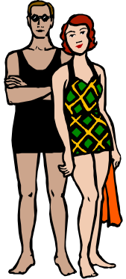
Simple Sentence
play tennis and swim.
Tom and Mary
Compound Subject Compound Predicate
&
&

Slide 12
SIMPLE SENTENCE with compound subject
Tom and Mary play tennis.

Slide 13
SIMPLE SENTENCE with compound subject and compound predicate
Tom and Mary play tennis and swim.

Slide 14
Compound Sentence

Slide 15
Compound Sentence
A compound sentence has more than one part that can stand alone (independent clauses).
Independent clauses are connected by coordinating conjunctions, conjunctive adverbs or a semi-colon.

Slide 16

Compound Sentence
  We went to San Juan, and
most of us danced all night.

Slide 17
Compound Sentence
Subject
Verb
Prepositional phrase
  We went to San Juan,
Predicate
Coordinating
Conjunction
and most of us danced all night .
Subject
Verb
Modifying phrase

Slide 18

Compound Sentence
Use of Coordinating Conjunctions
SUBJECT
PREDICATE
SUBJECT
PREDICATE

Slide 19
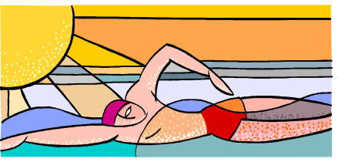
Compound Sentence
Tom
swims,
and
Mary
plays tennis.

Slide 20
COMPOUND SENTENCE:
COORDINATING CONJUNCTIONS
FOR
AND
NOR
BUT
OR
YET
SO

Slide 21
COMPOUND SENTENCE:
COORDINATING CONJUNCTIONS
Tom swims, and Mary plays tennis.
Clause 1 Clause 2
Independent Independent

Slide 22

COMPOUND SENTENCE:
COORDINATING CONJUNCTIONS
Tom swims, and Mary plays tennis.
Comma before “and”
in compound
sentences!

Slide 23
COMPOUND SENTENCE:
CONJUNCTIVE ADVERBS
MOREOVER
HOWEVER
OTHERWISE
THEREFORE

Slide 24
COMPOUND SENTENCE:
CONJUNCTIVE ADVERBS
Bob is handsome; moreover, he is rich.
Clause 1 Clause 2
Independent Independent

Slide 25
COMPOUND SENTENCE:
CONJUNCTIVE ADVERBS
Bob is handsome; moreover, he is rich.
Note: Semicolon
before conjunctive
adverb and comma
after conjunctive adverb!

Slide 26
Conjunctive Adverbs “float”
Conjunctive adverbs are sometimes called “floating” adverbs because they can be positioned at the beginning, in the middle, or at the end of a clause.

Slide 27
CONJUNCTIVE ADVERB:
AT THE BEGINNING, IN THE MIDDLE,AT THE END
Bob is handsome; moreover, he is rich.
Bob is handsome; he is, moreover, rich.
Bob is handsome; he is rich, moreover.

Slide 28
Semicolons
“If the relation between the ideas expressed in the main clauses is very close and obvious without a conjunction, you can separate the clauses with a semicolon” (Little, Brown Handbook, 9th Edition, p. 361).

Slide 29
COMPOUND SENTENCE:
SEMICOLON
Tom has benefited from his exercise program; he is slim and energetic.

Slide 30
Complex Sentence

Slide 31
Complex Sentence
A complex sentence has at least two parts: one that can stand alone and another one that cannot
The part that cannot stand alone is linked to the rest of the sentence by a subordinating conjunction

Slide 32

Complex Sentence
  Since my boyfriend and I wanted to have fun,
  we went to San Juan yesterday.

Slide 33
Complex Sentence
  Since we wanted to have fun,
Subordinating
Conjunction
Part that cannot stand alone
Subject
Predicate
  we went to San Juan yesterday.

Slide 34
Complex Sentence
SUBJECT
PREDICATE
even though
SUBJECT
PREDICATE

Slide 35
Complex Sentence
Bob
is popular
even though
he
is ugly.

Slide 36
COMPLEX SENTENCE:
SUBORDINATING CONJUNCTIONS
The most common subordinating conjunctions are "after," "although," "as," "because," "before," "how," "if," "once," "since," "than," "that," though," "till," "until," "when," "where," "whether,” and while."

Slide 37
COMPLEX SENTENCE:
SUBORDINATING CONJUNCTIONS
Bob is popular even though he is ugly.
Clause 1 Clause 2
Independent Dependent

Slide 38
COMPLEX SENTENCE:
SUBORDINATING CONJUNCTIONS
Even though Bob is ugly, he is popular.
Clause 1 Clause 2
Dependent Independent

Slide 39
Compound-Complex Sentence

Slide 40
Compound-Complex Sentence
This type of sentence has more than one part that can stand alone, and at least one that cannot.
Conjunctions link the different parts of this sentence.

Slide 41
Compound-Complex Sentence
Since we wanted to have fun,
my boyfriend and I went to San Juan yesterday,
and we danced all night.

Slide 42
Compound-Complex Sentence
Subordinating
Conjunction
Since we wanted to have fun,
Part that cannot stand alone
my boyfriend and I went to San Juan,
Coordinating
Conjunction
Subject
Predicate
and we danced all night.

Slide 43
Compound-Complex Sentence
Mike
is popular
because
he
is good looking,
but
he
is not very happy.

Slide 44
Exercises
Say if the following sentences are:
Simple, compound, complex or compound-complex.

Slide 45
The bell rang.
Bridget ran the first part of the race, and Tara biked the second part.
He stands at the bottom of the cliff while the climber moves up the rock.
The skier turned and jumped.
Naoki passed the test because he studied hard and understood the material.

Slide 46
Answers
Simple
Compound
Complex
Simple
Compound-complex

Slide 47
Because Kayla has so much climbing experience , we asked her to lead our group.
You and I need piano lessons.
I planned to go to the hockey game, but I couldn’t get tickets.
Dorothy likes white water rafting, but she also enjoys kayaking.
There are many problems to solve before this program can be used, but engineers believe that they will be able to solve them soon.

Slide 48
Answers
Complex
Simple
Compound
Compound
Compound-complex

Slide 49
References
Writing Academic English, Second Edition, by Alice Oshima and Ann Hogue. White Plains: Addison, Wesley, Longman, 1999.
The Little, Brown Handbook, by H. Ramsey Fowler and Jane E. Aaron, Pearson, 2004.

