Slide 1
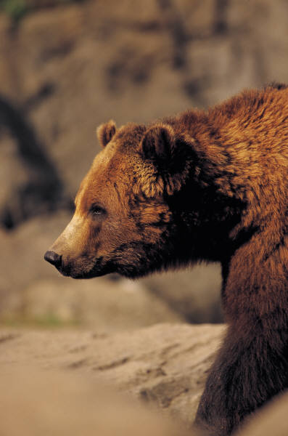
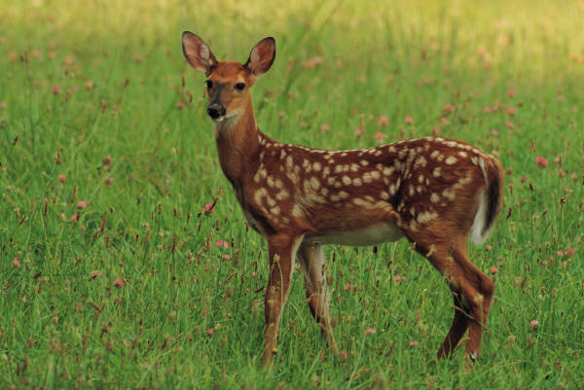
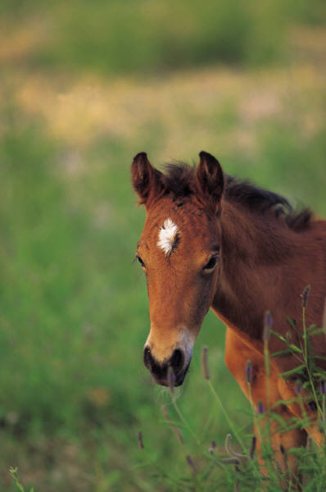
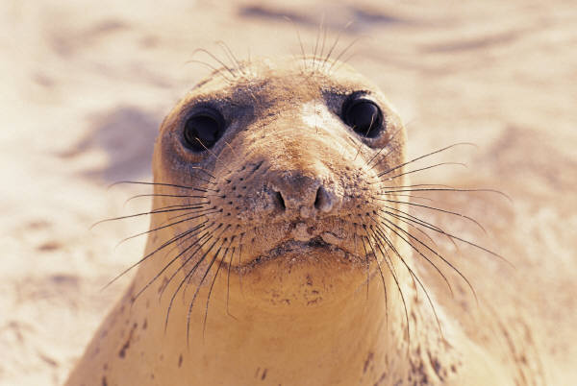
Homophones
.
Notes:
Vicky Walkup

Slide 2
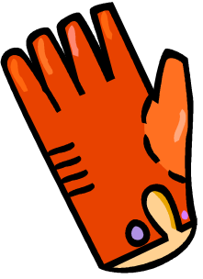

Homophones are words that sound alike but have different spellings and meanings.
For example, there is a pear that
is good to eat. I use a pair of
gloves because I have two hands.
Pay attention to see how the following
homophones are spelled.

Slide 3
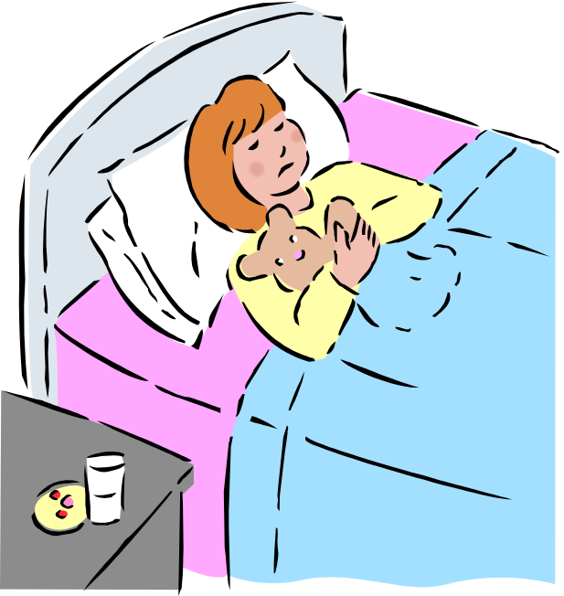
week weak
There are 7 days in a week.
She has been sick and is still weak.
Sunday Monday Tuesday Wednesday Thursday Friday Saturday

Slide 4

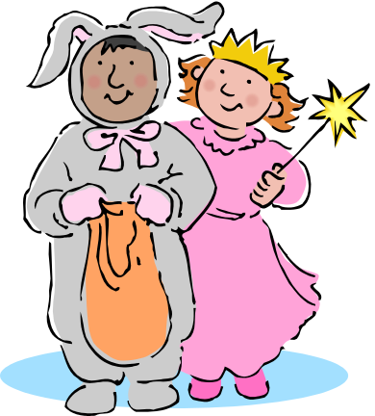
there their
The books are right there.
Halloween is their favorite holiday.

Slide 5

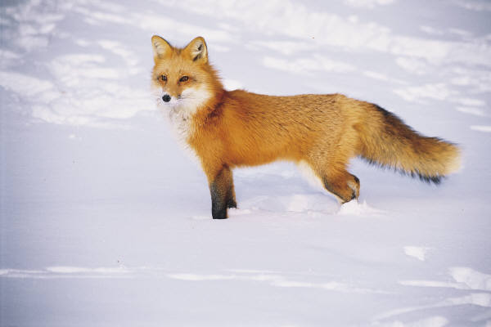
tale tail
I love the fairy tale, “Cinderella.”
The fox has a bushy tail.

Slide 6
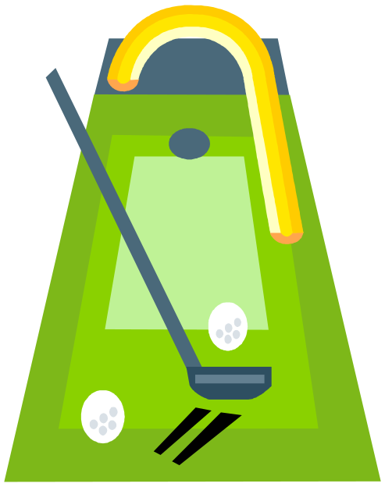
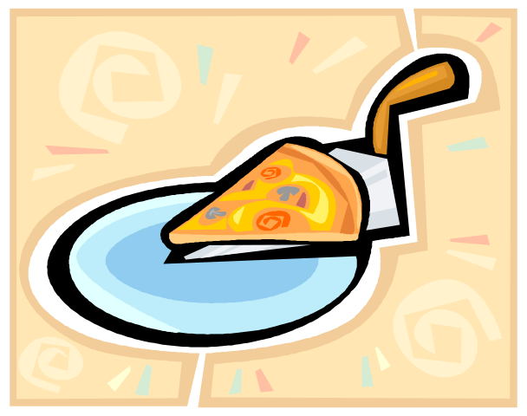
hole whole
The golf ball went in the hole.
I ate the whole pizza!

Slide 7
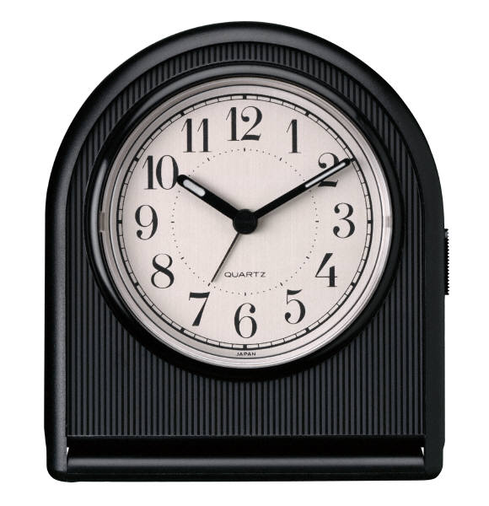
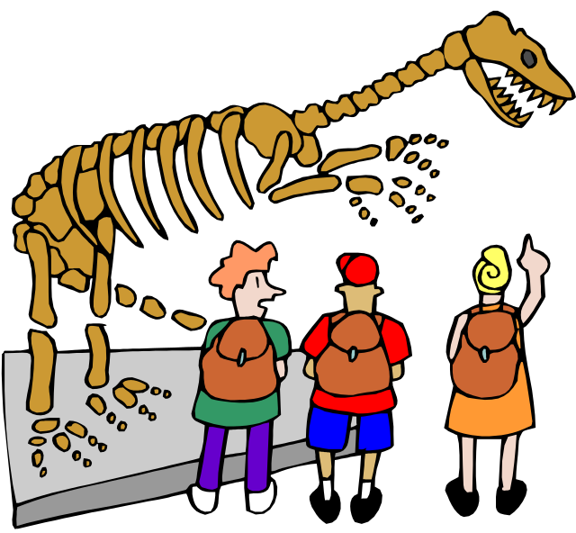
hour our
There are 60 minutes in an hour.
Our class is going to the museum.

Slide 8
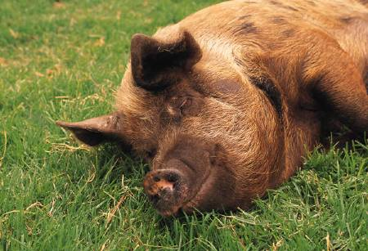
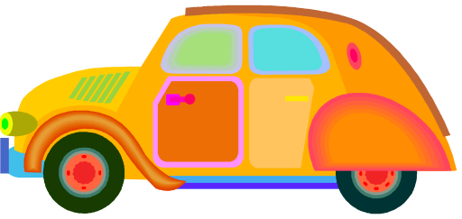
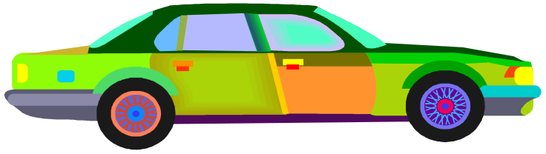
ate eight
I can’t believe I ate the whole thing!
There are eight cars in the parking lot.

Slide 9
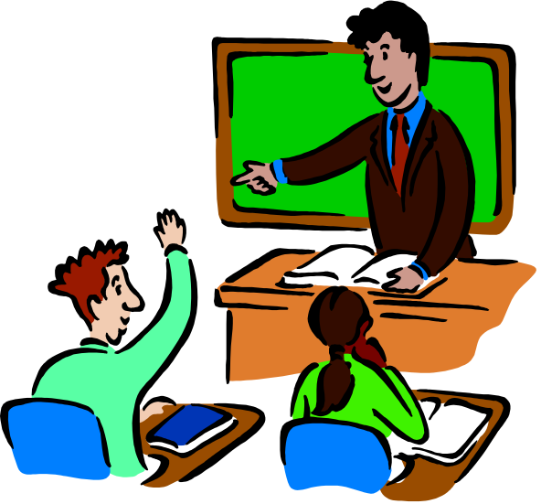
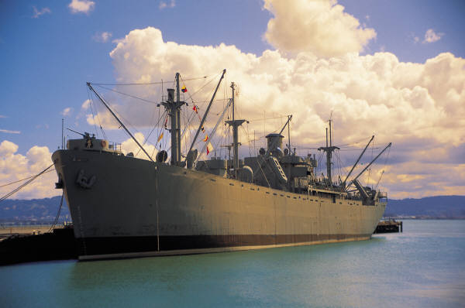
see sea
Do you see the teacher?
The ship travels on the sea.

Slide 10
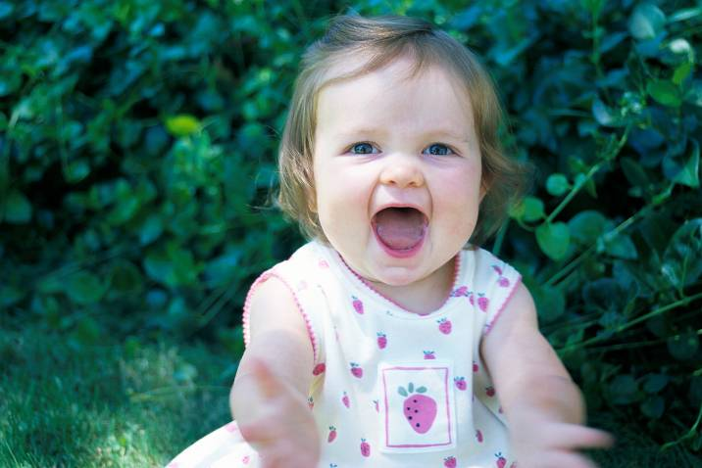
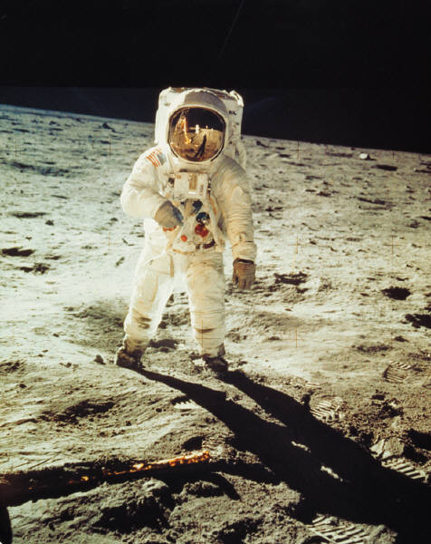

two too to
The baby has two new teeth.
I have too much homework!
Astronauts went to the moon.

Slide 11
Can you find ate or nine mistakes in these sentences?
Make a list of the incorrectly spelled words on a sheet of paper. Write them correctly.
I will chews to take the advice.
Please weight for me.
The son is very bright today.
What is the mane idea?
I knead a knew pear of shoes.

Slide 12
eight
choose
wait
sun
main
need
new
pair
You’re a homophone expert!

